Slide 1
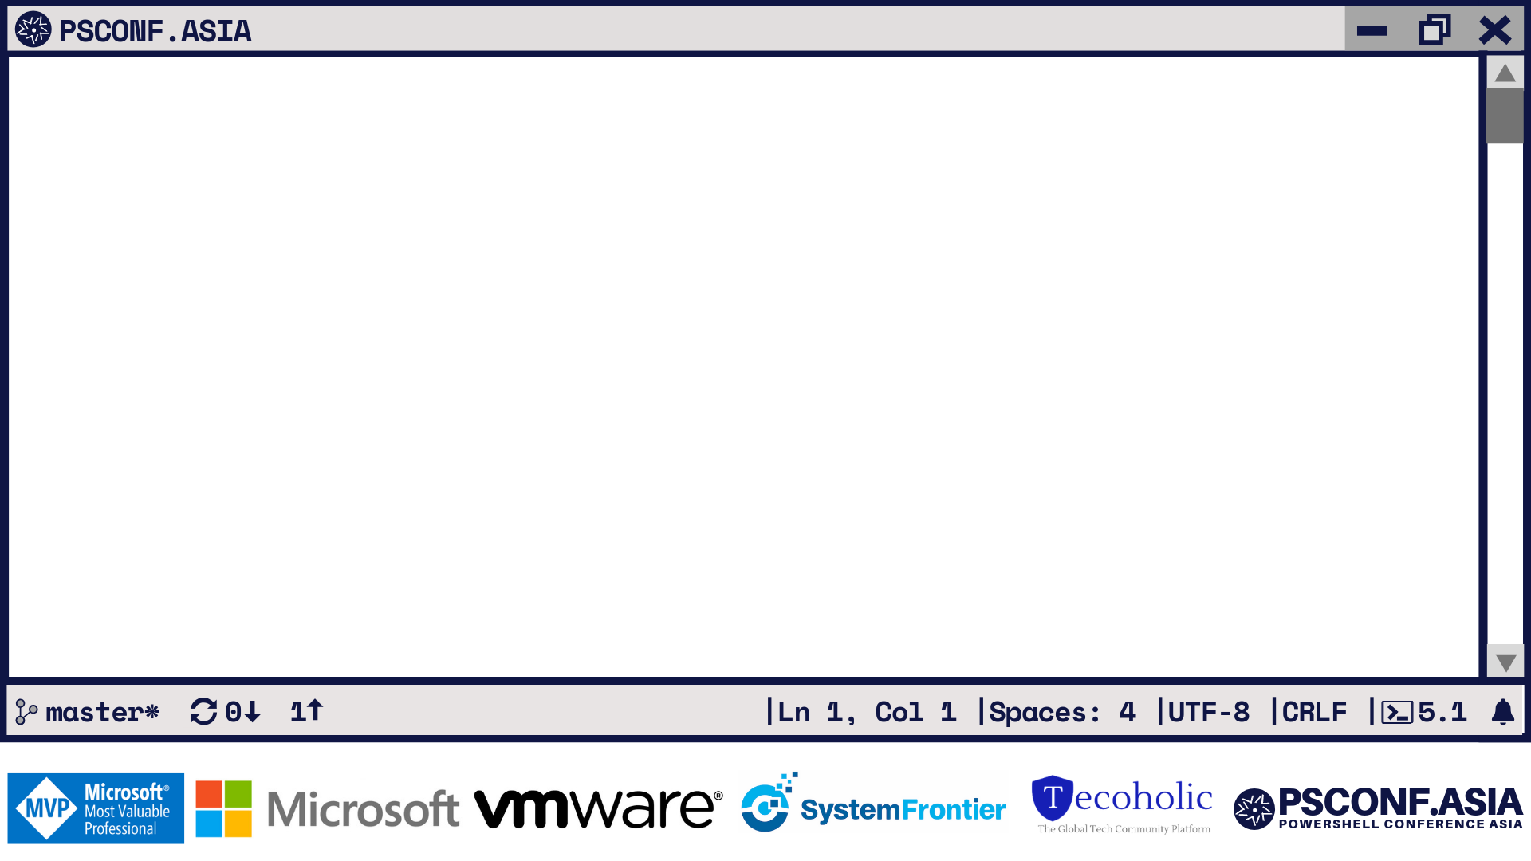
PowerShell based API
On kubernetes?!
David O'Brien Cloud Architect, XIRUS

Slide 2
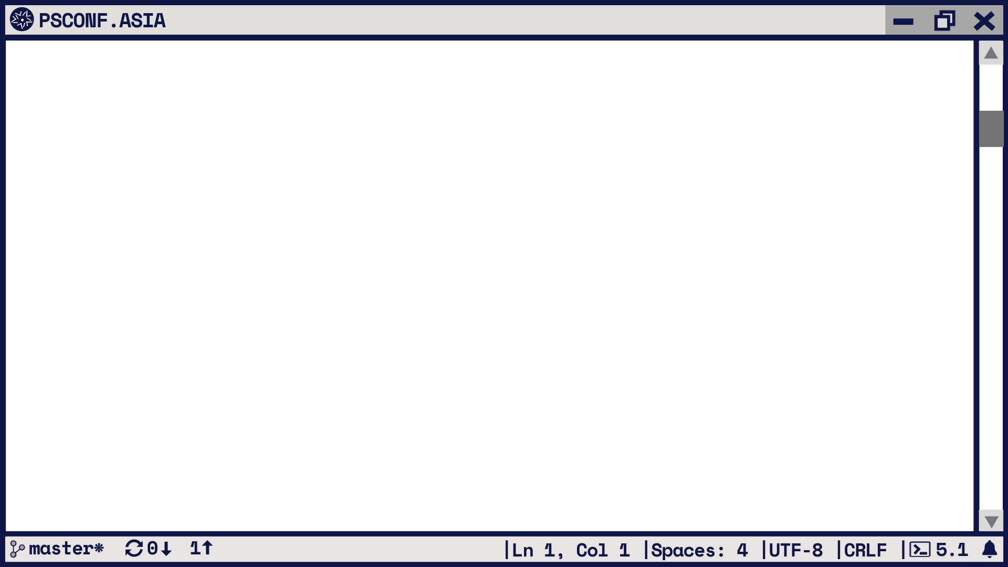
AGENDA
Why PowerShell?
Why NOT PowerShell?
What are we building?
What are the tools?
Conclusion

Slide 3
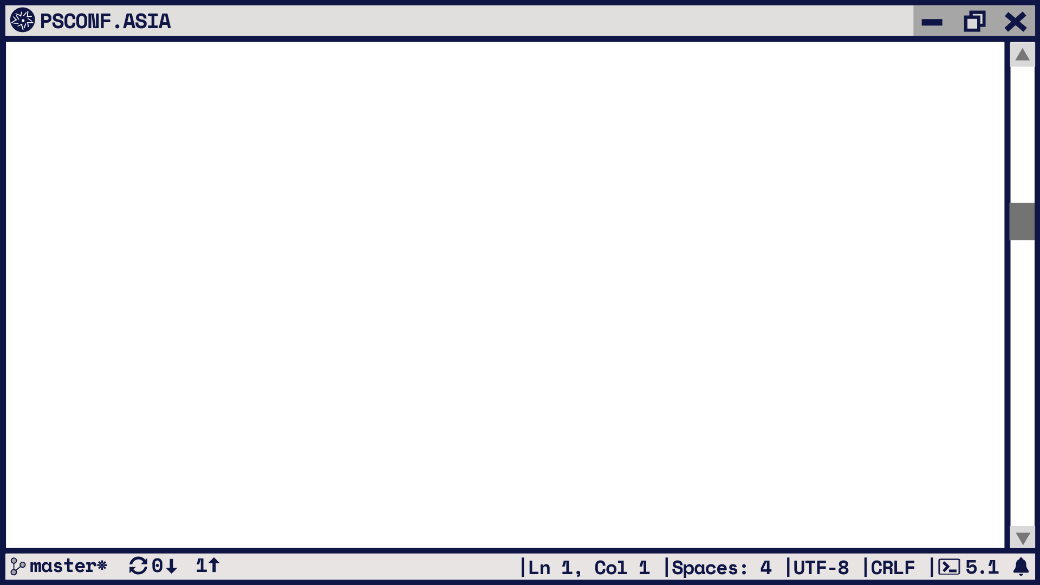







Get-ItemProperty -Name David
Microsoft MVP for Microsoft Azure
Director of XIRUS
Cloud // Automation // DevOps
From Melbourne / Australia
@david_obrien
https://david-obrien.net
https://xirus.com.au

Slide 4
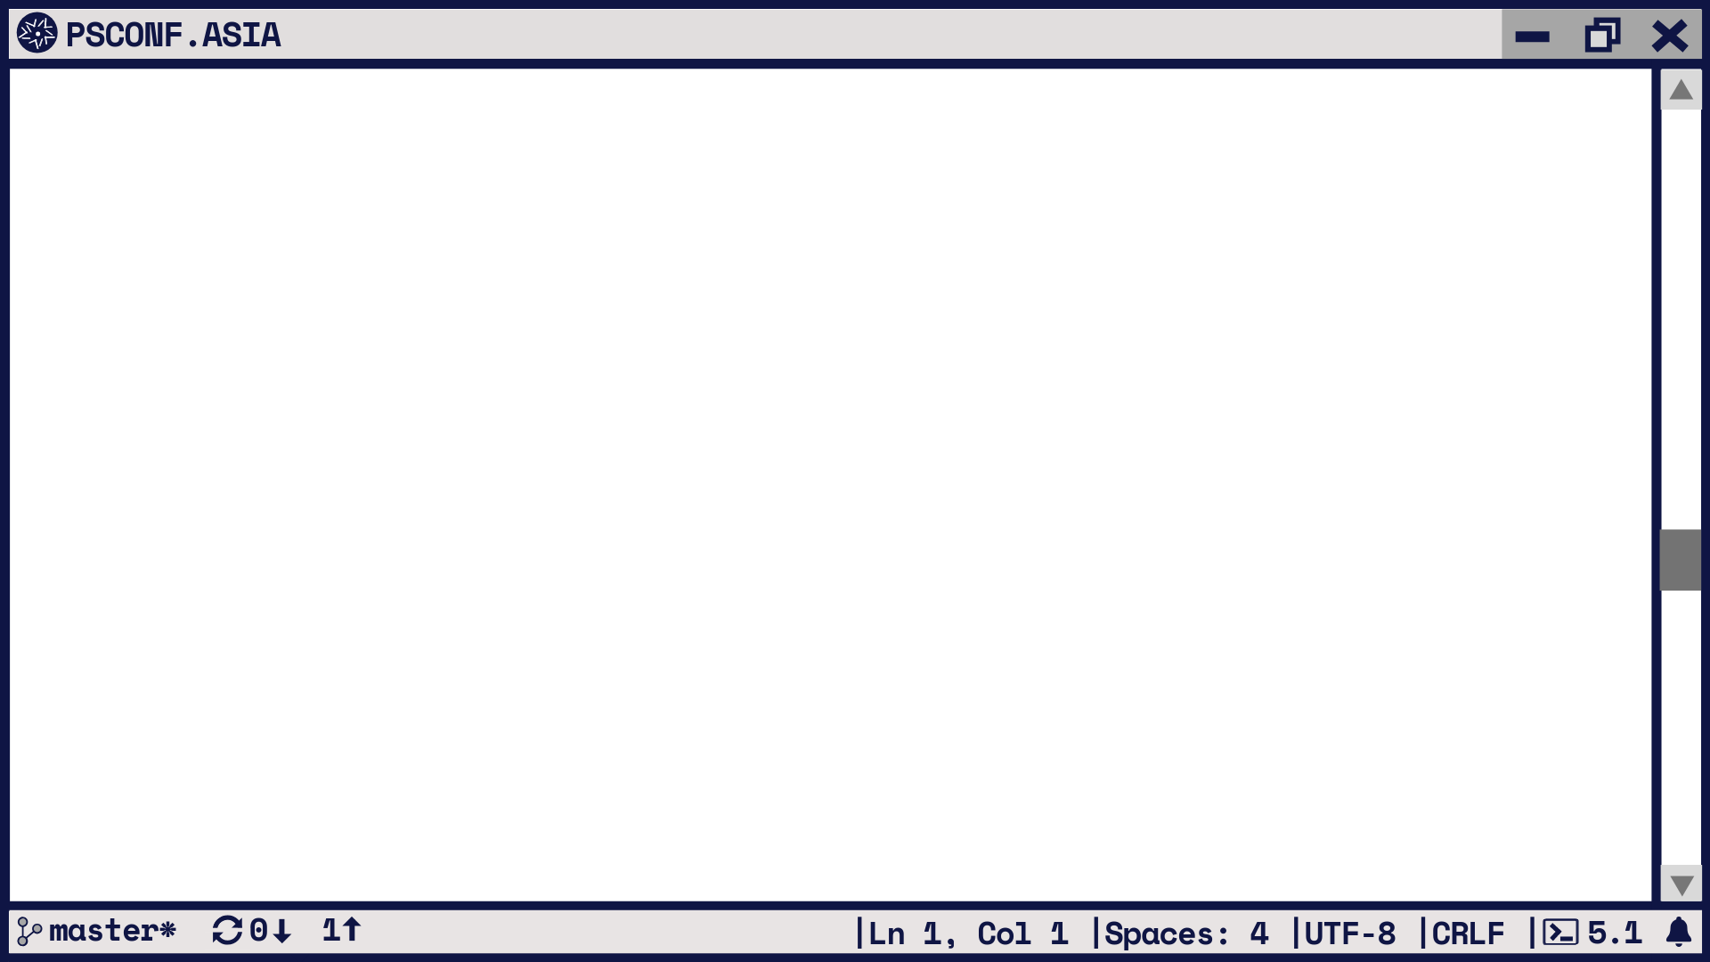
In non-technical terms it can be understood as a 'contract' that says to software developers that if you send a request from a 'client' computer […] to a 'server’ […] in the specified format you will always get a response in a specified format or initiate a defined action.
https://books.google.com/books?id=tJdmDwAAQBAJ&pg=PA9

Slide 5
Why PowerShell?
Familiarity
“good enough”
Does everything we need it to do
Active community

Slide 6
Why NOT PowerShell?
It is fairly slow for web workloads
Not necessarily the first language that comes to mind when one says “API”
Python – 5853 companies (https://stackshare.io/python)
Uber, Netflix, Instagram
PHP – 42285 companies (https://stackshare.io/php)
Facebook, Slack, Lyft
NodeJS – 5359 companies (https://stackshare.io/nodejs)
Uber, Netflix, Twitter
Javascript – 10127 companies (https://stackshare.io/javascript)
AirBnB, Instagram, reddit
PowerShell – 308 companies (https://stackshare.io/powershell)

Slide 7
Why NOT PowerShell?
Really though, there’s no reason why not ;-)

Slide 8

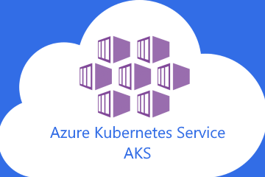



What are we building?

Slide 9
DEMO

Slide 10
What are the tools?
Pulumi
http://pulumi.io
Polaris
https://github.com/PowerShell/Polaris
Cosmos DB
https://github.com/PlagueHO/CosmosDB
Azure kubernetes services
https://azure.microsoft.com/en-in/topic/what-is-kubernetes/
Notes:
Demo time

Slide 11
Conclusion
It works
Not super fast
Can run on modern platforms (i.e. AKS)
It’s very familiar
Actively developed

Slide 12
CALL TO ACTION
Please rate session on EventRAFT app!
Notes:
Demo time

Slide 13
