Slide 1

FEAL Cipher
AGARWALA PRATHAM – differential cryptanalysis – feal4
Parashar Kshitij​ - boomerang attack – feal6

Slide 2
Agenda
Introduction
Structure of feal cipher
Cryptanalysis
legacy

Slide 3

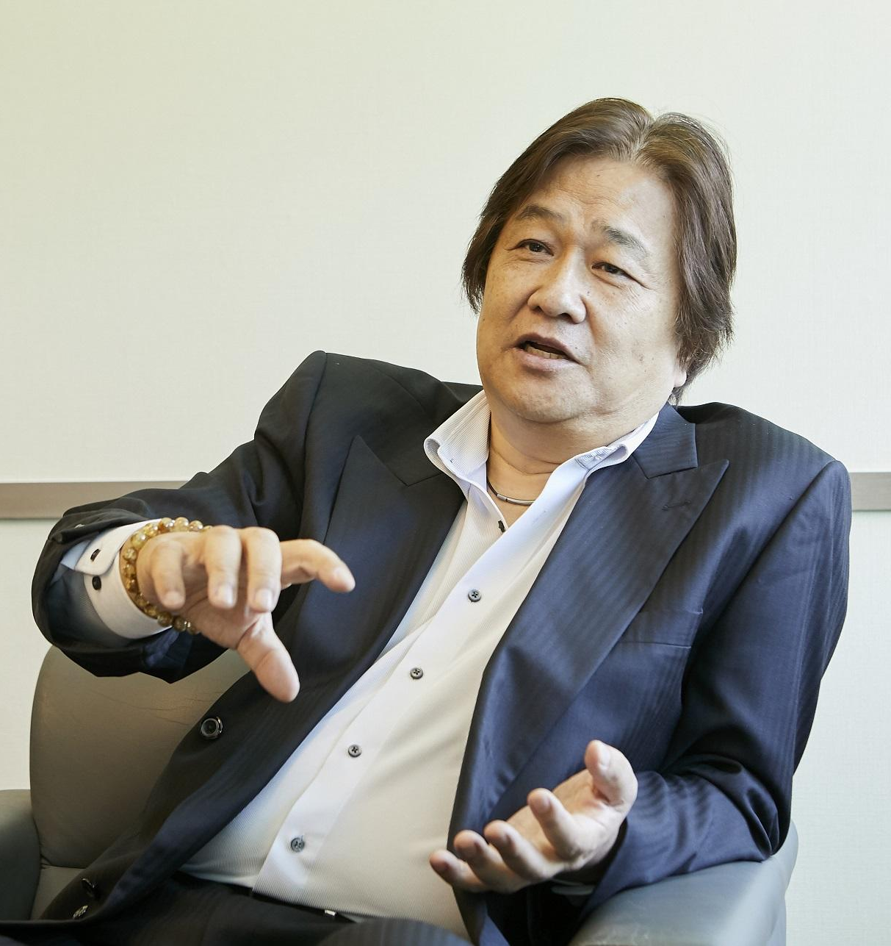
Introduction
FEAL (Fast data Encipherment ALgorithm) is a symmetric block cipher developed in 1987 by Akihiro Shimizu and Shoji Miyaguchi of NTT labs in Japan.
It was designed to be faster and more secure than the DES (Data Encryption Standard) cipher.
FEAL has a lot of variations
FEAL-4
FEAL-N (n<=4)
FEAL-NX
Notes:
FEAL-8 has been expanded to FEAL-N (N round FEAL with 64-bit key), where FEAL-N with N=4/8 is identical to FEAL-4/- 8 which have been previously published respectively. N is a user defined parameter (N>4, N:even, N=2”, 2 >2 is recommended). FEAL-N has also been expanded to FEAL-NX (X: expansion, N round FEAL with 128bit key) that accepts 128 bit keys. When the right half of the 128-bit key is all zeros, FEAL-NX works as FEAL-N. Upward compatibility is an important concept of the FEAL cipher family (I].
FEAL-NX can avoid chosen plaintext attacks.
The author thinks that exhaustive searches for FEAL-N 64-bit keys may be possible. Therefore, FEAL-NX which accepts 128-bit keys has been designed.

Slide 4
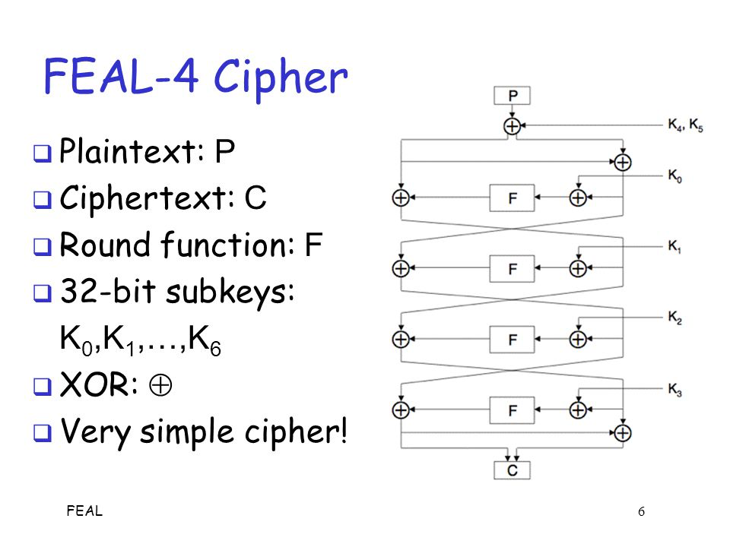
STRUCTURE OF FEAL-4
FEAL is a Feistel cipher, hence the plain text splits into left and right halves for encryption.
First, subkeys 4 and 5 are used to XOR the incoming plaintext.
The right half is mixed with the round's subkey, then it is run through a one-way function called the round function and combined with the left half using the XOR operation.
The resulting halves are then swapped, and the process is repeated for n-1 rounds.
For the final round, output halves do not swap. Instead, they come straight down, and the final round's left output half becomes the final ciphertext's left half. The final ciphertext's right half is produced by XORing that left half with the final round's original right half.
Three main parts of the cipher are:
Round Function (F)
G-Box
Subkey Generation/Key Schedule

Slide 5
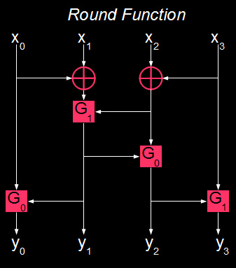







Round FUNCTION and G-BOX
G-Box is the only non-linear component of the Cipher and is the source of confusion of the cipher
Round Function is denoted by
$$G_{0}\text{​(} \text{a} \text{,} \text{b} \text{)} \text{=((}\text{a} \text{+}\text{b} \text{)} \text{mod}\text{256)⋘2}$$
$$G_{1}\text{​(} \text{a} \text{,} \text{b} \text{)} \text{=((}\text{a} \text{+}\text{b}\text{ +1}\text{)} \text{mod}\text{256)⋘2}$$
$$\text{Where}\text{ "<<<" }\text{is} \text{left} \text{cyclic} \text{shift}\text{ (}\text{rotation}\text{)}$$
$$\text{F} \text{(} \text{x}\text{0}\text{​,} \text{x}\text{1}\text{​,} \text{x}\text{2}\text{​,} \text{x}\text{3}\text{​} \text{)=(} \text{y}\text{0}\text{​,} \text{y}\text{1}\text{​,} \text{y}\text{2}\text{​,} \text{y}\text{3} \text{​)}$$
$$Y\text{1} \text{​=}\text{G}\text{1} \text{​(} \text{x}\text{0} \text{​⊕} \text{x}\text{1} \text{​,} \text{x}\text{2}\text{​} \text{⊕} \text{x}\text{3}\text{​)}$$
$$Y\text{2} \text{=}\text{G}\text{1} \text{​(}\text{y}\text{1}\text{,} \text{x}\text{2}\text{​} \text{⊕} \text{x}\text{3}\text{​)}$$
$$Y\text{3} \text{=}\text{G}\text{0 }\text{​(}\text{x}\text{0}\text{,} \text{y}\text{1}\text{)}$$
$$Y\text{4} \text{=}\text{G}\text{1 }\text{​(}\text{y}\text{2}\text{,} \text{y}\text{3}\text{)}$$

Slide 6
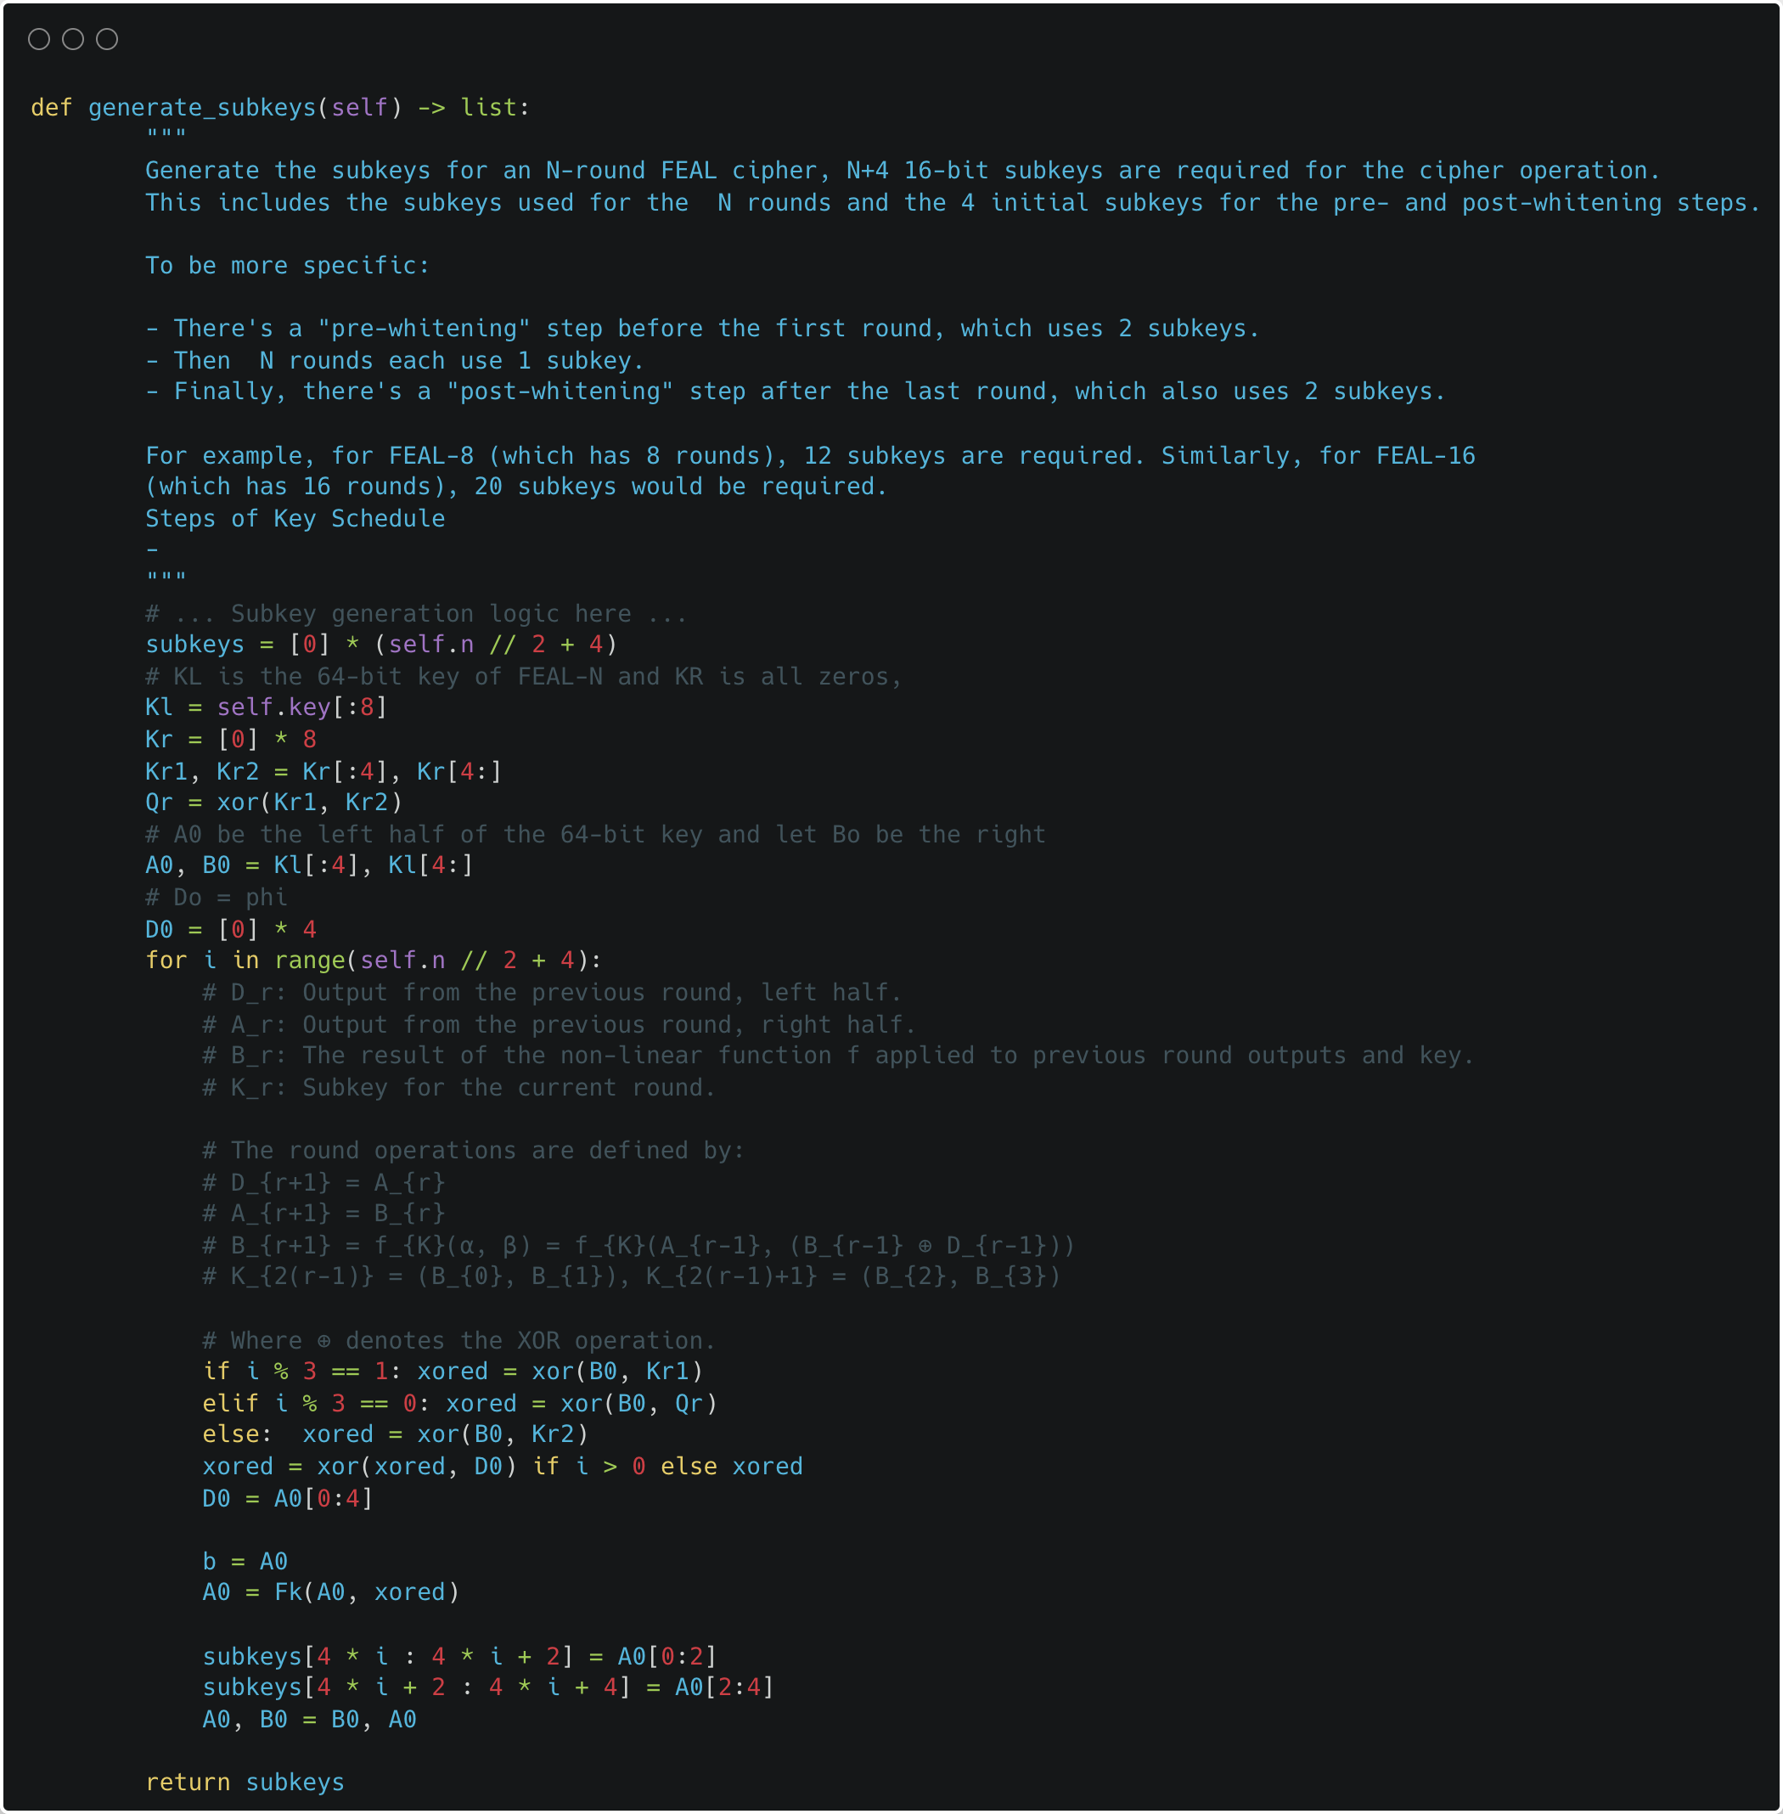
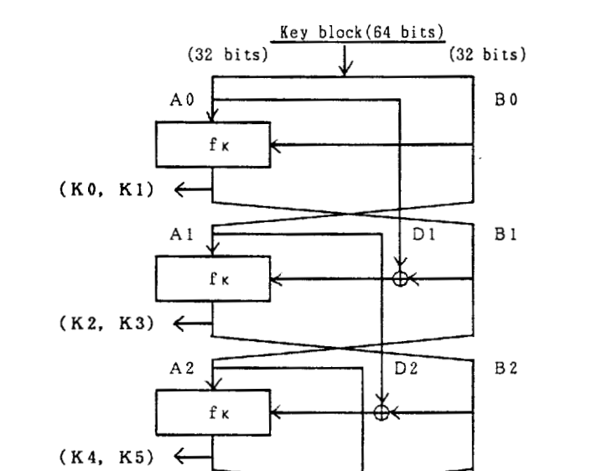
Subkey Generation
This our implementation of official subkey generation algorithm suggested in the Feal-N and Feal-NX paper.

Slide 7
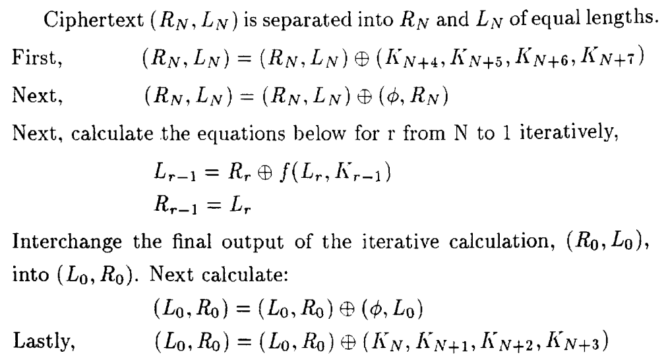
Decryption
Plaintext P is separated into L(0) and R(0) of equal lengths (32 bits)
Note: Φ refers to a 32-bit long zero-block

Slide 8
Cryptanalysis
Differential Cryptanalysis of FEAL-4
Boomerang Attack on FEAL-6

Slide 9

Timeline of attacks
1987
1988
1990
1991
1992
The FEAL-4 cipher was introduced by Akihiro Shimizu and Shoji Miyaguchi of NTT.
Den Boer published a paper describing an attack on FEAL-4 requiring between 100 to 10,000 chosen plaintexts. In response to these weaknesses, the designers released FEAL-8 .
Sean Murphy found an improvement to the chosen plaintext attack on FEAL-4 that needed only 20 chosen plaintexts. Additionally, Gilbert and Chassé published a statistical attack on FEAL-8 similar to differential cryptanalysis, requiring 10,000 pairs of chosen plaintexts .
Eli Biham and Adi Shamir described a differential attack on FEAL-8 . They also showed that both FEAL-N and FEAL-NX could be broken faster than exhaustive search for N ≤ 31 rounds using differential cryptanalysis .
Matsui and Yamagishi presented a new method for a known plaintext attack of FEAL cipher. Their attack could break FEAL-4 with just 5 known plaintexts, FEAL-6 with 100, and FEAL-8 with 2^15 known plaintexts .
Notes:
1987 : Almost immediately, weaknesses were reported by Bert den Boer in an unpublished session at the same conference where FEAL was presented .

Slide 10
Number Chosen Plain texts required
FEAL VARIANT | ATTACK TYPE | Number of Text | Complexity
FEAL-4 | Differential | 12 | 5 mins
FEAL-6 | Boomerang | 4 | 1 min

Slide 11
Differential Cryptanalysis
This is type of chosen plaintext attack, which analyzes the changes in the plaintext on changes in the resulting cipher text.
Basically, at each step it produces two plaintext messages differing by some value. It observes the difference in the two ciphertexts generated by the encryptor. Hence deriving a differential characteristic for the S-Box or the non-linear component of the cipher.
Objective is to perform a differential characteristic over the first n-1 rounds and generate pairs plaintexts with defined differential and extract the respective cyphertexts.
For retrieving the the last key, we backpropagate from the cipher text and perform search over the key space and choose the key which satisfies the differential characteristic the maximum number of times.
Notes:
(the difference is defined as XOR of the two bitstrings in most cases)

Slide 12
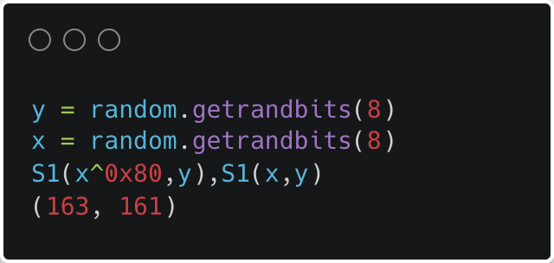
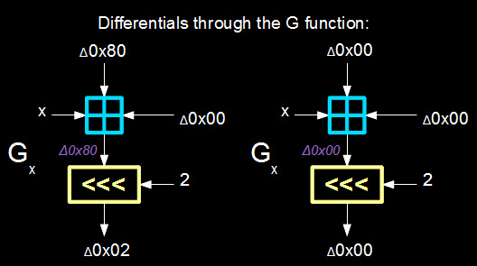
G-Box Differential Analysis
Linear operations in the scheme affect differentials in a both ways, so once again the problem boils down to analysing the effects of the non-linear G-boxes on differentials.
For every possible input difference, the distribution of output differences is analysed. Each G-box differential is a tuple (∆X, ∆Y, p) such that an input difference of ∆X gives an output difference of ∆Y with probability p.
For FEAL G-Box the differentials
G_{x}(0x80 , 0x00) = 0x02 , with p=1
G_{x}(0x00 , 0x00) = 0x00 , with p=1
G_{x}(0x00 , 0x80) = 0x02 , with p=1
G_{x}(0x80 , 0x80) = 0x00 , with p=1
Differential of 0x02

Slide 13

Values used in G | Binary | Hex & Decimal
A 0x80 | 0000 0001 1000 0000 | 0x01 = 1d 0x80 = 128d
A XOR 0x80 | 1000 0001 | 0x81 = 129d
A+ B+ 1 | 0000 0001 0000 0100 0000 0001 | 0x01 = 1d 0x04 = 4d 0x01 = 1d
 | 0000 0110 | 0x06 = 6d
Rotate 2 bits from left | 0001 1000 | 0x18 = 24d
B+ (A XOR 0x80)+ 1 | 0000 0100 1000 0001 0000 0001 | 0x04 = 4d 0x81 = 128d 0x01 = 1d
 | 1000 0110 | 0x86 = 134d
Rotate 2 bits from left | 0001 1010 | 0x1A = 26d

Slide 14
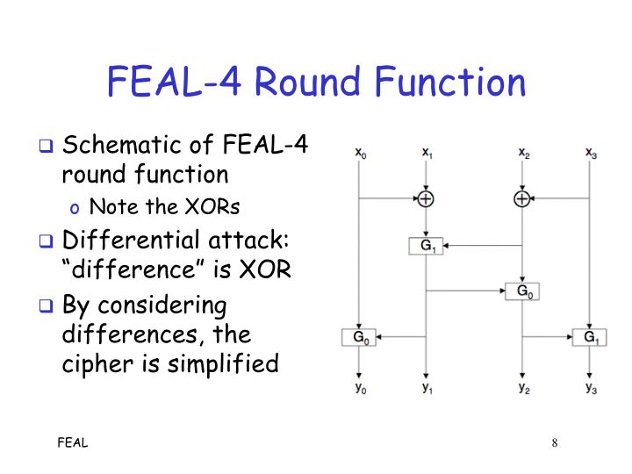
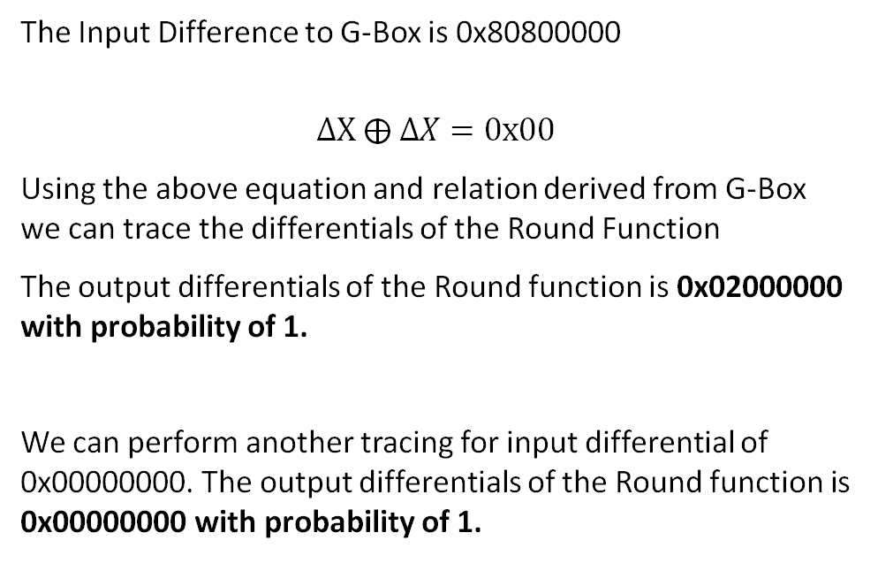
Round Function Differential Analysis
0x80
0x80
The Input Difference to G-Box is 0x80800000
$$∆X ⨁ ∆X=0x00$$
Using the above equation and relation derived from G-Box we can trace the differentials of the Round Function
The output differentials of the Round function is 0x02000000 with probability of 1.
We can perform another tracing for input differential of 0x00000000. The output differentials of the Round function is 0x00000000 with probability of 1.
0x00
0x00
0x00
0x00
0x00
0x00
0x02
0x00
0x00
0x00

Slide 15
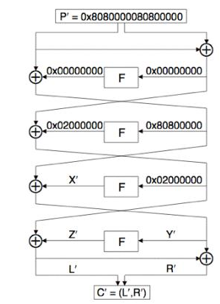
Tracing the whole Cipher
0x80800000
0x80800000
Now using the differential characteristic, we derived for the Round Function(F) we can apply it to the whole FEAL-4 encryption scheme.
If we inject the cipher with input differential of 0x8080000080800000, will split into two differentials of 32-bit each.
Note : Before each round function(F) we perform XOR operation with round Subkey. Since same key is applied for both plaintexts so the difference is always 0x00 for this operation.
We can trace the differentials with 100% certainty until round 3 - F function.
0x00
0x80800000
0x80800000
Notes:
When the differentials hit a round function, we cannot reliably predict what the output differential will be. There are two exceptions to this rule. When the input is 0x00, the output is 0x00 as well. This is because there is no difference in the inputs, so you are effectively feeding it the same input twice. This produces identical outputs and because the outputs are identical, their difference is 0x00. The other exception is the major flaw in the round function that we found earlier. When 0x80800000 is fed into the round function, the output differential is 0x02000000. We also saw earlier that the XOR operation performs XOR on the differentials (just like it does the actual texts that produce the differentials).
The reason that we don't know the output differential of the last round function stems from not knowing the output differential of the 3rd round function. This is because the input differential to round 3's function is 0x02000000. We cannot predict reasonably what differential this will produce through the round function.

Slide 16
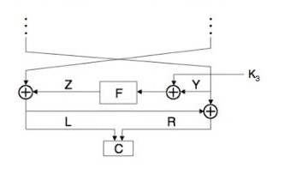
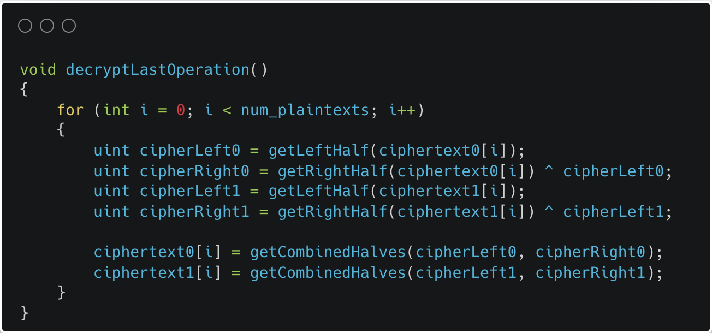
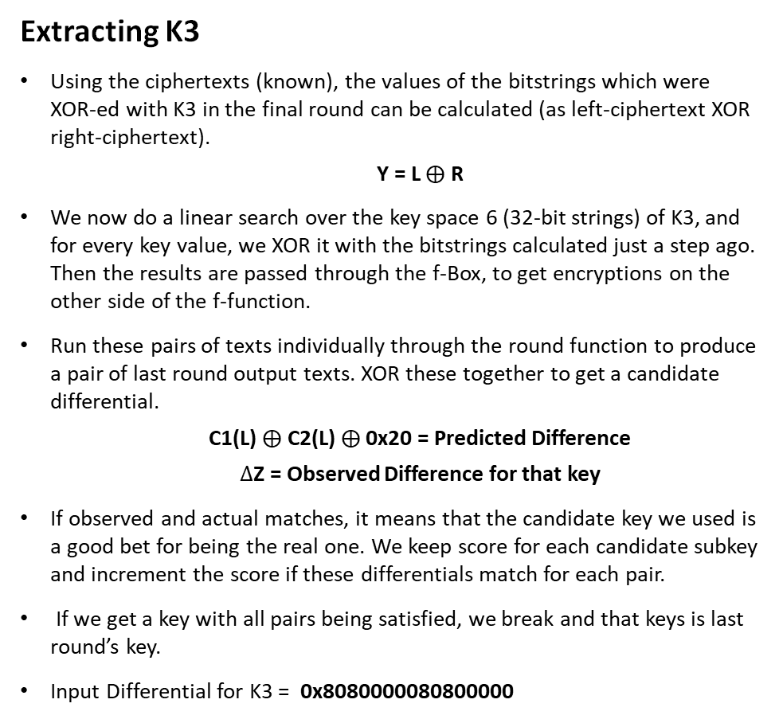
Back-Tracing the Final Round from cipher text
Extracting K3
Using the ciphertexts (known), the values of the bitstrings which were XOR-ed with K3 in the final round can be calculated (as left-ciphertext XOR right-ciphertext).
Y = L $⨁$ R
We now do a linear search over the key space 6 (32-bit strings) of K3, and for every key value, we XOR it with the bitstrings calculated just a step ago. Then the results are passed through the f-Box, to get encryptions on the other side of the f-function.
Run these pairs of texts individually through the round function to produce a pair of last round output texts. XOR these together to get a candidate differential.
C1(L) $⨁$ C2(L) $⨁$ 0x20 = Predicted Difference
$∆$Z = Observed Difference for that key
If observed and actual matches, it means that the candidate key we used is a good bet for being the real one. We keep score for each candidate subkey and increment the score if these differentials match for each pair.
If we get a key with all pairs being satisfied, we break and that keys is last round’s key.
Input Differential for K3 = 0x8080000080800000
0x20

Slide 17
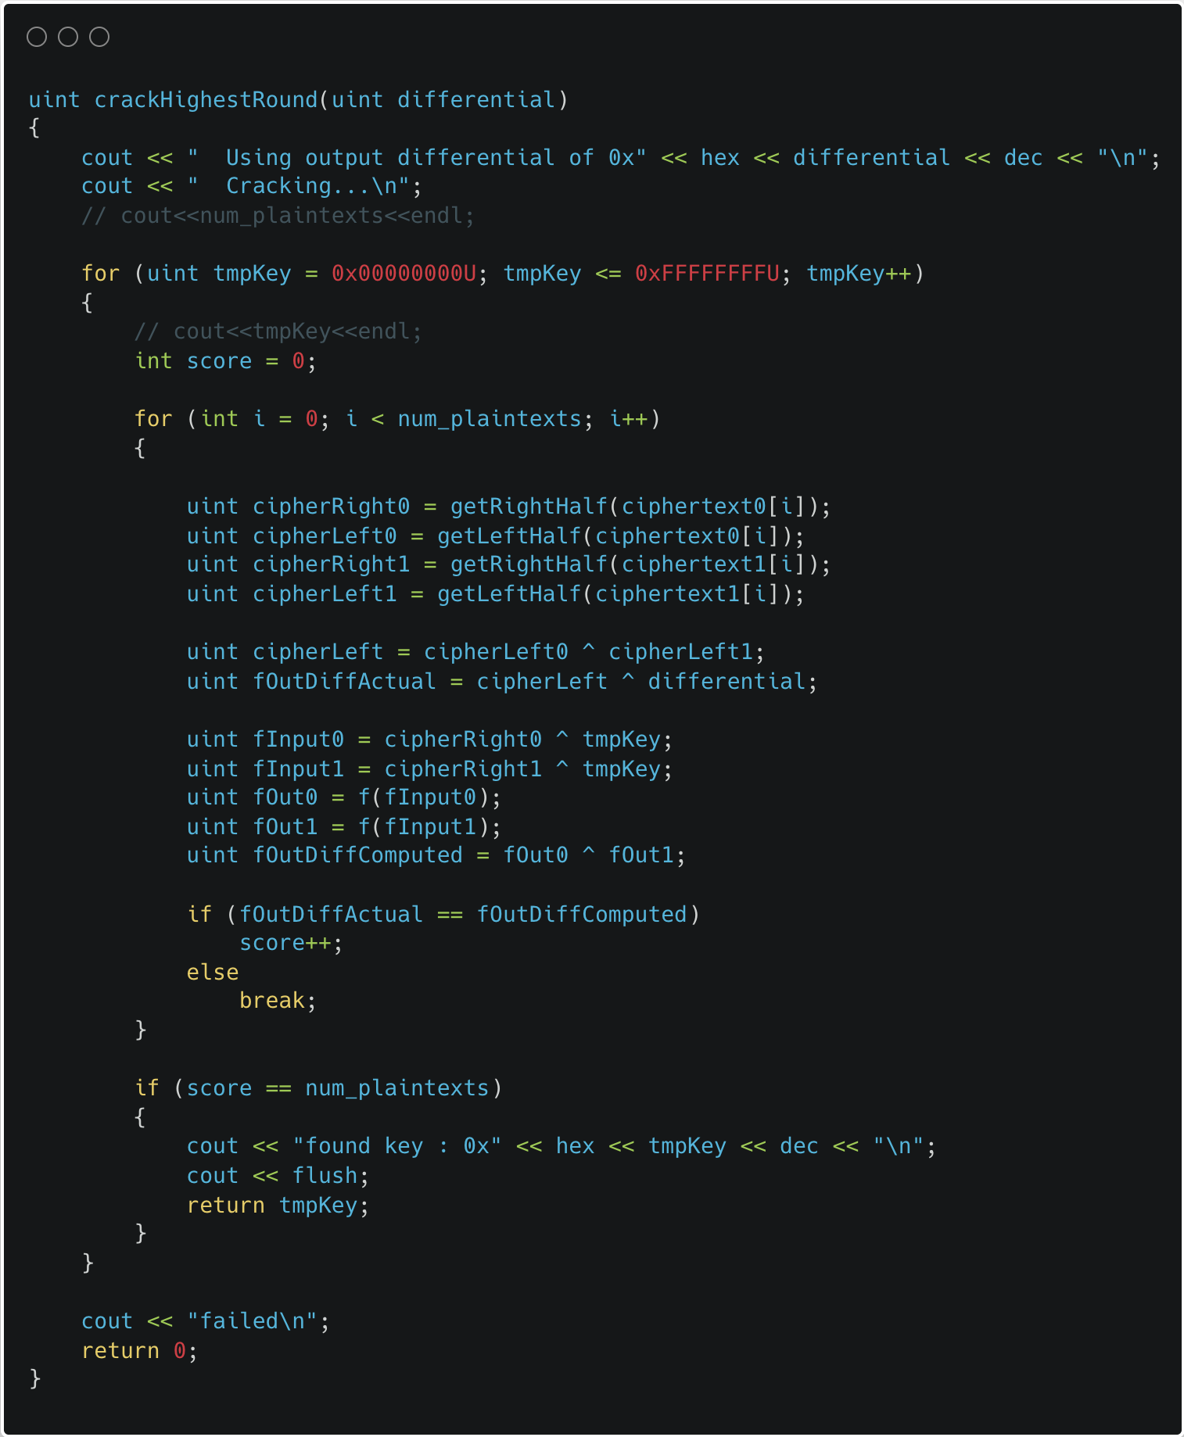
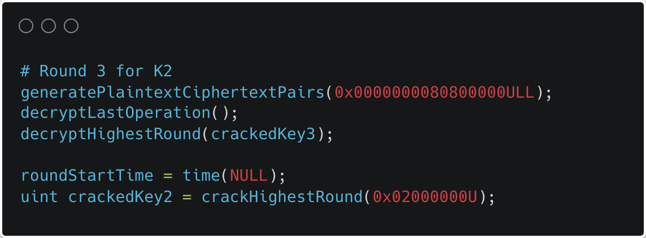
Back-Tracing the Second and Third Round from cipher text
Extracting K2, K1
Similar process as K3 is repeated for cracking K1,K2 just that the input differentials will change. We can use the previous K3 we cracked to decrypt the Round 4.
Input Differential for K2 = 0x0000000080800000
Input Differential for K1 = 0x0000000020000000
We generate new chosen-plaintext pairs for each round using these input differentials. And perform linear search over key space of 32 bits. And take round key as the key with highest score or score = number of Plaintext pairs generated

Slide 18
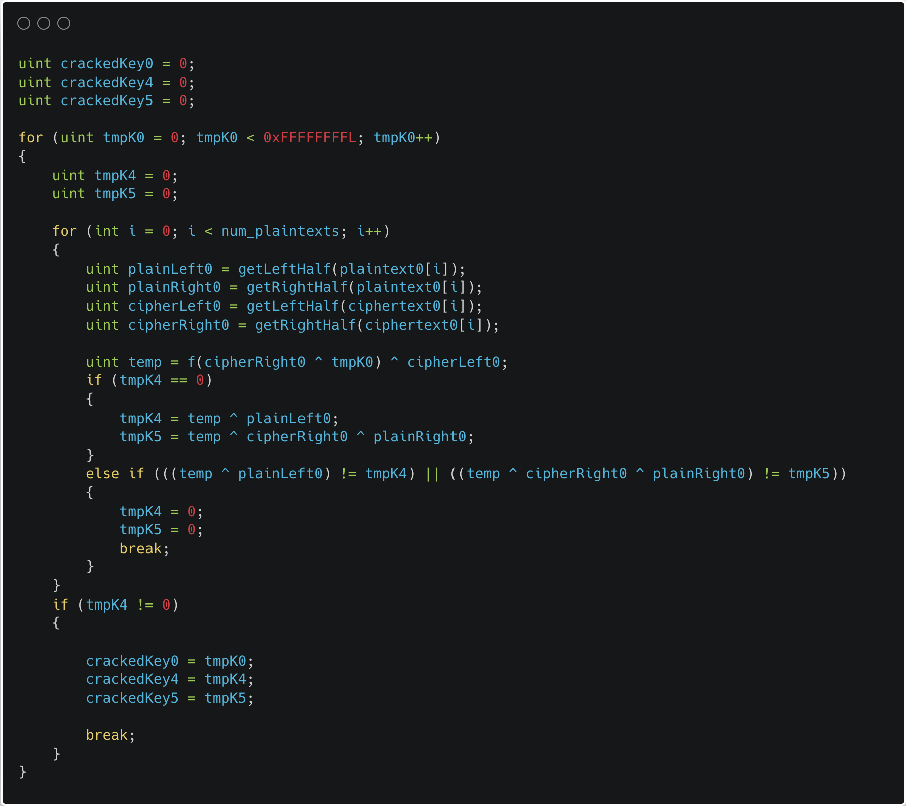
Back-Tracing the FIrst Round from cipher text
Extracting K0, K4, K5
For the first round, all three of K0 , K4 , and K5 need to be extracted. For this, we do a linear search over the 32-bit space for K0 , and for every candidate, the bitstrings are decrypted through the candidate K0 , and used to compute K4 and K5 by using the input plaintext.
The candidate key which yields the same K4 and K5 for all plaintext pairs it is tested with is selected as K0 , and the corresponding K4 and K5 are evaluated.

Slide 19
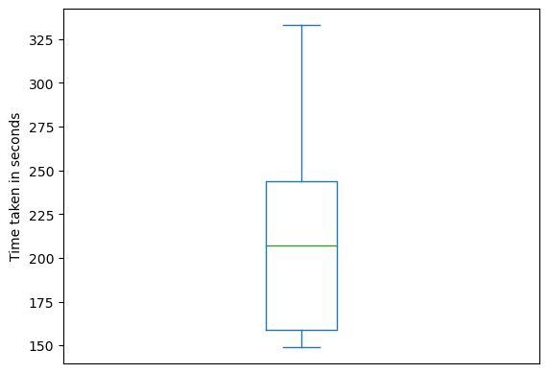
Runtime and Efficiency
Exhaustive search of the key space from the perspective of subkeys means brute forcing every permutation of 192 bits, which 2^192 complexity
However, with differential cryptanalysis, we only need to do individual key space searches for four 32-bit keys, i.e., each key space search is over 2^32 = 4294967296 keys, which sums up to a total of 4 × 4294967296 = 17179869184 ≈ 10^10 keys.
Fig : Runtime distribution to crack the keys with 12 plaintext

Slide 20
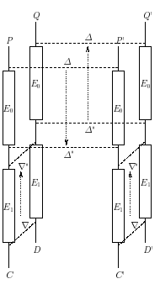
Boomerang attack on feal-6
This attack helps to ascertain whether the algorithm is FEAL-6 or not. Once it has been confirmed, further linear cryptanalysis can be performed to break the cipher.
Boomerang attacks are a way to extend the power of normal differential cryptanalysis. It allows the use of two unrelated differential characteristics to attack the same cipher.
2 plaintext blocks are chosen which differ by some input differential value.

Slide 21
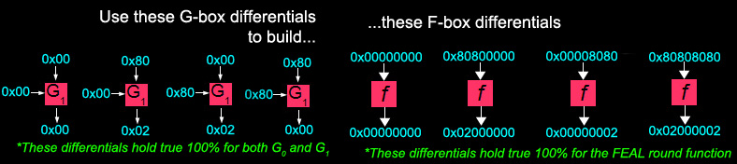
Prerequisites
Like the standard G-box differentials, there are some F-box differentials which never change:
0x00000000 → 0x00000000
0x80800000 → 0x02000000
0x00008080 → 0x00000002
0x80808080 → 0x02000002

Slide 22
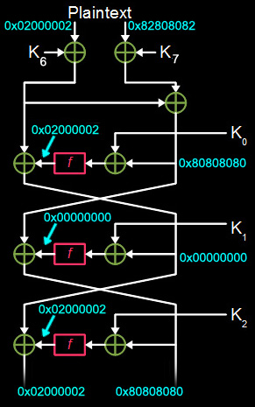
Working of boomerang attack

Slide 23
Working of boomerang attack
Q
P

Slide 24
Explanation
The key steps of a boomerang attack on FEAL-6 are:
Choose two plaintext pairs (P1, P2) and (P3, P4) that have a specific XOR difference (ΔP). When encrypted, this is likely to lead to ciphertexts C1, C2, C3 and C4 that also have some XOR difference (ΔC).
Then decrypt C3 and C4 to get the plaintexts P3' and P4'. XOR the decrypted plaintexts to get ΔP'.
If ΔP' = ΔP, it means the differential characteristic held with high probability over the 6 rounds of encryption and decryption. This allows the attacker to determine information about the key.
By analyzing many plaintext pairs and finding many "boomerang" quartets where ΔP = ΔP', the key bits can be determined faster than brute force through statistical analysis.

Slide 25
REFERENCES
Matsui, Mitsuru, and Atsuhiro Yamagishi. "A new method for known plaintext attack of FEAL cipher." Advances in Cryptology—EUROCRYPT’92: Workshop on the Theory and Application of Cryptographic Techniques Balatonfüred, Hungary, May 24–28, 1992 Proceedings 11. Springer Berlin Heidelberg, 1993.
http://www.theamazingking.com/crypto-feal.php
Miyaguchi, Shoji. "The FEAL cipher family." Advances in Cryptology-CRYPTO’90: Proceedings 10. Springer Berlin Heidelberg, 1991.
https://github.com/Vozec/Feal-ALL/tree/main/FEAL
Wagner, D. (1999). The Boomerang Attack. In: Knudsen, L. (eds) Fast Software Encryption. FSE 1999. Lecture Notes in Computer Science, vol 1636. Springer, Berlin, Heidelberg. https://doi.org/10.1007/3-540-48519-8_12

Slide 26

Thank you

Slide 27
