Slide 1

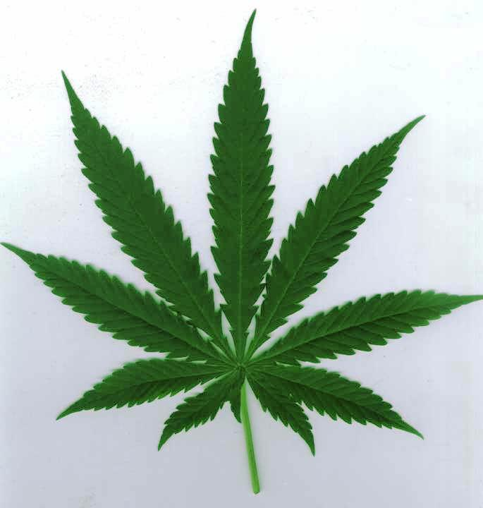
Marijuana in Canada
SES and Policy

Slide 2
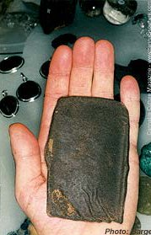
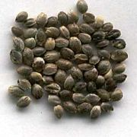
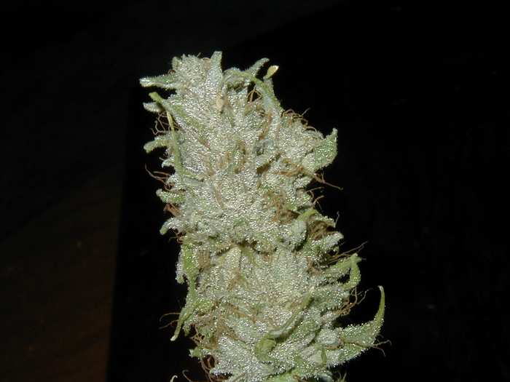
What is Marijuana?
Cannabis Sativa or Cannabis Indica.
Produces Tetrahydrocannabinol (THC).
Consumed dried, as Hash, ingested, or as a pharmaceutical.

Slide 3
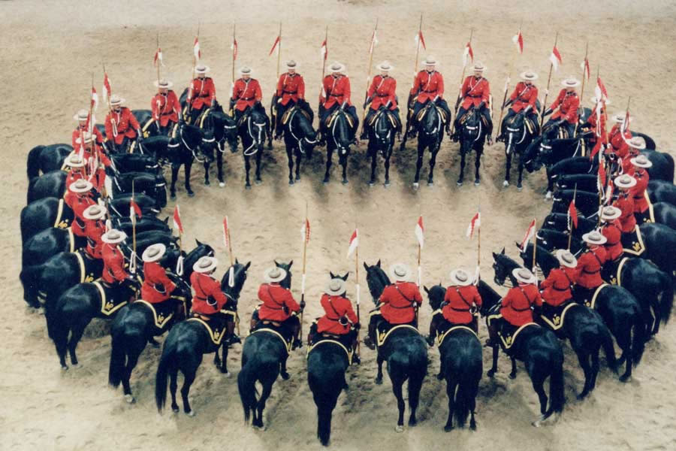
The Law
Is Marijuana Illegal in Canada?

Slide 4
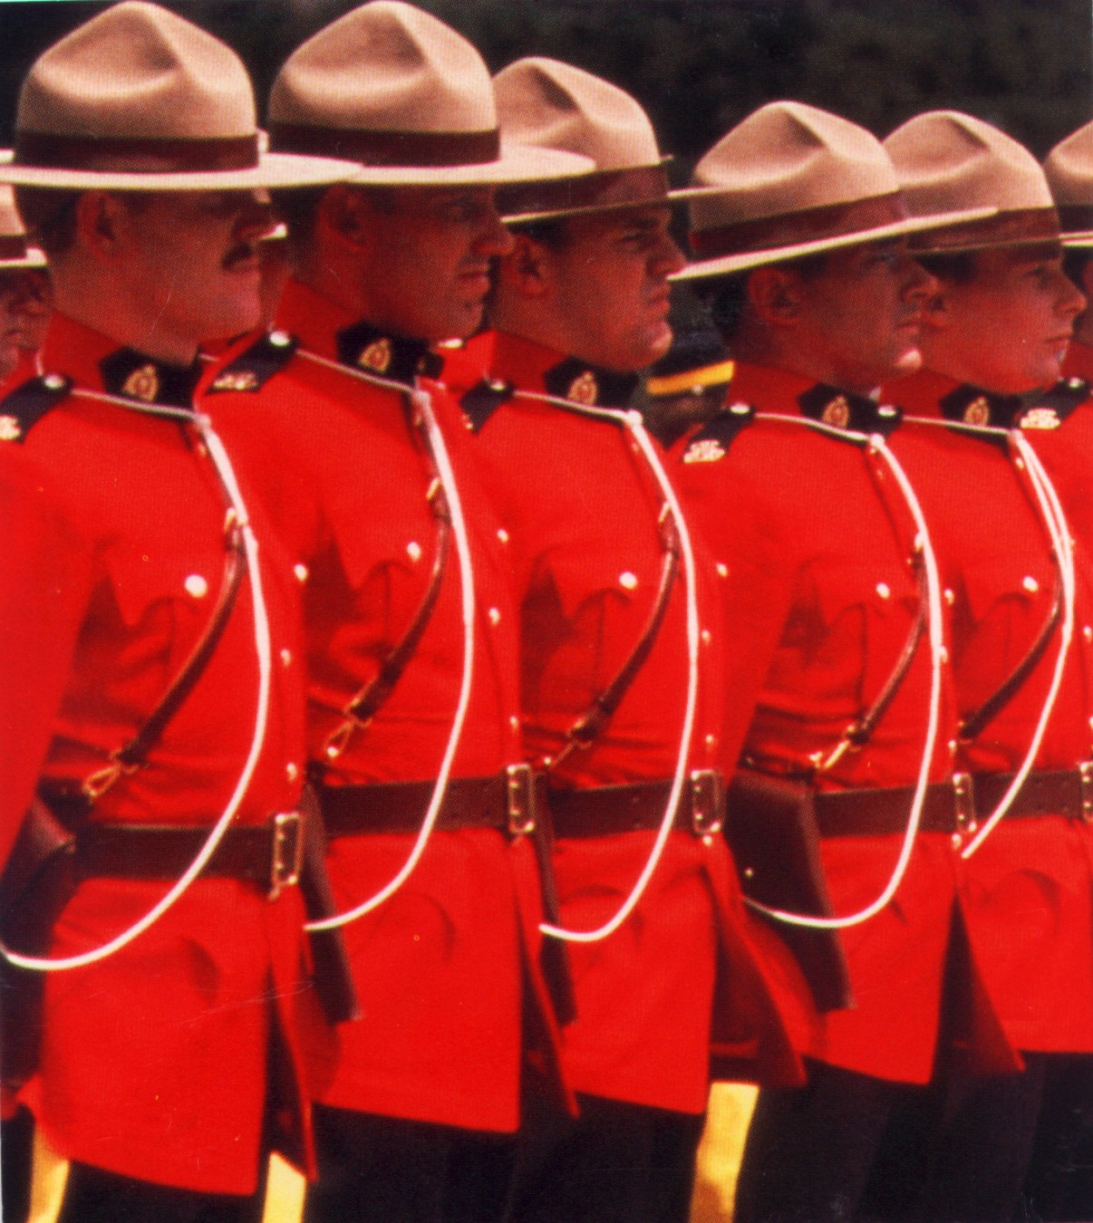
YES!

Slide 5
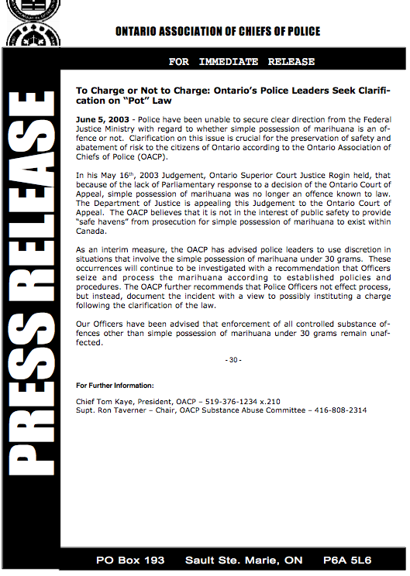
Things are not Black and White…
“…unable to secure from the Federal Justice Ministry with regards to whether simple possession of marihuana is an offence or not.”
“The OACP further recommends that Police Officers not effect process…”

Slide 6
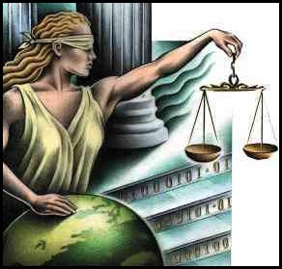
So…What is the law?

Slide 7
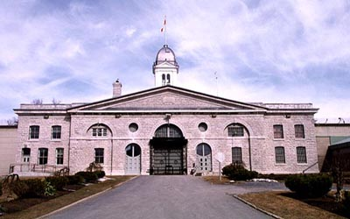
Under the Controlled Drugs and Substances Act it is illegal to:
Posses
Produce
Traffic
Import or Export

Slide 8
Still Not Black and White…
Three judges of the Ontario Court of Appeal
“…unanimously struck down as unconstitutional the law making the possession of marijuana a crime.” The Globe and Mail, Wen. 2nd, 2000
Ontario Supreme Court Judge
“Canada has no laws prohibiting marijuana possession…”
The Globe and Mail, Saturday, May 17, 2003
Canadian Centre on Substance Abuse
“Cannabis possession enforcement varies considerably among regions in Canada…”
“…particularly with regard to urban and rural areas within regions.” May 1998

Slide 9
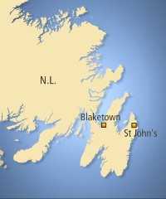
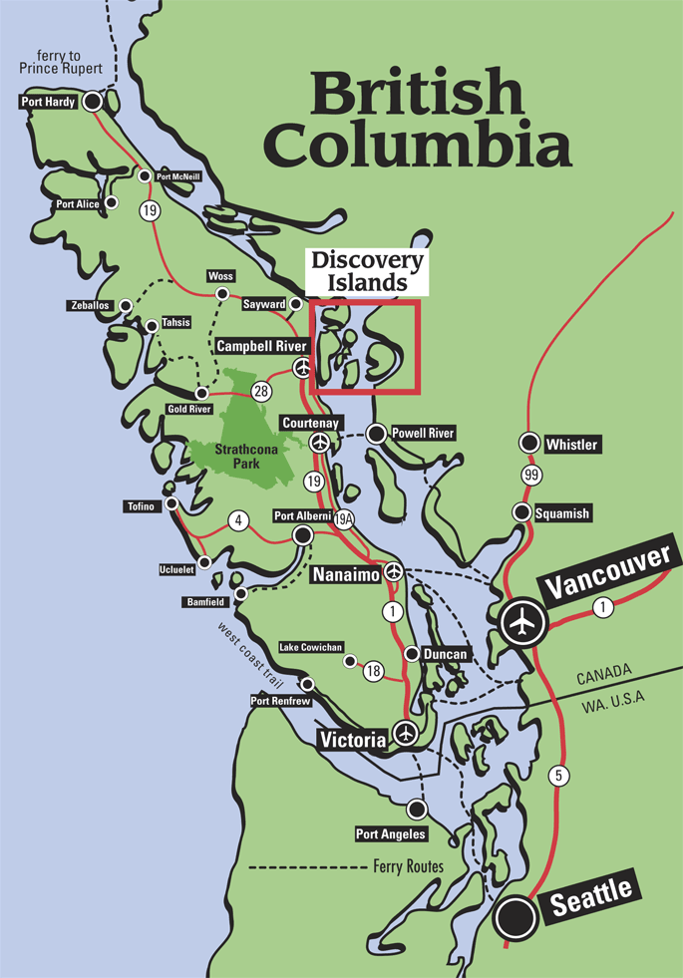
Enforcement Inconsistency
“Single joint leads to trafficking charge for high school student”
CBC, May 17, 2006
“Inconsistent sentences for pot-growing offences unfair”
“Provincial Court Judge Brian Saunderson in Courtenay decided jail in such cases is a dumb idea. Police seized 860 marijuana clones, 549 marijuana plants, 14.5 kilograms of fresh buds drying in trays, and 3.4 kilograms of dried product separately bagged in half-pound quantities.”
Vancouver Sun, Wen. Aug. 23 2006.
Notes:
Officials at the student's school in Blaketown, Trinity Bay,Avalon

Slide 10
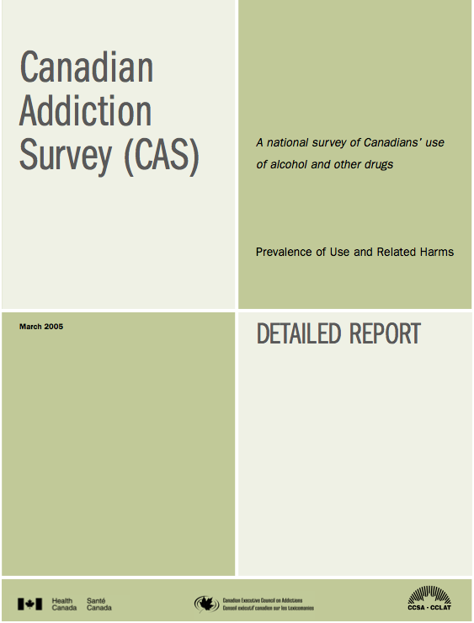
SES: Who is Consuming?
44.5% of Canadians have tried
More males than females (50.1 vs 39.2%)
Younger people (70% 18-24 year olds)
Single people use slightly more
(57.5% single vs 40.9% married)

Slide 11
SES: Who is Consuming?
Increases with education
(34.9% w/o High School vs 52.4% HS completion)
Declines with University degree
(44.2%)
Increases with Income
(Lowest 42.%, Mid 44.6 %, Highest 54.8%)
Location of household
(Rural 41.4% vs Non-Rural 45%)

Slide 12

Approx.
2 Million
People!
Heath Canada
557,655
Players Registered
Hockey Canada 2007

Slide 13
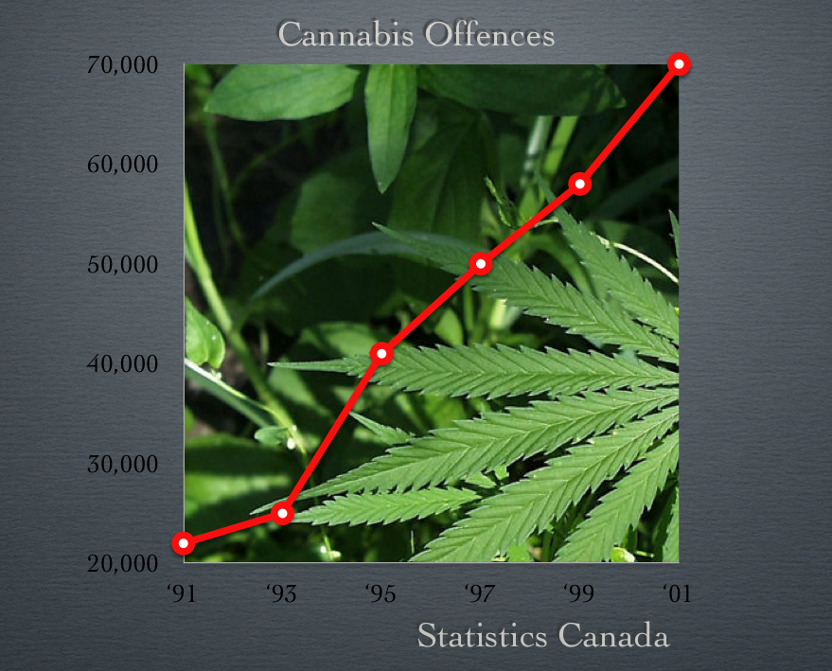
What About Crime?
Marijuana now Accounts for 3/4 of all drug offences.
2/3rds of the 70,000 Marijuana offences in ‘01 were possession charges.
Approximate Enforcement Cost:
300 million dollars

Slide 14
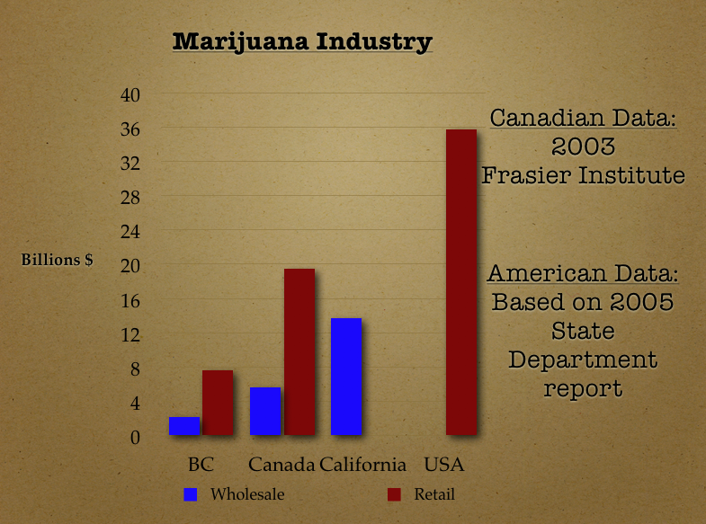
Where is it Coming from?

Slide 15

Marijuana and Health
"Tetrahydrocannabinol is a very safe drug. To overdose, a 70 kg person must swallow more than 70 grams of the drug, about 5,000 times more than is required to produce a high.” "The Science of Marijuana" (London, England: Oxford University Press, 2000), p. 178
“Our meta-analysis failed to demonstrate a substantial, systematic, and detrimental effect of cannabis use on neuropsychological performance.”
"Non-Acute (Residual) Neurocognitive Effects Of Cannabis Use: A Meta-Analytic Study," Journal of the International Neuropsychological Society (Cambridge University Press: July 2003), 9, p. 687
"no significant differences in cognitive decline between heavy users, light users, and nonusers of cannabis.”
"Cannabis Use and Cognitive Decline in Persons under 65 Years of Age," American Journal of Epidemiology, Vol. 149, No. 9. 1999

Slide 16
“We conclude that marijuana does not have a long-term
negative impact on global intelligence.”
"Current and former marijuana use: preliminary findings of a longitudinal study of effects on IQ in young
adults," Canadian Medical Association Journal, April 2, 2002, 166(7), p. 887
"There is no conclusive evidence that the drug effects of marijuana are causally linked to the subsequent abuse of other illicit drugs.”
“Marijuana and Medicine: Assessing the Science Base.” Division of Neuroscience and Behavioral Research, Institute of Medicine (Washington, DC: National Academy Press, 1999).
“In strict medical terms marijuana is far safer than many foods
we commonly consume. For example, eating 10 raw potatoes can result in a toxic response.”
US Department of Justice, Drug Enforcement Agency, "In the Matter of Marijuana Rescheduling Petition," [Docket #86-22], (September 6, 1988), p. 57.
“The risks from cannabis] would be unlikely to seriously [compare to] the public health risks of alcohol and tobacco even if as many people used cannabis as now drink alcohol or smoke tobacco.” World Health Organization, March 1998

Slide 17

Medical Marijuana
“U of T philosophy professor Doug Hutchinson, who won the right this week to smoke pot during work hours for an undisclosed medical condition” NOW Magazine SEPTEMBER 28 - OCTOBER 4, 2006
`We have to accommodate people with disabilities and recognize medical needs’
Margaret MacMillan, Provost, Trinity College, sept. 27 2006

Slide 18
WHY?
On July 30, 2001, Health Canada implemented the Marihuana Medical Access Regulations
Severe pain and/or persistent muscle spasms from multiple sclerosis; spinal cord injury; spinal cord disease
Severe pain, cachexia, anorexia, weight loss, and/or severe nausea from cancer; from HIV/AIDS infection
Severe pain from severe forms of arthritis; or
Seizures from epilepsy.s from epilepsy.

Slide 19




Endorsements
“The Multiple Sclerosis Society of Canada welcomes the approval of Sativex”
MS Society Of Canada 2005
“…believes that people living with HIV/AIDS should have access to cannabis for therapeutic purposes in the treatment of HIV/AIDS through a compassionate framework.”
Canadian Aids Society, 2004
“We encourage more research about the medicinal benefits of marijuana use…”
Canadian Cancer Society 2007
If you are a Canadian with specific health problems and have a supportive doctor or two, it is now perfectly legal for you to smoke marijuana.
Epilepsy Ontario, 2006
Notes:
Sativex is sprayed under the tongue or on the inside of the cheek from a dispenser that is programmed to deliver a pre-selected dosage. It is described as a whole marijuana plant extract. It includes two components of marijuana tetrahydrocannabinol (THC) and cannabidiol.

Slide 20


Opposition
"opposes the Marijuana Medical Access Regulations, as we believe they create significant concerns for both you and your patients.”
CMA 2002, Letter to members
But…
“Health Canada's decision to legitimize the medicinal use of marijuana is a step in the right direction. But a bolder stride is needed. The possession of small quantities for personal use should be decriminalized”

Slide 21
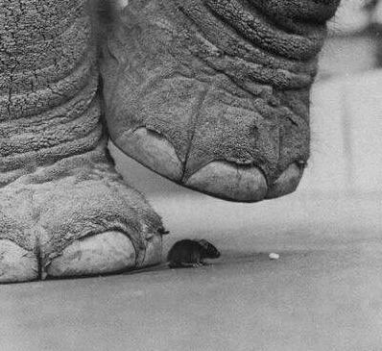
Conclusion
Highly Politicised Issue
Misinformation is EVERYWHERE on BOTH sides of the debat
Because of Legality, Government policy takes little, if any, account of SES when developing Health care policy.
The Waters Remain Dark and Murky

