Slide 1
主讲人：杨中科 .NET /.NET Core 教程 第五部分 ASP.NET Core高级-7 让Swagger中调试带JWT的请求

Slide 2
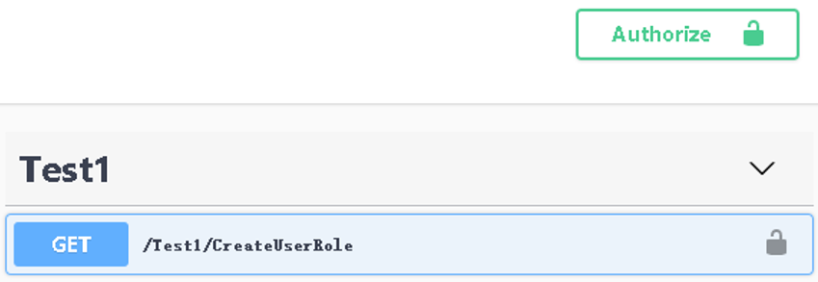
对OpenAPI进行配置
builder.Services.AddSwaggerGen(c =>
{
var scheme = new OpenApiSecurityScheme()
{
Description = "Authorization header. \r\nExample: 'Bearer 12345abcdef'",
Reference = new OpenApiReference{Type = ReferenceType.SecurityScheme,
Id = "Authorization"},
Scheme = "oauth2",Name = "Authorization",
In = ParameterLocation.Header,Type = SecuritySchemeType.ApiKey,
};
c.AddSecurityDefinition("Authorization", scheme);
var requirement = new OpenApiSecurityRequirement();
requirement[scheme] = new List<string>();
c.AddSecurityRequirement(requirement);
});

Slide 3
谢谢
我是杨中科
一名快乐的程序员

