Slide 1
Speech
Emotion Recognition
STAT 453: Intro to Deep Learning
Prof. Sebastian Raschka
Group 2: Weijia Cao, ChuYang Chen, Xiu Xie

Slide 2
Introduction
Deep Learning on audio signals
Speech Emotion Recognition (SER) is the task of recognizing emotions from speech signals - easy for most humans but challenging for machines and/or people with certain mental health issues.

Slide 3
01
Motivations
Why do we study SER?

Slide 4
Motivations
01
02
Marketing
Voice-controlled devices
03
In-car systems
04
Scientific implications
Better understand orders without seeing or touching the user
Detect customers’ emotions to predict attitudes and provide sensible feedbacks
Take preventive actions when detecting a dangerous-for-driving mood
Help find defining features of different emotions in psychological and linguistic research

Slide 5

Motivations

Slide 6
Motivations
01
02
Marketing
Voice-controlled devices
03
In-car systems
04
Scientific implications
Better understand orders without seeing or touching the user
Detect customers’ emotions to predict attitudes and provide sensible feedbacks
Take preventive actions when detecting a dangerous-for-driving mood
Help find defining features of different emotions in psychological and linguistic research

Slide 7
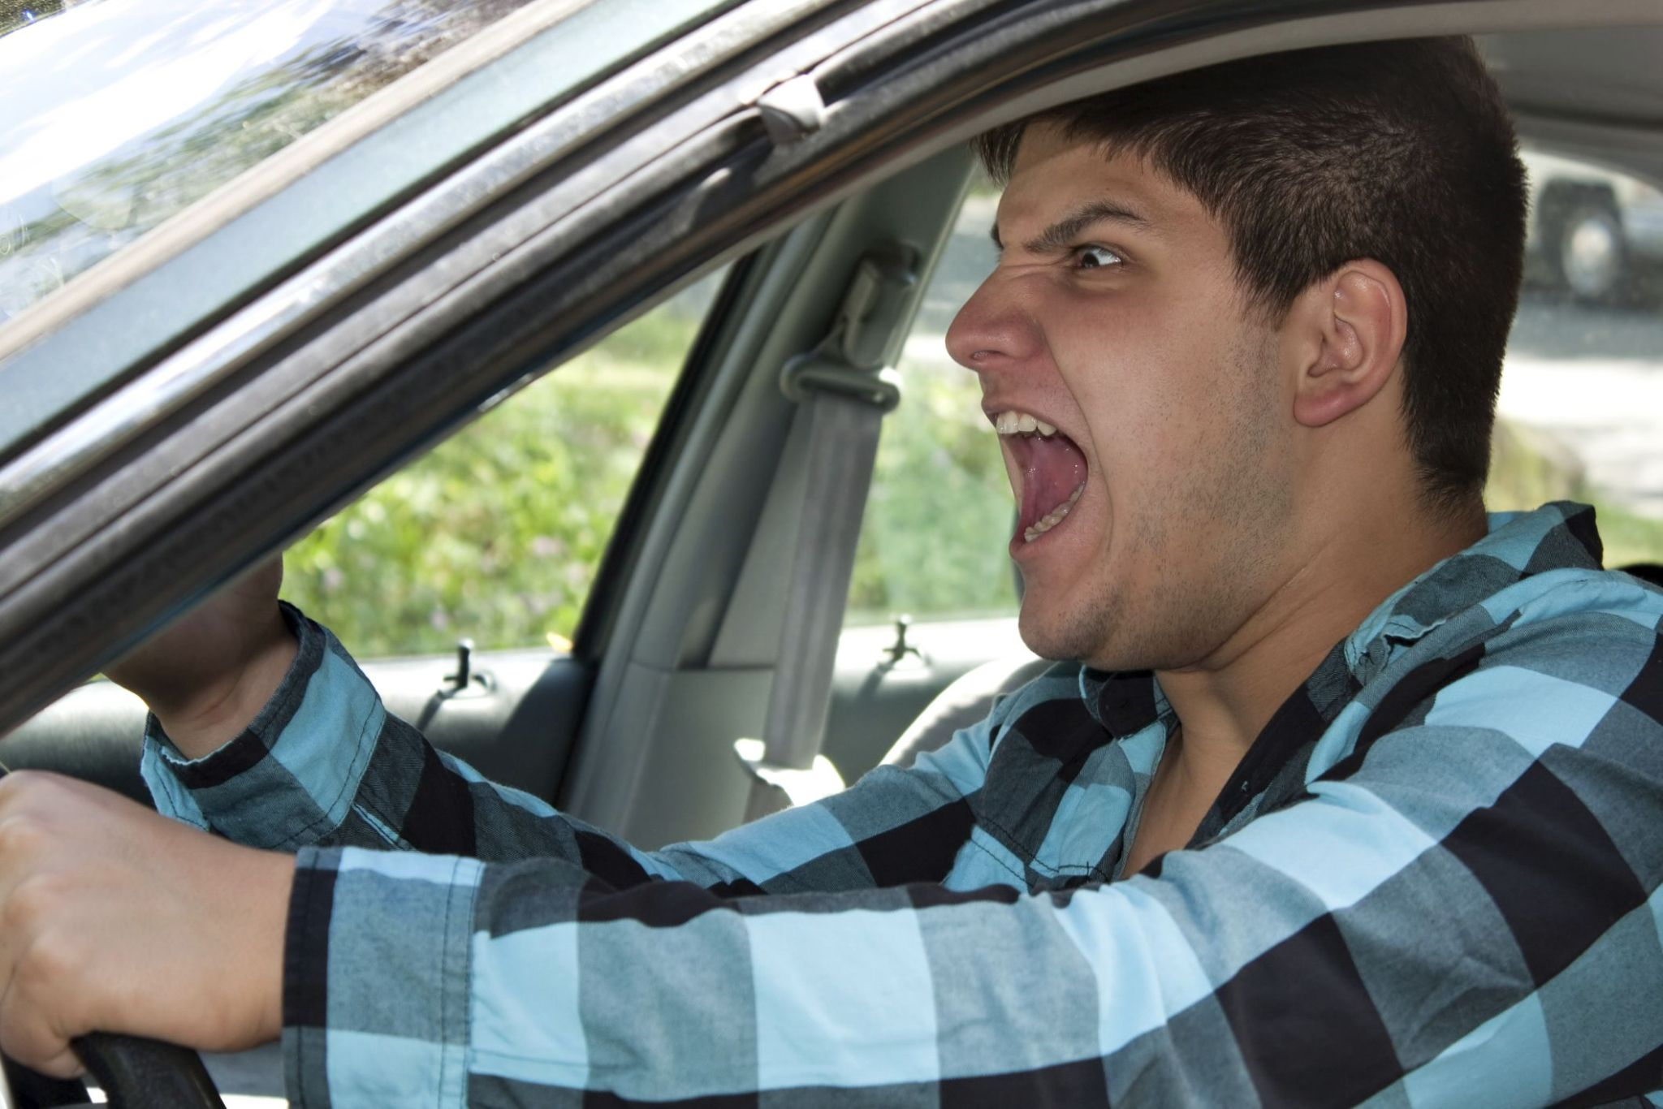
Motivations

Slide 8
Motivations
01
02
Marketing
Voice-controlled devices
03
In-car systems
04
Scientific implications
Better understand orders without seeing or touching the user
Detect customers’ emotions to predict attitudes and provide sensible feedbacks
Take preventive actions when detecting a dangerous-for-driving mood
Help find defining features of different emotions in psychological and linguistic research

Slide 9

02
Data Collection & Preparation

Slide 10
Data Collection
An already sorted-by-label dataset from Kaggle, consisting of the following emotional speech datasets:
Ryerson Audio-Visual Database of Emotional Speech and Song (RAVDESS) - 2,076 (16.22%)
Crowd-sourced Emotional Multimodal Actors Dataset (CREMA-D) - 7,442 (58.15%)
Surrey Audio-Visual Expressed Emotion (SAVEE) Database - 480 (3.75%)
Toronto emotional speech set (TESS) - 2,800 (21.88%)

Slide 11
Data Collection
As mentioned above, the examples are sorted by labels, aka different emotions:
Angry - 2167 records (16.7%)
Happy - 2167 records (16.46%)
Sad - 2167 records (16.35%)
Neutral - 1795 records (14.26%)
Fearful - 2047 records (16.46%)
Disgusted - 1863 records (15.03%)
Surprised - 592 records (4.74%)

Slide 12
Data Preparation
Train-test split:
Randomly split: 80% training data & 20% test data
Transfer the voice data into Mel-Frequency Cepstral Coefficients (MFCC), which can be put into various deep learning models for further analysis.
Normalize the input based on the training data

Slide 13
03
Methodology

Slide 14
Proposed Methods
Multinomial Logistic Regression
CNN
RNN
Baseline / Benchmark
Useful for sequential data
Good for large datasets and sequential modeling

Slide 15
04
Experiments

Slide 16
Multinomial Logistic Regression
19.0% accuracy
Disregard of sequentiality in the data
Assumption of independence among class labels

Slide 17
Convolutional Neural Network (CNN)
Regularization: Dropout
Prevent the model from relying too heavily on certain connections
Make weight values more spread out
Make the model more robust
Normalization: BatchNorm
Reduce internal covariate shift
Provide more parameters and make the model learn more independently

Slide 18
Convolutional Neural Network (CNN)
Relatively high training accuracy: 86.79%
Moderate test accuracy: 62.30%
Our best performing model
Overfitting issue

Slide 19
Transfer Learning (CNN)
Speech Emotion Recognition with CNN - project by Ritzing (2020) from Kaggle.
Original accuracy on Ritzing’s project: 50.21%
Accuracy on our dataset: 52.99%

Slide 20
05
Results
The exciting part! Finally!

Slide 21
Result Comparison
Multinomial Logistic Regression
CNN
Transfer
19.0%
62.3%
53.2%

Slide 22
Conclusion
Highest test accuracy is 62.3%
Highest training accuracy is 86.79%
Can’t solve the problem of overfitting.
SER is still a difficult task for machine.

Slide 23
Future Work
Solve the problem of imbalance dataset
Find more data to solve the problem of overfitting
Split our dataset into two parts based on speaker’s gender
Include more categories of emotions

Slide 24
Thanks
Do you have any questions?
wcao34@wisc.edu
cchen466@wisc.edu
xxie65@wisc.edu

