Slide 1
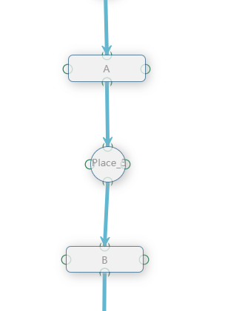
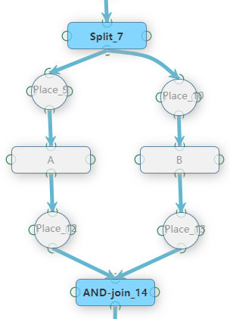
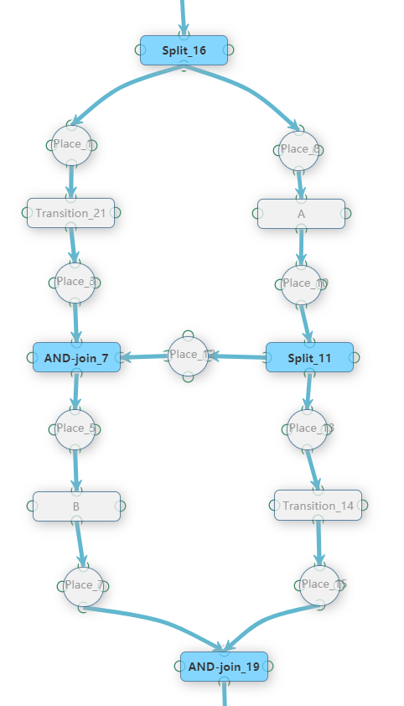
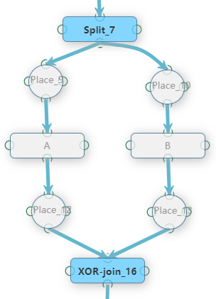
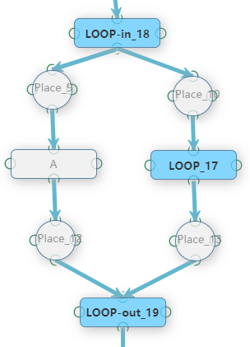
Sequence: B executes after A | Parallel: A and B execute in parallel | Control Dependency: A and B are in parallel branches, there exists a control dependency between them
XOR: A and B are in two mutually exclusive branches | Loop: A executes in loop

