Slide 1

Notes:
Presenter: all, opened by the team lead.
HuiTong, 汇通, means "converge and connect". It is our answer to Problem Statement 17 from Organisation E, a financial-services group with a Singapore operation and a China headquarters.
In one sentence: HuiTong connects the HR systems the group already runs, so that approved data can flow between them instead of being re-keyed through Excel.
Everything you will see runs on synthetic data, and every system HuiTong connects to is a clearly labelled mock, or a synthetic sample file, until we meet the client's IT team.

Slide 2
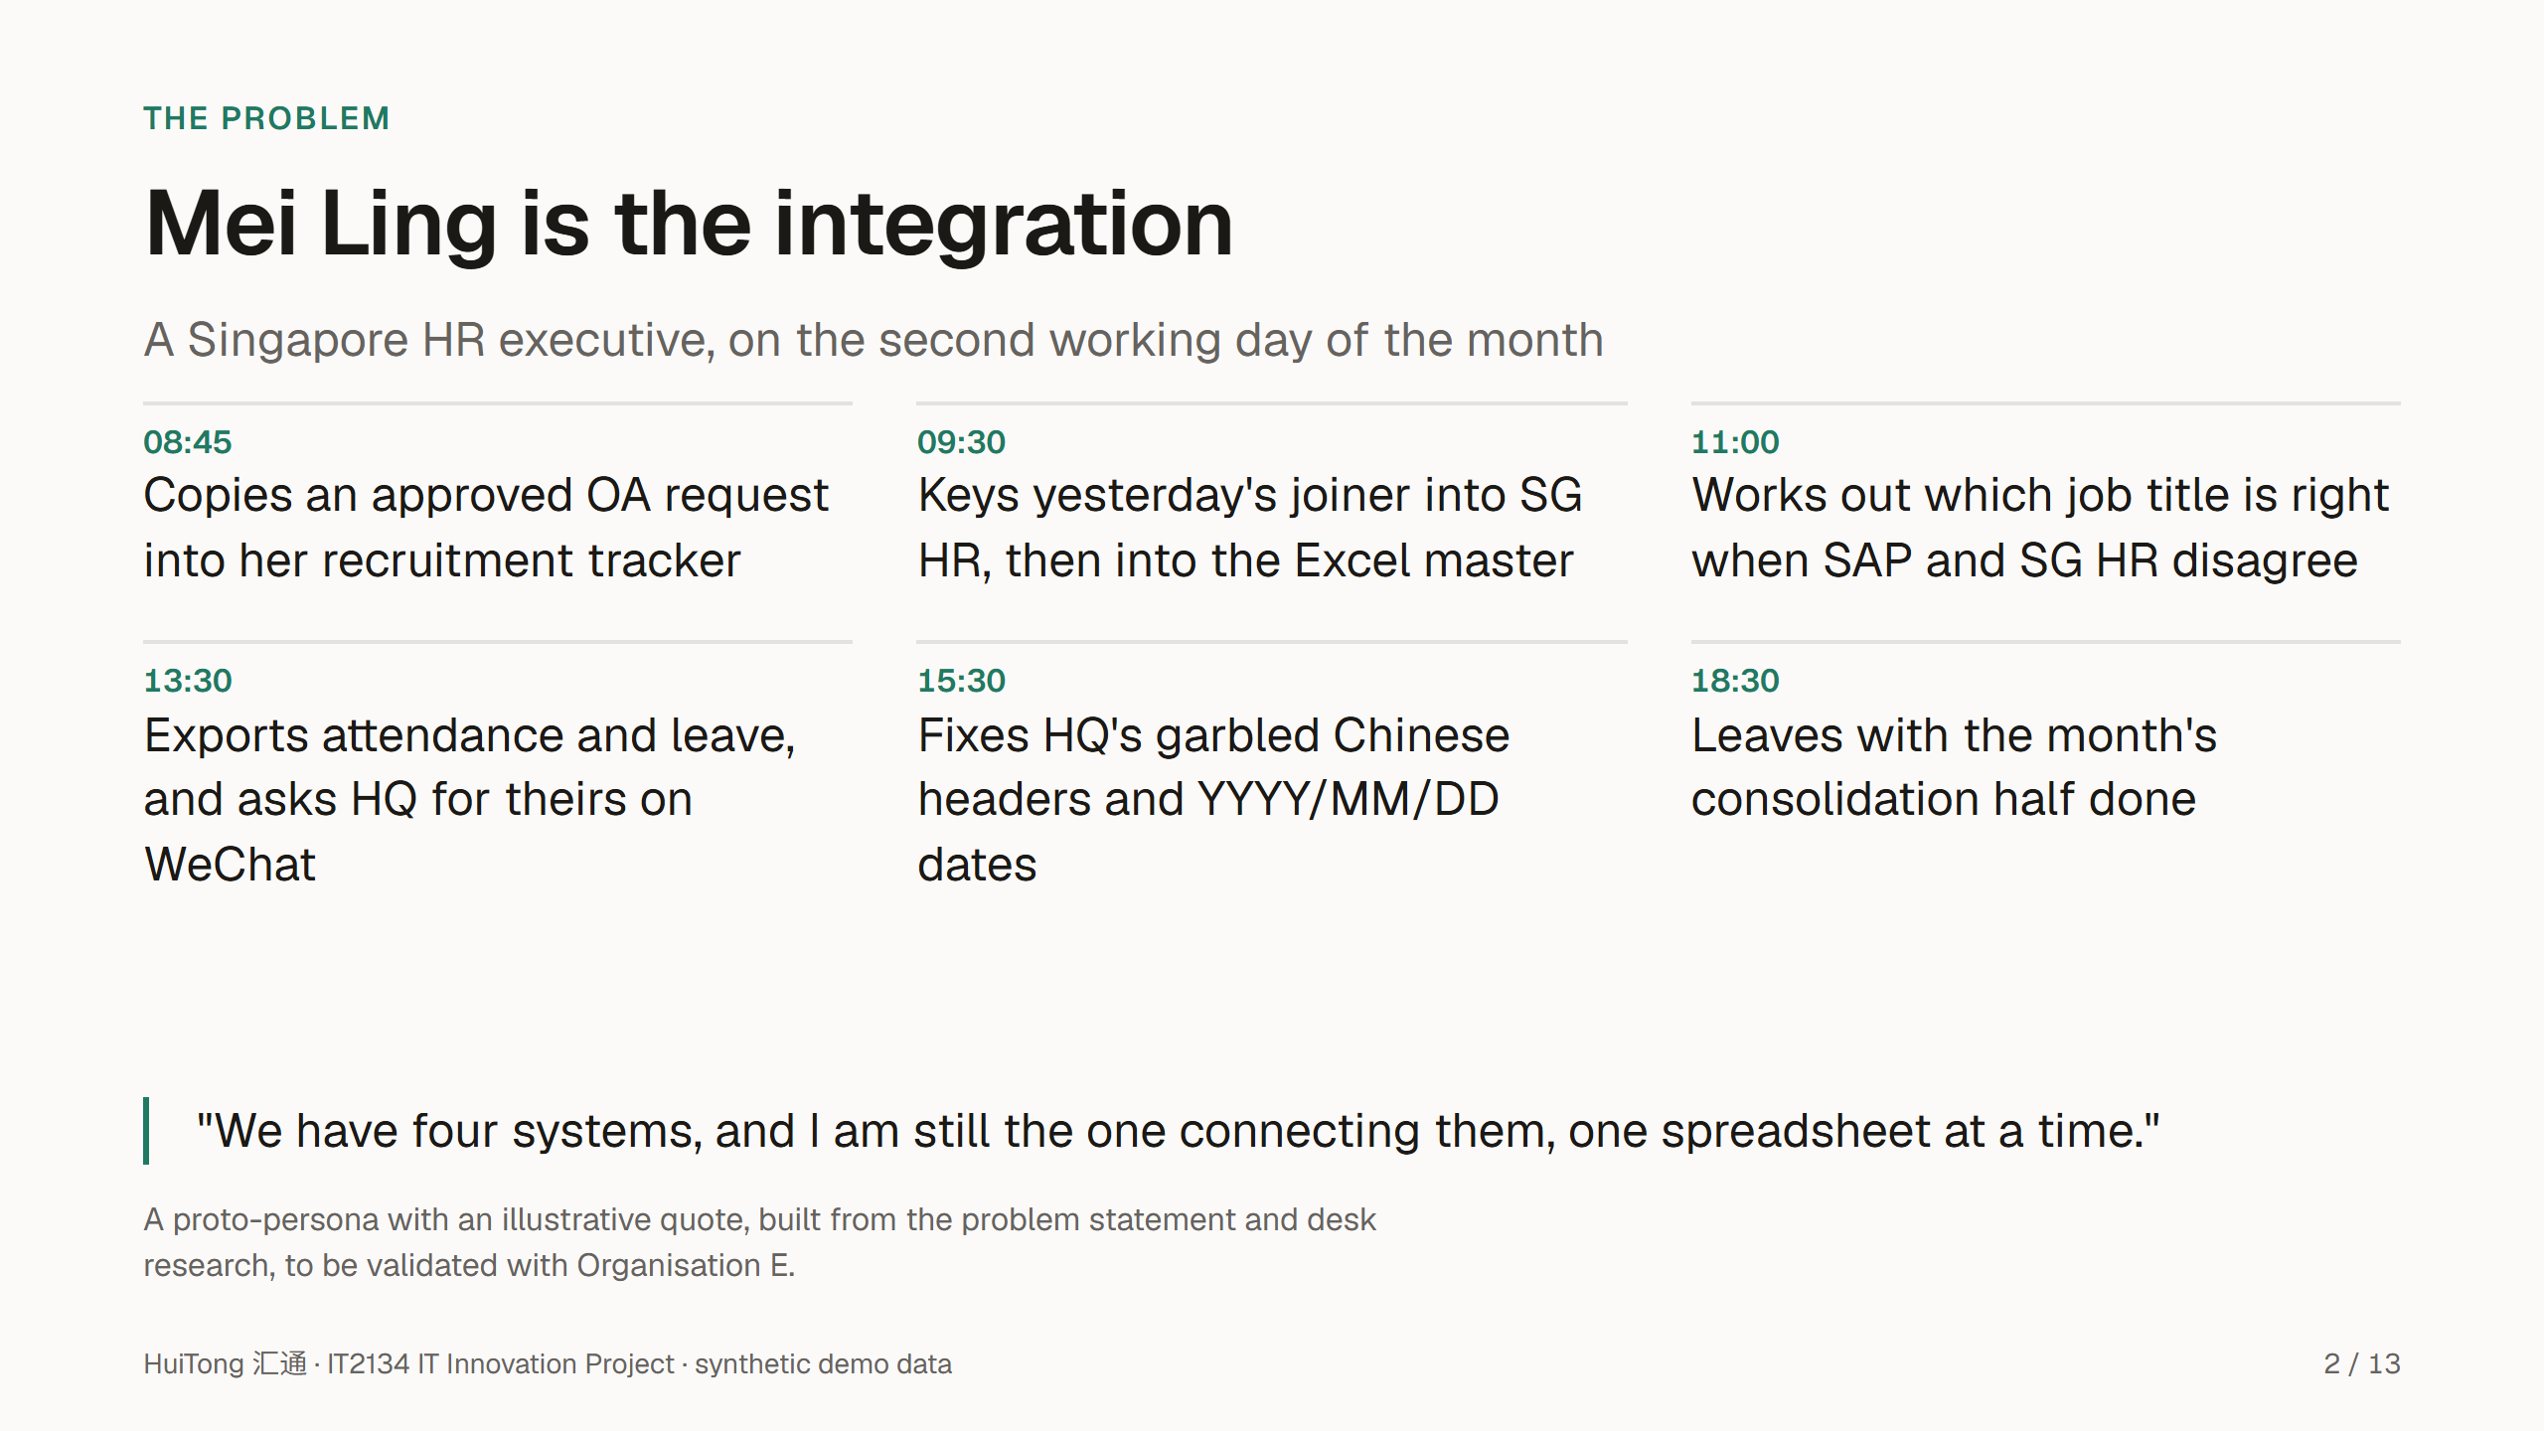
Notes:
Tan Mei Ling is our primary persona: an HR executive supporting the Singapore entity.
Her day is not hard because any one system is bad. It is hard because she is the only link between them: she copies from OA, re-keys into SG HR and the Excel master, and reconciles what the China HQ system says.
Month-end is the worst of it. HQ's file arrives with Chinese headers, a different date format and sometimes a different encoding, and she maps leave categories such as 年假 and 调休 by hand.
Be clear that this is a proto-persona: we test it with the client in the first meeting.

Slide 3
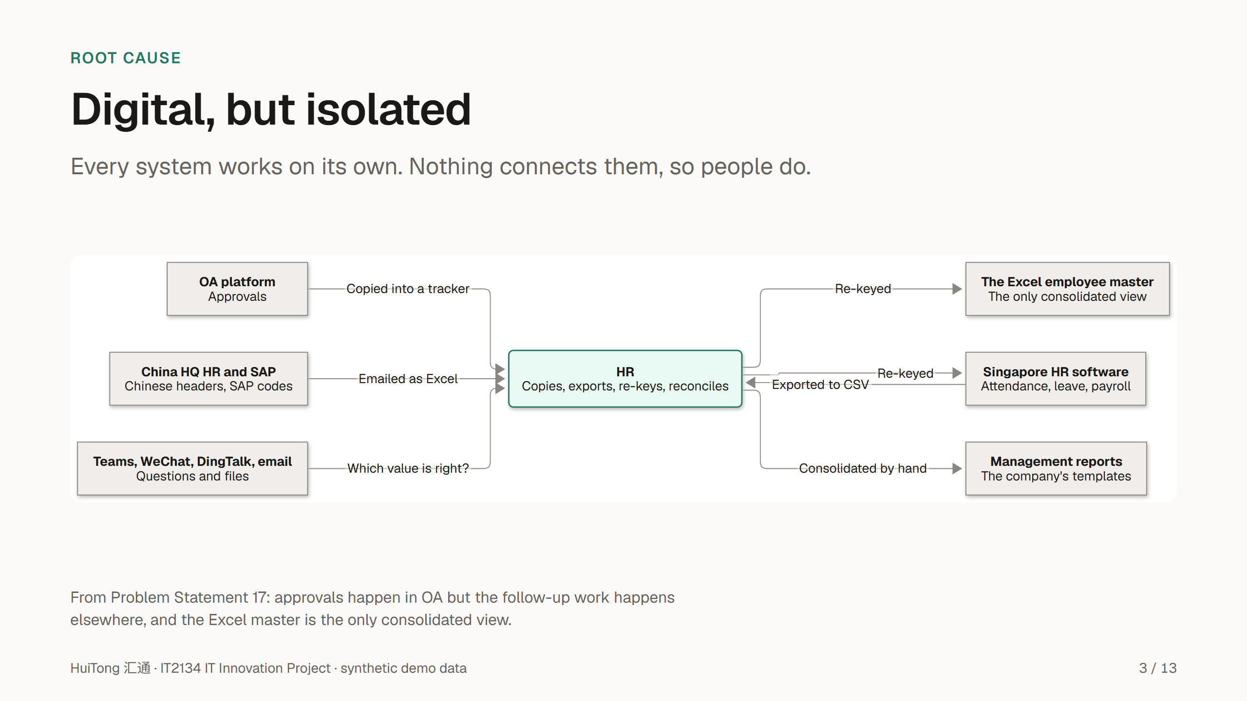
Notes:
The root cause is in the problem statement itself: the group digitalised its tasks, but never connected the systems, so task-level digitalisation never became end-to-end automation.
OA approves a hire, but someone copies it onward. SG HR and China HQ hold the same people in different structures. The Excel master is the only place they meet, HR keeps it alive by hand, and HR consolidates the management reports by hand every month.
The fix is therefore not another system to replace them, but a layer between them.

Slide 4
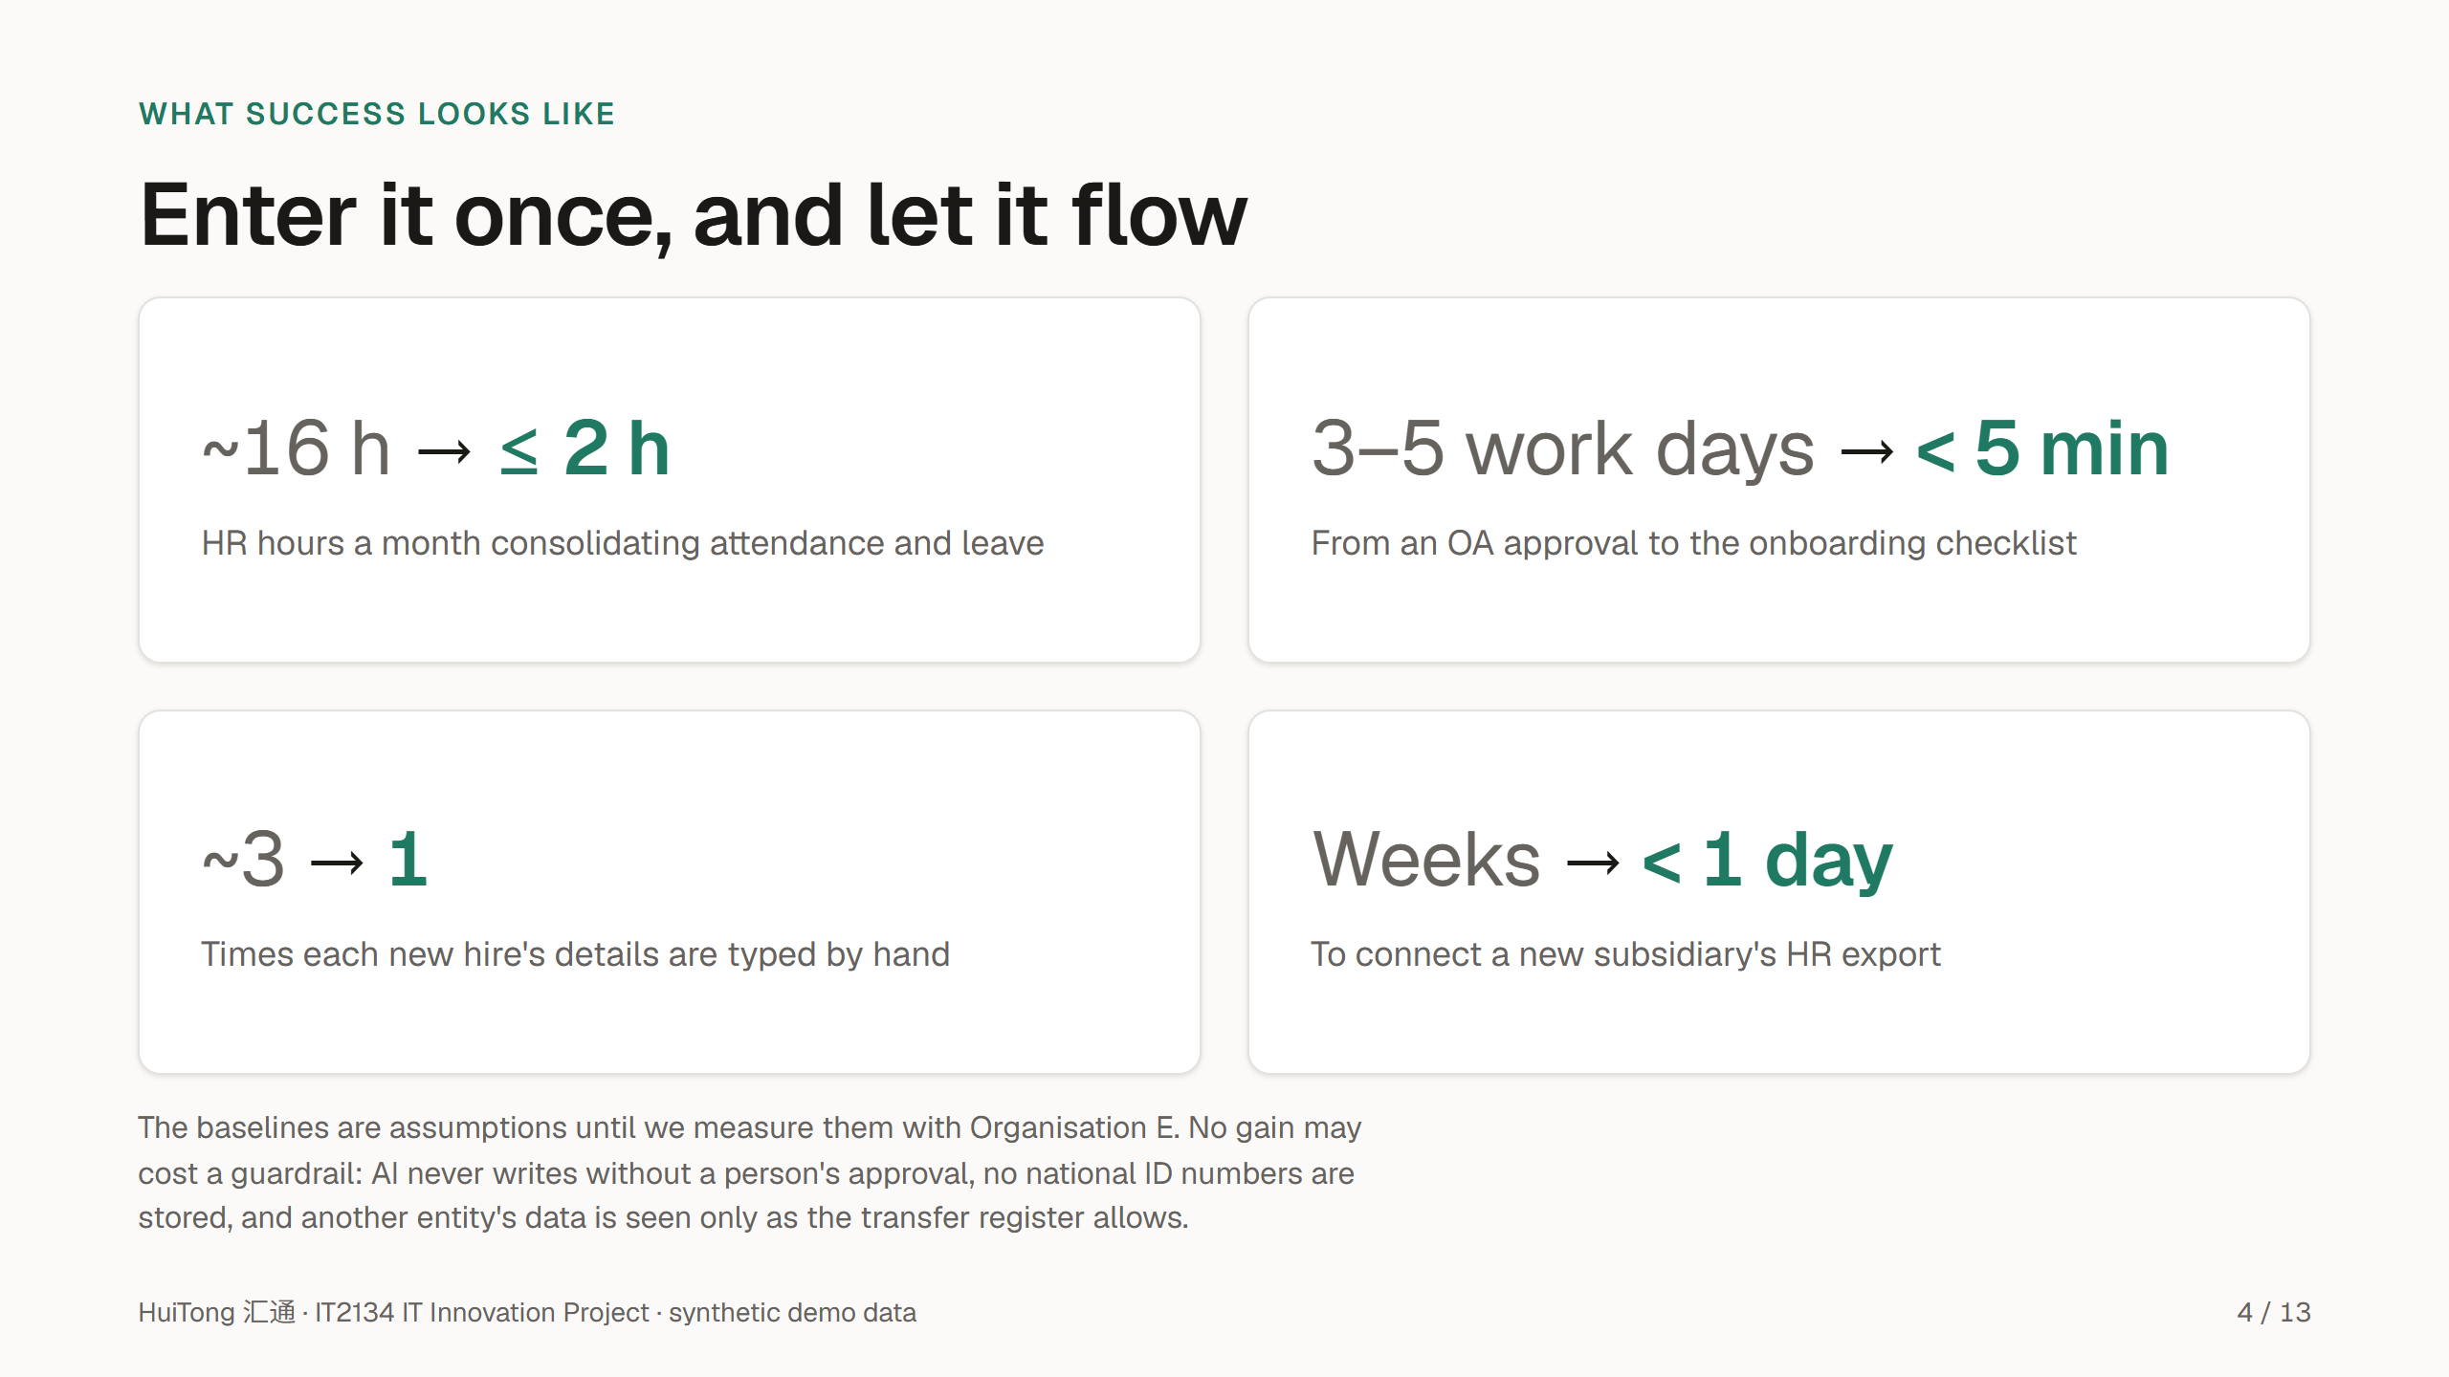
Notes:
These are the outcomes we commit to measure, from our success metrics.
Monthly consolidation drops from about sixteen hours to two or less. An approved manpower request becomes an onboarding checklist in minutes, not days. A new hire's details are typed once, at the source. And a new subsidiary's export is mapped and approved in a day, through configuration.
Every baseline is an assumption today; the first client meeting is where we measure the real ones. The guardrails matter as much as the gains: speed never comes at the cost of approval, privacy or cross-border rules.

Slide 5
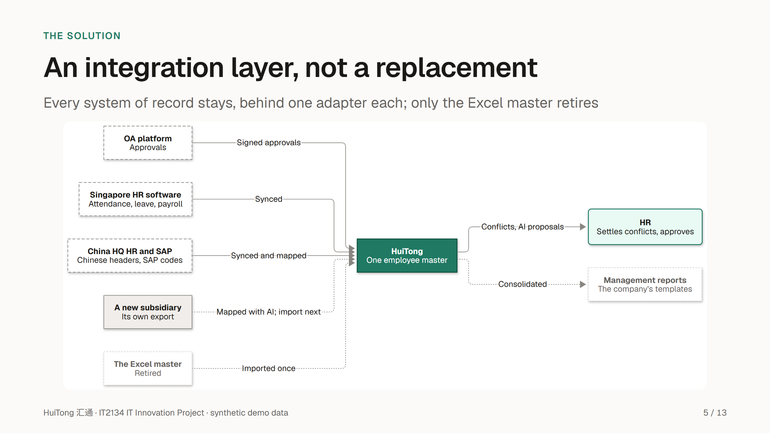
Notes:
The client asked for a feasible architecture that extends to other functions and subsidiaries, not a global platform that replaces everything.
So every system of record stays where it is, each behind one adapter, and HuiTong keeps one employee master that records where every value came from. HR stops re-keying and settles only the exceptions: the conflicts between systems, and the AI's mapping proposals.
What runs today: OA's signed approvals are verified, stored once with an audit record, and kept in an outbox until area 2's workflow subscribes from week 8; SG HR and China HQ sync into the master; and a new subsidiary, such as the Malaysia demo, gets an AI-proposed mapping that HR approves and saves as a version, and its whole export imports through that mapping, with no code change (A-5). The dotted parts are designed but not built: the Excel master's one-off import, and area 3's consolidated reports.

Slide 6
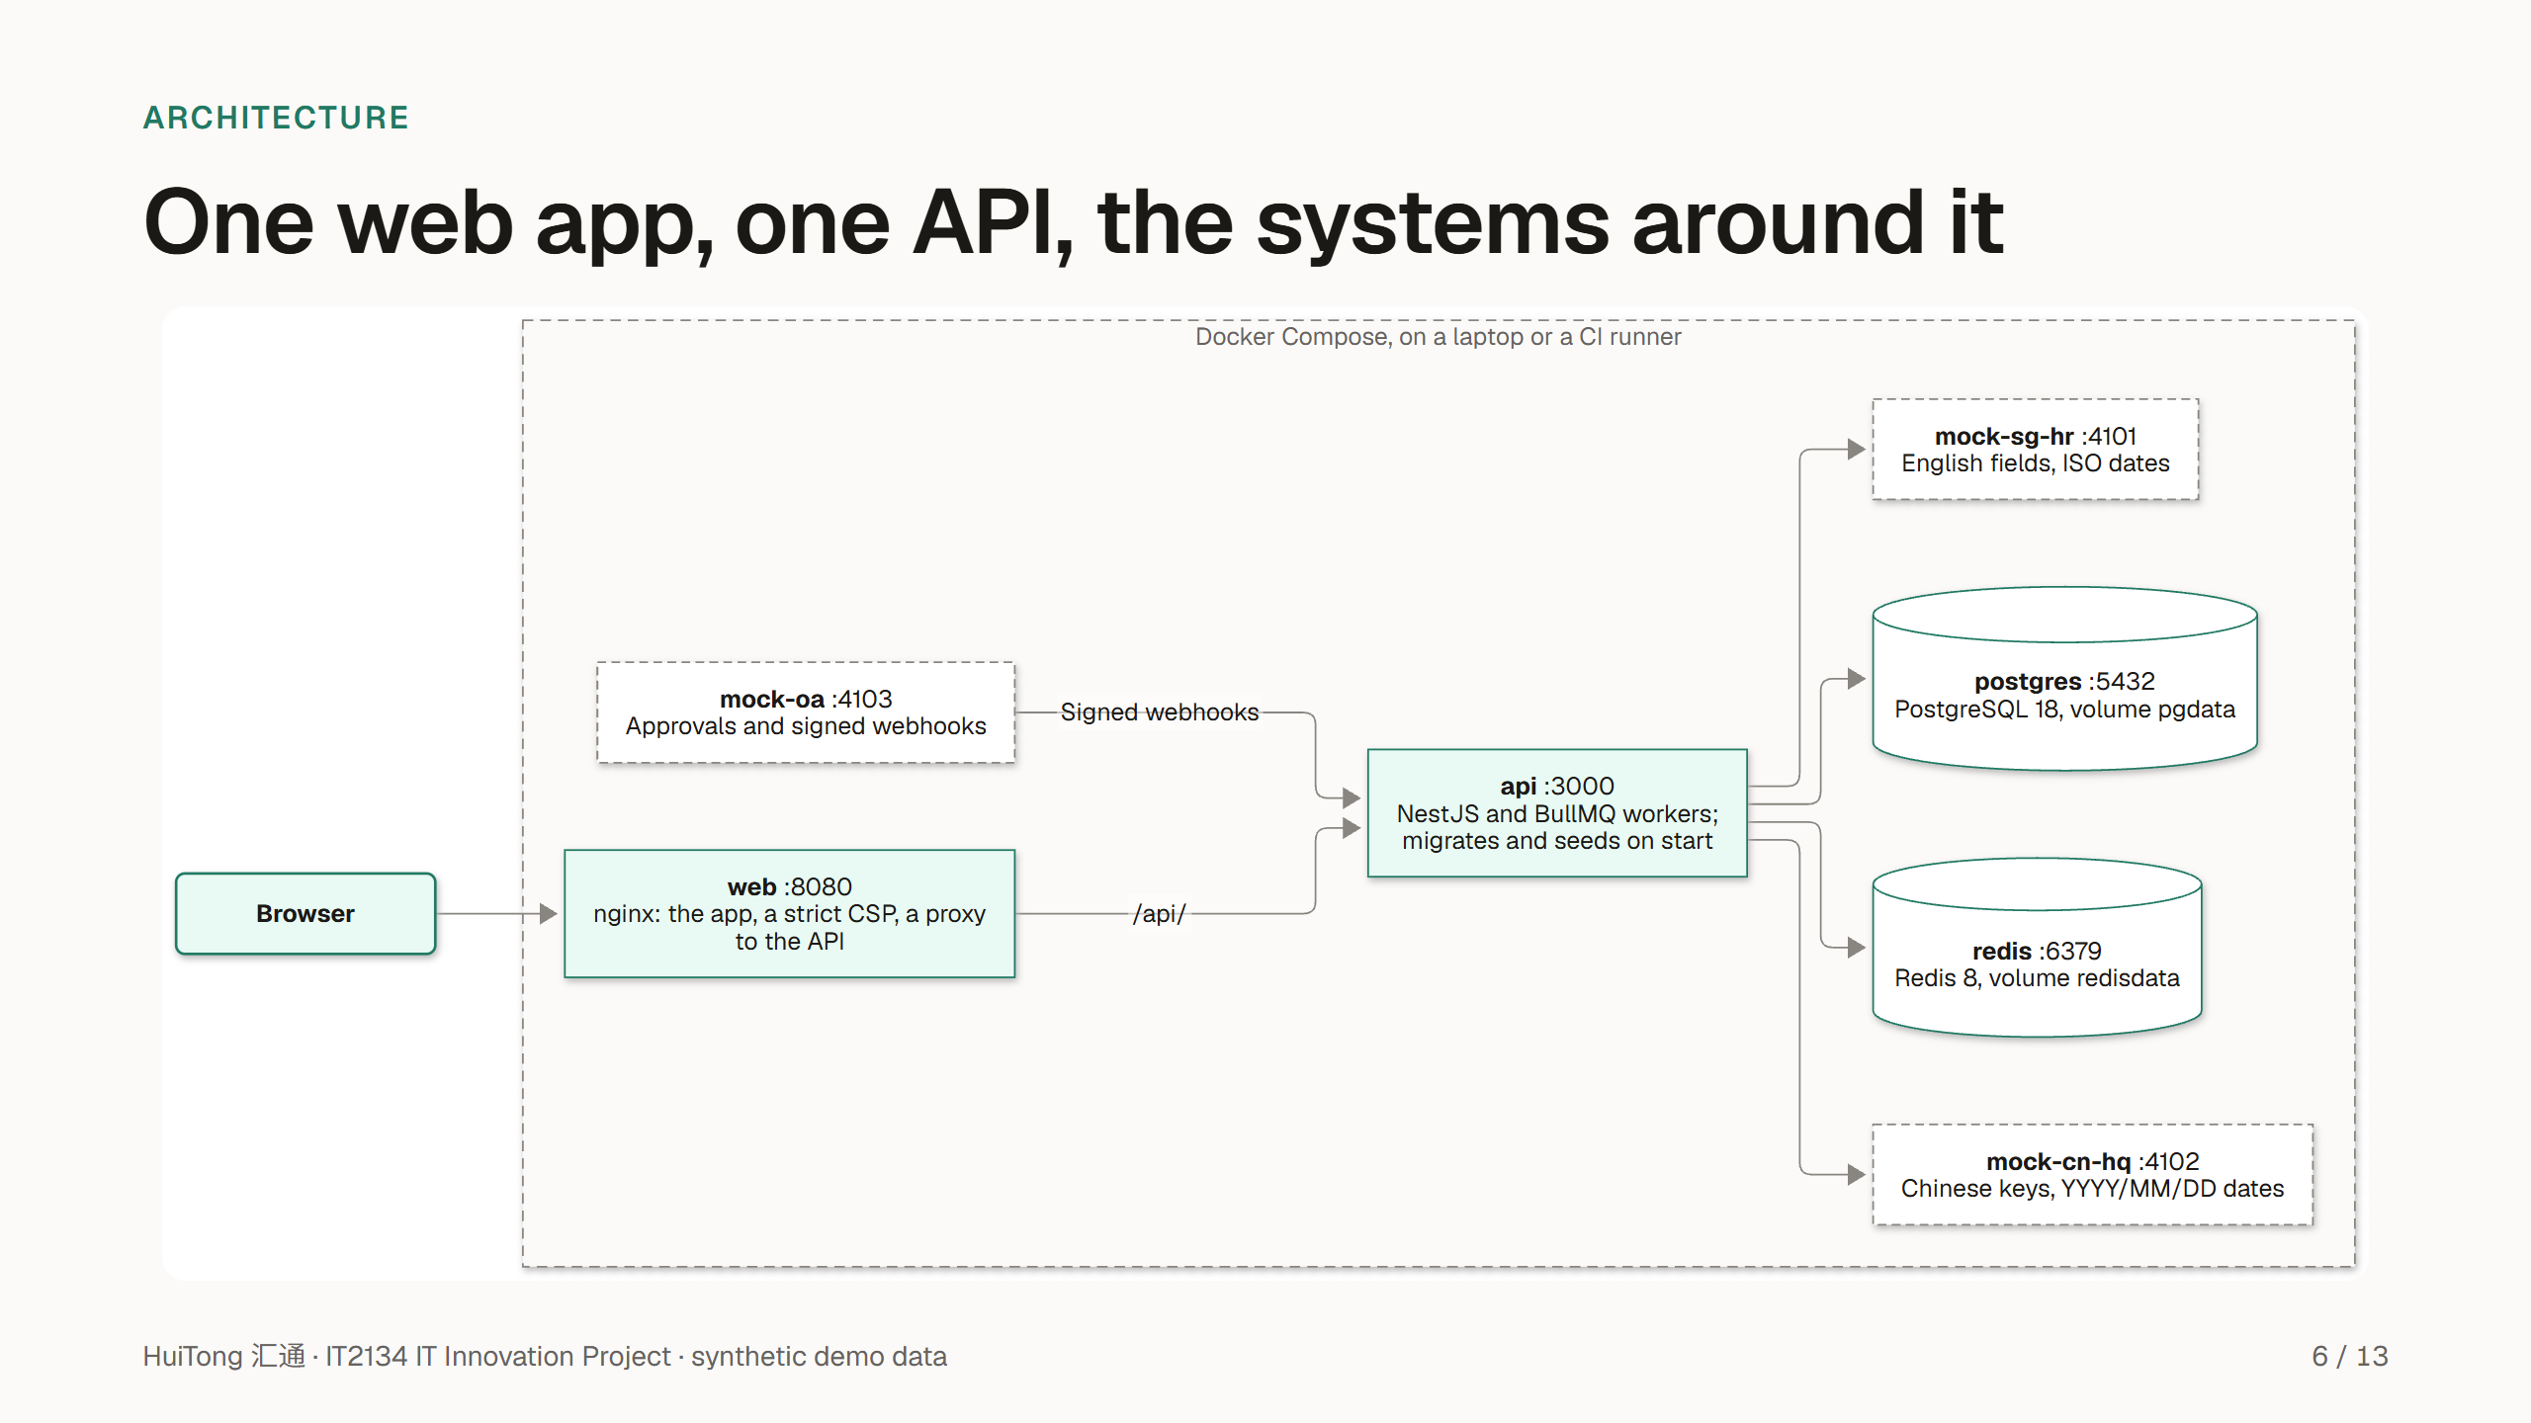
Notes:
The architecture is deliberately plain. The React 19 app is served by nginx, with a content security policy that allows no inline or third-party scripts, and nginx proxies the API. The NestJS API has a module per domain, each owned by one area, with BullMQ jobs and their retries; PostgreSQL 18 holds the data and Redis the queues. AI calls go through one gateway, with a deterministic mock by default.
The mock systems are separate services with deliberately different schemas, Chinese keys and SAP-like codes for HQ, so the integration problems are real even though the data is not.
Everything runs with one command, docker compose up. The AWS target, with Fargate, RDS and CloudFront, is designed in ADR 0014 and drawn in docs/architecture; area 4 deploys it. All seventeen diagrams, from today's problem to the data model, are explained there, with their sources in docs/diagrams.

Slide 7
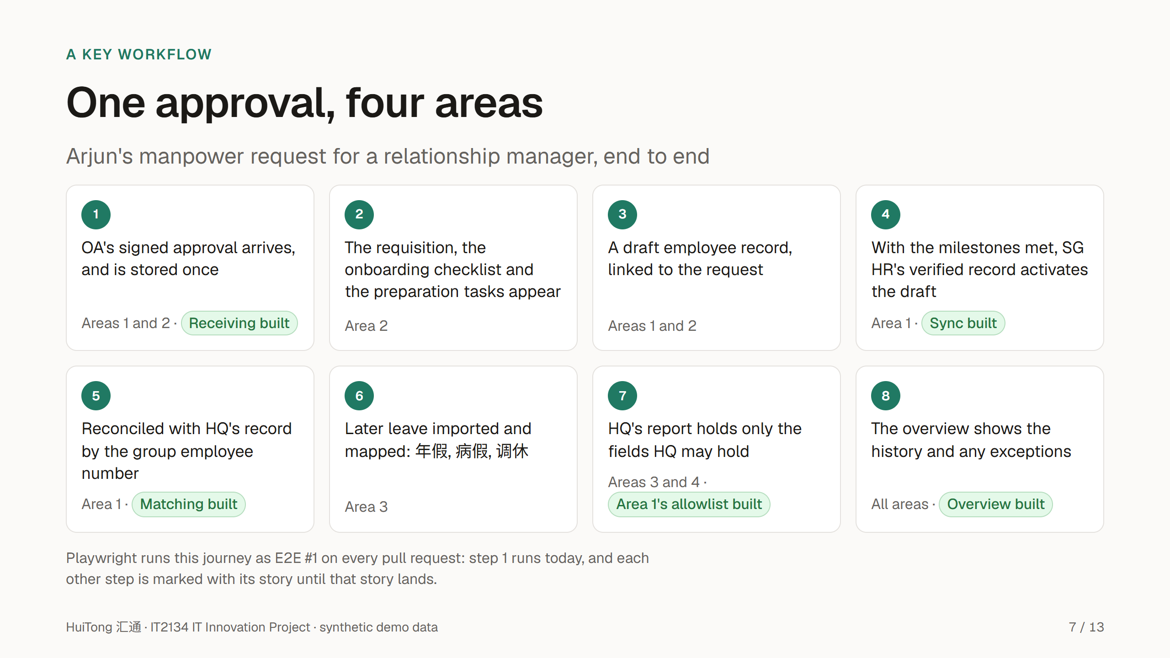
Notes:
Presenters, as in the hero-journey presenter plan: area 2's owner walks steps 1 to 3, area 1 steps 4 and 5, and area 3's owner steps 6 and 7.
This is the hero journey: one approval followed through all four areas. Arjun, a hiring manager, raises a manpower request in OA, and every approver signs it off.
Area 1 receives the signed approval once; area 2 turns it into tasks with owners and due dates. The master holds only a draft record until the onboarding milestones are met and the verified record arrives from SG HR, so an approval never creates an active employee. Later, area 3 maps the employee's leave into the group's categories, and HQ's report holds only the fields HQ may hold.
Be precise about what runs. Step 1 runs end to end in E2E #1 today. The green tags name the building blocks that are built: the SG HR sync, matching on the employee number, area 1's allowlist, which E2E #3 already tests, and the overview. Those steps join the journey when the steps before them land. Activation (B-6) and HQ's report (D-4) come in weeks 9 and 10, and the rest is each owner's to build from week 8.

Slide 8
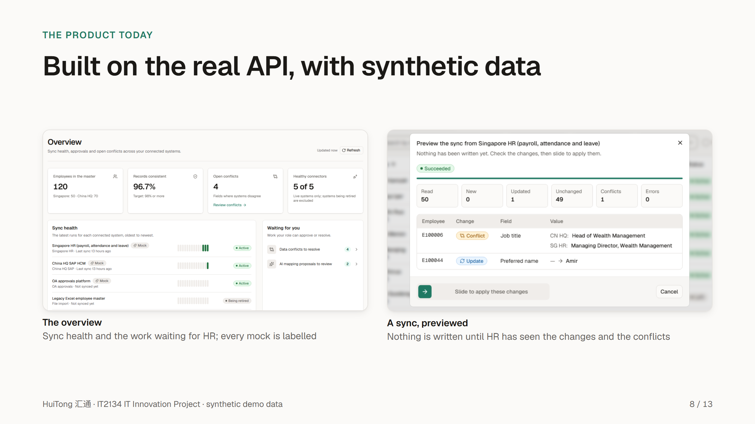
Notes:
These are real screenshots of the running product, in English; every screen also works in Chinese, and in a dark theme. Every mocked system carries a Mock badge.
The overview shows the master's size and consistency, the sync health of each system, and the work waiting for HR: here four data conflicts and two AI mapping proposals. The healthy-connector count includes the Teams and DingTalk channels, which are placeholders until notifications are built (C-5).
A sync is previewed before HR applies it. Here SG HR and HQ disagree on a job title, so the preview shows a conflict instead of overwriting either value. HR applies the change with a slide, and the apply writes exactly what the preview showed; if the source has changed since, it writes nothing.

Slide 9
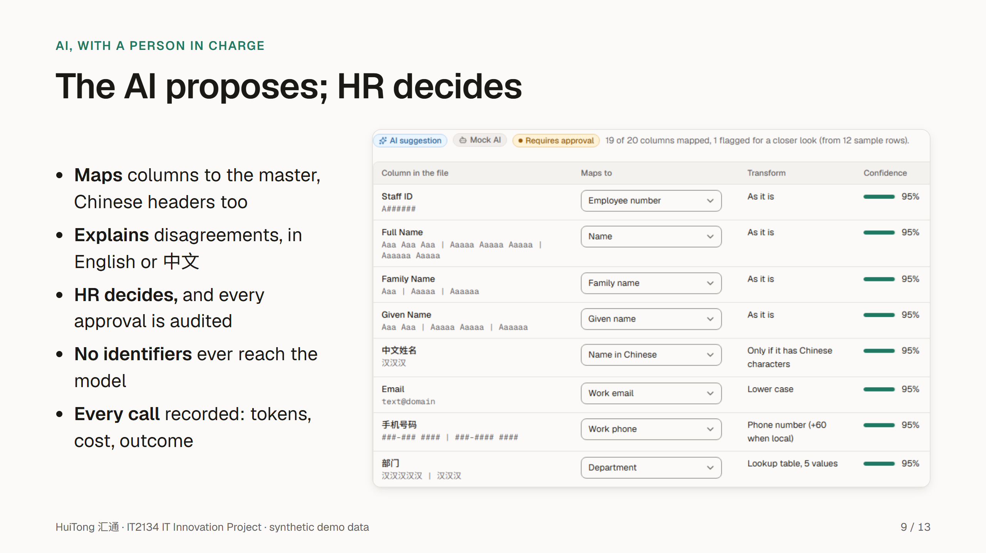
Notes:
AI does two jobs in HuiTong, and both are advisory.
The mapping assistant reads a new system's sample file, Chinese headers included, and proposes how each column maps to the canonical model, with a confidence and a reason. Here it maps 中文姓名 to the name in Chinese and 手机号码 to the work phone, and the whole proposal is labelled Requires approval. The explainer tells HR, in English or Chinese, why two systems disagree about a record.
Three rules hold. The AI never writes to a system of record: HR approves, and the approval is audited. No employee identifier reaches a model: the mapper sees headers, value shapes and category codes, and the explainer sees a system's value only when it identifies no one and is classified Internal or lower. And every call is recorded with its tokens, cost and outcome. By default the model is a deterministic mock, labelled Mock AI, until the client approves a real one.

Slide 10
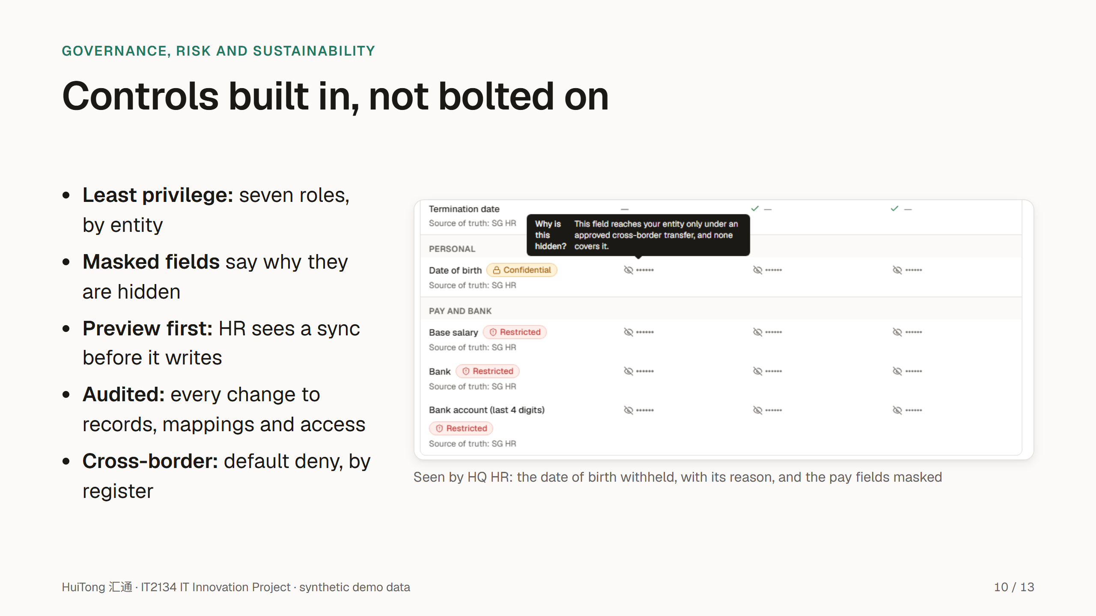
Notes:
GRS is designed into three layers: the data model stores governance facts, the API enforces them so no screen can bypass them, and the UI shows people why the system behaves as it does.
Each role sees only what it needs, scoped by entity. Here an HQ user opens a Singapore record: the restricted pay fields are masked, and the date of birth is withheld because no active transfer shares it, each with its reason. A sync that a person runs is previewed first, and the server refuses an apply without a recent preview; the one exception is the demo stack's first load. Every change to an employee record, a mapping, a connector or access lands in an append-only audit log, chained by hash so tampering shows.
A user in one entity sees another entity's employee values only where an active entry in the cross-border transfer register shares them, with Singapore's PDPA and China's PIPL in mind; every other value is withheld by default, in the API today and in exports when they are built. Where the hub runs, and whether China HQ's data must stay in China, is a question for the client (Q-37 and Q-39).
For sustainability, one governed master replaces the emailed Excel copies, and the 3D map draws only while it is on screen.

Slide 11
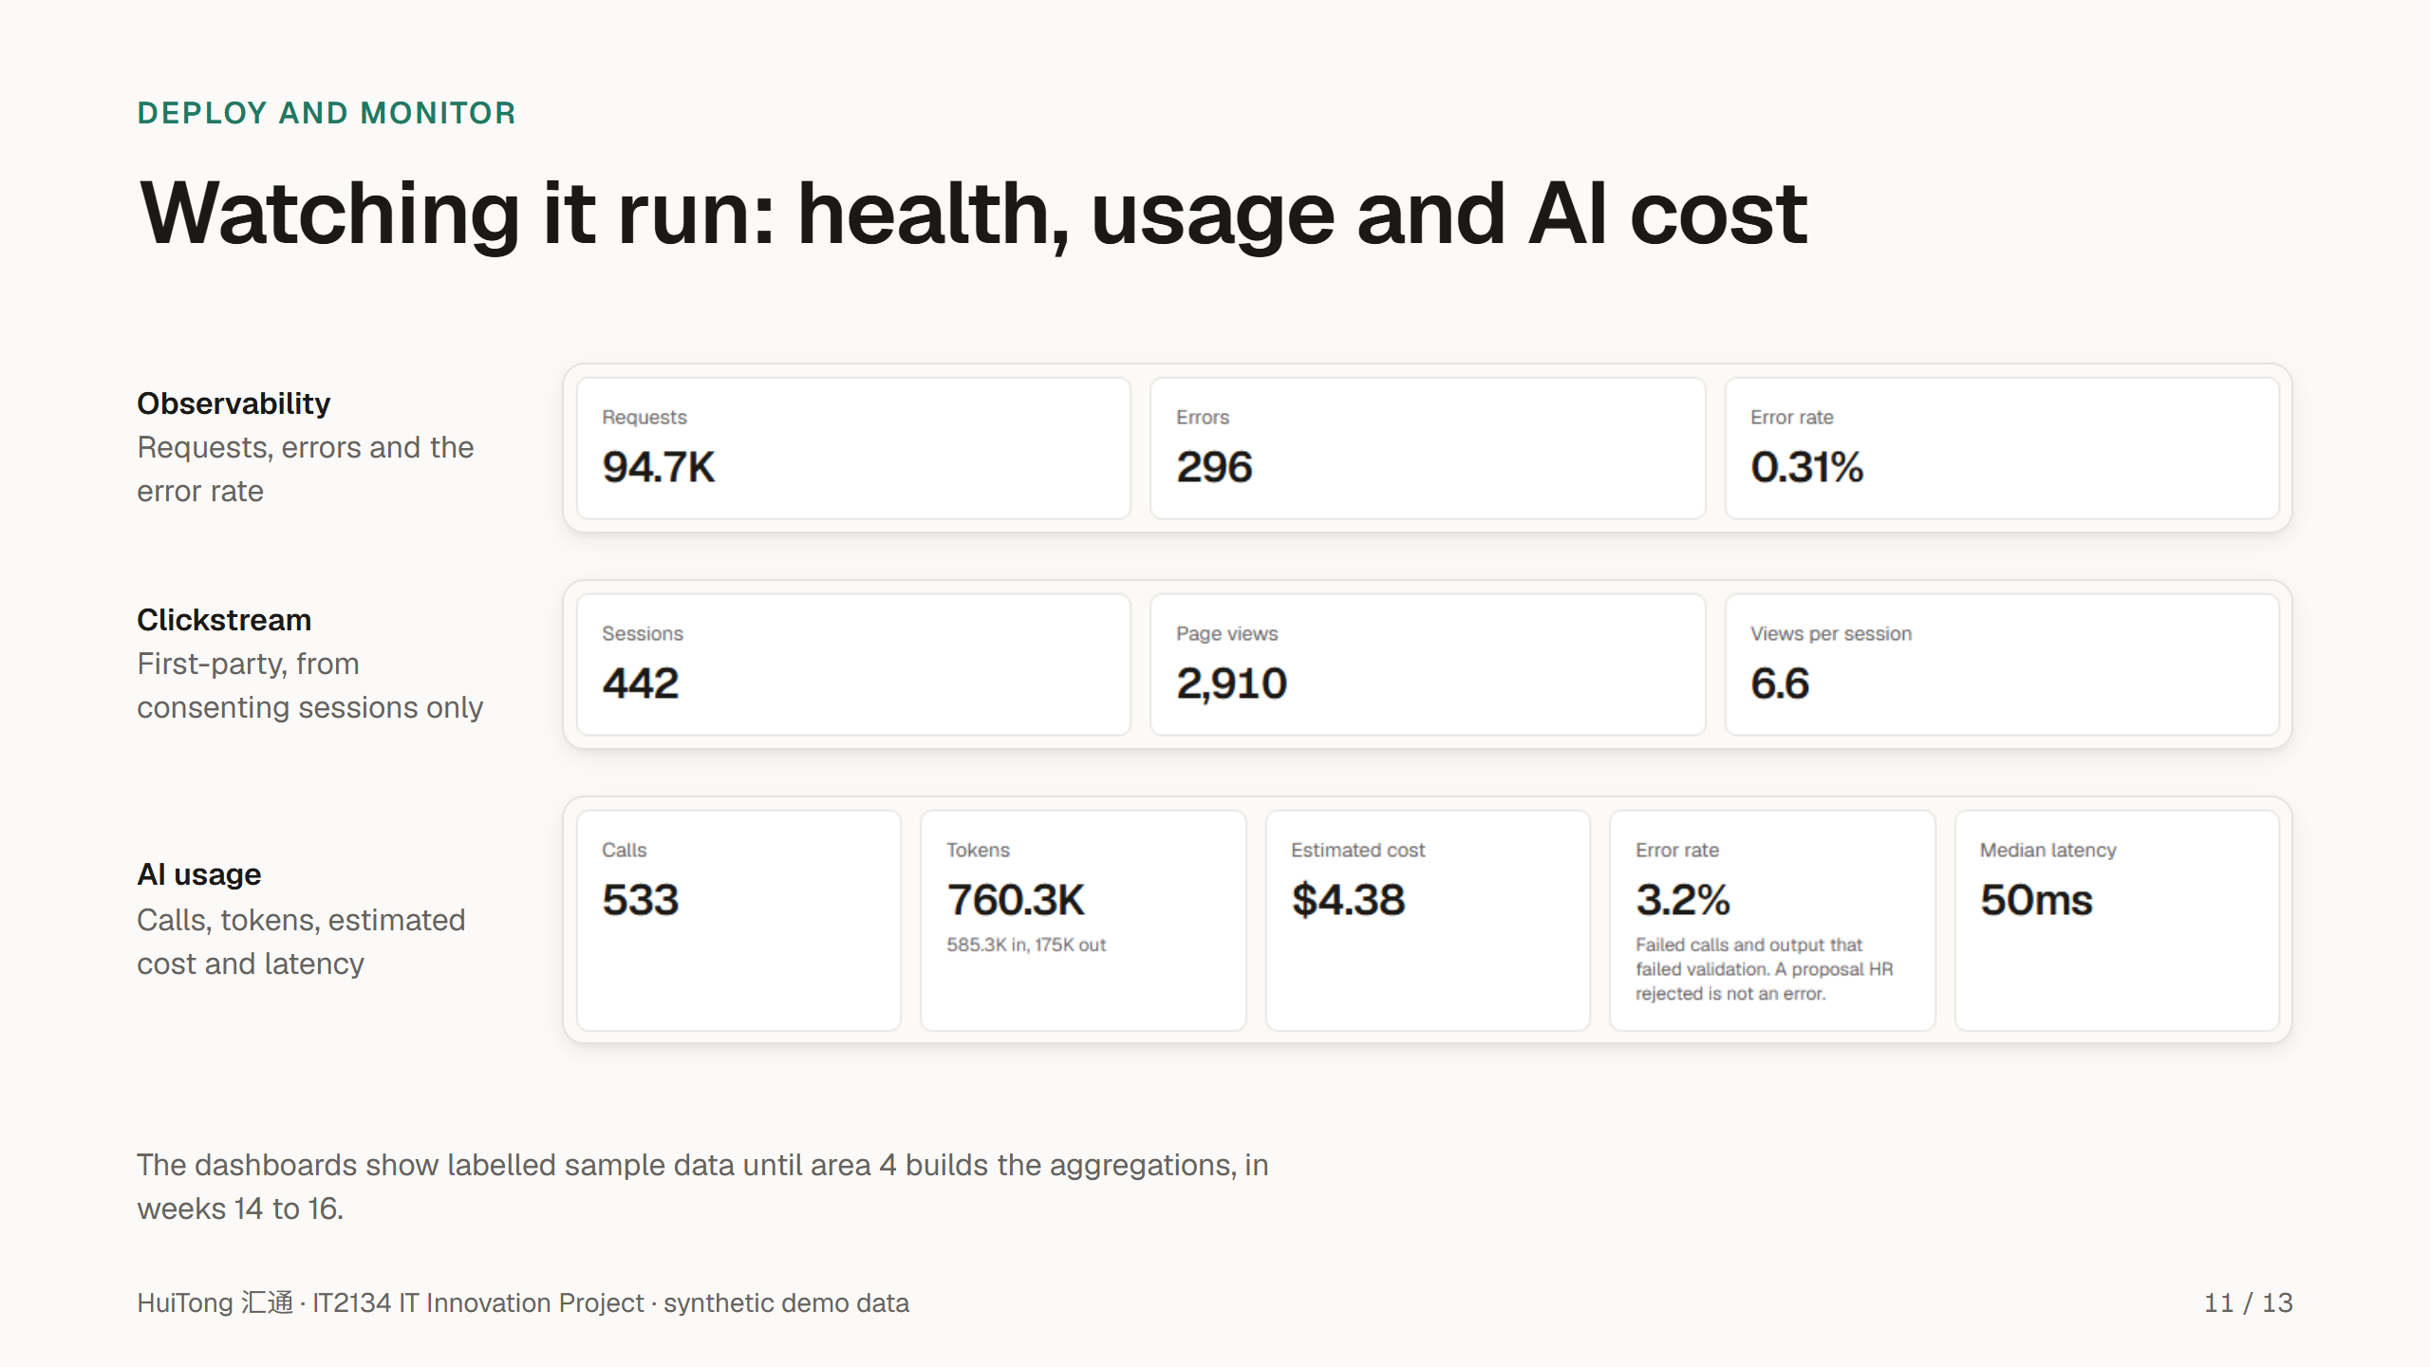
Notes:
Presenter: area 4's owner.
The module asks for observability, clickstream analytics and AI token tracking, each with its own dashboard, and all three screens exist today.
Observability shows service health, request volumes, errors and latency. Clickstream is first-party: it records route patterns, never raw URLs or personal data, and only from sessions that consented. AI usage shows the calls, tokens, estimated cost and outcome of every model call, by feature.
Be clear that the dashboards show labelled sample data for now; area 4 builds the real aggregations in weeks 14 to 16, and deploys to AWS with CloudWatch in week 17.

Slide 12
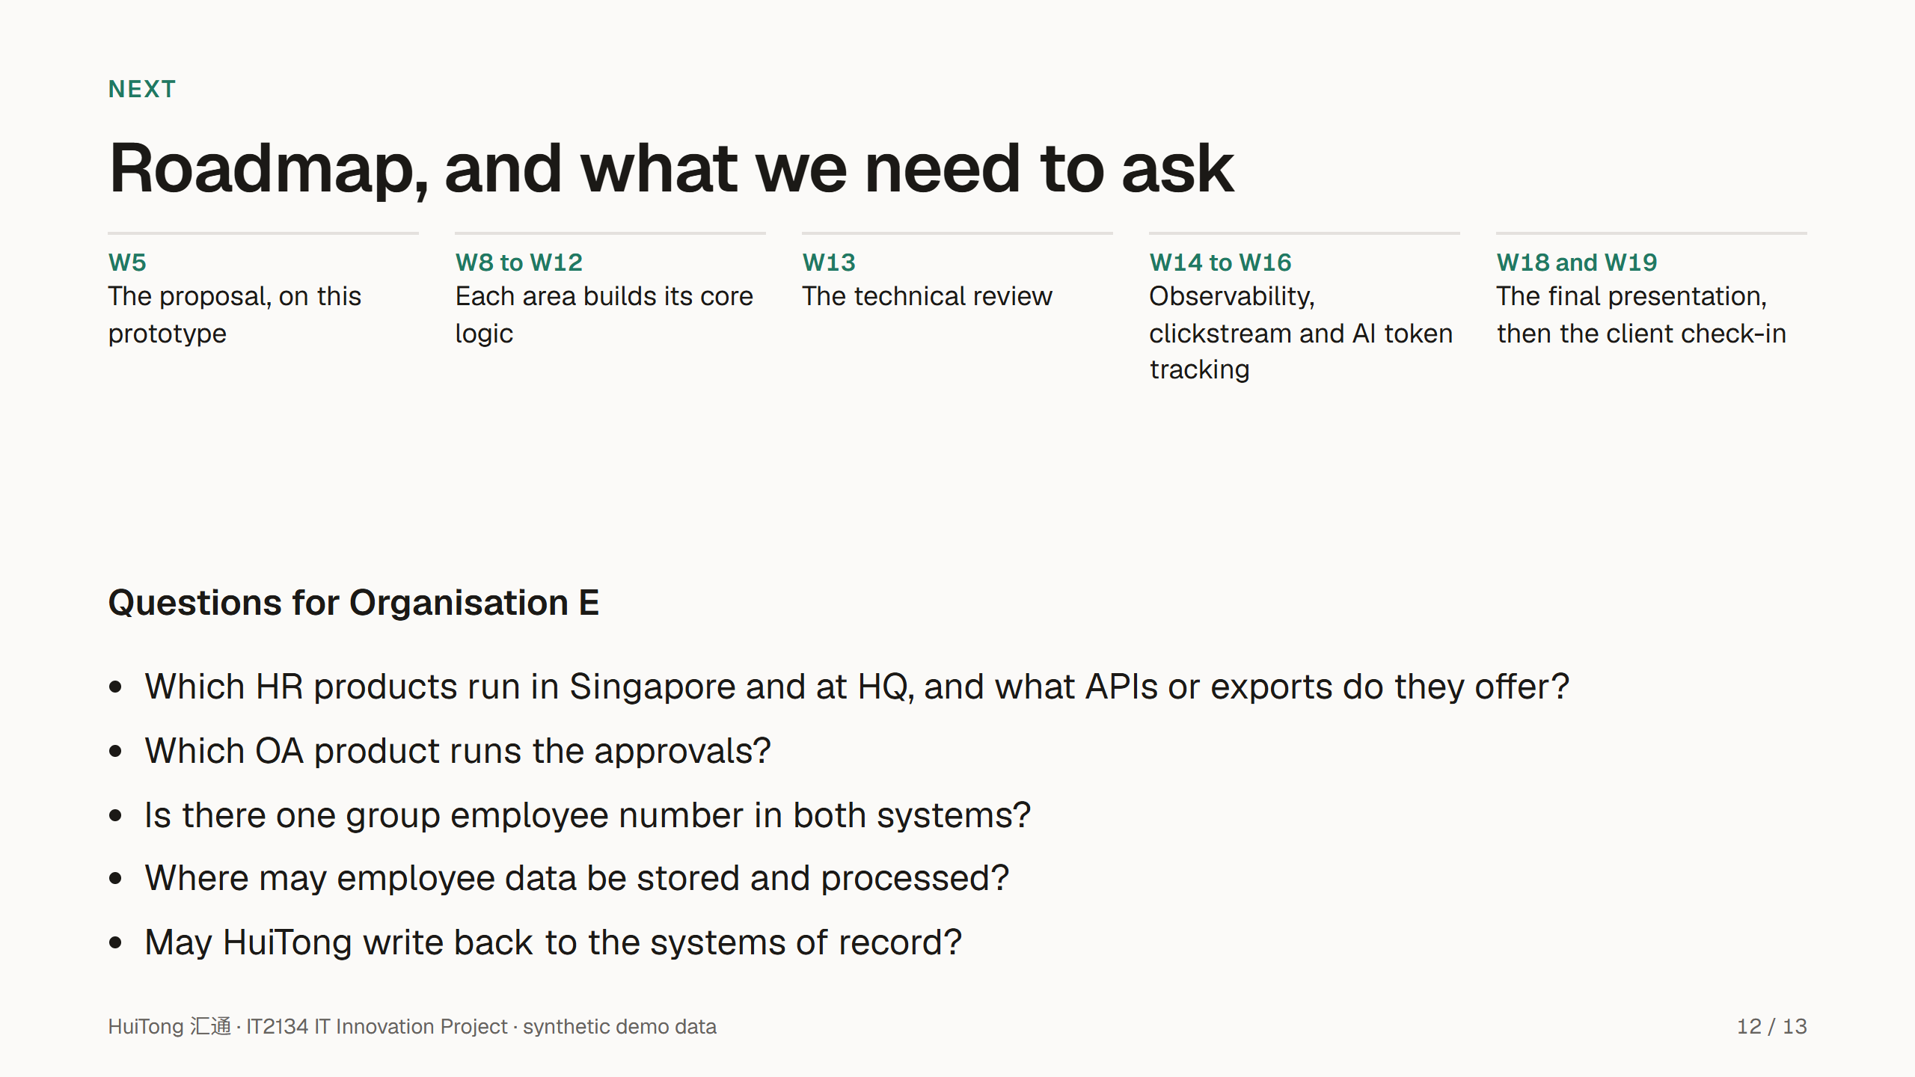
Notes:
The build follows the module's schedule: this prototype for the proposal, each area's core logic from week 8, the technical review in week 13, then monitoring in weeks 14 to 16.
Everything outside HuiTong is mocked until we meet the client, so these questions come first. Which systems and vendors run today, and what interfaces they offer. Whether one employee number links people across systems. Where personal data may be stored and processed. And whether HuiTong may ever write back to a system of record.
The full list, with their priorities, is in docs/client/questions-for-client.md.

Slide 13
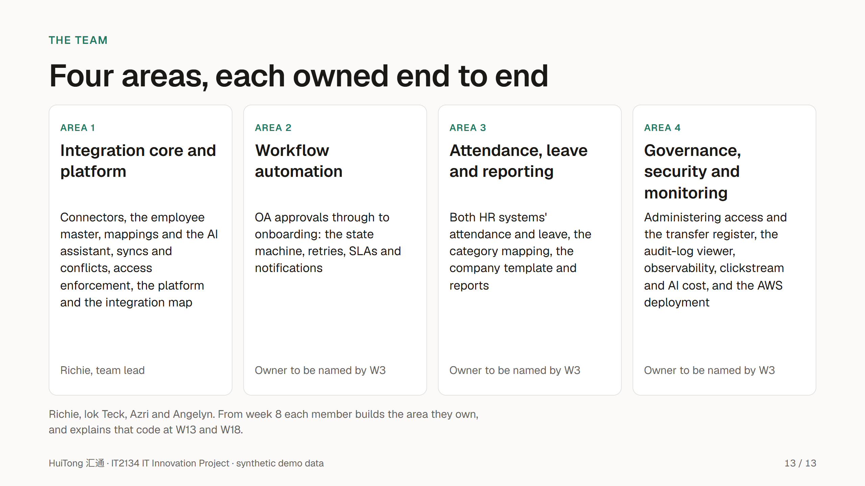
Notes:
Presenter: all.
HuiTong is split into four ownership areas, so every member owns, builds and can explain a distinct part of the system.
Area 1 is the integration core and the shared platform, including the enforcement of access and masking. Area 2 automates the workflow from approval to onboarding. Area 3 consolidates attendance and leave into the company's reports. Area 4 administers governance, and owns security monitoring and the AWS deployment.
Replace "Owner to be named by W3" with each owner's name once the team confirms them in the W3 project plan. Thank you; we are happy to take questions.

