Slide 1
Additional Benchmark Experiments
By Xiufeng Liu

Slide 2
Some Directions
Data File Format
Data Compression
Data Serialization Methods
Index
File System
Shark (on Spark) vs. Spark

Slide 3
Data File Format
Data file formats:
  Text file format
  SequenceFile format ( http://blog.cloudera.com/blog/2011/09/snappy-and-hadoop/)
    Binary storage format can improve Hadoop scan performance by 3X [1] than text format
  Parquet: columnar data format [2]
  RCFile: record columnar file format [3]
  Skip list column format [1]
[1] Floratou, A., Patel, J. M., Shekita, E. J., & Tata, S. (2011). Column-oriented storage techniques for MapReduce. Proceedings of the VLDB Endowment, 4(7), 419-429.
[2] Parquet. www.parquet.io
[3] He, Yongqiang, et al. "RCFile: A fast and space-efficient data placement structure in MapReduce-based warehouse systems." Data Engineering (ICDE), 2011 IEEE 27th International Conference on. IEEE, 2011.

Slide 4
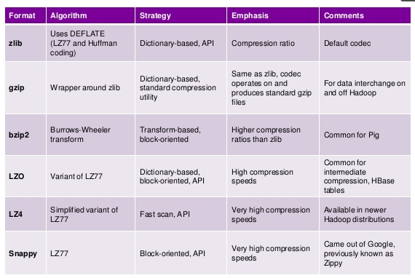
Data Compression

Slide 5
Data (De-)Serialization
Readable/Writable (built-in support by Hadoop)
Avro (http://avro.apache.org/)
Thrift (https://thrift.apache.org/)
Protobufs (https://code.google.com/p/protobuf/)

Slide 6
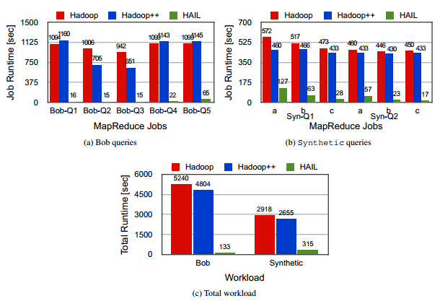
Indexing on HDFS
Hadoop++
HAIL (Lazy Indexing and Adaptivity in Hadoop)
Reference:
Dittrich, Jens, et al. "Hadoop++: Making a yellow elephant run like a cheetah (without it even noticing)."
Proceedings of the VLDB Endowment 3.1-2 (2010): 515-529.
Dittrich, Jens, et al. “Efficient OR Hadoop: Why not both?”
see http://sites.computer.org/debull/A13mar/jens.pdf

Slide 7
File System
Hadoop Distributed File System (HDFS)
  Data co-location vs. no co-location (see CoHadoop)
Network File System
Access file on disk/HDFS VS. cached files (e,g., ramfs, tmpfs)

Slide 8
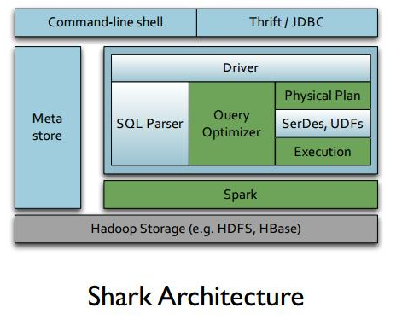
Shark on Spark
Shark builds on Hive that translate SQL-like queries to execution plans running on Spark
Our Purpose: Present our experience of using Shark of facilitating processing time-series data vs. merely using Spark
Benefits and comprises?

