Slide 1
Literature Review of Water Consumption Data Analytics

Slide 2
Water Data Analysis
Outliner Analysis
  Data acquisition problems
  Pipe busts, leaks and anormal consumption
Water Consumption Analysis
  Socio-demographic, billing and infrastructure analysis (descriptive analysis): Analyze from different dimesions: time (hourly, daily or monthly, season) customer, customer group, location, etc.
  Consumption pattern discovery (summer, winter, day and night consmption);
  Clustering
Water Consumption Modeling
  Model demand with climate effect;
  Forecast model

Slide 3
Paper 1: Quantifying the inﬂuence of residential water appliance efﬁciency on average day diurnal demand patterns at an end use level: A precursor to optimised water service infrastructure planning (Byron et al., Griffith University, Australia, 2012)
Research Objectives
  Develop the weighted classfication method to cluster household based on the warter stock effciency (i,e., shower, clothes washer, tap and toile)
  Discover the average daily demand pattern
Study Method
  Data: 191 household hourly diurnal water consumption in two weeks
  Calculate the overall efficiency (composite star rating) using the weighted primary end use.

Slide 4
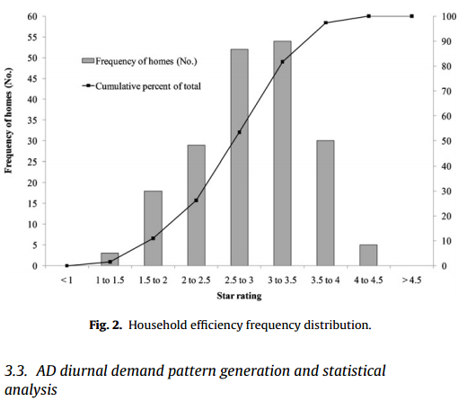
Household efficiency distribution in terms of overall star rating

Slide 5
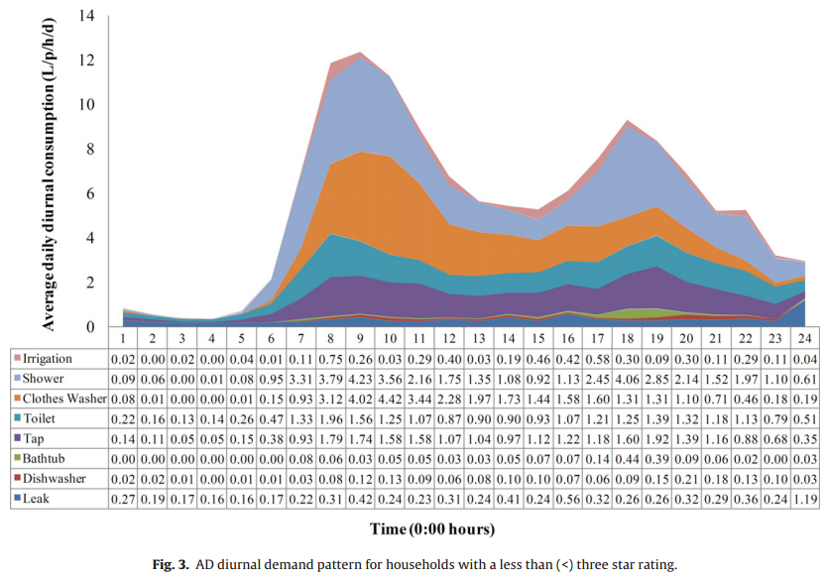
The disaggreted consumption pattern
1. The average daily diurnal demand pattern for households with a less than three start rating

Slide 6
Other disaggreted consumption patterns
2. The average daily diurnal demand pattern for households with greater or equal to (>=) three start rating;
3. AD diurnal demand pattern for 50 most efﬁcient households;
4. AD diurnal demand pattern for 50 least efﬁcient households.

Slide 7
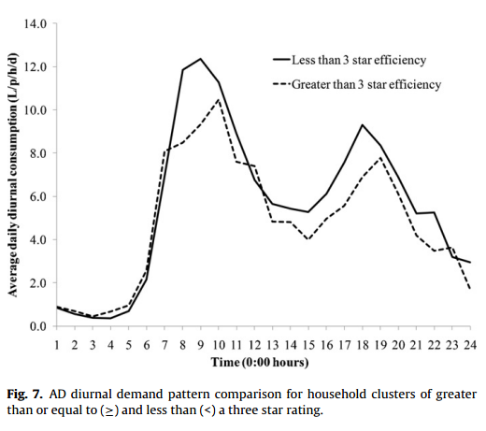
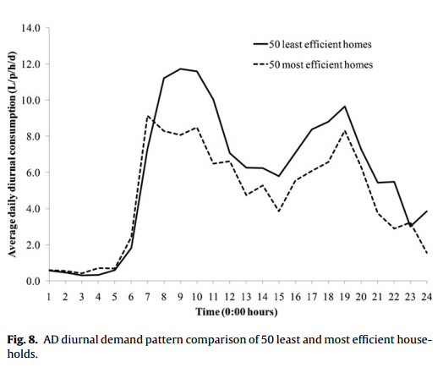
Daily consumption pattern of clustered households

Slide 8
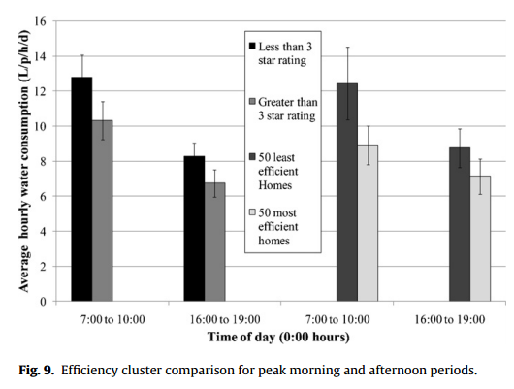
Morning and afternoon peak of the clustered households

Slide 9
Key Conclusions
Statistically signiﬁcant reduction in AD peak hour water consumption in households with a higher composite star rating
More efficient water appliances decreased peak demand in the diurnal consumption patterns.

Slide 10
Paper 2: Smart meter enabled disaggregation of urban peak water demand: precursor to effective urban water planning (By Graham et. al., 2012)
Research objectives
  Identify the proporation of indoor and outdoor residential water consumption
  Identify the major courses of significant consumption fluctuation (e.g.. temperature, lot size, dwelling types, etc.)
  Measure the end use volumnes at peak demand period
Data sets
  2884 residential and light commercial customers (houly resolution within one year).
    4 groups: 1 urban residential, 1 suburban residential, 1 mixed residential and commercial, 1 commercial.
    2494 single residential, 390 multi-residential

Slide 11
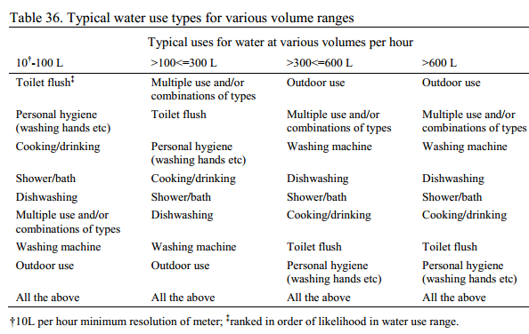
Identify the volume ranges for typical water use types

Slide 12
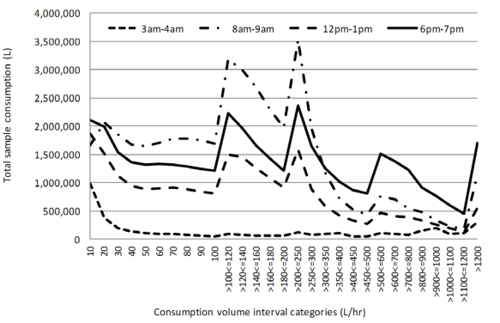
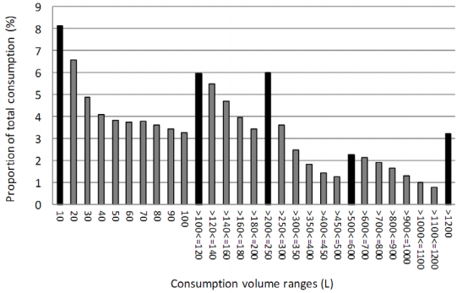
The breakdown by volumn range of average hourly consumption in for selected period
Proportion of total consumption in each volume range

Slide 13
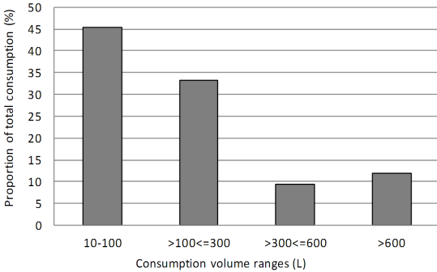
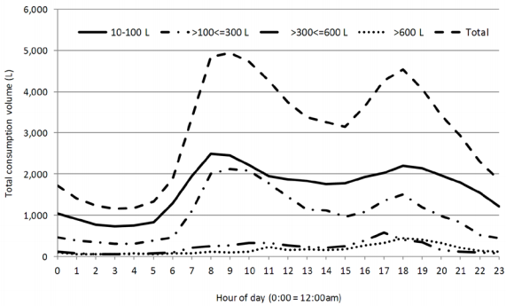
Proportion of consumption in four volume ranges as % of total consumption
Average hourly consumption for four volume ranges

Slide 14
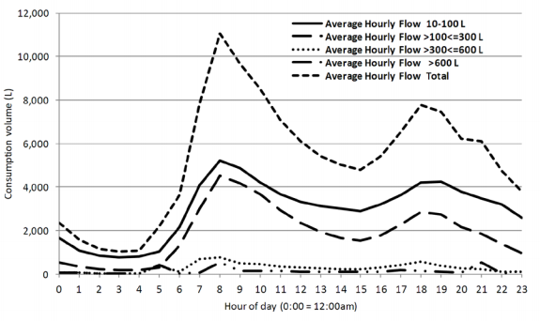
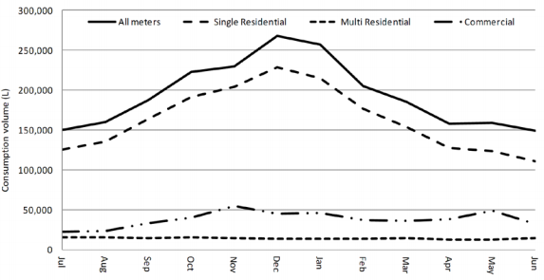
Multi-residential average hourly consumption for four volume ranges
Monthly peak hour demand for all property types

Slide 15
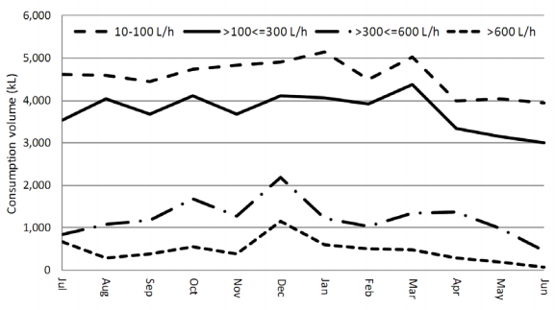
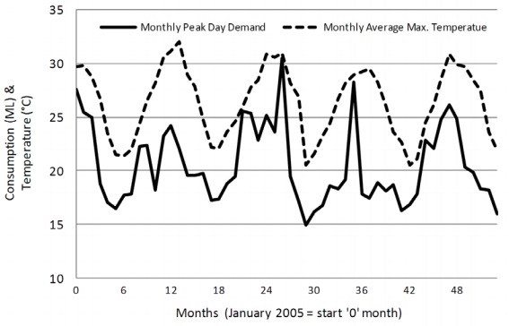
Monthly consumption in four volume ranges
Monthly peak water demand and monthly average max temperature

Slide 16
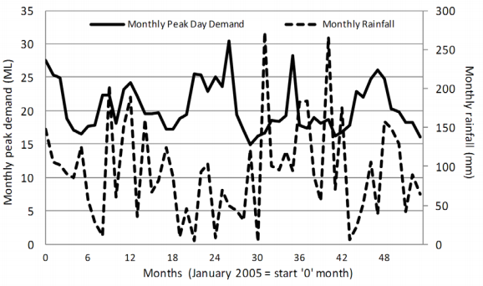
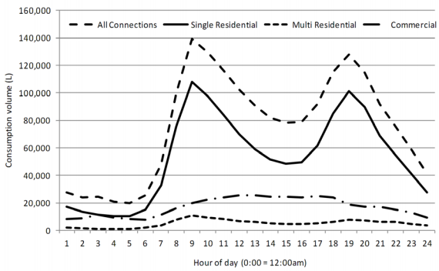
Monthly peak demand and monthly average monthly rainfall
Comparison of diurnal pattern by property type

Slide 17
Paper 3: Water demand pattern classification from smart meter data (By McKenna, et. Al, IBM research)
Objectives:
  Develop an approach for classfication of demand patterns
Data sets:
  Hourly readings of 6-month period at a single district metered area
  Commercial and residential customers
  Only weekday data is used

Slide 18



Demand pattern discovery
Method:
  Use Gaussian Mixture Models (GMM) for representing the demand pattern:
  where
  Use Multivariate clustering using k-means algorithm:

Slide 19
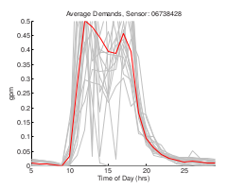
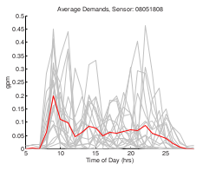
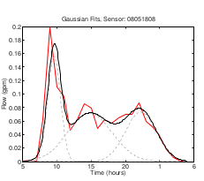
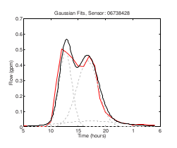
Use GMM to fit daily demand pattern
Individual daily demands for 20 weekdays (grey) and
the average demand (red) are shown for three different sensors
Gaussian Mixture Model fits to average demands for three sensors.

Slide 20
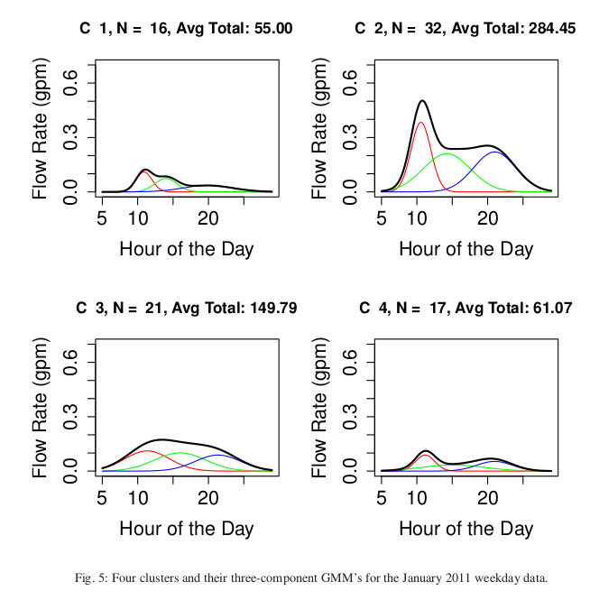
Four clusters and their three-component GMM’s for the January 2011 weekday data.

Slide 21
Paper 4: A class of time-series urban water demand models with nonlinear climatic effects (by shaw, University of Tennessee)
Water demand model:
  Model water consumption into Base Use + Seasonal Use.
  Season Use consists of three components: a potential use (dependent on temperature only), a water use reduction (due to rainfall) and a random component

Slide 22




Urban water demand Model
Base Use:
  Tm is the monthly maximum aire temperature
  R monthly total rainfall
  X a set of socioeconomic variable
  T, and r are the thresholds of temperature, and rainfall
  Use the lowest level monthly use, e.g., Dec.~ Feb.
Seasonal Use:
  The seasonal use in Winter: the total use is substracted the base use.
  The seasonal use in Summer:
  M1: use multiple linear regression model
  M2: Non-linear models with rainfall thresholds , e,g.,

