Slide 2
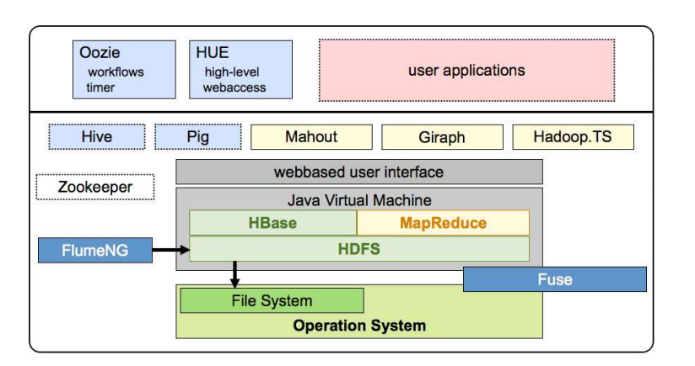
HadoopTS

Slide 3
HadoopTS
Use HBase as the underlying data store
TSBucket: time-series bucket saves the times series data of equal resolution and length
TSProcessor: Controls the analysis flow for all individual opeations on all records within TSBucket.
UDF: Integrate HadoopTS with other systems, such as Hive, Pig.
Time series analysis:
  Auto correlation
  Detrended fluctuation analysis (DFS)
  Return Interval statistics
  Cross correlation
  Event synchronization (ES)

Slide 4
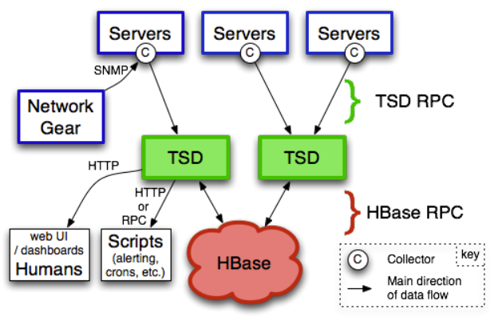
OpenTSDB

Slide 5
Hbase Tables
tsdb - Data point table. Massive
tsdb-uid - Name to UID and UID to name mappings
tsdb-meta - Time series index and meta-data (new in 2.0)
tsdb-tree - Config and index for heirarchical naming schema

Slide 6
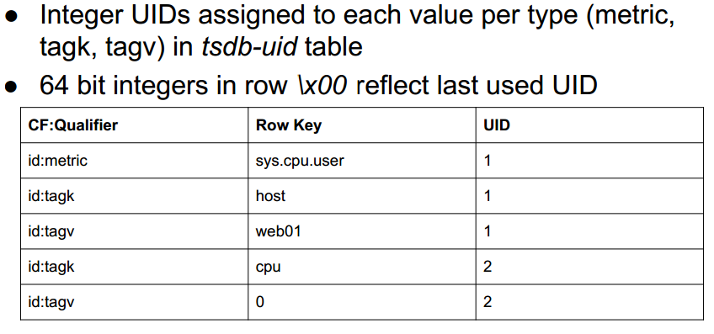
HBase Tables

Slide 7
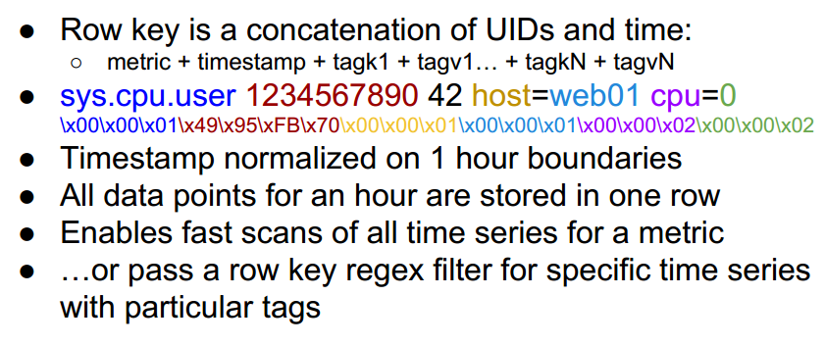
Data table schema

