Slide 1
Smart Meter Data Analytics
Xiufeng Liu
xiufeng.liu@uwaterloo.ca
University of Waterloo, Canada

Slide 2
Outline
Benchmarking smart meter data analytic technologies
Smart meter data analytics system (SMAS)
  Demo

Slide 3
Introduction
The widely use of smart meters makes the data analytic possible
Smart data analytics can help energy providers and consumers understand and reduce energy usage
Diverse analytic technologies appear
  What technologies to be used?
  Best practices?
The need of data generator

Slide 4
The benchmark technologies
Centralized Systems:
  The traditional analytic tool: Matlab
  In-database analytic tool: MADLib in PostgreSQL
  In-memory column store: System C (KDB)
Distributed Computing Systems:
  Main memory based: Spark
  Hadoop based: Hive

Slide 5
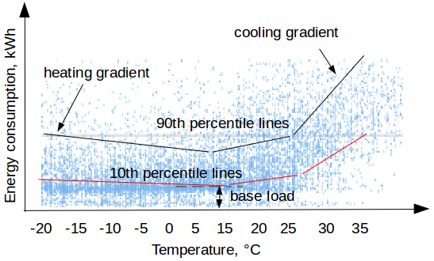
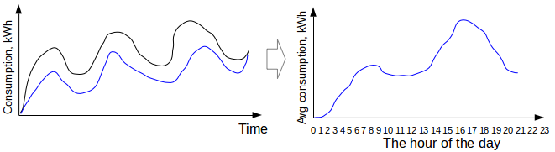
The benchmark algorithms
3-Line algorithm:
Periodic auto-regression (PAR):

Slide 6
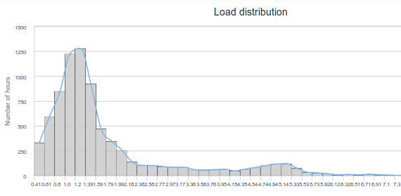

The benchmark algorithms
Histogram:
Cosine similarity:

Slide 7
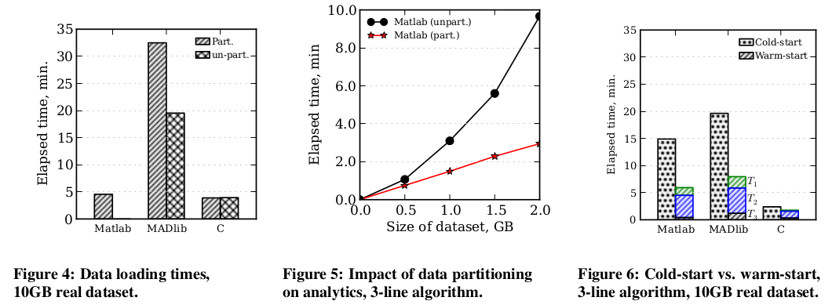
Experiments – centralized systems
Using real-world (Essex 10GB) and synthetic data sets
  Data loading: partition vs. non-partition
  Impact of partitioning on performance
  Cold start vs. warm start

Slide 8
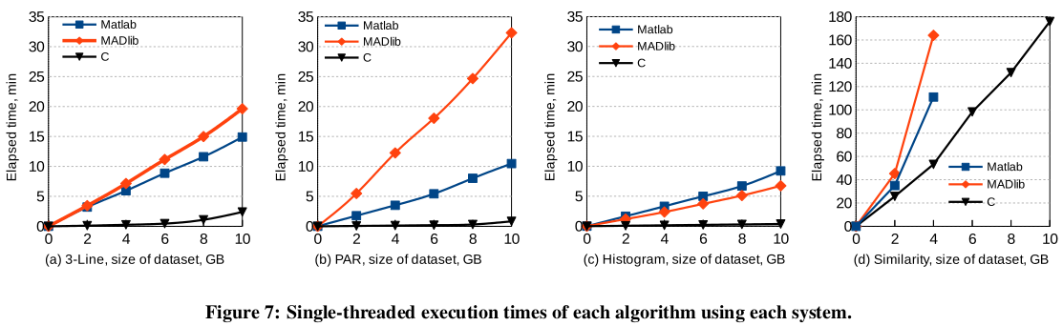
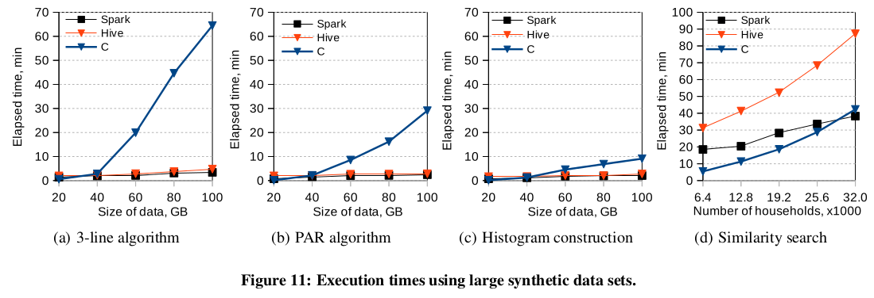
Experiments – centralized systems
Execution times of using real-world data sets (10GB essex)
Execution times using large synthetic data sets.

Slide 9
Experiments – distributed systems
Cluster: one master node + 16 slave nodes
Test systems: Spark and Hive
Use three types of data formats:
  1st Format: one file (that may be partitioned arbitrarily) with one smart meter reading per line
  2nd Format: One file with one household per line (i.e., all the readings from a single household on a single line)
  3rd Format: Many files, with one or more households per file (but no household scattered among many files)
Measure the scalability and speedup

Slide 10
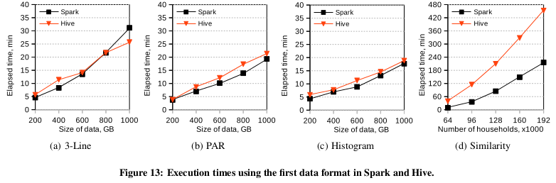
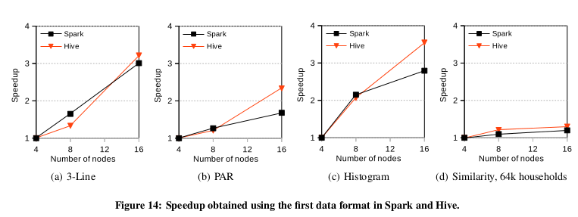
Experiments – distributed systems
The execution times and speedup of the 1st data format:

Slide 11
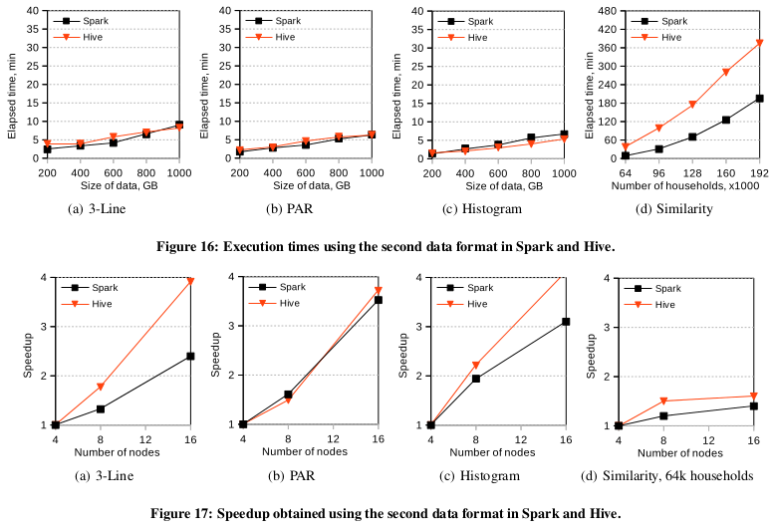
Experiments – distributed systems
The execution times and speedups of the 2nd data format:

Slide 12
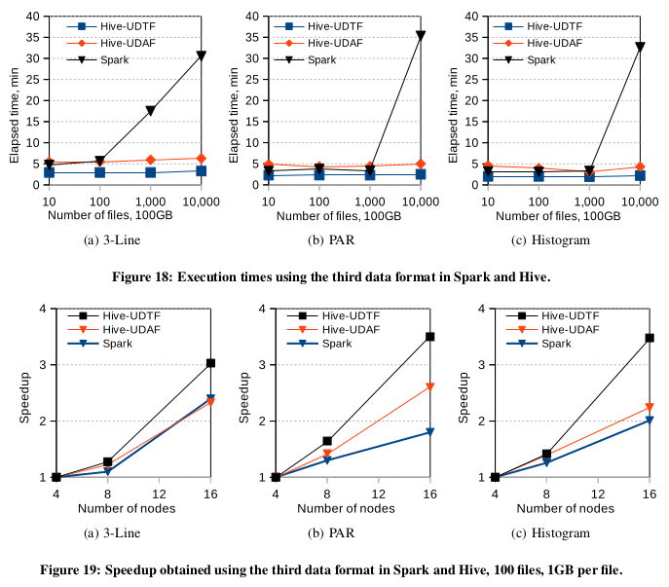
Experiments – distributed systems
The execution times and speedups of the 3rd data format:

Slide 13
Summary
Centralized Systems:
  System C is the best choices for smart meter data analytics
  Matlab and MADlib are more programmer-friendly but slower
  Matlab works better for each time-series in a separate file
Distributed Computing Systems:
  Suitable for the analytics of large-scale data sets
  Spark is faster than Hive, but Hive scale slightly better, and is easier to implement
The data format does matter with the implementation, and the performance

Slide 14
Smart Meter Data Analytics System (SMAS)
Xiufeng Liu
xiufeng.liu@uwaterloo.ca
University of Waterloo, Canada

Slide 15
Introduction
SMAS is the system that provides smart meter data analytics for different users, including
Utilities:
  Understand consumption patterns
  Forecasting
Energy consultants:
  Load profiling
  Feedback
Energy consumers:
  Understand one's own consumption
  Rank against one's neighbors

Slide 16
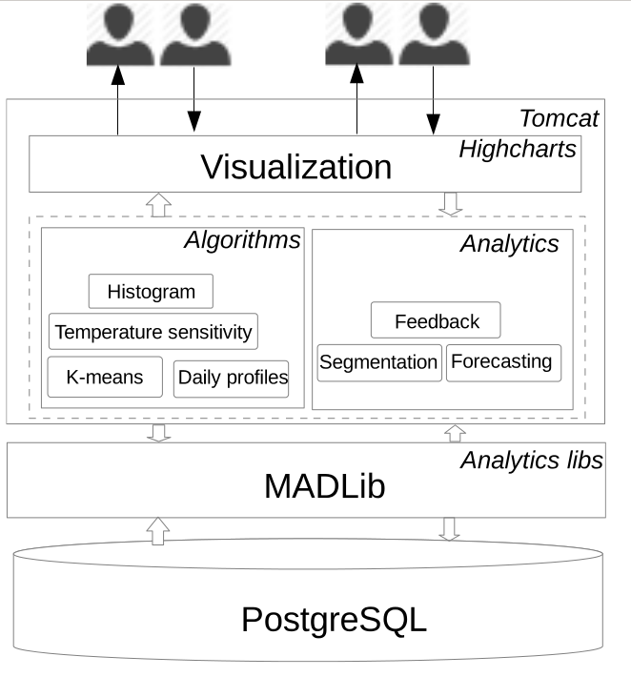
System Architecture

Slide 17
Functionalities
Energy consumption time series analytics
  Time and location dimensions
  Different granularities
Segmentation analytics
  Cluster customers with a similar consumption pattern
  Show on Google map

Slide 18
Functionalities
Energy demand forecasting
Pattern discovery
  Load profiling
  Load distribution
  Load disaggregation
Consumption comparison
Customer feedback

Slide 19
Demo

Slide 20
Research outcomes
Smart meter data generator
Benchmark of smart meter data analytics
  Paper: X. Liu, L. Golab, and I. F. Iiyas, Benchmarking Smart Meter Data Analytics, In submission to EDBT, 2015
Smart meter data analytics system (SMAS)
  Demo paper: X. Liu, L. Golab, and I. F. Iiyas, SMAS: A Smart Meter Data Analytics System, Accepted ICDE 2015 F. Ilyas
Water data analytics (In-progress)

Slide 21
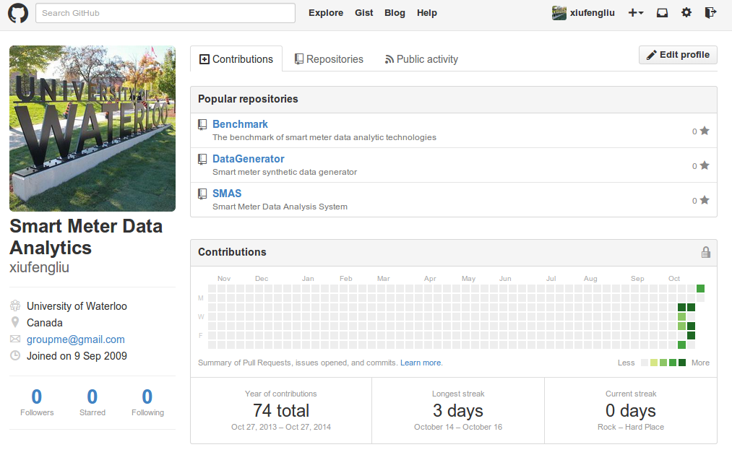
Open source - https://github.com/xiufengliu

Slide 22
Future Work
Monetize data for utilities:
  Develop personalized services
  Help to decrease the load reservation by forecasting
  Decrease the probability of energy theft and abandonment
Big data analytics
  Analytics in the cloud
  Real-time data integration and analytics
Data modeling
  Forecasting model: the energy demand with the forecasting of weather
  Model the data with the social-economic metrics, including the properties, families, personal info., etc.

Slide 23
Questions?

