Slide 1
Water Data Analysis

Slide 2
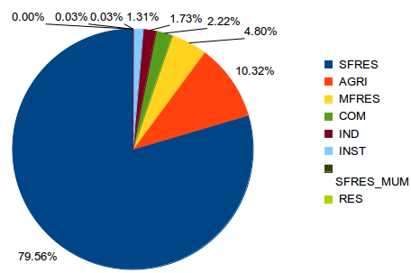
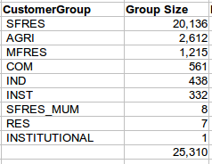
Water Data
Customer
Total 25,310 customers
Living in 1,053 streets
2,424 postcodes
Meter Reading
Time-series Fact
Time-series: Sept 1, 2012~Aug. 31, 2013
215,172,496 hourly data points (roughly 10GB)
Customer Group
Meter
25,858 meters
Install location (latitude, lontitude)
9 customer groups

Slide 3
Water Data
215,172,496 time-series data points distribution on Customer Groups

Slide 4
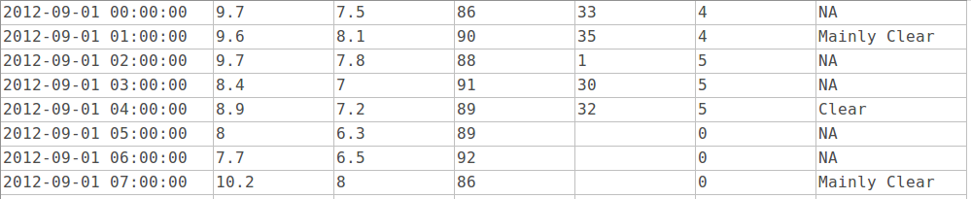
Weather Data
The hourly resolution weather data from Environment Canada (https://weather.gc.ca)
Readtime Temperature DewPointTemperature RelativeHumidity WindDirection WindSpeed Weather

Slide 5
Explore Water Time-series Data
Demo

Slide 6
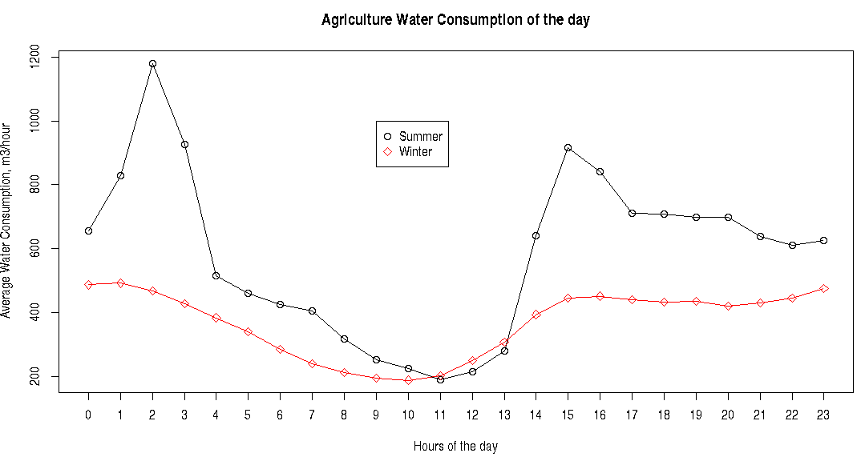
The average daily water consumption of Agriculture

Slide 7
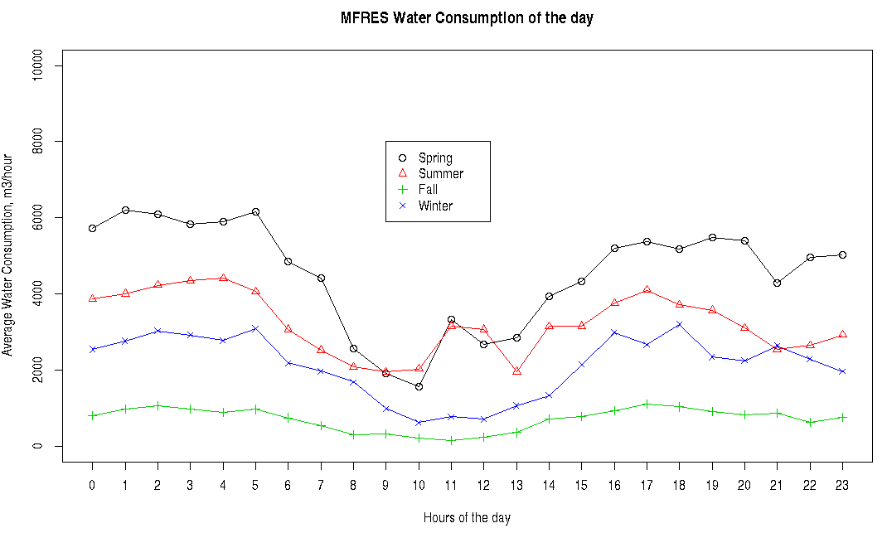
The average daily water consumption of MFRES

Slide 8
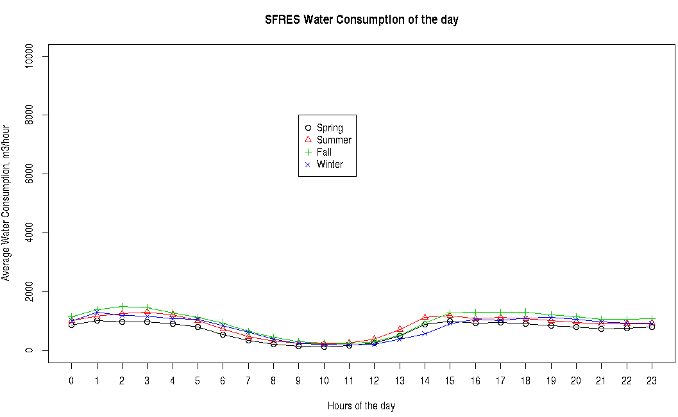
The average daily water consumption of SFRES

Slide 9
The average daily water consumption of SFRES

Slide 10
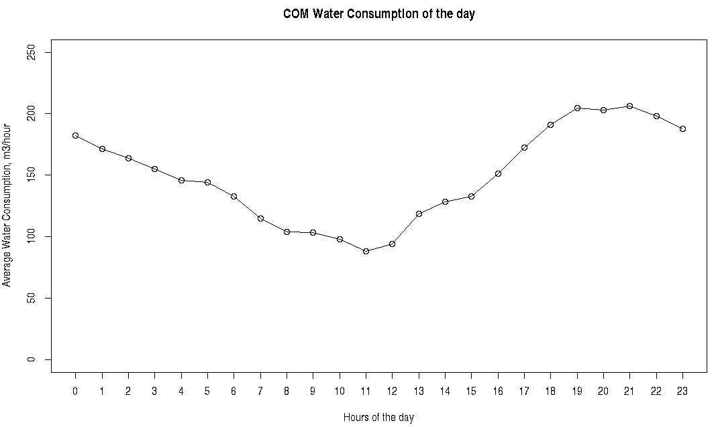
The average daily water consumption of COM

Slide 11
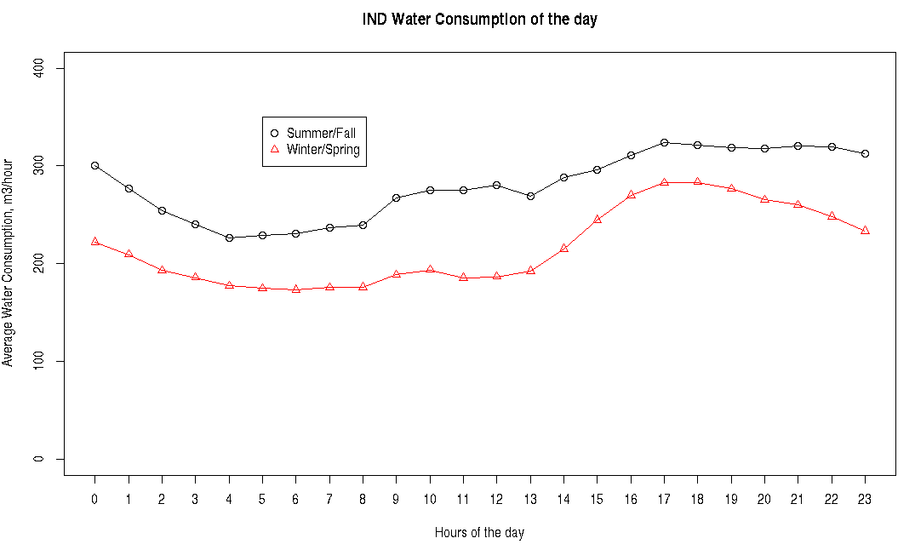
The average daily water consumption of IND

Slide 12
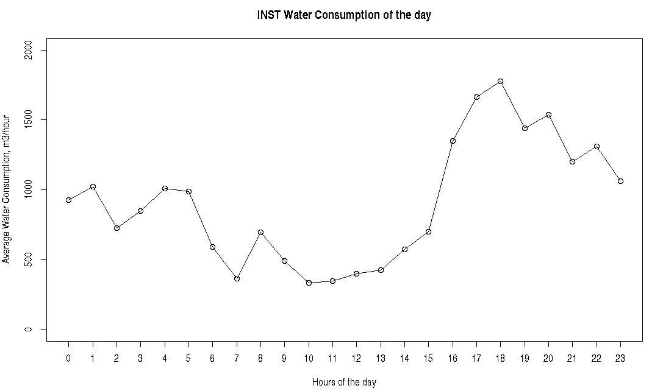
The average daily water consumption of INST

