Slide 1

Bayesian Filtering Approaches for 3D Localization of Quadruped Robots on the Grand Tour Dataset
Group 7
Hao Duan, Xiuping Yang, Zexing Lin, Junxian Wang

Slide 2
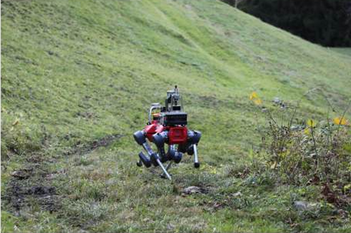
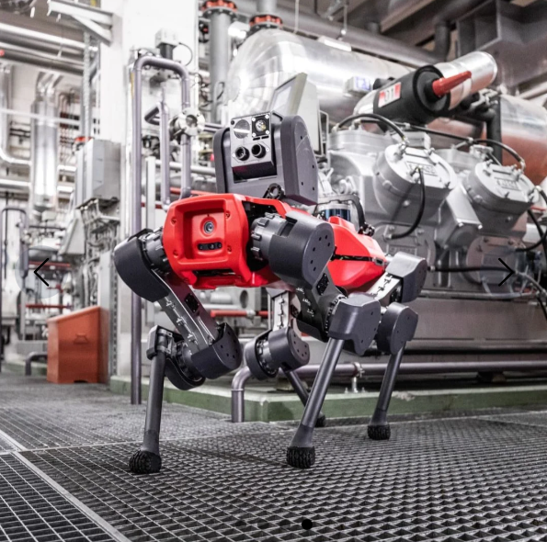
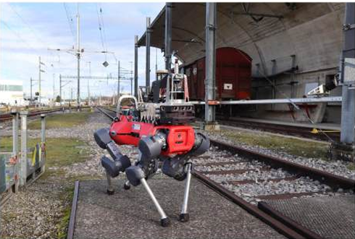

introduction
Challenge: State estimation of Quadruped Robots in different complex environments
Equipment: Quadruped Robots
Issues: terrain irregularities, foot slipping, and sensor noise
Dataset: GrandTour
ANYmal Grand Tour
Tested Environments:ETH-1, SPX-1, and SNOW-1
Four Frameworks: EKF,UKF,PF and InEKF
10x Cameras
3x LiDARs
8x IMUs
6x Depth Cameras
12x Actuator
49Missions
Ground Truth Poses

Slide 3
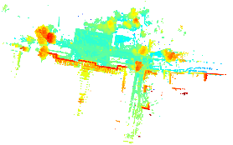
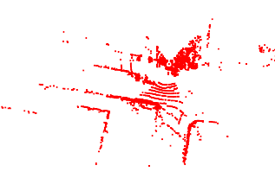
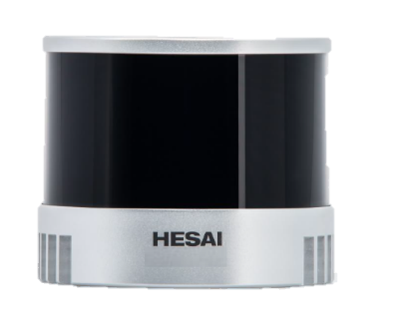
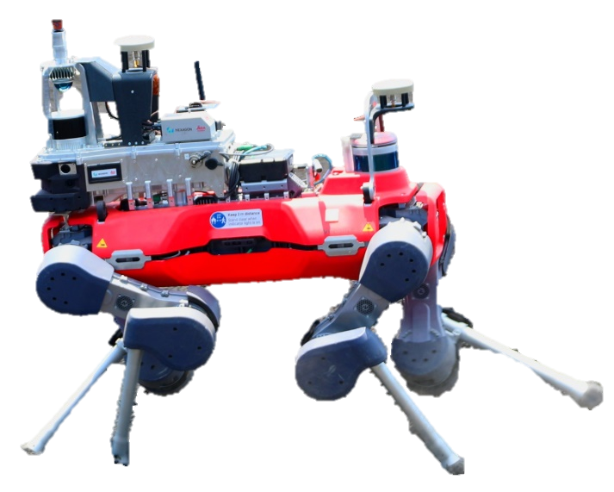
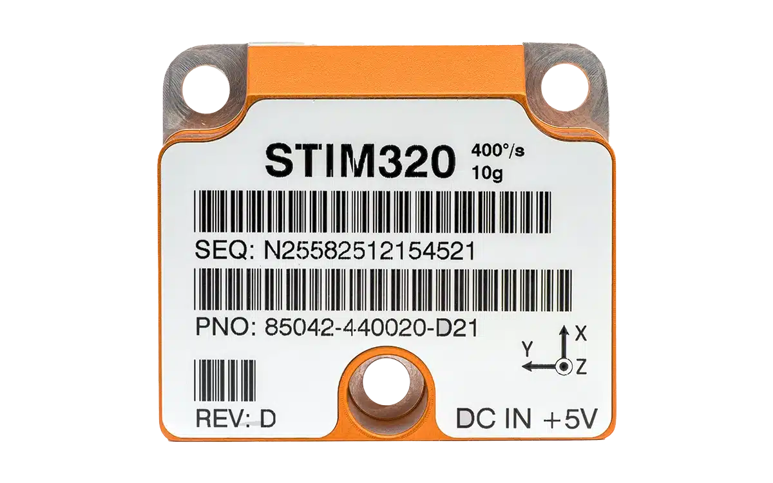



methodology
Point Cloud Map
LiDAR Scan
3D Trajectory
Bayesian Filtering
Hesai XT-32
ICP
Pose Measurement
Correction
$${\hat{x}}_{k|k}$$
$${\hat{x}}_{k|k−1}$$
STIM320
Prediction
ANYmal D
${\tilde{ω}}_{k},{\tilde{a}}_{k}$(IMU measurements)

Slide 4
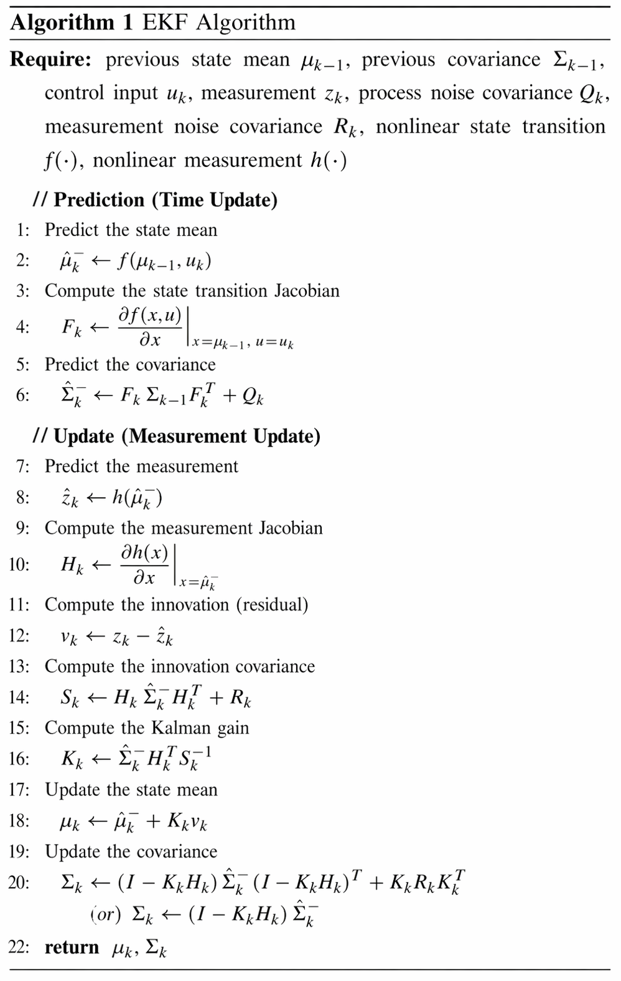
EKF
EKF Algorithm
EKF performs state prediction and measurement update for nonlinear systems. It linearizes the motion and observation models using Jacobians, which makes it computationally efficient but less accurate under strong nonlinearity.

Slide 5
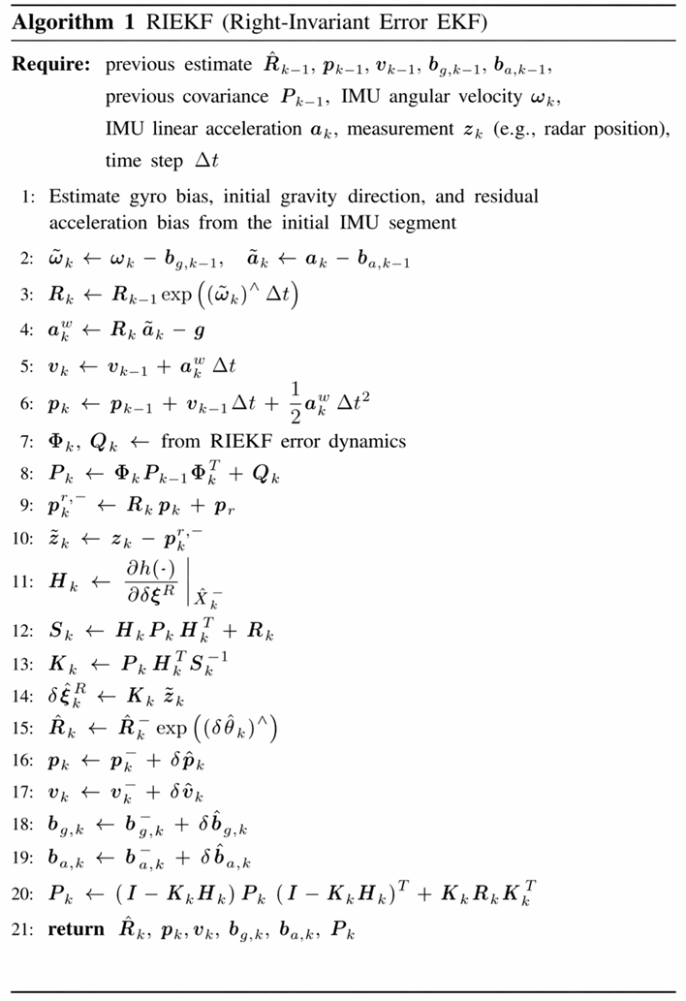
In-EKF
InEKF Algorithm
InEKF combines IMU-based prediction with radar-based correction for state estimation. By formulating the error on Lie groups, it achieves better consistency and robustness than the standard EKF.

Slide 6
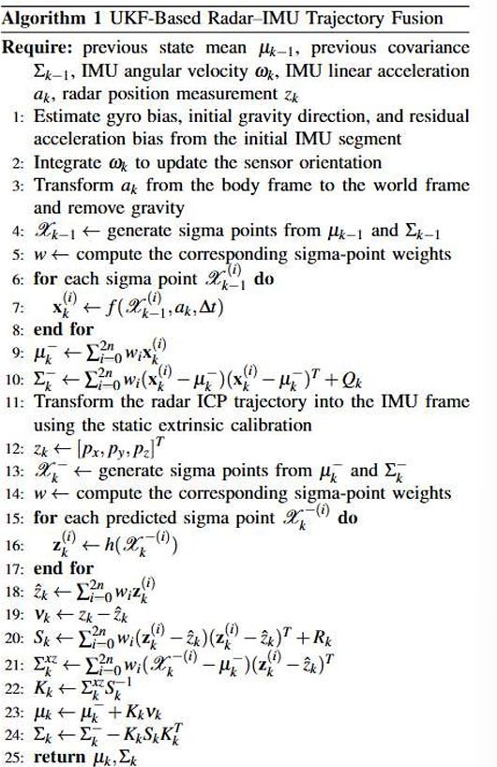
UKF
UKF Algorithm
The algorithm uses IMU data for prediction and radar ICP position measurements for correction. By propagating sigma points instead of linearizing the model, UKF provides a more accurate estimate under nonlinear dynamics.

Slide 7
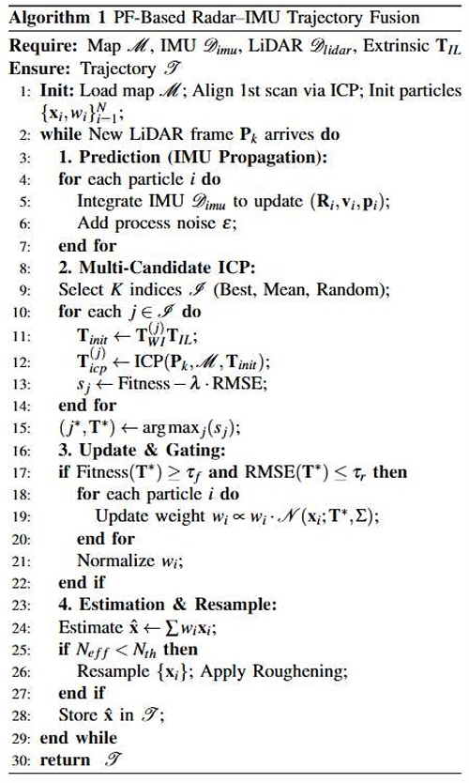
PF
PF Algorithm
The algorithm first propagates particles using IMU measurements and then updates their weights based on ICP matching results. Resampling is applied to keep high-likelihood particles, which improves robustness in complex environments.

Slide 8
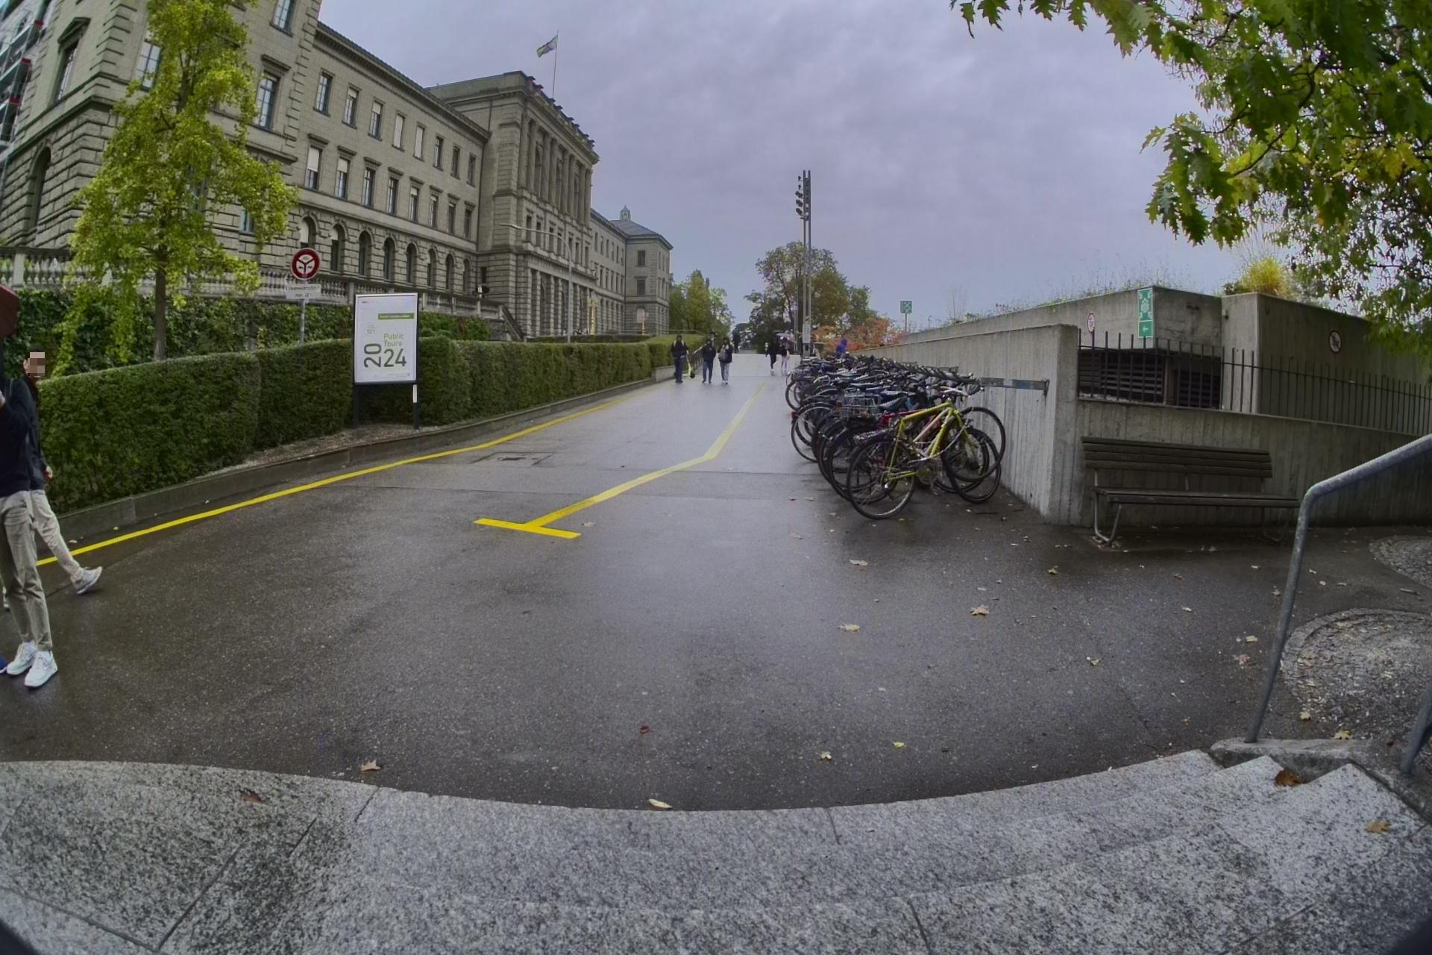
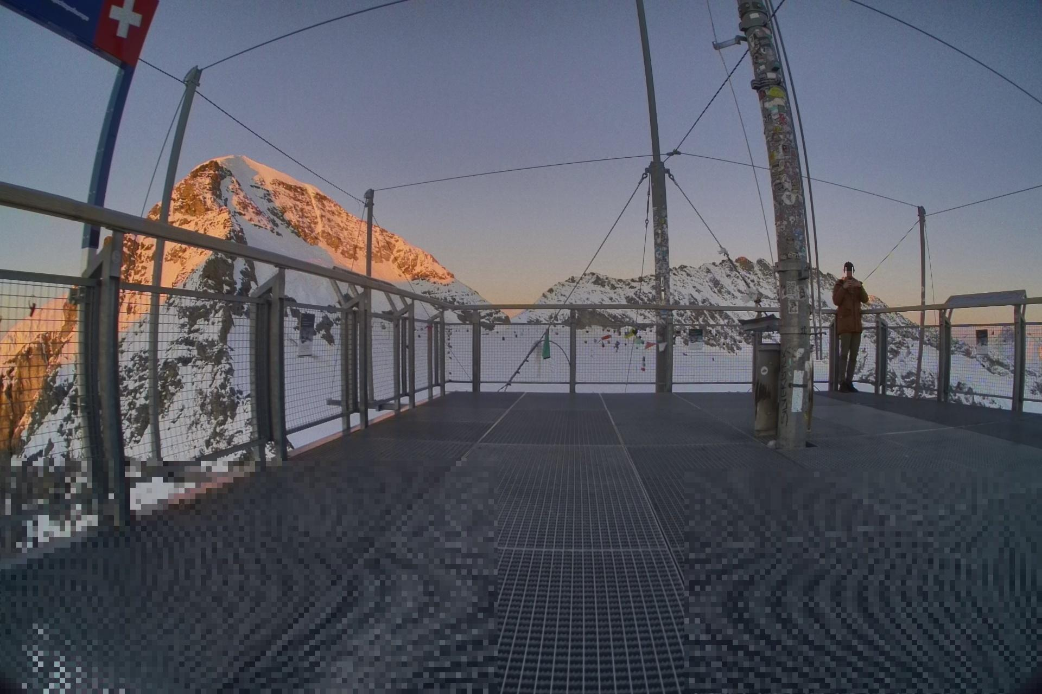
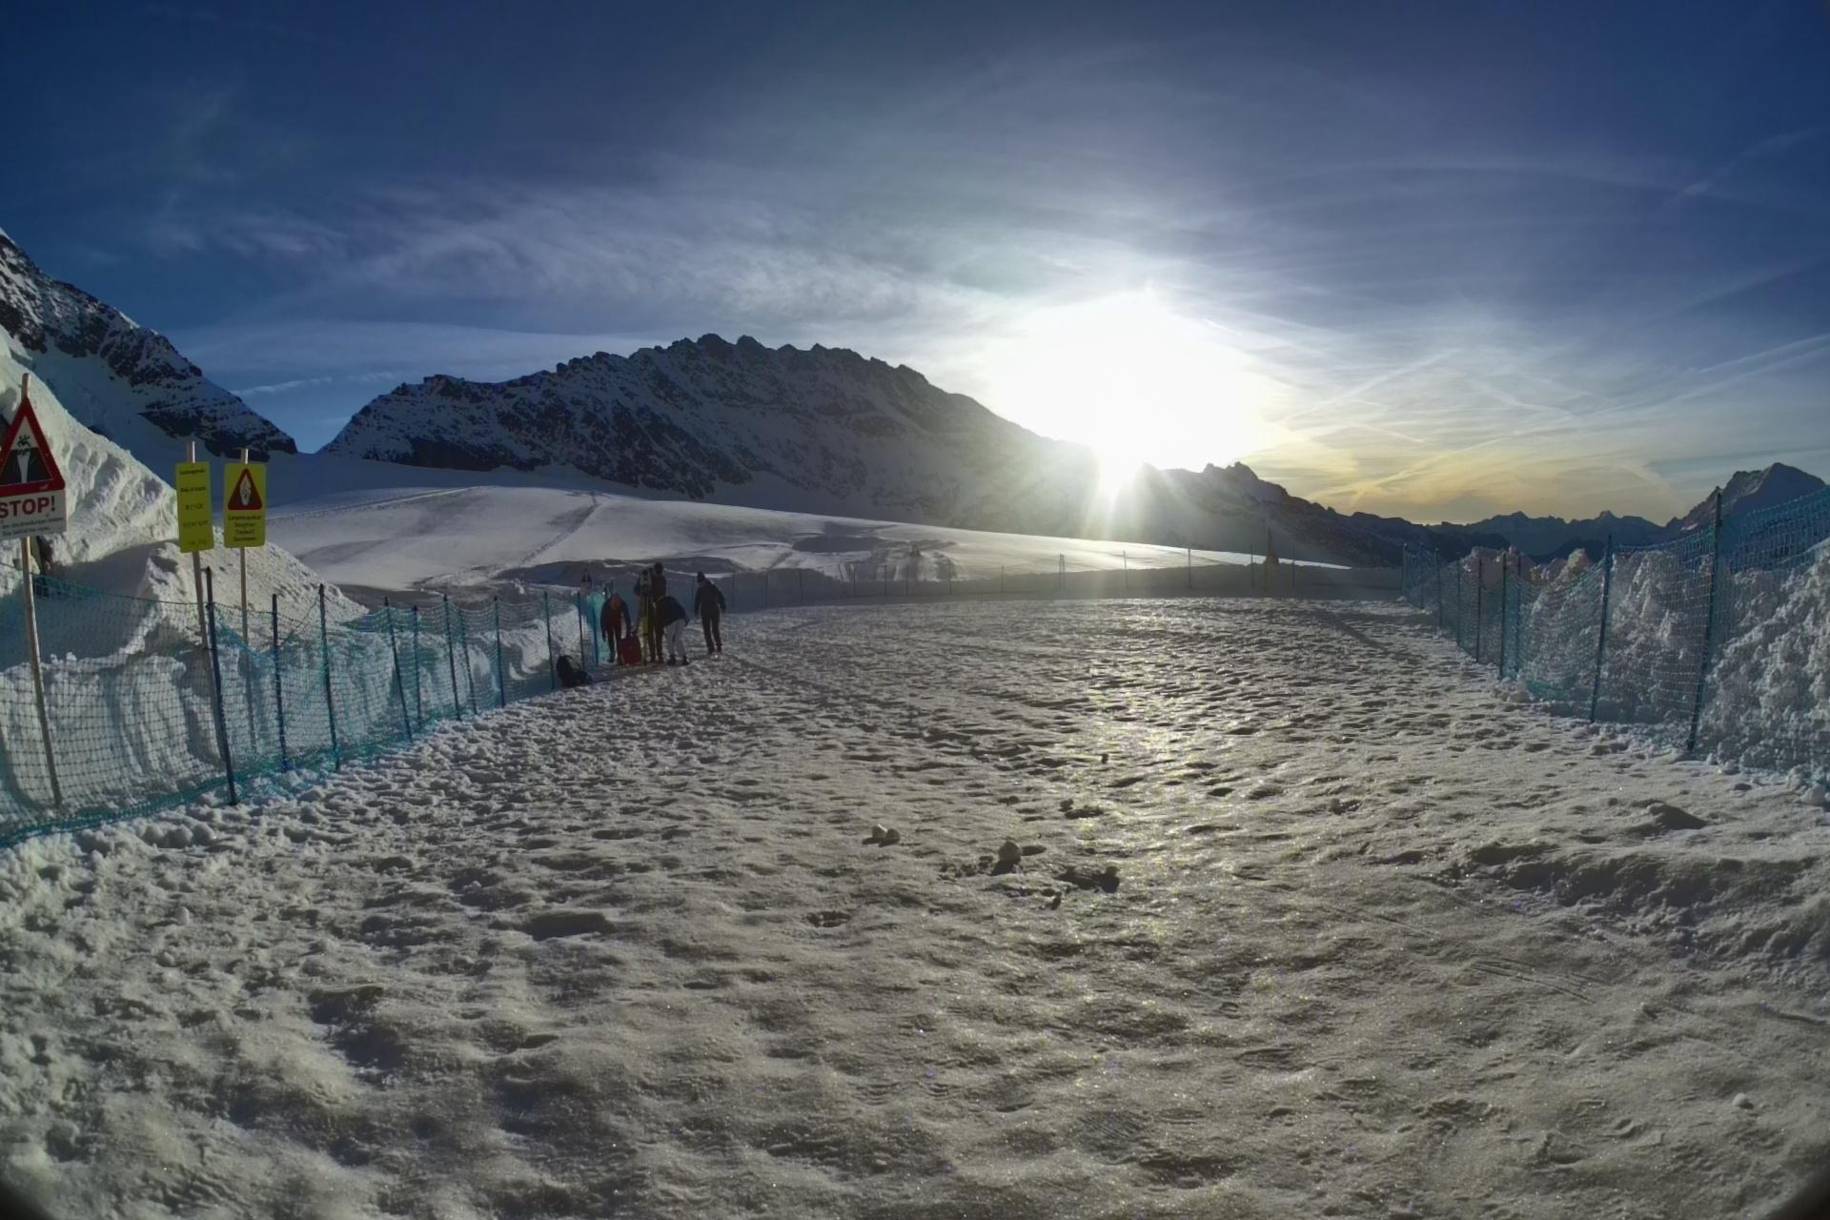
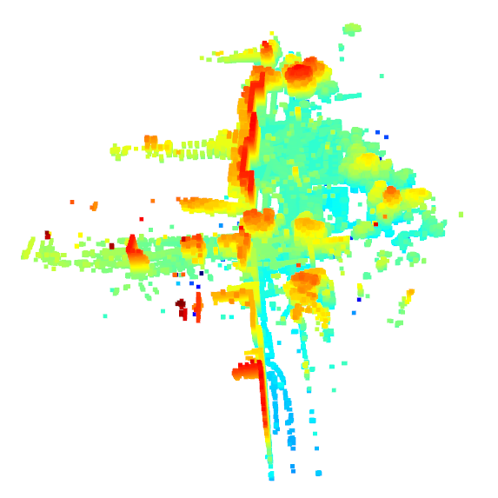
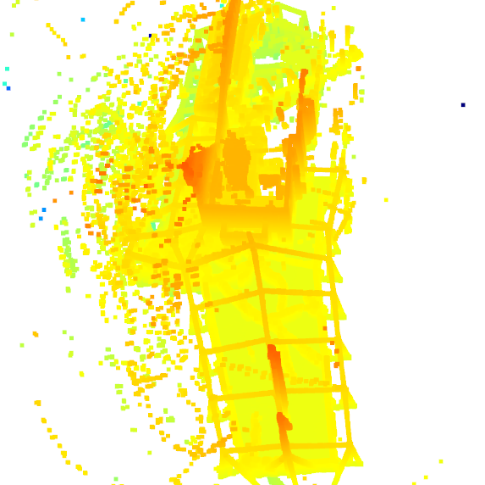
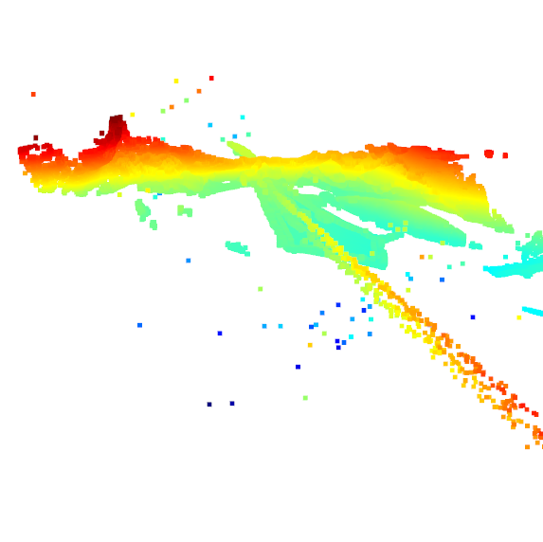
Results
ETH-1
SPX-1
SNOW-1
We evaluate the proposed method on three challenging scenes: ETH-1, SPX-1, and SNOW-1. The results demonstrate robust performance and consistent geometric reconstruction under diverse environments.

Slide 9
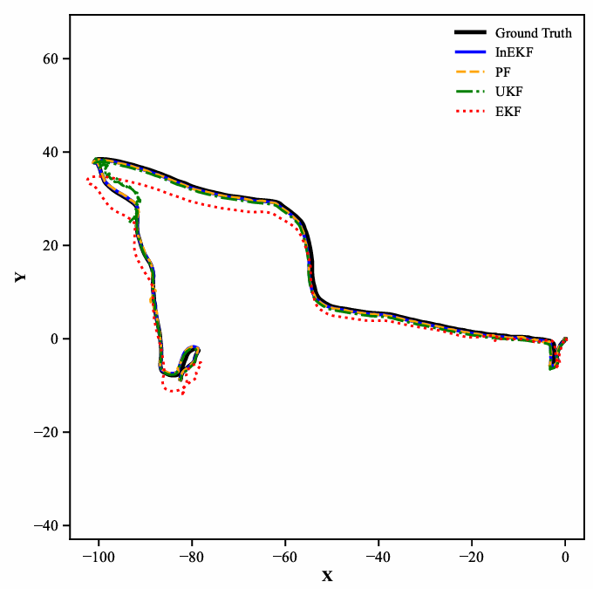
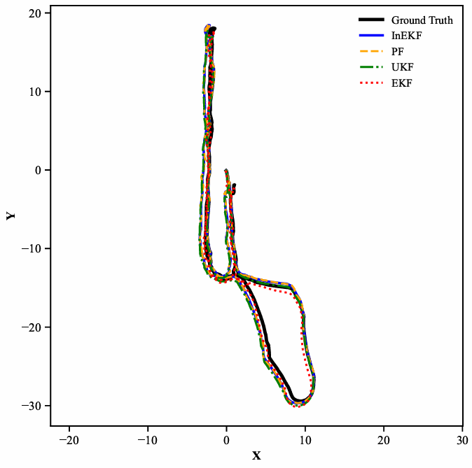
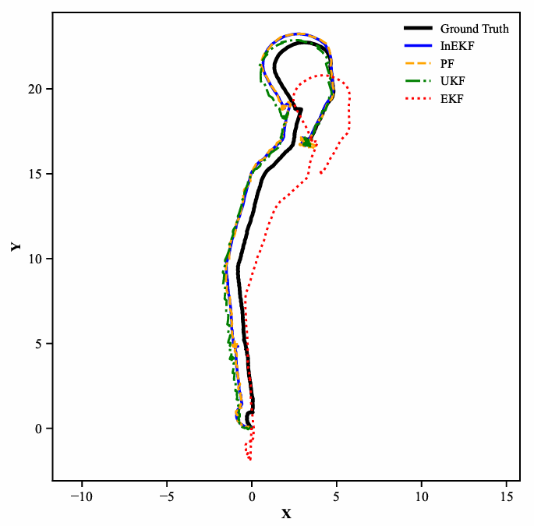
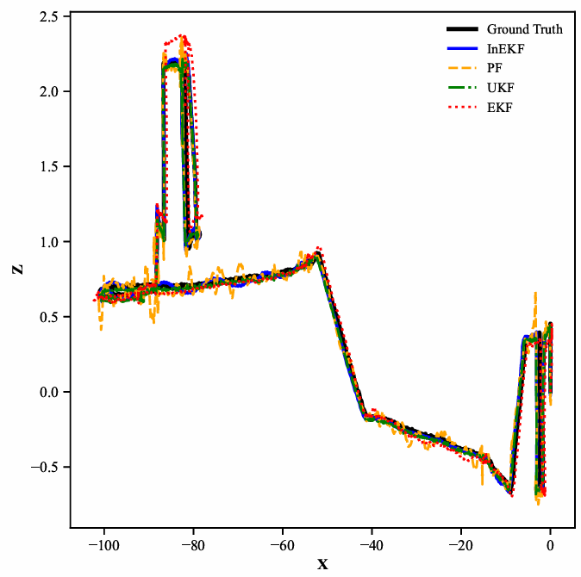
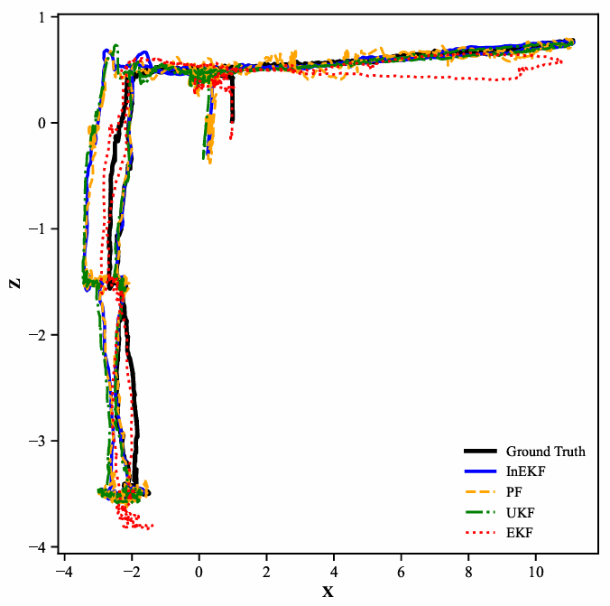
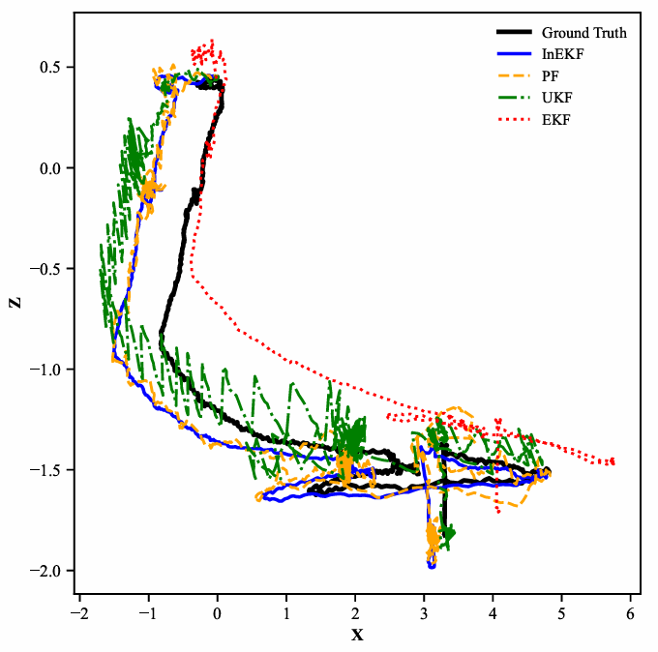
Trajectory comparison
ETH-1
SPX-1
SNOW-1
Top View
(xy)
Side View
(xz)
InEKF shows the closest agreement with the ground truth, while EKF exhibits larger deviations, especially in more challenging scenes.

Slide 10
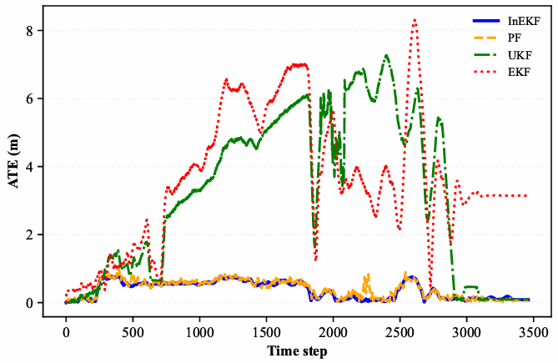
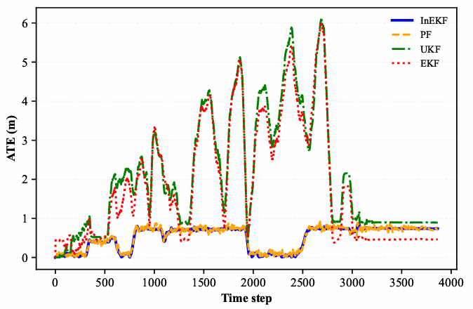
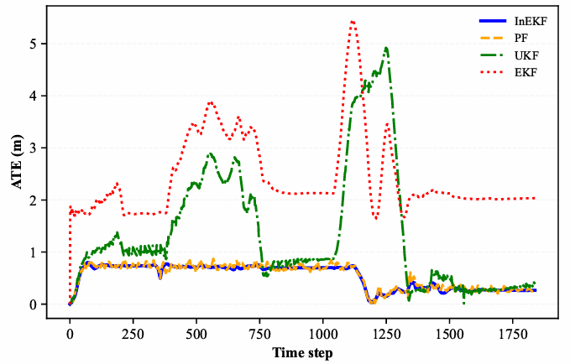
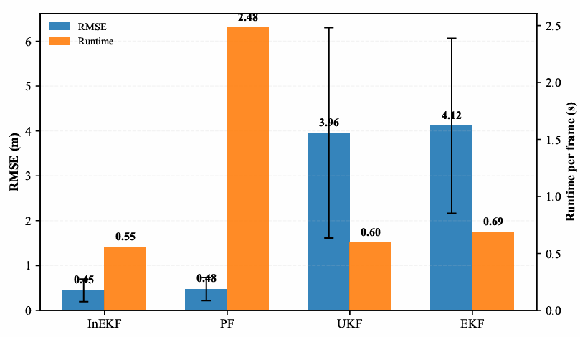
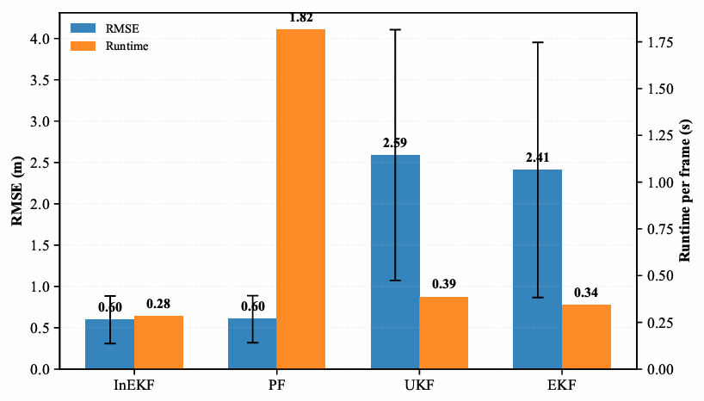
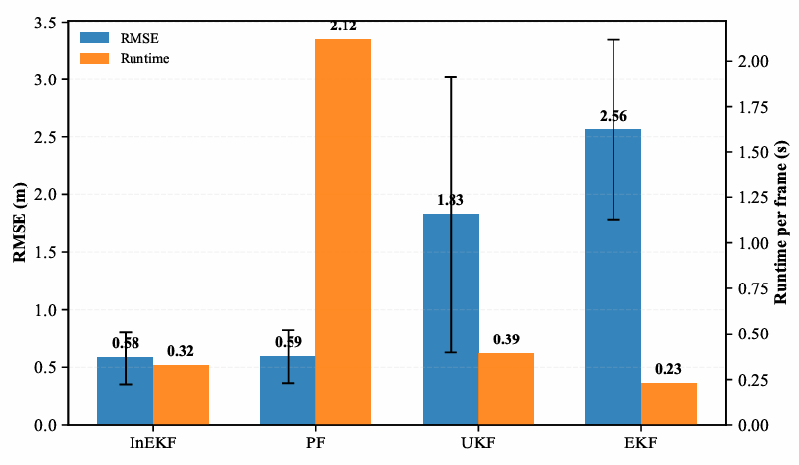
Error & Runtime comparison
ETH-1
SPX-1
SNOW-1
We further compare the filters in terms of trajectory error and computational cost across the three datasets. InEKF achieves the best overall trade-off between estimation accuracy and runtime efficiency.

Slide 11
Discussion
1.InEKF performs better in accuracy and computational efficiency
2. PF provides competitive accuracy, but its runtime is much higher.
3. EKF and UKF are more sensitive to nonlinear motion and degraded measurements.
Future works:
Integrate additional sensing modalities, improve registration strategies, and incorporate contact-aware information.
Limitations:
highly dependence on LiDAR & ICP

Slide 12
Thank you!
Group 7

