Slide 1
Sentiment Analysis on Amazon Reviews
Yuntian Xiao

Slide 2
Use Cases
Business: A product manager ingests the full review history of any Amazon category through the pipeline and receives a structured sentiment breakdown The resulting signals feed directly into product iteration decisions, marketing messaging adjustments, and supply chain risk alerts, turning unstructured customer voice into a continuous, automated intelligence layer across the entire product portfolio.
System: User launches the application; system loads the dataset, trains a Logistic Regression model on feature vectors, and displays each review's predicted label alongside its sentiment score and original rating.

Slide 3
Methodology
Original:
Phase 1: Establishing a baseline using the AFINN-111 sentiment lexicon and Spark broadcast variables for efficient dictionary lookups.
Phase 2: Transitioning to a supervised learning approach using Logistic Regression and Naive Bayes.

Slide 4
Methodology
Update:
Both phases were completed as planned, with Phase 2 expanding beyond the original scope. Rather than simply replacing the lexicon approach, I retained it as a quantitative baseline within a unified framework comparing three feature configurations: lexicon-only, TF-IDF-only, and a hybrid combination. Additional engineering decisions made during implementation included feature standardization to address scale disparity in the hybrid setting, inverse-frequency class weighting to handle label imbalance, and cross-validated hyperparameter tuning for both classifiers.

Slide 5
Data Sources
Original:
Dataset: McAuley-Lab / Amazon-Reviews-2023, 750 GB
Format: JSONL
Fields: rating, text, title
Update:
The McAuley-Lab Amazon Reviews 2023 dataset was used as planned. Due to time and compute constraints, experiments were conducted on two category-level subsets (327 MB, 50.2 MB) rather than the full 750 GB corpus.

Slide 6
Phase 1: Setup & Baseline
M1 (4/10 - 4/11 Environment & Ingestion) ✅ Completed on schedule
Set up thez Spark environment and load the Amazon Reviews All_Beauty.jsonl subset, mapping records to Case Classes. Establish the data scale and sampling strategy.
M2 (4/12 Lexicon-Based Baseline) ✅ Completed on schedule
Load a sentiment lexicon and build a rule-based sentiment scorer, delivering the first end-to-end runnable version.

Slide 7
Phase 2: Feature Evolution & Model Depth
M3 (4/13 Feature Engineering Pipeline) ✅ Completed on schedule
Refactor processing logic into a Spark MLlib Pipeline, integrating Tokenizer, stopword filtering, and TF-IDF feature transformation using a functional data flow style.
M4 (4/14 Supervised Learning Comparison) ✅ Completed on schedule
Integrate multiple classifiers into the existing Pipeline under a unified experimental framework, quantifying performance gains over the lexicon baseline. Generate a model performance heatmap and accuracy comparison.

Slide 8
Phase 3: Optimization & Delivery
M5 (4/15 Generalization Validation) ✅ Completed on schedule
Extend the existing Pipeline to additional product category datasets, evaluating model stability across varying data distributions and quantifying cross-category performance differences.
M6 (4/16 Delivery & Demo) Wrap the prediction logic into an API to simulate a production inference workflow. Finalize the course demo and organize project metrics into visual dashboards to validate performance goals.
Actual: Training speed was prioritized over production-level deployment considerations.

Slide 9
Code
Tech Stack: 100% of core logic, Python for final report visualization
GitHub: https://github.com/xiuqizhiping123/amazon-review-spark
No changes

Slide 10
Acceptance Criteria
Original:
Achieves an AUC-ROC of at least 0.80 on All_Beauty.
When applied without retraining to at least one additional product category. The weighted F1-score drops by no more than 0.05.
Update:
Given the class imbalance, AUC-ROC was replaced by weighted F1 as the primary evaluation metric.
F1 Score: 0.858 on All_Beauty.

Slide 11
Goals of the project
Master the core techniques for processing unstructured text data with Spark, including environment setup, data cleaning, and schema mapping.
Learn how Spark MLlib Pipelines work by building one — from raw JSONL to trained classifier — using functional Scala throughout.
Build a sentiment pipeline that works on any Amazon product category.

Slide 12
Results
Two Amazon product categories — All_Beauty (beauty and personal care products, 701,421 reviews) and Gift_Cards (152,404 reviews)
Four-experiment framework: LR [LexiconOnly], LR [TfidfOnly], LR [Hybrid], and NaiveBayes [TfidfOnly].
The Hybrid model combines two types of features: lexicon-derived scores from AFINN, and TF-IDF weights learned from the text corpus

Slide 13
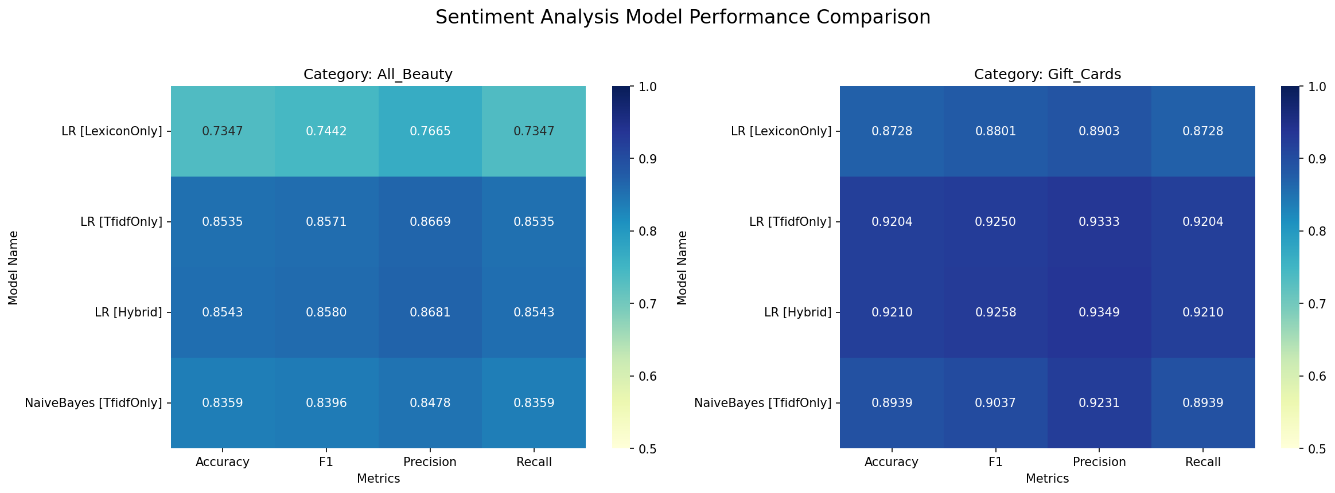
Results

Slide 14
Results
On All_Beauty, LR [Hybrid] achieved the highest weighted F1 of 0.8580, marginally outperforming LR [TfidfOnly] at 0.8571. LR [LexiconOnly] served as the lexicon baseline at F1 0.7442.
Moving from the rule-based lexicon baseline to TF-IDF with Logistic Regression improved F1 by over 0.11, which confirms that learning feature weights from labeled data is significantly more effective than applying a fixed sentiment dictionary.
On Gift_Cards, the same ranking held. The cross-category F1 drop from Gift_Cards to All_Beauty was 0.068 for LR [Hybrid], marginally exceeding the original acceptance criterion of 0.05. All other trends generalized consistently across categories.

Slide 15
Results
Experimental results show no significant overfitting:
Regularization: Both TF-IDF models preferred L2 regularization over L1, suggesting that retaining the collective contribution of all features yields better generalization than aggressive sparsification.
Feature Utilization: The absence of zero-out weights indicates the model is fully leveraging the data rather than collapsing onto a few dominant features.
Generalization: Robust F1 scores (0.858 for All_Beauty and 0.926 for Gift_Cards) across different domains confirm stable performance, whereas overfitted models would typically show a sharp decline on unseen data.

Slide 16
Data Insights
The two datasets differ substantially in class distribution. All_Beauty has a positive-to-negative ratio of approximately 3:1, while Gift_Cards exhibits a ratio of approximately 11.6:1, with 5-star reviews comprising over 83% of all records. This imbalance directly inflates aggregate metrics on Gift_Cards: a model that predicts the majority class exclusively would achieve over 83% accuracy without learning any discriminative signal.

Slide 17
Data Insights
Class-weighted sampling was applied during training to partially counteract this imbalance, assigning inverse-frequency weights to each label.
The resulting negative-class recall on All_Beauty reached 69.5% for LR [TfidfOnly] and 70.1% for LR [Hybrid], indicating that the weighting mechanism was effective in preventing the model from collapsing to majority-class prediction.

Slide 18
Feature Analysis
The lexicon baseline was extended from a single sentiment score to a four-dimensional feature vector, incorporating word count, positive word count, and negative word count alongside the raw sentiment score.
The LexiconOnly coefficient vector reveals that raw sentiment score carries the dominant signal (0.589 on All_Beauty), while word count contributes near zero (-0.036), indicating that review length is not a reliable indicator of sentiment polarity. Negative word count carries a moderate negative coefficient (-0.212), suggesting that the presence of negative lexicon terms is a stronger signal than their absence of positive ones.

Slide 19
Feature Analysis
When calculating TF-IDF, each review is represented as a 10,000-dimensional sparse vector, where each dimension corresponds to a hash bucket. HashingTF maps tokens to buckets via a hash function, and IDF down-weights terms that appear across many reviews. The result is a feature vector that emphasizes words with high discriminative power.

Slide 20
Feature Analysis
Dataset scale directly affects TF-IDF feature stability.
On the small All_Beauty subset (2,000 reviews), LR [TfidfOnly] retained only 494 non-zero coefficients out of 10,000 under L1 regularization. On the full dataset (701,421 reviews), all 10,000 features (mapped from 10,000 hash buckets) remained non-zero under L2 regularization (elasticNetParam=0.0), indicating that sufficient data volume stabilizes sparse feature estimates to the point where regularization no longer needs to suppress them.
This transition also explains why the Hybrid advantage diminishes at scale: TF-IDF alone becomes expressive enough to subsume the signal provided by lexicon features.

