Slide 1
1
Functions and Models
Copyright © Cengage Learning. All rights reserved.

Slide 2
1.1
Four Ways to Represent a Function
Copyright © Cengage Learning. All rights reserved.

Slide 3
Functions

Slide 4
Functions (1 of 11)
Functions arise whenever one quantity depends on another. Consider the following four situations.
A. The area A of a circle depends on the radius r of the circle. The rule that
connects r and A is given by the equation
With each positive
number r there is associated one value of A, and we say that A is a function of r.

Slide 5
Functions (2 of 11)
B. The human population of the world P depends on the time t. Table 1 gives estimates of the world population P at time t, for certain years. For instance,
Year | Population (millions)
19 00 | 1650
19 10 | 1750
19 20 | 1860
19 30 | 2070
19 40 | 2300
19 50 | 2560
19 60 | 3040
19 70 | 3710
19 80 | 4450
19 90 | 5280
2000 | 6080
2010 | 6870
P ≈ 2,560,000,000 when t = 1950
For each value of the time t there is a corresponding value of P, and we say that P is a function of t.
World Population
Table 1

Slide 6
Functions (3 of 11)
C. The cost C of mailing an envelope depends on its weight w. Although there is no simple formula that connects w and C, the post office has a rule for determining C when w is known.
D. The vertical acceleration a of the ground as measured by a seismograph during an earthquake is a function of the elapsed time t.

Slide 7
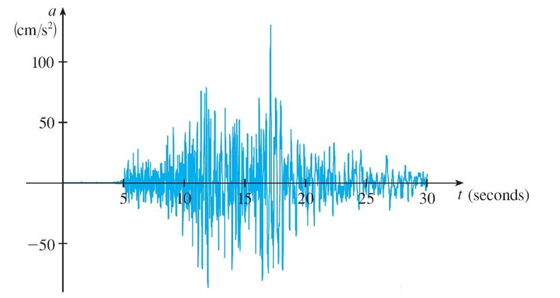
Functions (4 of 11)
Figure 1 shows a graph generated by seismic activity during the Northridge earthquake that shook Los Angeles in 19 94. For a given value of t, the graph provides a corresponding value of a.
Vertical ground acceleration during the Northridge earthquake
Figure 1

Slide 8
Functions (5 of 11)
If f represents the rule that connects A to r in Example A, then we express this in function notation as A = f (r).
A function f is a rule that assigns to each element x in a set D exactly one element, called f(x), in a set E.
We usually consider functions for which the sets D and E are sets of real numbers. The set D is called the domain of the function.
The number f (x) is the value of f at x and is read “f of x.” The range of f is the set of all possible values of f (x) as x varies throughout the domain.
A symbol that represents an arbitrary number in the domain of a function f is called an independent variable.

Slide 9
Functions (6 of 11)
A symbol that represents a number in the range of f is called a dependent variable. In Example A, for instance, r is the independent variable and A is the dependent variable.
It’s helpful to think of a function as a machine (see Figure 2).
Machine diagram for a function f
Figure 2

Slide 10
Functions (7 of 11)
If x is in the domain of the function f, then when x enters the machine, it’s accepted as an input and the machine produces an output f (x) according to the rule of the function.
So we can think of the domain as the set of all possible inputs and the range as the set of all possible outputs.

Slide 11
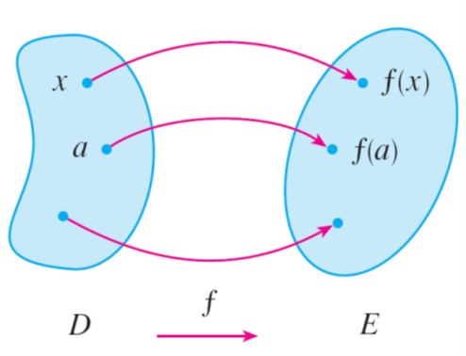
Functions (8 of 11)
Another way to picture a function is by an arrow diagram as in Figure 3.
Arrow diagram for f
Figure 3
Each arrow connects an element of D to an element of E. The arrow indicates that f (x) is associated with x, f (a) is associated with a, and so on.

Slide 12
Functions (9 of 11)
The most useful method for visualizing a function is its graph. If f is a function with domain D, then its graph is the set of ordered pairs
In other words, the graph of f consists of all points (x, y) in the coordinate plane such that y = f (x) and x is in the domain of f.
The graph of a function f gives us a useful picture of the behavior or “life history” of a function.

Slide 13
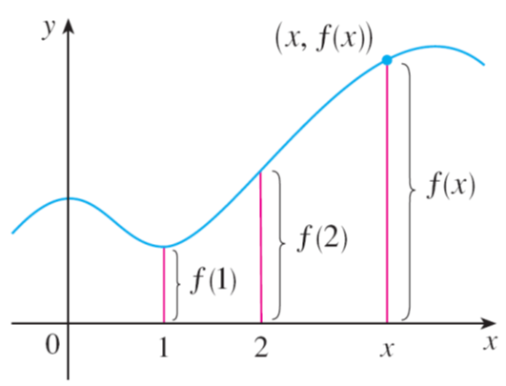
Functions (10 of 11)
Since the y-coordinate of any point (x, y) on the graph is y = f (x), we can read the value of f (x) from the graph as being the height of the graph above the point x. (See Figure 4).
Figure 4

Slide 14
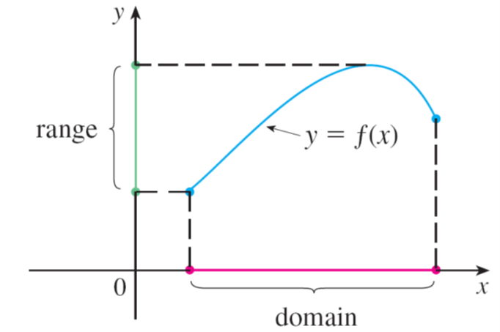
Functions (11 of 11)
The graph of f also allows us to picture the domain of f on the x-axis and its range on the y-axis as in Figure 5.
Figure 5

Slide 15
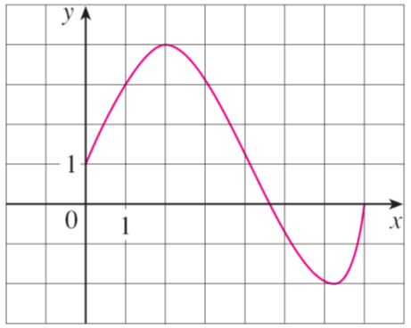
Example 1
The graph of a function f is shown in Figure 6.
(a) Find the values of f(1) and f (5).
(b) What are the domain and range of f ?
Figure 6

Slide 16
Example 1 – Solution
(a) We see from Figure 6 that the point (1, 3) lies on the graph of f, so the value of f at 1 is f(1) = 3. (In other words, the point on the graph that lies above x = 1 is 3 units above the x-axis.)
When x = 5, the graph lies about 0.7 unit below the x-axis, so we estimate that f(5) ≈ −0.7.
(b) We see that f(x) is defined when
so the domain of f is the closed
interval [0, 7]. Notice that f takes on all values from −2 to 4, so the range of f is

Slide 17
Representations of Functions

Slide 18
Representations of Functions (1 of 1)
We consider four different ways to represent a function:
verbally (by a description in words)
numerically (by a table of values)
visually (by a graph)
algebraically (by an explicit formula)

Slide 19
Example 4
When you turn on a hot-water faucet that is connected to a hot-water tank, the temperature T of the water depends on how long the water has been running. Draw a rough graph of T as a function of the time t that has elapsed since the faucet was turned on.
Solution:
The initial temperature of the running water is close to room temperature because the water has been sitting in the pipes.
When the water from the hot-water tank starts flowing from the faucet, T increases quickly. In the next phase, T is constant at the temperature of the heated water in the tank.

Slide 20
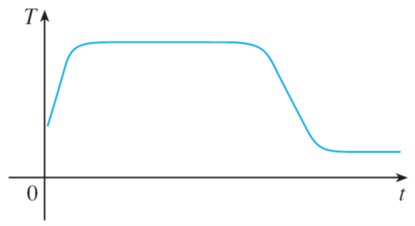
Example 4 – Solution
When the tank is drained, T decreases to the temperature of the water supply. This enables us to make the rough sketch of T as a function of t shown in Figure 11.
Figure 11

Slide 21
Which Rules Define Functions?

Slide 22
Which Rules Define Functions? (1 of 6)
What about curves drawn in the xy-plane? Which curves are graphs of functions?
The following test gives an answer.
The Vertical Line Test A curve in the xy-plane is the graph of a function of x if and only if no vertical line intersects the curve more than once.

Slide 23
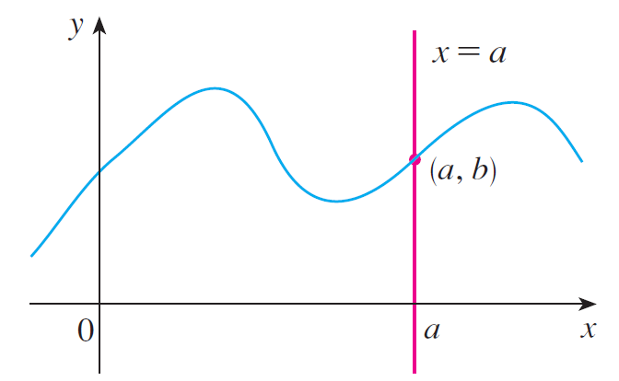
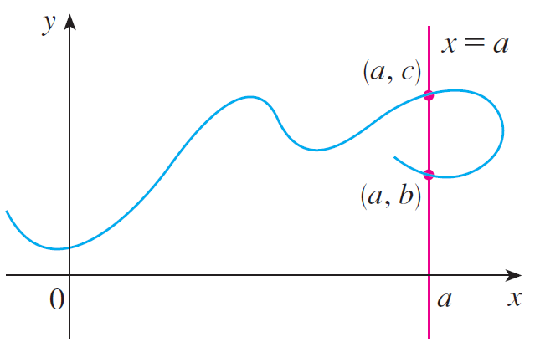
Which Rules Define Functions? (2 of 6)
The reason for the truth of the Vertical Line Test can be seen in Figure 13.
(a) This curve represents a function.
(b) This curve doesn’t represent a function.
Figure 13

Slide 24
Which Rules Define Functions? (3 of 6)
If each vertical line x = a intersects a curve only once, at (a, b), then exactly one function value is defined by f (a) = b.
But if a line x = a intersects the curve twice, at (a, b) and (a, c), then the curve can’t represent a function because a function can’t assign two different values to a.

Slide 25
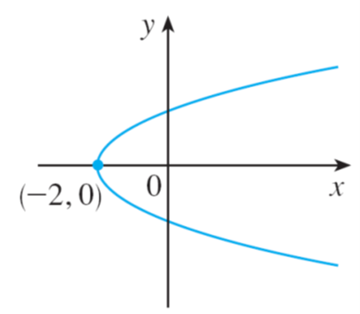
Which Rules Define Functions? (4 of 6)
For example, the parabola
shown in Figure 14(a) is not the graph of
a function of x because, as you can see, there are vertical lines that intersect the parabola twice. The parabola, however, does contain the graphs of two functions of x.
Figure 14(a)

Slide 26
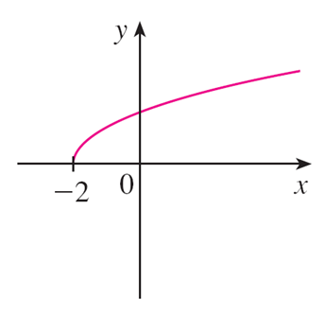
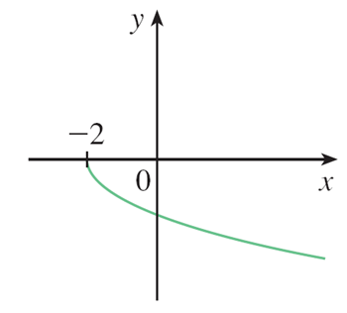
Which Rules Define Functions? (5 of 6)
Notice that the equation
Thus the upper and lower halves of the parabola are the graphs of the functions
[See Figures 14(b) and (c).]
Figure 14(b)
Figure 14(c)

Slide 27
Which Rules Define Functions? (6 of 6)
We observe that if we reverse the roles of x and y, then the equation
does define x as a function of y (with y as the independent
variable and x as the dependent variable). The graph of the function h is the parabola in Figure 14(a).
Figure 14(a)

Slide 28
Piecewise Defined Functions

Slide 29
Piecewise Defined Functions (1 of 4)
The functions in the following three examples are defined by different formulas in different parts of their domains. Such functions are called piecewise defined functions.

Slide 30
Example 7
A function f is defined by
Evaluate f(−2), f(−1), and f (0) and sketch the graph.
Solution:
Remember that a function is a rule. For this particular function the rule is the following:
First look at the value of the input x. If it happens that
then the value of
f (x) is 1 − x.

Slide 31
Example 7 – Solution (1 of 2)
Note that even though two different formulas are used, f is one function, not two.
On the other hand, if x > −1, then the value of f (x) is
How do we draw the graph of f ? We observe that if
then f (x) = 1 − x, so the
part of the graph of f that lies to the left of the vertical line x = −1 must coincide with the line y = 1 − x, which has slope −1 and y-intercept 1.

Slide 32
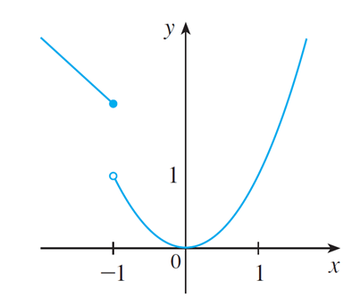
Example 7 – Solution (2 of 2)
If x > −1, then
so the part of the graph of f that lies to the right of the
line x = −1 must coincide with the graph of
which is a parabola. This
enables us to sketch the graph in Figure 15.
Figure 15
The solid dot indicates that the point (−1, 2) is included on the graph; the open dot indicates that the point (−1, 1) is excluded from the graph.

Slide 33
Piecewise Defined Functions (2 of 4)
The next example of a piecewise defined function is the absolute value
function. We know that the absolute value of a number a, denoted by
is the distance from a to 0 on the real number line. Distances are always positive or 0, so we have
For example,

Slide 34
Piecewise Defined Functions (3 of 4)
In general, we have
(Remember that if a is negative, then −a is positive.)

Slide 35
Example 8
Sketch the graph of the absolute value function
Solution:
From the preceding discussion we know that

Slide 36
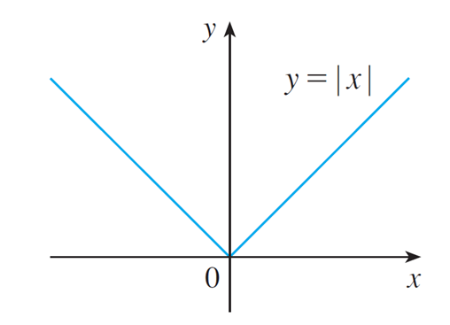
Example 8 – Solution
Using the same method as in Example 7, we see that the graph of f coincides with the line y = x to the right of the y-axis and coincides with the line y = −x to the left of the y-axis (see Figure 16).
Figure 16

Slide 37
Example 10 (1 of 2)
In Example C at the beginning of this section we considered the cost C (w) of mailing a large envelope with weight w.
In effect, this is a piecewise defined function because, from the table shown in the right side,
we have
w (ounces) | C(w) (dollars)
0 < w ≤ 1 | 1.00
1 < w ≤ 2 | 1.15
2 < w ≤ 3 | 1.30
3 < w ≤ 4 | 1.45
4 < w ≤ 5 | 1.60
⋮ | ⋮

Slide 38
Example 10 (2 of 2)
The graph is shown in Figure 18.
Figure 18

Slide 39
Piecewise Defined Functions (4 of 4)
Looking at Figure 18, you can see why a function like the one in Example 10 is called a step function.

Slide 40
Even and Odd Functions

Slide 41
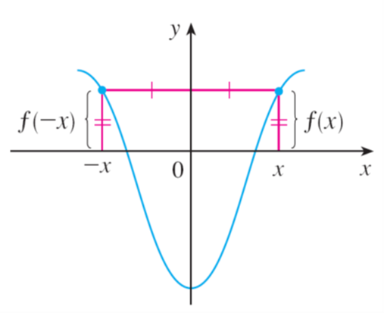
Even and Odd Functions (1 of 4)
If a function f satisfies f (−x) = f (x) for every number x in its domain, then f is
called an even function. For instance, the function
is even because
The geometric significance of an even function is that its graph is symmetric with respect to the y-axis (see Figure 19).
An even function
Figure 19

Slide 42
Even and Odd Functions (2 of 4)
This means that if we have plotted the graph of f for
we obtain the entire
graph simply by reflecting this portion about the y-axis.
If f satisfies f (−x) = −f (x) for every number x in its domain, then f is called an
odd function. For example, the function
is odd because

Slide 43
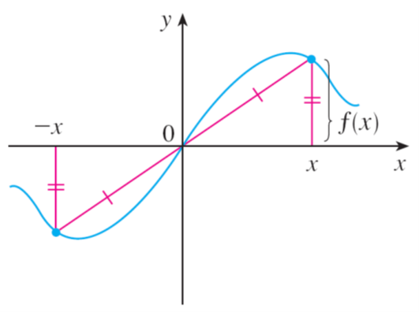
Even and Odd Functions (3 of 4)
The graph of an odd function is symmetric about the origin (see Figure 20).
An odd function
Figure 20
If we already have the graph of f for
we can obtain the entire graph by
rotating this portion through 180° about the origin.

Slide 44
Example 11
Determine whether each of the following functions is even, odd, or neither even nor odd.
(a)
(b)
(c)
Solution:
(a)
Therefore f is an odd function.

Slide 45
Example 11 – Solution
(b)
So g is even.
(c)
Since h(−x) ≠ h (x) and h(−x) ≠ −h(x), we conclude that h is neither even nor odd.

Slide 46
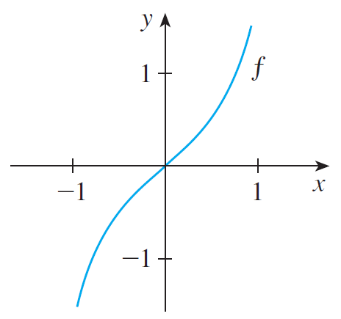
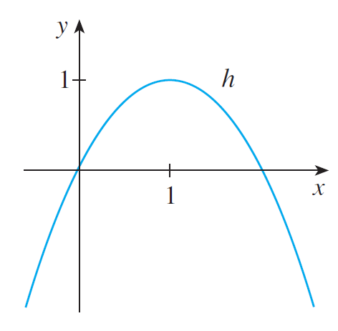
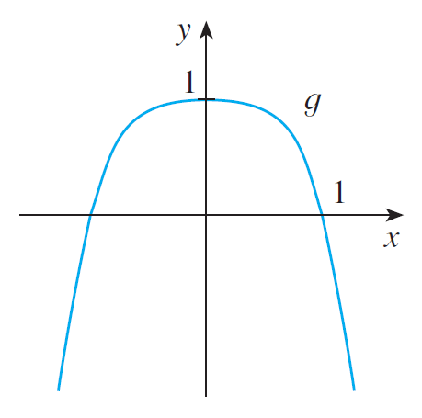
Even and Odd Functions (4 of 4)
The graphs of the functions in Example 11 are shown in Figure 21. Notice that the graph of h is symmetric neither about the y-axis nor about the origin.
(a)
(b)
(c)
Figure 21

Slide 47
Increasing and Decreasing Functions

Slide 48
Increasing and Decreasing Functions (1 of 3)
The graph shown in Figure 22 rises from A to B, falls from B to C, and rises again from C to D. The function f is said to be increasing on the interval [a, b], decreasing on [b, c], and increasing again on [c, d ].
Figure 22

Slide 49
Increasing and Decreasing Functions (2 of 3)
Notice that if x₁ and x₂ are any two numbers between a and b with x₁ < x₂, then f (x₁) < f (x₂).
We use this as the defining property of an increasing function.
A function f is called increasing on an interval I if
It is called decreasing on I if

Slide 50
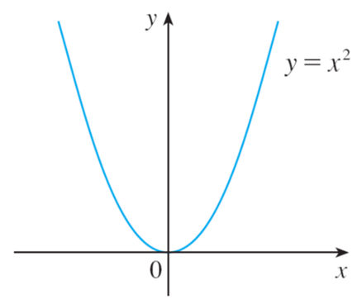
Increasing and Decreasing Functions (3 of 3)
In the definition of an increasing function it is important to realize that the inequality f (x₁) < f (x₂) must be satisfied for every pair of numbers x₁ and x₂ in I with x₁ < x₂.
You can see from Figure 23 that the function
is decreasing on the interval
and increasing on the interval
Figure 23

