Slide 1
1
Functions and Models
Copyright © Cengage Learning. All rights reserved.

Slide 2
1.2
Mathematical Models: A Catalog of Essential Functions
Copyright © Cengage Learning. All rights reserved.

Slide 3
Mathematical Models: A Catalog of Essential Functions (1 of 3)
A mathematical model is a mathematical description (often by means of a function or an equation) of a real-world phenomenon such as the size of a population, the demand for a product, the speed of a falling object, the concentration of a product in a chemical reaction, the life expectancy of a person at birth, or the cost of emission reductions.
The purpose of the model is to understand the phenomenon and perhaps to make predictions about future behavior.

Slide 4
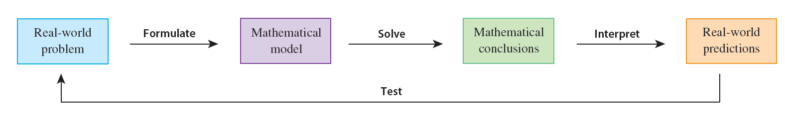
Mathematical Models: A Catalog of Essential Functions (2 of 3)
Figure 1 illustrates the process of mathematical modeling.
The modeling process
Figure 1

Slide 5
Mathematical Models: A Catalog of Essential Functions (3 of 3)
A mathematical model is never a completely accurate representation of a physical situation—it is an idealization. A good model simplifies reality enough to permit mathematical calculations but is accurate enough to provide valuable conclusions.
It is important to realize the limitations of the model.
There are many different types of functions that can be used to model relationships observed in the real world. In what follows, we discuss the behavior and graphs of these functions and give examples of situations appropriately modeled by such functions.

Slide 6
Linear Models

Slide 7
Linear Models (1 of 4)
When we say that y is a linear function of x, we mean that the graph of the function is a line, so we can use the slope-intercept form of the equation of a line to write a formula for the function as
y = f (x) = mx + b
where m is the slope of the line and b is the y-intercept.

Slide 8
Linear Models (2 of 4)
A characteristic feature of linear functions is that they change at a constant rate. For instance, Figure 2 shows a graph of the linear function f (x) = 3x − 2 and a table of sample values.
x | f (x) = 3x − 2
1.0 | 1.0
1.1 | 1.3
1.2 | 1.6
1.3 | 1.9
1.4 | 2.2
1.5 | 2.5
Figure 2

Slide 9
Linear Models (3 of 4)
Notice that whenever x increases by 0.1, the value of f (x) increases by 0.3. So f (x) increases three times as fast as x. This means that the slope of the graph of y = 3x − 2, namely 3, can be interpreted as the rate of change of y with respect to x.

Slide 10
Example 1
(a) As dry air moves upward, it expands and cools. If the ground temperature is 20°C and the temperature at a height of 1 km is 10°C, express the temperature T (in °C) as a function of the height h (in kilometers), assuming that a linear model is appropriate.
(b) Draw the graph of the function in part (a). What does the slope represent?
(c) What is the temperature at a height of 2.5 km?

Slide 11
Example 1(a) – Solution (1 of 3)
Because we are assuming that T is a linear function of h, we can write
T = mh + b
We are given that T = 20 when h = 0, so
20 = m · 0 + b = b
In other words, the y-intercept is b = 20.
We are also given that T = 10 when h = 1, so
10 = m · 1 + 20
The slope of the line is therefore m = 10 − 20 = −10 and the required linear function is
T = −10h + 20

Slide 12
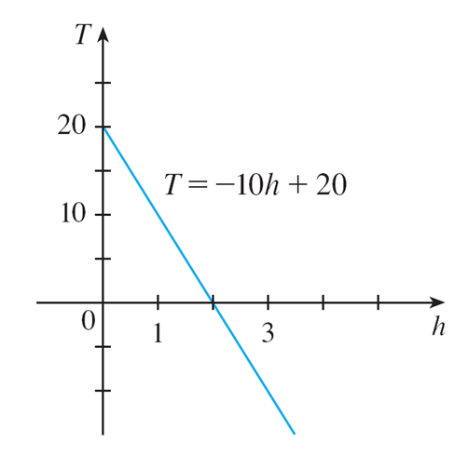
Example 1(b) – Solution (2 of 3)
The graph is sketched in Figure 3.
The slope is m = −10°C/km, and this represents the rate of change of temperature with respect to height.
Figure 3

Slide 13
Example 1(c) – Solution (3 of 3)
At a height of h = 2.5 km, the temperature is
T = −10(2.5) + 20 = −5°C

Slide 14
Linear Models (4 of 4)
If there is no physical law or principle to help us formulate a model, we construct an empirical model, which is based entirely on collected data.
We seek a curve that “fits” the data in the sense that it captures the basic trend of the data points.

Slide 15
Polynomials

Slide 16
Polynomials (1 of 4)
A function P is called a polynomial if
where n is a nonnegative integer and the numbers
are constants called the coefficients of the polynomial.
The domain of any polynomial is
If the leading coefficient
then the degree of the polynomial is n. For example, the function
is a polynomial of degree 6.

Slide 17
Polynomials (2 of 4)
A polynomial of degree 1 is of the form P (x) = mx + b and so it is a linear function.
A polynomial of degree 2 is of the form
and is called a
quadratic function.

Slide 18
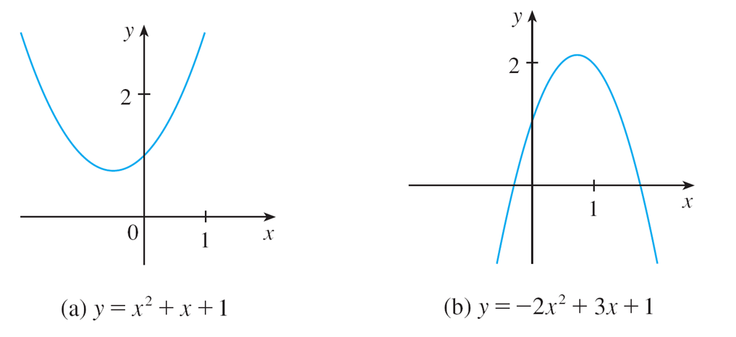
Polynomials (3 of 4)
Its graph is always a parabola obtained by shifting the parabola
The parabola opens upward if a > 0 and downward if a < 0. (See Figure 7.)
The graphs of quadratic functions are parabolas.
Figure 7

Slide 19
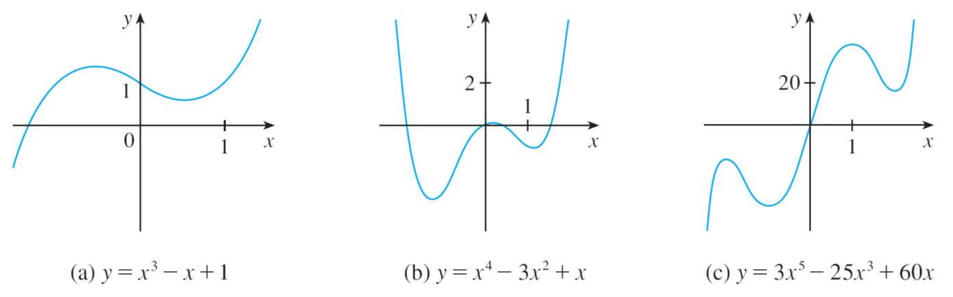
Polynomials (4 of 4)
A polynomial of degree 3 is of the form
and is called a cubic function. Figure 8 shows the graph of a cubic function in part (a) and graphs of polynomials of degrees 4 and 5 in parts (b) and (c).
Figure 8

Slide 20
Example 4
A ball is dropped from the upper observation deck of the CN Tower, 450 m above the ground, and its height h above the ground is recorded at 1-second intervals in Table 2.
Time (seconds) | Height (meters)
0 | 450
1 | 445
2 | 431
3 | 408
4 | 375
5 | 332
6 | 279
7 | 216
8 | 143
9 | 61
Find a model to fit the data and use the model to predict the time at which the ball hits the ground.
Table 2

Slide 21
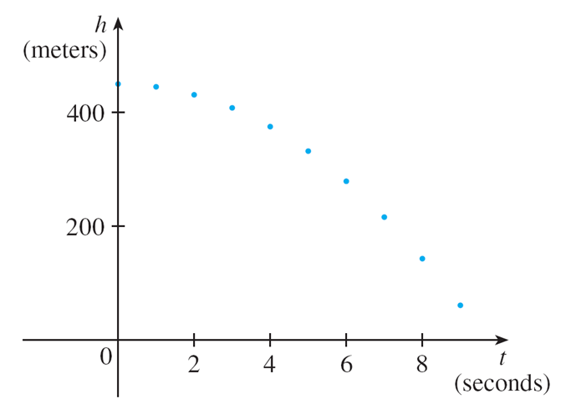
Example 4 – Solution (1 of 4)
We draw a scatter plot of the data in Figure 9 and observe that a linear model is inappropriate.
Scatter plot for a falling ball
Figure 9

Slide 22
Example 4 – Solution (2 of 4)
But it looks as if the data points might lie on a parabola, so we try a quadratic model instead.
Using a graphing calculator or computer algebra system (which uses the least squares method), we obtain the following quadratic model:
3

Slide 23
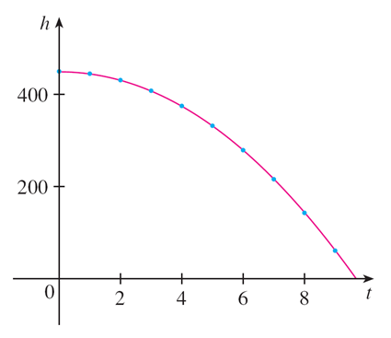
Example 4 – Solution (3 of 4)
In Figure 10 we plot the graph of Equation 3 together with the data points and see that the quadratic model gives a very good fit.
Quadratic model for a falling ball
Figure 10
The ball hits the ground when h = 0, so we solve the quadratic equation

Slide 24
Example 4 – Solution (4 of 4)
The quadratic formula gives
The positive root is t ≈ 9.67, so we predict that the ball will hit the ground after about 9.7 seconds.

Slide 25
Power Functions

Slide 26
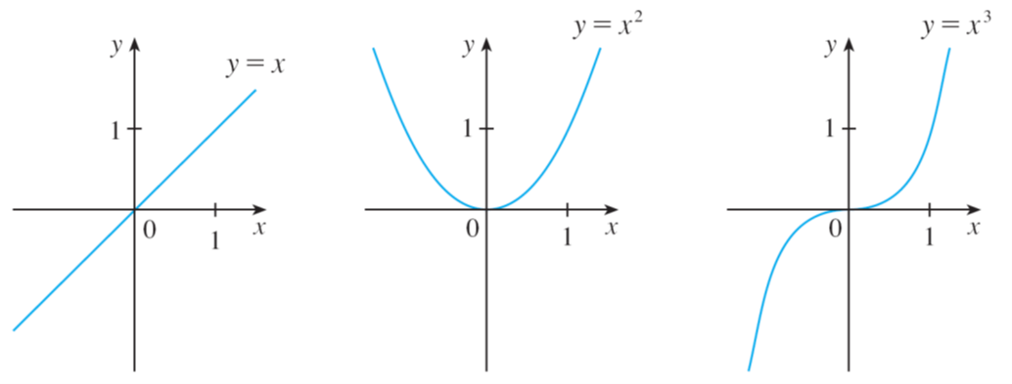
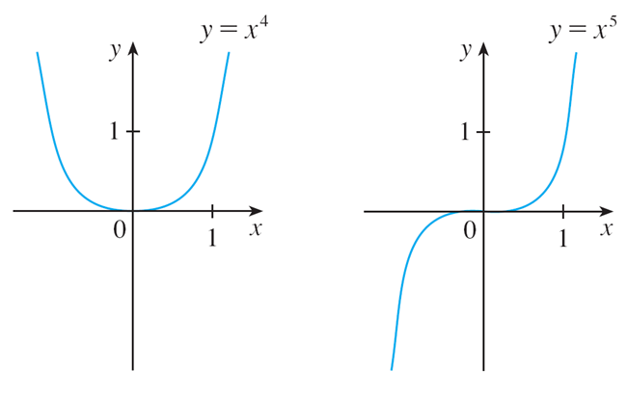
Power Functions (1 of 8)
A function of the form
where a is a constant, is called a power function.
We consider several cases.
(i) a = n, where n is a positive integer
The graphs of
for n = 1, 2, 3, 4, and 5 are shown in Figure 11.
(These are polynomials with only one term.)
Figure 11

Slide 27
Power Functions (2 of 8)
We already know the shape of the graphs of y = x (a line through the origin with
slope 1) and

Slide 28
Power Functions (3 of 8)
The general shape of the graph of
depends on whether n is even or odd.
If n is even, then
is an even function and its graph is similar to the
parabola
If n is odd, then
is an odd function and its graph is similar to that of

Slide 29
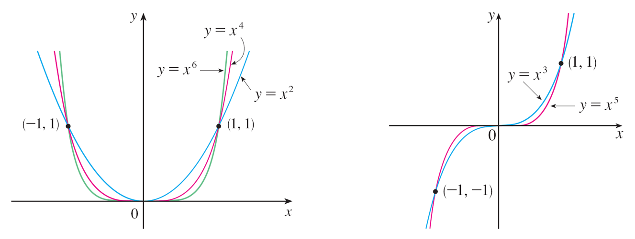
Power Functions (4 of 8)
Notice from Figure 12, however, that as n increases, the graph of
becomes flatter near 0 and steeper when
(If x is small, then
and so on.)
Figure 12

Slide 30
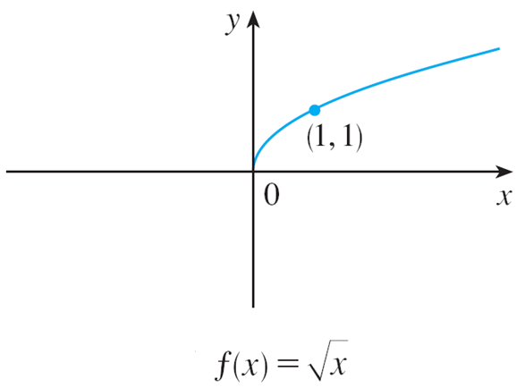
Power Functions (5 of 8)
(ii)
where n is a positive integer
The function
is a root function. For n = 2 it is the square root
function
whose domain is [0, ∞) and whose graph is the upper half of
the parabola
[See Figure 13(a).]
Graph of root function
Figure 13(a)

Slide 31
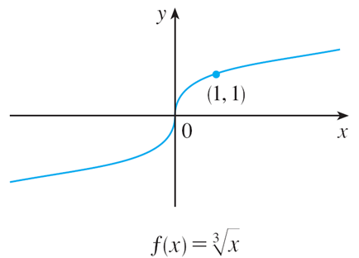
Power Functions (6 of 8)
For other even values of n, the graph of
is similar to that of
For n = 3 we have the cube root function
(recall that every real number has a cube root) and whose graph is shown in
Figure 13(b). The graph of
for n odd (n > 3) is similar to that of
Graph of root function
Figure 13(b)

Slide 32
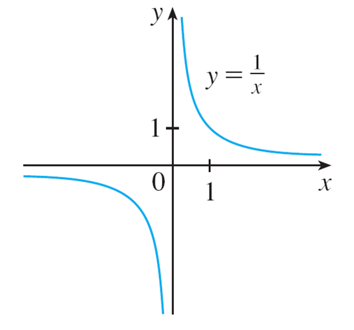
Power Functions (7 of 8)
(iii) a = −1
The graph of the reciprocal function
is shown in Figure 14.
Its graph has the equation
or xy = 1, and is a hyperbola with the
coordinate axes as its asymptotes.
The reciprocal function
Figure 14

Slide 33
Power Functions (8 of 8)
This function arises in physics and chemistry in connection with Boyle’s Law, which says that when the temperature is constant, the volume V of a gas is inversely proportional to the pressure P:
where C is a constant.
Thus the graph of V as a function of P (see Figure 15) has the same general shape as the right half of Figure 14.
Volume as a function of pressure at constant temperature
Figure 15

Slide 34
Power Functions (9 of 8)
(iv) a = −2
Among the remaining negative powers for the power function
by far the most important is that of a = −2. Many natural laws state that one quantity is inversely proportional to the square of another quantity. In other words, the first quantity is modeled by a function of the form
and we refer to this as an inverse square law.
For instance, the illumination I of an object by a light source is inversely proportional to the square of the distance x from the source:
where C is a constant.

Slide 35
Power Functions (10 of 10)
Thus the graph of I as a function of x (see Figure 17) has the same general shape as the right half of Figure 16.
The reciprocal of the squaring function
Illumination from a light source as a function of distance from the source
Figure 16
Figure 17

Slide 36
Rational Functions

Slide 37
Rational Functions (1 of 2)
A rational function f is a ratio of two polynomials:
where P and Q are polynomials. The domain consists of all values of x such that Q(x) ≠ 0.
A simple example of a rational function is the function
whose domain is
this is the
reciprocal function graphed in Figure 14.
The reciprocal function
Figure 14

Slide 38
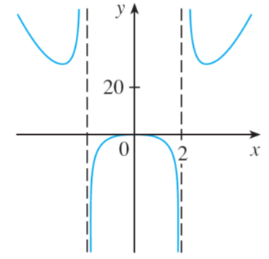
Rational Functions (2 of 2)
The function
is a rational function with domain
Its graph is shown in Figure 18.
Figure 18

Slide 39
Algebraic Functions

Slide 40
Algebraic Functions (1 of 2)
A function f is called an algebraic function if it can be constructed using algebraic operations (such as addition, subtraction, multiplication, division, and taking roots) starting with polynomials. Any rational function is automatically an algebraic function.
Here are two more examples:

Slide 41
Algebraic Functions (2 of 2)
An example of an algebraic function occurs in the theory of relativity. The mass of a particle with velocity v is
where m₀ is the rest mass of the particle and
is the speed of
light in a vacuum.
Functions that are not algebraic are called transcendental; these include the trigonometric, exponential, and logarithmic functions.

Slide 42
Trigonometric Functions

Slide 43
Trigonometric Functions (1 of 6)
In calculus the convention is that radian measure is always used (except when otherwise indicated).
For example, when we use the function f (x) = sin x, it is understood that sin x means the sine of the angle whose radian measure is x.

Slide 44
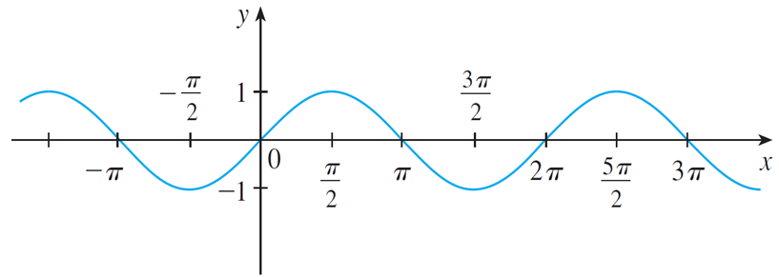
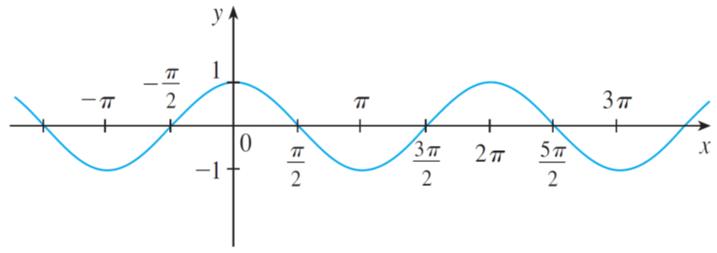
Trigonometric Functions (2 of 6)
Thus the graphs of the sine and cosine functions are as shown in Figure 19.
(a) f (x) = sin x
(b) g (x) = cos x
Figure 19

Slide 45
Trigonometric Functions (3 of 6)
Notice that for both the sine and cosine functions the domain is (−∞, ∞) and the range is the closed interval [−1, 1].
Thus, for all values of x, we have
or, in terms of absolute values,

Slide 46
Trigonometric Functions (4 of 6)
An important property of the sine and cosine functions is that they are periodic functions and have period 2π. This means that, for all values of x,

Slide 47
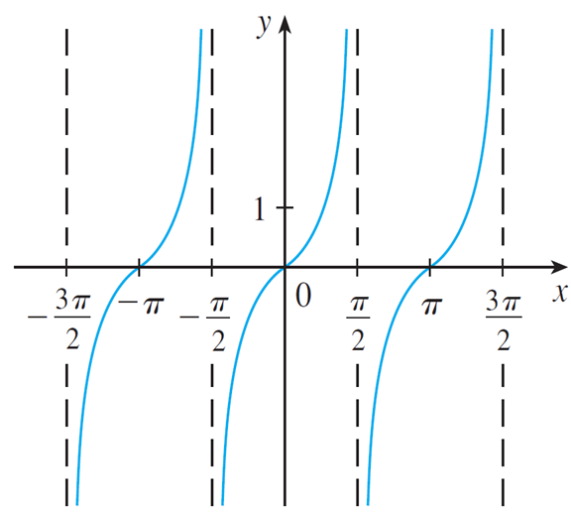
Trigonometric Functions (5 of 6)
The tangent function is related to the sine and cosine functions by the equation
and its graph is shown in Figure 20. It is undefined whenever cos x = 0, that is, when
Its range is (−∞, ∞).
y = tan x
Figure 20

Slide 48
Trigonometric Functions (6 of 6)
Notice that the tangent function has period π :
The remaining three trigonometric functions (cosecant, secant, and cotangent) are the reciprocals of the sine, cosine, and tangent functions.

Slide 49
Exponential Functions

Slide 50
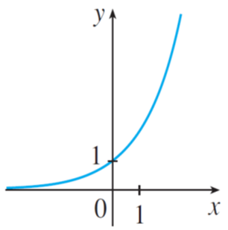
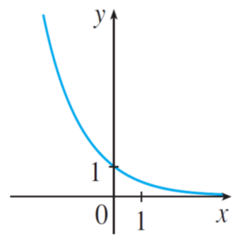
Exponential Functions (1 of 2)
The exponential functions are the functions of the form
where the base
b is a positive constant.
The graphs of
are shown in Figure 21. In both cases the
domain is (−∞, ∞) and the range is (0, ∞).
Figure 21

Slide 51
Exponential Functions (2 of 2)
Exponential functions are useful for modeling many natural phenomena, such as population growth (if b > 1) and radioactive decay (if b < 1).

Slide 52
Logarithmic Functions

Slide 53
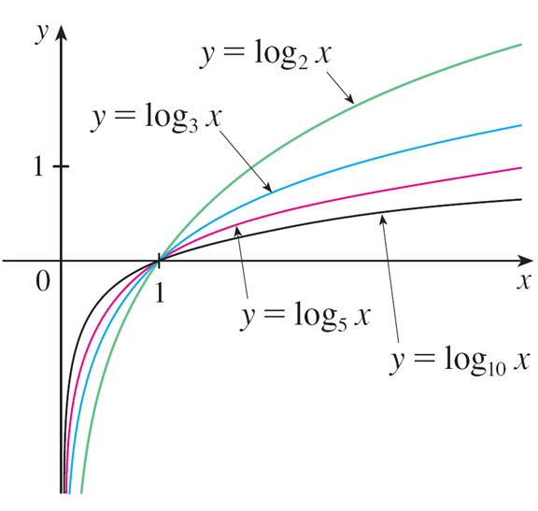
Logarithmic Functions
The logarithmic functions f (x) = log_{b}x, where the base b is a positive constant, are the inverse functions of the exponential functions. Figure 22 shows the graphs of four logarithmic functions with various bases.
Figure 22
In each case the domain is (0, ∞), the range is (−∞, ∞), and the function increases slowly when x > 1.

Slide 54
Example 6
Classify the following functions as one of the types of functions that we have discussed.
(a)
(b)
(c)
(d)

Slide 55
Example 6 – Solution
(a)
is an exponential function. (The variable x is the exponent.)
(b)
is a power function. (The variable x is the base.) We could also
consider it to be a polynomial of degree 5.
(c)
is an algebraic function. (It is not a rational function because
the denominator is not a polynomial.)
(d)
is a polynomial of degree 4.

