Slide 1
1
Functions and Models
Copyright © Cengage Learning. All rights reserved.

Slide 2
1.3
New Functions from Old Functions
Copyright © Cengage Learning. All rights reserved.

Slide 3
Transformations of Functions

Slide 4
Transformations of Functions (1 of 8)
By applying certain transformations to the graph of a given function we can obtain the graphs of related functions.
This will give us the ability to sketch the graphs of many functions quickly by hand. It will also enable us to write equations for given graphs.
Let’s first consider translations of graphs. If c is a positive number, then the graph of y = f (x) + c is just the graph of y = f (x) shifted upward a distance of c units (because each y-coordinate is increased by the same number c).

Slide 5
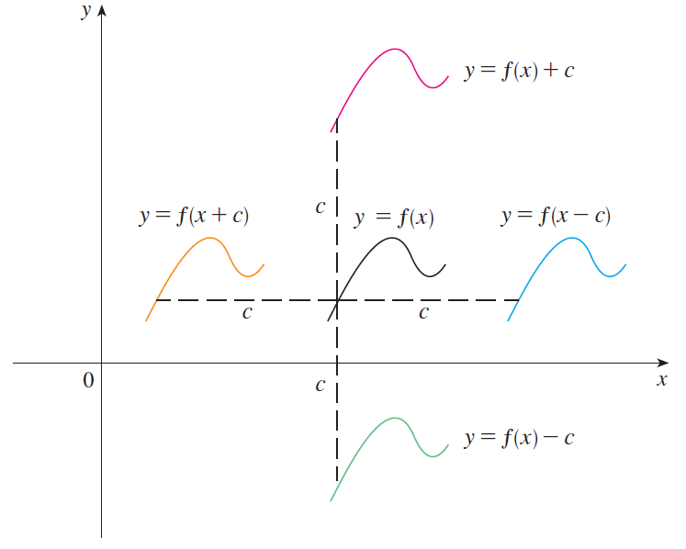
Transformations of Functions (2 of 8)
Likewise, if g(x) = f (x − c), where c > 0, then the value of g at x is the same as the value of f at x − c (c units to the left of x).
Therefore the graph of y = f (x − c) is just the graph of y = f (x) shifted c units to the right (see Figure 1).
Translating the graph of f
Figure 1

Slide 6
Transformations of Functions (3 of 8)
Vertical and Horizontal Shifts Suppose c > 0. To obtain the graph of
y = f (x) + c, shift the graph of y = f (x) a distance c units upward
y = f (x) − c, shift the graph of y = f (x) a distance c units downward
y = f (x − c), shift the graph of y = f (x) a distance c units to the right
y = f (x + c), shift the graph of y = f (x) a distance c units to the left
Now let’s consider the stretching and reflecting transformations. If c > 1, then the graph of y = cf (x) is the graph of y = f (x) stretched by a factor of c in the vertical direction (because each y-coordinate is multiplied by the same number c).

Slide 7
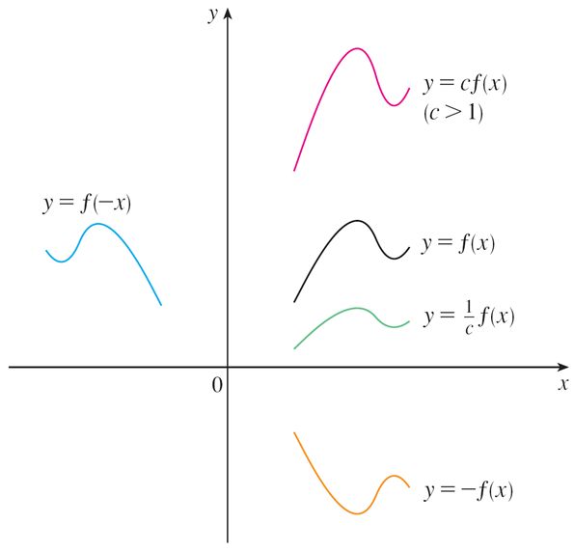
Transformations of Functions (4 of 8)
The graph of y = −f (x) is the graph of y = f (x) reflected about the x-axis because the point (x, y) is replaced by the point (x, −y).
(See Figure 2 and the following chart, where the results of other stretching, shrinking, and reflecting transformations are also given.)
Stretching and reflecting the graph of f
Figure 2

Slide 8
Transformations of Functions (5 of 8)
Vertical and Horizontal Stretching and Reflecting Suppose c > 1. To obtain the graph of

Slide 9
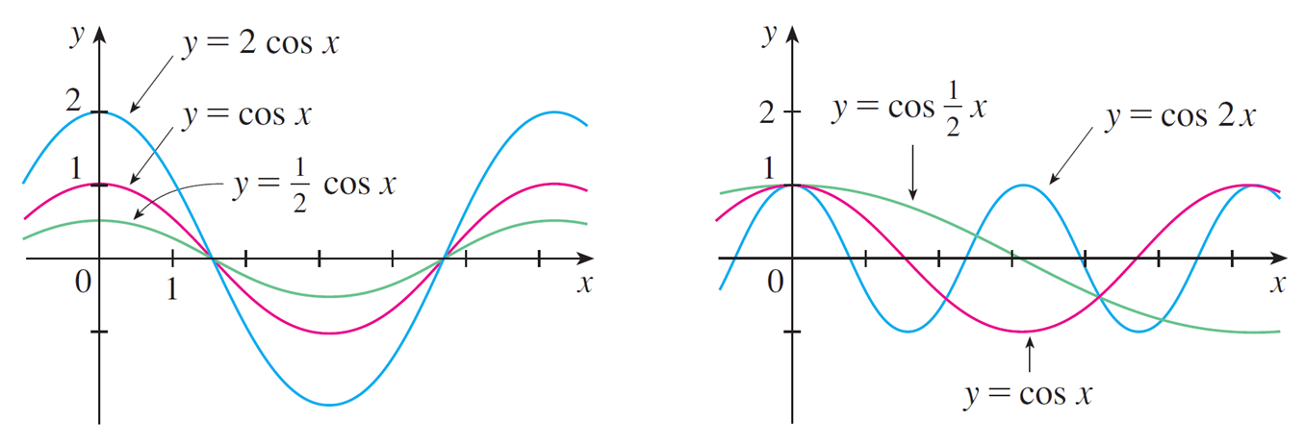
Transformations of Functions (6 of 8)
Figure 3 illustrates these stretching transformations when applied to the cosine function with c = 2.
Figure 3

Slide 10
Transformations of Functions (7 of 8)
For instance, in order to get the graph of y = 2 cos x we multiply the y-coordinate of each point on the graph of y = cos x by 2.
This means that the graph of y = cos x gets stretched vertically by a factor of 2.

Slide 11
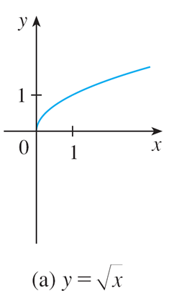
Example 1
Given the graph of
use transformations to graph
Solution:
The graph of the square root function
is shown in Figure 4(a).
Figure 4

Slide 12
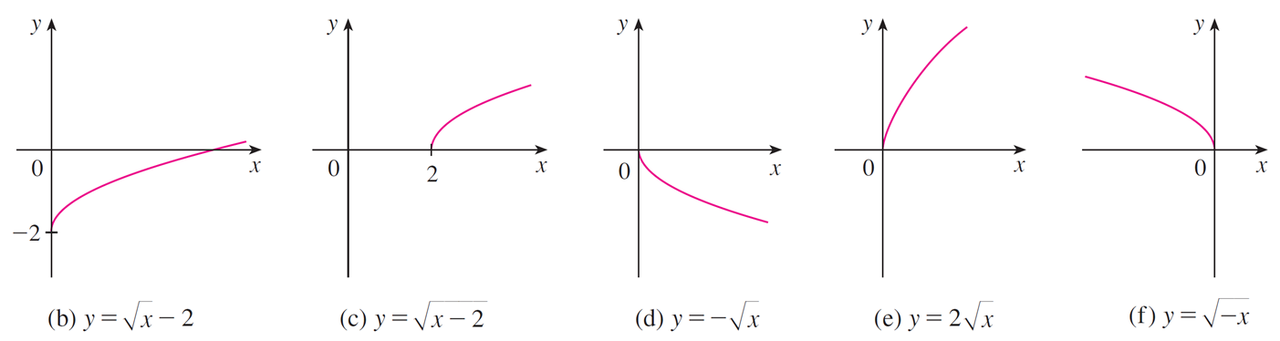
Example 1 – Solution
Figure 4
In the other parts of the figure we sketch
by shifting 2 units downward,
by shifting 2 units to the right,
by reflecting about the x-axis,
by stretching vertically by a factor of 2, and
by reflecting about
the y-axis.

Slide 13
Transformations of Functions (8 of 8)
Another transformation of some interest is taking the absolute value of a
function. If
then according to the definition of absolute value, y = f(x)
when f(x) ≥ 0 and y = −f(x) when f(x) < 0.
This tells us how to get the graph of
from the graph of y = f(x): the
part of the graph that lies above the x-axis remains the same, and the part that lies below the x-axis is reflected about the x-axis.

Slide 14
Combinations of Functions

Slide 15
Combinations of Functions (1 of 6)
Two functions f and g can be combined to form new functions f + g, f − g, fg, and
in a manner similar to the way we add, subtract, multiply, and divide real
numbers.
Definition Given two functions f and g, the sum, difference, product, and
quotient functions are defined by
If the domain of f is A and the domain of g is B, then the domain of f + g is the
intersection
because both f (x) and g(x) have to be defined.

Slide 16
Combinations of Functions (2 of 6)
and the domain of
For example, the domain of
so the domain of
The domain of f g is
but we can’t divide by 0 and so the domain of
For instance, if
and g (x) = x − 1, then the domain of the rational function

Slide 17
Combinations of Functions (3 of 6)
There is another way of combining two functions to obtain a new function. For
example, suppose that
Since y is a function of u and u is, in turn, a function of x, it follows that y is ultimately a function of x. We compute this by substitution:
The procedure is called composition because the new function is composed of the two given functions f and g.

Slide 18
Combinations of Functions (4 of 6)
In general, given any two functions f and g, we start with a number x in the domain of g and calculate g (x). If this number g (x) is in the domain of f, then we can calculate the value of f (g (x)).
The result is a new function h (x) = f (g (x)) obtained by substituting g into f. It is
called the composition (or composite) of f and g and is denoted by
Definition Given two functions f and g, the composite function
(also called the composition of f and g) is defined by

Slide 19
Combinations of Functions (5 of 6)
The domain of
is the set of all x in the domain of g such that g (x) is in the
domain of f.
In other words,
is defined whenever
both g (x) and f (g (x)) are defined.
Figure 11 shows how to picture
in terms of machines.
The
machine is composed of the g machine
(first) and then the f machine.
Figure 11

Slide 20
Example 6
If
and g (x) = x − 3, find the composite functions
Solution:
We have

Slide 21
Combinations of Functions (6 of 6)
We know that, the notation
means that the function g is applied first and then
f is applied second. In Example 6,
is the function that first subtracts 3 and
then squares;
is the function that first squares and then subtracts 3.
It is possible to take the composition of three or more functions. For instance,
the composite function
is found by first applying h, then g, and then f as
follows:

