Slide 1
1
Functions and Models
Copyright © Cengage Learning. All rights reserved.

Slide 2
1.4
Exponential Functions
Copyright © Cengage Learning. All rights reserved.

Slide 3
Exponential Functions
The function
is called an exponential function because the variable,
x, is the exponent. It should not be confused with the power function
in which the variable is the base.

Slide 4
Exponential Functions and Their Graphs

Slide 5
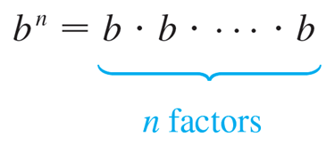
Exponential Functions and Their Graphs (1 of 12)
In general, an exponential function is a function of the form
where b is a positive constant. Let’s recall what this means. If x = n, a positive integer, then

Slide 6
Exponential Functions and Their Graphs (2 of 12)
If x = 0, then
and if x = −n, where n is a positive integer, then
If x is a rational number,
where p and q are integers and q > 0, then
But what is the meaning of
if x is an irrational number? For instance, what is
meant by

Slide 7
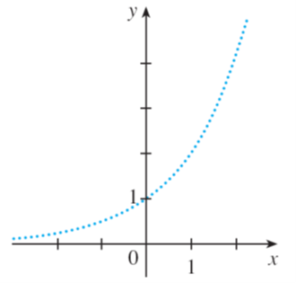
Exponential Functions and Their Graphs (3 of 12)
To help us answer this question we first look at the graph of the function
where x is rational. A representation of this graph is shown in Figure 1.
We want to enlarge the domain of
to include both rational and irrational numbers.
There are holes in the graph in Figure 1 corresponding to irrational values of x.
We want to fill in the holes by defining
where
so that f is
an increasing function.
Figure 1

Slide 8
Exponential Functions and Their Graphs (4 of 12)
In particular, since the irrational number
satisfies
we must have
and we know what
mean because 1.7 and 1.8 are rational numbers.

Slide 9
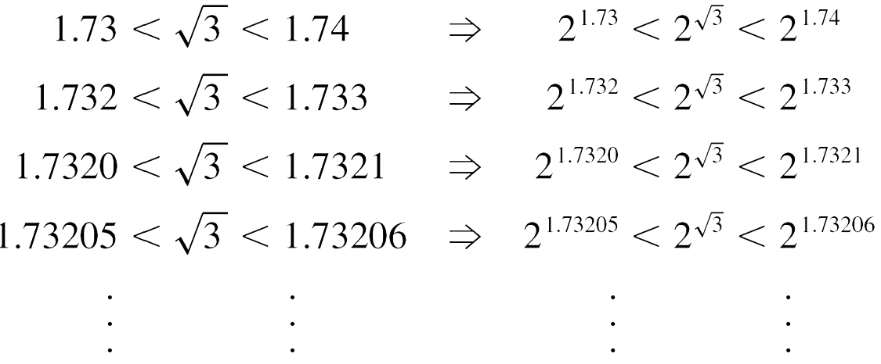
Exponential Functions and Their Graphs (5 of 12)
Similarly, if we use better approximations for
we obtain better approximations

Slide 10
Exponential Functions and Their Graphs (6 of 12)
It can be shown that there is exactly one number that is greater than all of the numbers
and less than all of the numbers
We define
to be this number. Using the preceding approximation process
we can compute it correct to six decimal places:

Slide 11

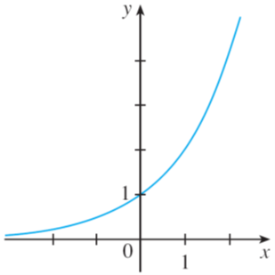
Exponential Functions and Their Graphs (7 of 12)
Similarly, we can define
where x is any irrational number.
Figure 2 shows how all the holes in Figure 1 have been filled to complete the graph of the function
Figure 1
Figure 2

Slide 12
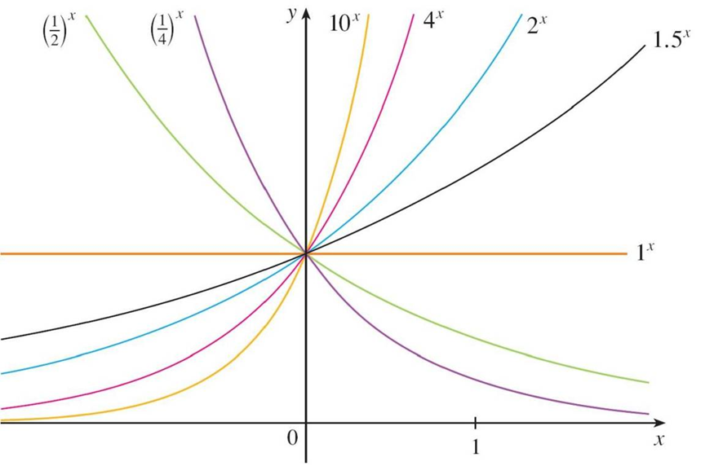
Exponential Functions and Their Graphs (8 of 12)
The graphs of members of the family of functions
are shown in Figure 3
for various values of the base b.
Figure 3

Slide 13
Exponential Functions and Their Graphs (9 of 12)
Notice that all of these graphs pass through the same point (0, 1) because
Notice also that as the base b gets larger, the exponential function grows more rapidly (for x > 0).
You can see from Figure 3 that there are basically three kinds of exponential
functions
If 0 < b < 1, the exponential function decreases; if b = 1, it is a constant; and if b > 1, it increases.

Slide 14
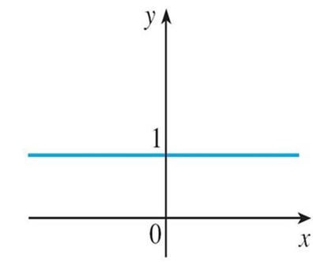
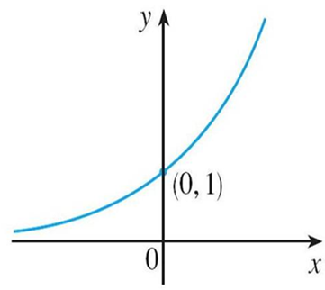
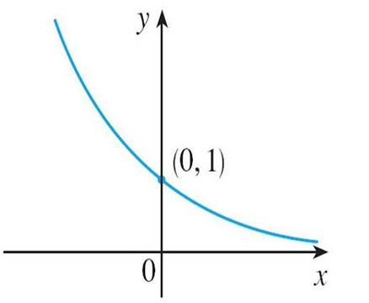
Exponential Functions and Their Graphs (10 of 12)
These three cases are illustrated in Figure 4.
(a)
(b)
(c)
Figure 4

Slide 15
Exponential Functions and Their Graphs (11 of 12)
Observe that if b ≠ 1, then the exponential function
and range (0, ∞).
Notice also that, since
the graph of
is just the reflection of the graph of

Slide 16
Exponential Functions and Their Graphs (12 of 12)
One reason for the importance of the exponential function lies in the following properties.
If x and y are rational numbers, then these laws are well known from elementary algebra. It can be proved that they remain true for arbitrary real numbers x and y.
Laws of Exponents If a and b are positive numbers and x and y are any real numbers, then
1.
2.
3.
4.

Slide 17
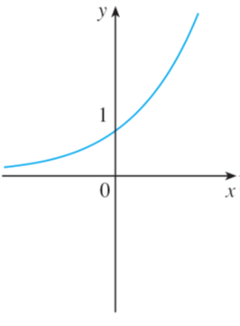
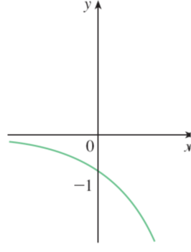
Example 1
Sketch the graph of the function
and determine its domain and range.
Solution:
First we reflect the graph of
[shown in Figures 2 and 5(a)] about the x-axis
to get the graph of
in Figure 5(b).
(a)
(b)
Figure 2
Figure 5

Slide 18
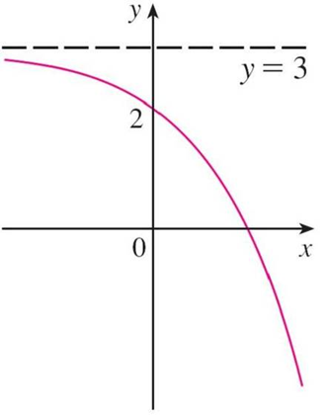
Example 1 – Solution
Then we shift the graph of
upward 3 units to obtain the graph of
in Figure 5(c).
Figure 5
The domain is
and the range is (−∞, 3).

Slide 19
Applications of Exponential Functions

Slide 20
Applications of Exponential Functions (1 of 3)
The exponential function occurs very frequently in mathematical models of nature and society. Here we indicate briefly how it arises in the description of increasing population or decreasing viral loads.
First we consider a population of bacteria in a homogeneous nutrient medium. Suppose that by sampling the population at certain intervals it is determined that the population doubles every hour.

Slide 21
Applications of Exponential Functions (2 of 3)
If the number of bacteria at time t is p (t), where t is measured in hours, and the initial population is p(0) = 1000, then we have
p(1) = 2p(0) = 2 × 1000
It seems from this pattern that, in general,

Slide 22
Applications of Exponential Functions (3 of 3)
This population function is a constant multiple of the exponential function
so it exhibits the rapid growth.
Under ideal conditions (unlimited space and nutrition and absence of disease) this exponential growth is typical of what actually occurs in nature.

Slide 23
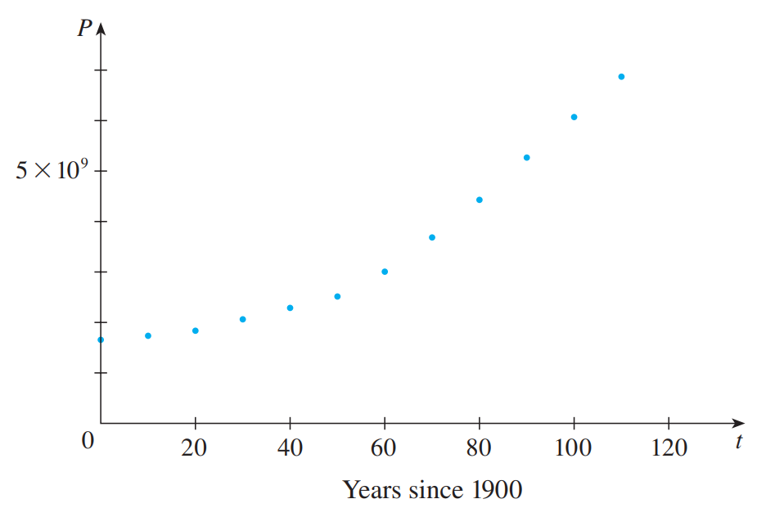
Example 3 (1 of 3)
Table 1 shows data for the population of the world in the 20th century and Figure 8 shows the corresponding scatter plot.
t (years since 19 00) | Population P (millions)
0 | 1650
10 | 1750
20 | 1860
30 | 2070
40 | 2300
50 | 2560
60 | 3040
70 | 3710
80 | 4450
90 | 5280
100 | 6080
110 | 6870
Scatter plot for world population growth
World Population
Figure 8
Table 1

Slide 24
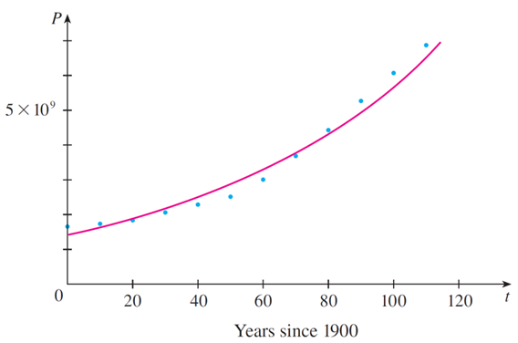
Example 3 (2 of 3)
The pattern of the data points in Figure 8 suggests exponential growth, so we use a graphing calculator (or computer) with exponential regression capability to apply the method of least squares and obtain the exponential model
where t = 0 corresponds to 19 00. Figure 9 shows the graph of this exponential function together with the original data points.
Exponential model for world population growth
Figure 9

Slide 25
Example 3 (3 of 3)
We see that the exponential curve fits the data reasonably well.
The period of relatively slow population growth is explained by the two world wars and the Great Depression of the 19 30s.

Slide 26
The Number e

Slide 27
The Number e (1 of 6)
Of all possible bases for an exponential function, there is one that is most convenient for the purposes of calculus.
The choice of a base b is influenced by the way the graph of
crosses the y-axis.

Slide 28
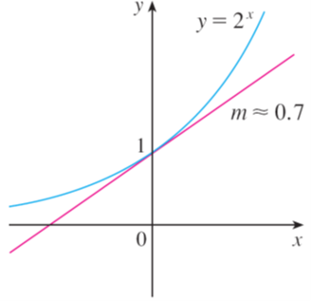
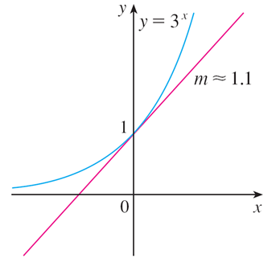
The Number e (2 of 6)
Figures 12 and 13 show the tangent lines to the graphs of
at the point (0, 1).
Figure 12
Figure 13
(For present purposes, you can think of the tangent line to an exponential graph at a point as the line that touches the graph only at that point.) If we measure the slopes of these tangent lines at (0, 1), we find that m ≈ 0.7 for

Slide 29
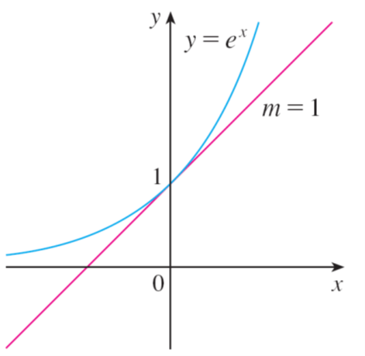
The Number e (3 of 6)
It turns out, that some of the formulas of calculus will be greatly simplified if we
choose the base b so that the slope of the tangent line to
at (0, 1) is
exactly 1. (See Figure 14.)
Figure 14

Slide 30
The Number e (4 of 6)
In fact, there is such a number and it is denoted by the letter e. (This notation was chosen by the Swiss mathematician Leonhard Euler in 17 27, probably because it is the first letter of the word exponential.)

Slide 31


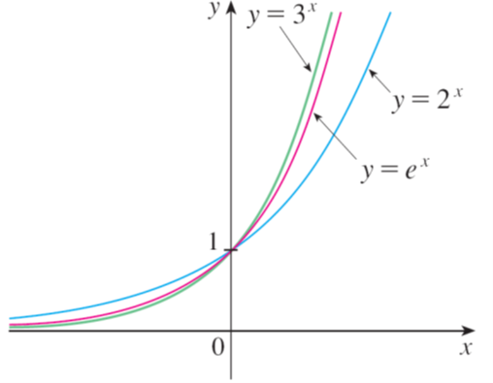
The Number e (5 of 6)
In view of Figures 12 and 13, it comes as no surprise that the number e lies
between 2 and 3 and the graph of
lies between the graphs of
Figure 12
Figure 13
Figure 15

Slide 32
The Number e (6 of 6)
We will see that the value of e, correct to five decimal places, is
e ≈ 2.71828
We call the function
the natural exponential function.

Slide 33
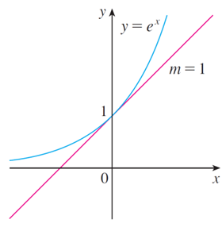
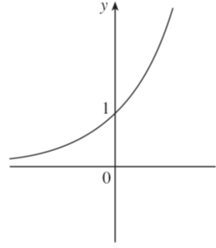
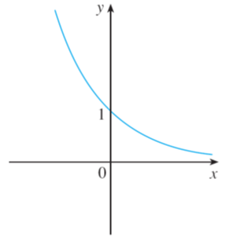
Example 5
Graph the function
and state the domain and range.
Solution:
We start with the graph of
from Figures 14 and 16(a) and reflect about
the y-axis to get the graph of
in Figure 16(b). (Notice that the tangent
line to the graph at the y-intercept has slope of −1).
Figure 14
(b)
(a)
Figure 16

Slide 34
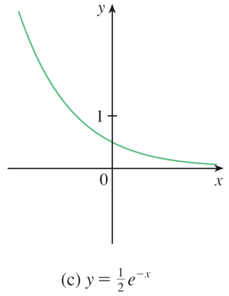
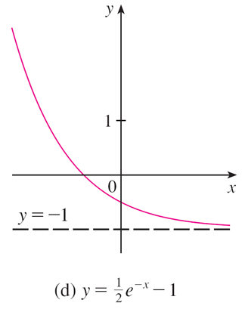
Example 5 – Solution
Then we compress the graph vertically by a factor of 2 to obtain the graph of
Finally, we shift the graph downward one unit to get
the desired graph in Figure 16(d).
Figure 16
The domain is
and the range is (−1,∞).

