Slide 1
1
Functions and Models
Copyright © Cengage Learning. All rights reserved.

Slide 2
1.5
Inverse Functions and Logarithms
Copyright © Cengage Learning. All rights reserved.

Slide 3
Inverse Functions

Slide 4
Inverse Functions (1 of 14)
Table 1 gives data from an experiment in which a bacteria culture started with 100 bacteria in a limited nutrient medium; the size of the bacteria population was recorded at hourly intervals.
The number of bacteria N is a function of the time t: N = f (t).
Suppose, however, that the biologist changes her point of view and becomes interested in the time required for the population to reach various levels. In other words, she is thinking of t as a function of N.
t (hours) | N = f(t) = population at time t
0 | 100
1 | 168
2 | 259
3 | 358
4 | 445
5 | 509
6 | 550
7 | 573
8 | 586
N as a function of t
Table 1

Slide 5
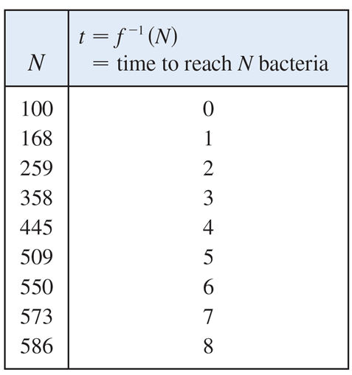
Inverse Functions (2 of 14)
This function is called the inverse function of f, denoted by
Thus
is the time required for the population level to reach N.
The values of
can be found
by reading Table 1 from right to left or by consulting Table 2.
For instance,
because f (6) = 550.
Not all functions possess inverses.
t as a function of N
Table 2

Slide 6
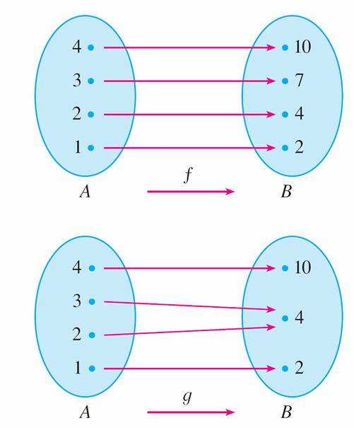
Inverse Functions (3 of 14)
Let’s compare the functions f and g whose arrow diagrams are shown in Figure 1.
Note that f never takes on the same value twice (any two inputs in A have different outputs), whereas g does take on the same value twice (both 2 and 3 have the same output, 4).
In symbols,
g (2) = g (3)
but f (x₁) ≠ f (x₂) whenever x₁ ≠ x₂
f is one-to-one; g is not.
Figure 1

Slide 7
Inverse Functions (4 of 14)
Functions that share this property with f are called one-to-one functions.
1 Definition A function f is called a one-to-one function if it never takes on the same value twice; that is.

Slide 8
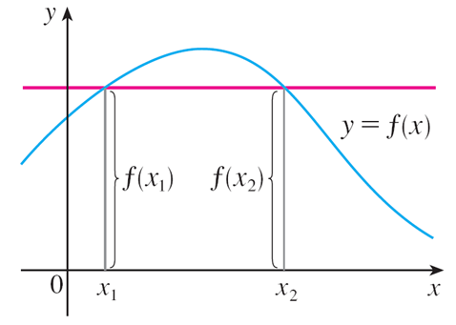
Inverse Functions (5 of 14)
If a horizontal line intersects the graph of f in more than one point, then we see from Figure 2 that there are numbers x₁ and x₂ such that f (x₁) = f (x₂).
This means that f is not one-to-one.
Therefore we have the following geometric method for determining whether a function is one-to-one.
This function is not one-to-one because f (x₁) = f (x₂).
Figure 2
Horizontal Line Test A function is one-to-one if and only if no horizontal line intersects its graph more than once.

Slide 9
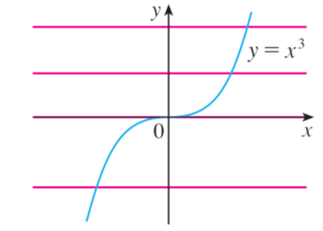
Example 1
Is the function
one-to-one?
Solution 1:
If x₁ ≠ x₂, then
(two different numbers can’t have the same cube).
Therefore, by Definition 1,
Solution 2:
From Figure 3 we see that no horizontal line
intersects the graph of
Therefore, by the Horizontal Line Test, f is one-to-one.
Figure 3

Slide 10
Inverse Functions (6 of 14)
One-to-one functions are important because they are precisely the functions that possess inverse functions according to the following definition.
2 Definition Let f be a one-to-one function with domain A and range B.
Then its inverse function
has domain B and range A and is defined by
for any y in B.
This definition says that if f maps x into y, then
maps y back into x. (If f were
not one-to-one, then
would not be uniquely defined.)

Slide 11
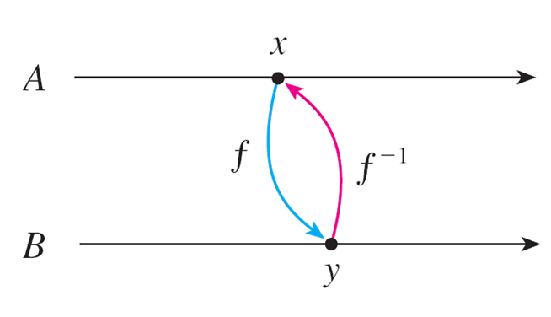
Inverse Functions (7 of 14)
The arrow diagram in Figure 5 indicates that
reverses the effect of f.
Figure 5
Note that

Slide 12
Inverse Functions (8 of 14)
For example, the inverse function of
because if
then
Caution
Do not mistake the −1 in
for an exponent. Thus
The reciprocal
could, however, be written as

Slide 13
Example 3
If is a one-to-one function and f (1) = 5, f (3) = 7, and f (8) = −10, find
Solution:
From the definition of
we have

Slide 14
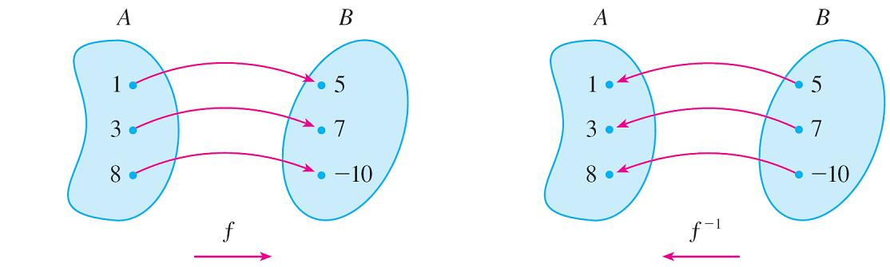
Example 3 – Solution
The diagram in Figure 6 makes it clear how
reverses the effect of f in this case.
The inverse function reverses inputs and outputs.
Figure 6

Slide 15
Inverse Functions (9 of 14)
The letter x is traditionally used as the independent variable, so when we
concentrate on
rather than on f, we usually reverse the roles of x and y in
Definition 2 and write
3
By substituting for y in Definition 2 and substituting for x in (3), we get the following cancellation equations:
4

Slide 16
Inverse Functions (10 of 14)
The first cancellation equation says that if we start with x, apply f, and then apply
we arrive back at x, where we started (see the machine diagram in Figure 7).
Figure 7
Thus
undoes what f does.
The second equation says that f undoes what
does.

Slide 17
Inverse Functions (11 of 14)
For example, if
and so the cancellation equations
become
These equations simply say that the cube function and the cube root function cancel each other when applied in succession.

Slide 18
Inverse Functions (12 of 14)
Now let’s see how to compute inverse functions.
If we have a function y = f (x) and are able to solve this equation for x in terms of
y, then according to Definition 2 we must have
If we want to call the independent variable x, we then interchange x and y and
arrive at the equation
5 How to Find the Inverse Function of a One-to-One Function f
STEP 1 Write y = f (x).
STEP 2 Solve this equation for x in terms of y (if possible).
STEP 3
To express
as a function of x, interchange x and y.
The resulting equation is

Slide 19
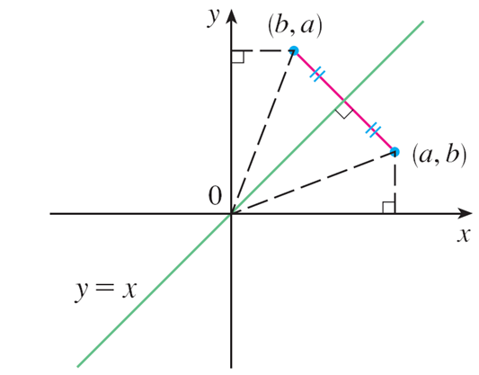
Inverse Functions (13 of 14)
The principle of interchanging x and y to find the inverse function also gives us
the method for obtaining the graph of
from the graph of f.
Since f (a) = b if and only if
the point (a, b) is on the graph of f if and only
if the point (b, a) is on the graph of
But we get the point (b, a) from (a, b) by reflecting about the line y = x. (See Figure 8.)
Figure 8

Slide 20
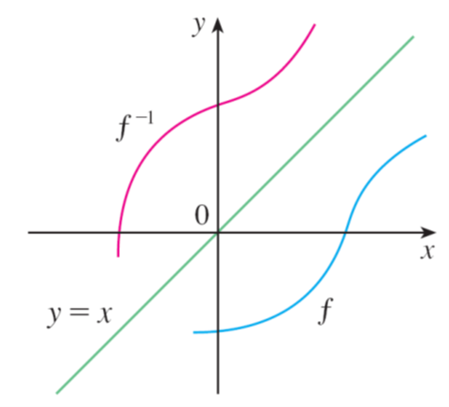
Inverse Functions (14 of 14)
Therefore, as illustrated by Figure 9:
The graph of
is obtained by reflecting the graph of f about the line y = x.
Figure 9

Slide 21
Logarithmic Functions

Slide 22
Logarithmic Functions (1 of 5)
If b > 0 and b ≠ 1, the exponential function
is either increasing or
decreasing and so it is one-to-one by the Horizontal Line Test. It therefore has
an inverse function
which is called the logarithmic function with base b
and is denoted by log_{b}.
If we use the formulation of an inverse function given by 3,
then we have
6

Slide 23
Logarithmic Functions (2 of 5)
Thus, if x > 0, then log_{b} x is the exponent to which the base b must be raised to give x.
For example,
The cancellation equations (4), when applied to the functions
become
7

Slide 24
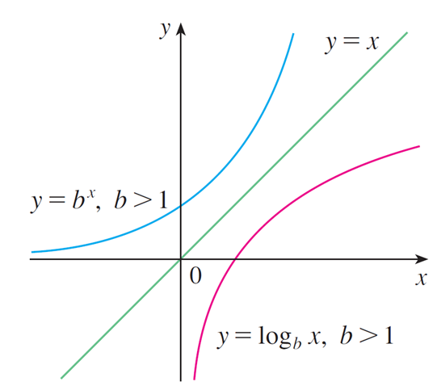
Logarithmic Functions (3 of 5)
The logarithmic function log_{b} has domain (0,∞) and range
Its graph is the
reflection of the graph of
about the line y = x.
Figure 11 shows the case where b > 1. (The most important logarithmic functions have base b > 1.)
The fact that
is a very rapidly
increasing function for x > 0 is reflected in the fact that y = log_{b} x is a very slowly increasing function for x > 1.
Figure 11

Slide 25
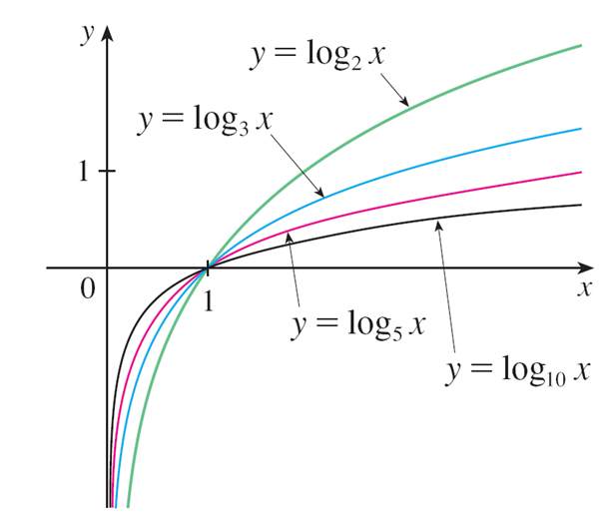
Logarithmic Functions (4 of 5)
Figure 12 shows the graphs of y = log_{b} x with various values of the base b > 1.
Since log_{b} 1 = 0, the graphs of all logarithmic functions pass through the point (1, 0).
Figure 12

Slide 26
Logarithmic Functions (5 of 5)
The following properties of logarithmic functions follow from the corresponding properties of exponential functions.
Laws of Logarithms If x and y are positive numbers, then

Slide 27
Example 6
Use the laws of logarithms to evaluate
Solution:
Using Law 2, we have
because

Slide 28
Natural Logarithms

Slide 29
Natural Logarithms (1 of 4)
Of all possible bases b for logarithms, we will see that the most convenient choice of a base is the number e.
The logarithm with base e is called the natural logarithm and has a special notation:
If we set b = e and replace log_{e} with “ln” in (6) and (7), then the defining properties of the natural logarithm function become
8

Slide 30
Natural Logarithms (2 of 4)
9
In particular, if we set x = 1, we get

Slide 31
Natural Logarithms (3 of 4)
Combining Property 9 with Law 3 allows us to write
Thus a power of x can be expressed in an equivalent exponential form; we will find this useful in the chapters to come.
10

Slide 32
Example 7
Find x if ln x = 5.
Solution 1:
From (8) we see that
Therefore
(If you have trouble working with the “ln” notation, just replace it by log_{e}. Then
the equation becomes log_{e} x = 5; so, by the definition of logarithm,

Slide 33
Example 7 – Solution
Solution 2:
Start with the equation
ln x = 5
and apply the exponential function to both sides of the equation:
But the second cancellation equation in (9) says that
Therefore

Slide 34
Natural Logarithms (4 of 4)
The following formula shows that logarithms with any base can be expressed in terms of the natural logarithm.
11 Change of Base Formula For any positive number b (b ≠ 1). we have

Slide 35
Example 11
Evaluate log₈ 5 correct to six decimal places.
Solution:
Formula 11 gives

Slide 36
Graph and Growth of the Natural Logarithm

Slide 37
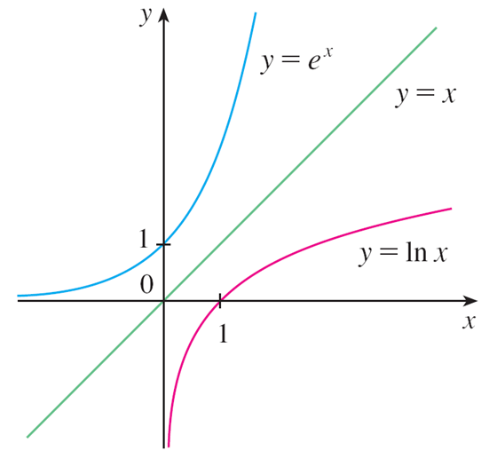
Graph and Growth of the Natural Logarithm (1 of 4)
The graphs of the exponential function
and its inverse function, the natural
logarithm function, are shown in Figure 13.
The graph of y = ln x is the reflection of the graph of
Figure 13

Slide 38
Graph and Growth of the Natural Logarithm (2 of 4)
In common with all other logarithmic functions with base greater than 1, the natural logarithm is an increasing function defined on (0, ∞) and the y-axis is a vertical asymptote. (This means that the values of ln x become very large negative as x approaches 0.)

Slide 39
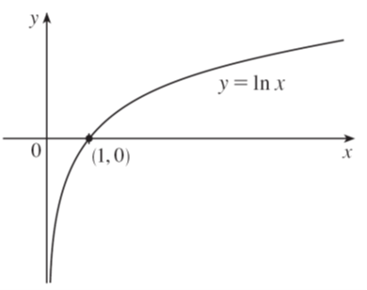
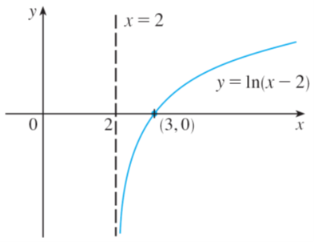
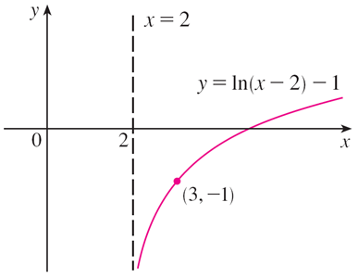
Example 12
Sketch the graph of the function y = ln(x − 2) − 1.
Solution:
We start with the graph of y = ln x as given in Figure 13.
We shift it 2 units to the right to get the graph of y = ln(x − 2) and then we shift it 1 unit downward to get the graph of y = ln(x − 2) − 1. (See Figure 14.)
Figure 14

Slide 40
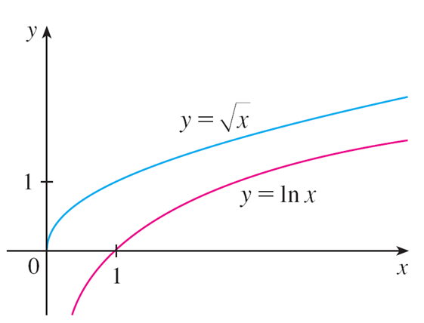
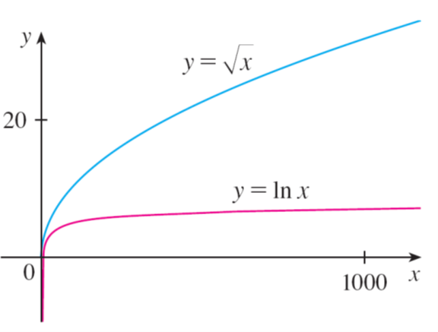
Graph and Growth of the Natural Logarithm (3 of 4)
Although ln x is an increasing function, it grows very slowly when x > 1. In fact, ln x grows more slowly than any positive power of x.
To illustrate this fact, we graph
in Figure 15 and 16.
Figure 15
Figure 16

Slide 41
Graph and Growth of the Natural Logarithm (4 of 4)
You can see that the graphs initially grow at comparable rates, but eventually the root function far surpasses the logarithm.

Slide 42
Inverse Trigonometric Functions

Slide 43
Inverse Trigonometric Functions (1 of 10)
When we try to find the inverse trigonometric functions, we have a slight difficulty: Because the trigonometric functions are not one-to-one, they don’t have inverse functions.
The difficulty is overcome by restricting the domains of these functions so that they become one-to-one.

Slide 44
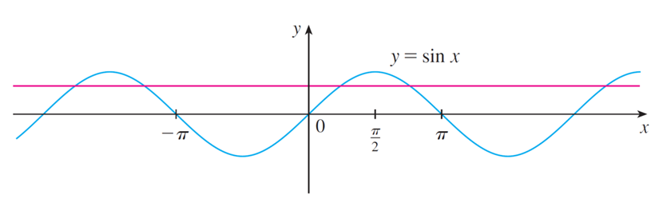
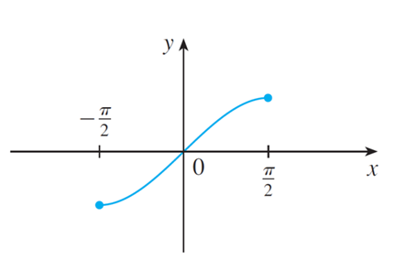
Inverse Trigonometric Functions (2 of 10)
You can see from Figure 17 that the sine function y = sin x is not one-to-one (use the Horizontal Line Test).
Figure 17
However, if we restrict the domain to the interval
then the function is one-to-one and all values in the range of y = sin x are attained (see Figure 18).
Figure 18

Slide 45
Inverse Trigonometric Functions (3 of 10)
The inverse function of this restricted sine function f exists and is denoted by
or arcsin. It is called the inverse sine function or the arcsine function.
Since the definition of an inverse function says that
we have

Slide 46
Inverse Trigonometric Functions (4 of 10)
So, if −1 ≤ x ≤ 1,
is the number between
whose sine is x.

Slide 47
Example 13
Evaluate (a)
and (b)
Solution:
(a) We have
because
lies between

Slide 48
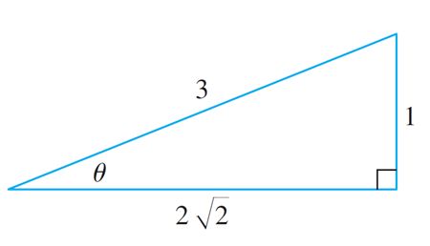
Example 13 – Solution
(b) Let
Then we can draw a right triangle with angle θ as in Figure 19 and deduce from
the Pythagorean Theorem that the third side has length
This enables us to read from the triangle that
Figure 19

Slide 49
Inverse Trigonometric Functions (5 of 10)
The cancellation equations for inverse functions become, in this case,

Slide 50

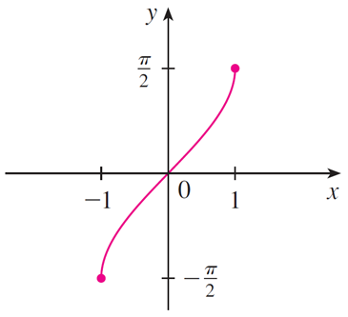
Inverse Trigonometric Functions (6 of 10)
The inverse sine function,
has domain [−1, 1] and range
and its graph, shown in Figure 20, is obtained from that of the restricted sine function (Figure 18) by reflection about the line y = x.
Figure 18
Figure 20

Slide 51
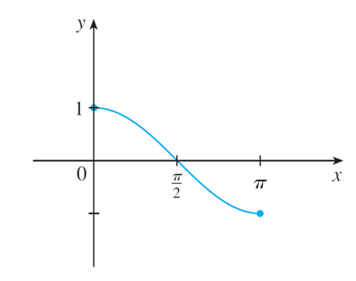
Inverse Trigonometric Functions (7 of 10)
The inverse cosine function is handled similarly. The restricted cosine function f (x) = cos x, 0 ≤ x ≤ π , is one-to-one (see Figure 21) and so it has an
inverse function denoted by
y = cos x, 0 ≤ x ≤ π
Figure 21

Slide 52
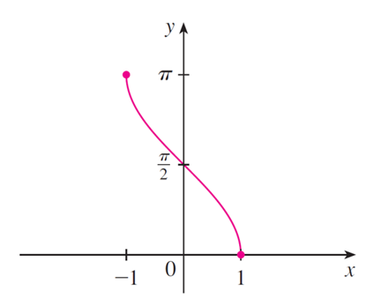
Inverse Trigonometric Functions (8 of 10)
The cancellation equations are
The inverse cosine function,
has domain [−1, 1] and range [0, π]. Its graph is shown in Figure 22.
Figure 22

Slide 53
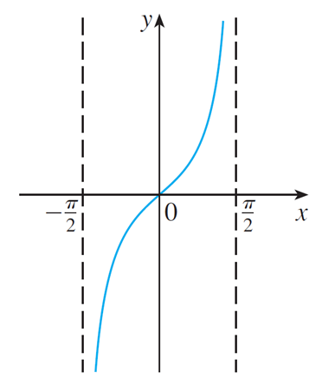
Inverse Trigonometric Functions (9 of 10)
The tangent function can be made one-to-one by restricting it to the interval
Thus the inverse tangent function is defined as the inverse of
the function
(See Figure 23.) It is denoted by
or arctan.
Figure 23

Slide 54
Inverse Trigonometric Functions (10 of 10)
The remaining inverse trigonometric functions are summarized here.
12

