Slide 1
2
Limits and Derivatives
Copyright © Cengage Learning. All rights reserved.

Slide 2
2.1
The Tangent and Velocity Problems
Copyright © Cengage Learning. All rights reserved.

Slide 3
The Tangent Problem

Slide 4
The Tangent Problem (1 of 5)
The word tangent is derived from the Latin word tangens, which means “touching.”
We can think of a tangent to a curve as a line that touches the curve and follows the same direction as the curve at the point of contact. How can this idea be made precise?

Slide 5
The Tangent Problem (2 of 5)
For a circle we could simply follow Euclid and say that a tangent is a line ℓ that intersects the circle once and only once, as in Figure 1(a).
Figure 1(a)
For more complicated curves this definition is inadequate.

Slide 6
The Tangent Problem (3 of 5)
Figure 1(b) shows a line ℓ that appears to be a tangent to the curve C at point P, but it intersects C twice.
Figure 1(b)

Slide 7
Example 1
Find an equation of the tangent line to the parabola
at the point P (1, 1).
Solution:
We will be able to find an equation of the tangent line ℓ as soon as we know its slope m.
The difficulty is that we know only one point, P, on ℓ, whereas we need two points to compute the slope.

Slide 8
Example 1 – Solution (1 of 4)
But observe that we can compute an approximation to m by choosing a nearby
point
on the parabola (as in Figure 2) and computing the slope m_{PQ}
of the secant line PQ. (A secant line, from the Latin word secans, meaning cutting, is a line that cuts [intersects] a curve more than once.)
Figure 2

Slide 9
Example 1 – Solution (2 of 4)
We choose x ≠ 1 so that Q ≠ P. Then
For instance, for the point Q (1.5, 2.25) we have

Slide 10
Example 1 – Solution (3 of 4)
The tables in the margin show the values of m_{PQ} for several values of x close to 1.
x | m_{PQ}
2 | 3
1.5 | 2.5
1.1 | 2.1
1.01 | 2.01
1.001 | 2.001
x | m_{PQ}
0 | 1
0.5 | 1.5
0.9 | 1.9
0.99 | 1.99
0.999 | 1.999
The closer Q is to P, the closer x is to 1 and, it appears from the tables, the closer m_{PQ} is to 2.

Slide 11
Example 1 – Solution (4 of 4)
This suggests that the slope of the tangent line ℓ should be m = 2.
We say that the slope of the tangent line is the limit of the slopes of the secant lines, and we express this symbolically by writing
Assuming that the slope of the tangent line is indeed 2, we use the point-slope form of the equation of a line [ y − y₁ = m(x − x₁)] to write the equation of the tangent line through (1, 1) as

Slide 12
The Tangent Problem (4 of 5)
Figure 3 illustrates the limiting process that occurs in Example 1.
Q approaches P from the right
Figure 3

Slide 13
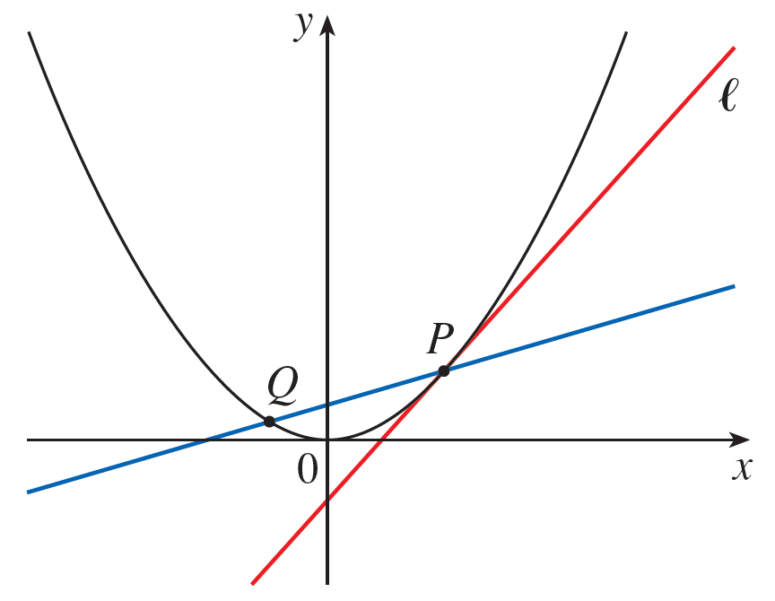
The Tangent Problem (5 of 5)
Q approaches P from the left
Figure 3
As Q approaches P along the parabola, the corresponding secant lines rotate about P and approach the tangent line ℓ.

Slide 14
The Velocity Problem

Slide 15
The Velocity Problem (1 of 1)
Through experiments carried out four centuries ago, Galileo discovered that the distance fallen by any freely falling body is proportional to the square of the time it has been falling. (This model for free fall neglects air resistance.)

Slide 16
Example 3
Suppose that a ball is dropped from the upper observation deck of the CN Tower in Toronto, 450 m above the ground. Find the velocity of the ball after 5 seconds.
Solution:
The difficulty in finding the instantaneous velocity at 5 seconds is that we are dealing with a single instant of time (t = 5), so no time interval is involved.

Slide 17
Example 3 – Solution (1 of 3)
However, we can approximate the desired quantity by computing the average velocity over the brief time interval of a tenth of a second from t = 5 to t = 5.1:

Slide 18
Example 3 – Solution (2 of 3)
The following table shows the results of similar calculations of the average velocity over successively smaller time periods.
Time interval | Average velocity (m/s)
5 ≤ t ≤ 5.1 | 49.49
5 ≤ t ≤ 5.05 | 49.245
5 ≤ t ≤ 5.01 | 49.049
5 ≤ t ≤ 5.001 | 49.0049

Slide 19
Example 3 – Solution (3 of 3)
It appears that as we shorten the time period, the average velocity is becoming closer to 49 m/s.
The instantaneous velocity when t = 5 is defined to be the limiting value of these average velocities over shorter and shorter time periods that start at t = 5.
Thus it appears that the (instantaneous) velocity after 5 seconds is 49 m/s.

