Slide 1
2
Limits and Derivatives
Copyright © Cengage Learning. All rights reserved.

Slide 2
2.2
The Limit of a Function
Copyright © Cengage Learning. All rights reserved.

Slide 3
The Limit of a Function (1 of 1)
To find the tangent to a curve or the velocity of an object, we now turn our attention to limits in general and numerical and graphical methods for computing them.

Slide 4
Finding Limits Numerically and Graphically

Slide 5
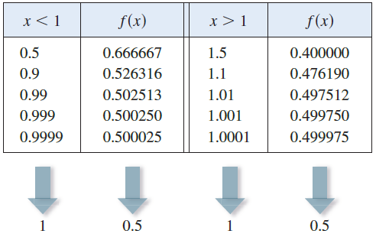
Finding Limits Numerically and Graphically (1 of 6)
Let’s investigate the behavior of the function f defined by
for values of x near 1.
The following table gives values of f (x) for values of x close to 1 but not equal to 1.

Slide 6
Finding Limits Numerically and Graphically (2 of 6)
From the table and the graph of f shown in Figure 1 we see that the closer x is to 1 (on either side of 1), the closer f (x) is to 0.5.
Figure 1

Slide 7
Finding Limits Numerically and Graphically (3 of 6)
In fact, it appears that we can make the values of f (x) as close as we like to 0.5 by taking x sufficiently close to 1.
We express this by saying “the limit of the function
as x approaches 1 is equal to 0.5.”
The notation for this is

Slide 8
Finding Limits Numerically and Graphically (4 of 6)
In general, we use the following notation.
1 Intuitive Definition of a Limit Suppose f(x) is defined when x is near the number a. (This means chat f is defined on some open interval that contains a, except possibly at a itself.) Then we write
and say "the limit of f(x), as x approaches a, equals L"
if we can make the values of f(x) arbitrarily close to L (as close to L as we like) by restricting x to be sufficiently close to a (on either side of a) but not equal to a.
This says that the values of f(x) approach L as x approaches a. In other words, the values of f(x) tend to get closer and closer to the number L as x gets closer and closer to the number a (from either side of a) but x ≠ a.

Slide 9
Finding Limits Numerically and Graphically (5 of 6)
An alternative notation for
is
which is usually read “f (x) approaches L as x approaches a.”
Notice the phrase “but x not equal to a” in the definition of limit. This means that in finding the limit of f (x) as x approaches a, we never consider x = a. In fact, f (x) need not even be defined when x = a. The only thing that matters is how f is defined near a.

Slide 10
Finding Limits Numerically and Graphically (6 of 6)
Figure 2 shows the graphs of three functions. Note that in part (b), f (a) is not defined and in part (c), f (a) ≠ L.
But in each case, regardless of what happens at a, it is true that
in all three cases
Figure 2

Slide 11
Example 2
Guess the value of
Solution:
The function
is not defined when x = 0. Using a calculator
(and remembering that, if
sin x means the sine of the angle whose radian
measure is x), we construct a table of values correct to eight decimal places.

Slide 12
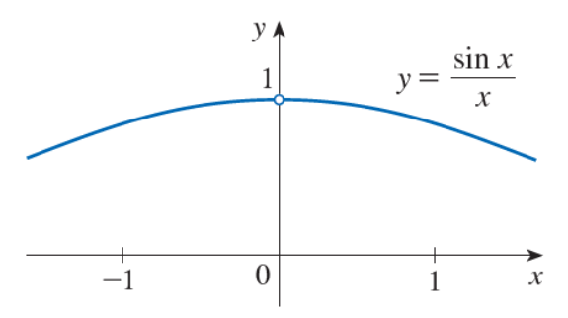
Example 2 – Solution
From the table below and the graph in Figure 4,
Year | sin x/x
±1.0 | 0.84147098
±0.5 | 0.95885108
±0.4 | 0.97354586
±0.3 | 0.98506736
±0.2 | 0.99334665
±0.1 | 0.99833417
±0.05 | 0.99958339
±0.01 | 0.99998333
±0.005 | 0.99999583
±0.001 | 0.99999983
Figure 4
we guess that

Slide 13
One-Sided Limits

Slide 14
One-Sided Limits (1 of 5)
The Heaviside function H is defined by
As t approaches 0 from the left, H(t) approaches 0. As t approaches 0 from the right, H(t) approaches 1.
We indicate this situation symbolically by writing
and we call these one-sided limits.

Slide 15
One-Sided Limits (2 of 5)
The notation
indicates that we consider only values of t that are less than 0.
Likewise,
indicates that we consider only values of t that are greater than 0.

Slide 16
One-Sided Limits (3 of 5)
2 Intuitive Definition of One-Sided Limits We write
and say the left-hand limit of f (x) as x approaches a [or the limit of f (x) as x approaches a from the left] is equal to L if we can make the values of f (x) arbitrarily close to L by restricting x to be sufficiently close to a with x less than a.
We write
and say that the right-hand limit of f (x) as x approaches a [or the limit of f (x) as x approaches a from the right] is equal to L if we can make the values of f (x) arbitrarily close to L by restricting x to be sufficiently close to a with x greater than a.

Slide 17
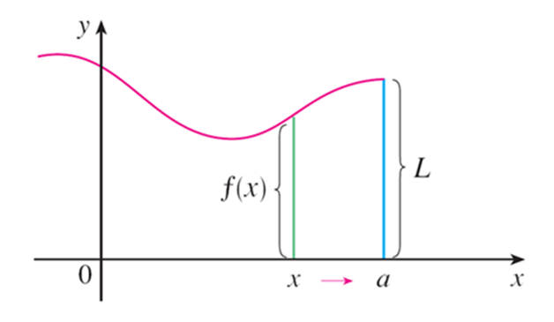
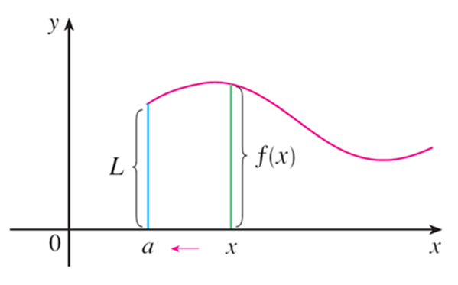
One-Sided Limits (4 of 5)
For instance, the notation
means that we consider only x < 5, and
means that we consider only x > 5. Definition 2 is illustrated in Figure 6.
(a)
(b)
Figure 6

Slide 18
One-Sided Limits (5 of 5)
Notice that Definition 2 differs from Definition 1 only in that we require x to be less than (or greater than) a. By comparing these definitions, we see that the following is true.
3

Slide 19
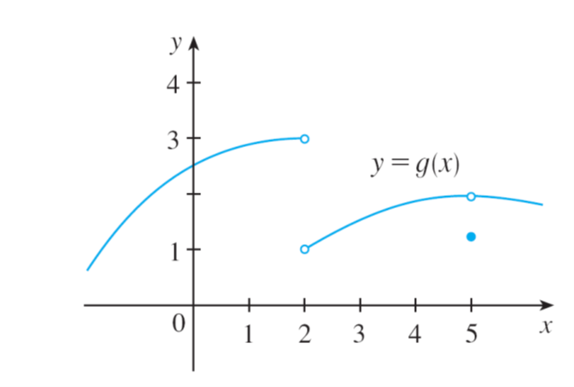
Example 4
The graph of a function g is shown in Figure 7. Use the graph to state the values (if they exist) of the following:
(a)
(b)
(c)
(d)
(e)
(f)
Figure 7

Slide 20
Example 4 – Solution (1 of 2)
Looking at the graph we see that the values of g(x) approach 3 as x approaches 2 from the left, but they approach 1 as x approaches 2 from the right.
Therefore
(a)
and (b)
(c) Since the left and right limits are different, we conclude from (3) that
does not exist.

Slide 21
Example 4 – Solution (2 of 2)
The graph also shows that
(d)
and (e)
(f) This time the left and right limits are the same and so, by (3), we have
Despite this fact, notice that g(5) ≠ 2.

Slide 22
How Can a Limit Fail to Exist?

Slide 23
How Can a Limit Fail to Exist? (1 of 1)
We have seen that a limit fails to exist at a number a if the left- and right-hand limits are not equal (as in Example 4). The next example illustrate additional ways that a limit can fail to exist.

Slide 24
Example 5
Investigate
Solution:
Notice that the function
is undefined at 0. Evaluating the function
for some small values of x, we get
Similarly, f (0.001) = f (0.0001) = 0.

Slide 25
Example 5 – Solution (1 of 2)
On the basis of this information we might be tempted to guess that the limit is 0, but this time our guess is wrong.
Note that although
for any integer n, it is also true that f (x) = 1
for infinitely many values of x (such as 2/5 or 2/101) that approach 0. You can see this from the graph of f shown in Figure 8.
Figure 8

Slide 26
Example 5 – Solution (2 of 2)
The dashed lines near the y-axis indicate that the values of
oscillate between 1 and −1 infinitely often as x approaches 0. Since the values of f (x) do not approach a fixed number as x approaches 0,

Slide 27
Infinite Limits; Vertical Asymptotes

Slide 28
Infinite Limits; Vertical Asymptotes (1 of 8)
4 Intuitive Definition of an Infinite Limit Let f be a function defined on both sides of a, except possibly at a itself. Then
means that the values of f (x) can he made arbitrarily large (as large as we please) by taking x sufficiently close to a, but not equal to a.
Another notation for
is

Slide 29
Infinite Limits; Vertical Asymptotes (2 of 8)
Again, the symbol ∞ is not a number, but the expression
is often read as
“the limit of f (x), as x approaches a, is infinity”
or “f (x) becomes infinite as x approaches a”
or “f (x) increases without bound as x approaches a”

Slide 30
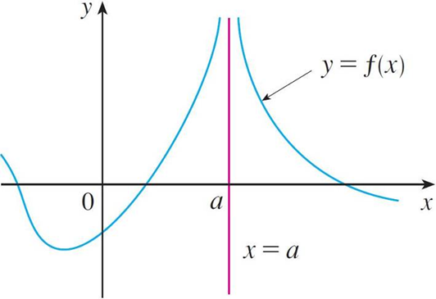
Infinite Limits; Vertical Asymptotes (3 of 8)
This definition is illustrated graphically in Figure 10.
Figure 10

Slide 31
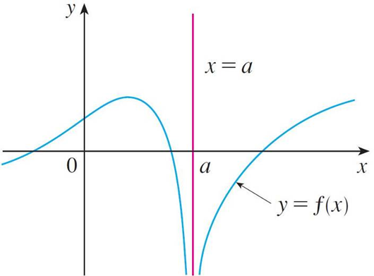
Infinite Limits; Vertical Asymptotes (4 of 8)
A similar sort of limit, for functions that become large negative as x gets close to a, is defined in Definition 5 and is illustrated in Figure 11.
Figure 11

Slide 32
Infinite Limits; Vertical Asymptotes (5 of 8)
5 Definition Let f be a function defined on both sides of a, except possibly at a itself. Then
means that the values of f(x) can be made arbitrarily large negative by taking x sufficiently close to a, but not equal to a.
The symbol
can be read as “the limit of f (x), as x approaches a,
is negative infinity” or “f (x) decreases without bound as x approaches a.” As an example we have

Slide 33
Infinite Limits; Vertical Asymptotes (6 of 8)
Similar definitions can be given for the one-sided infinite limits
remembering that
means that we consider only values of x that are less
than a, and similarly
means that we consider only x > a.

Slide 34
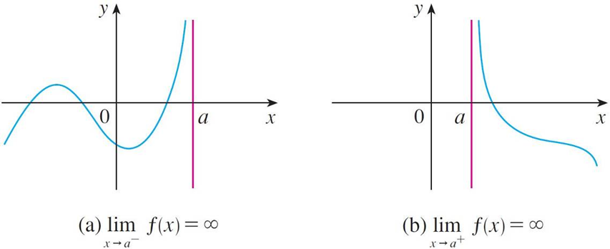
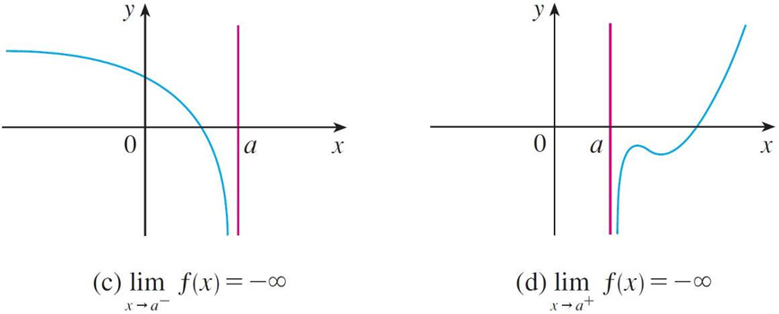
Infinite Limits; Vertical Asymptotes (7 of 8)
Illustrations of these four cases are given in Figure 12.
Figure 12

Slide 35
Infinite Limits; Vertical Asymptotes (8 of 8)
6 Definition The vertical line x = a is called a vertical asymptote of the curve y = f (x) if at least one of the following statements is true:

Slide 36
Example 8
Find the vertical asymptotes of f (x) = tan x.
Solution:
Because
there are potential vertical asymptotes where cos x = 0.
In fact, since
whereas sin x is
positive (near 1) when x is near
we have

Slide 37
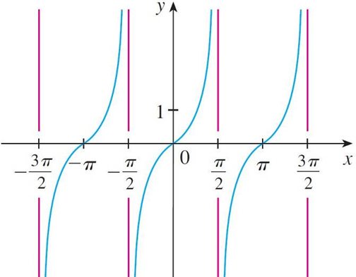
Example 8 – Solution
This shows that the line
is a vertical asymptote. Similar reasoning shows
that the lines
where n is an integer, are all vertical asymptotes of
f (x) = tan x.
The graph in Figure 14 confirms this.
y = tan x
Figure 14

