Slide 1
2
Limits and Derivatives
Copyright © Cengage Learning. All rights reserved.

Slide 2
2.3
Calculating Limits Using the Limit Laws
Copyright © Cengage Learning. All rights reserved.

Slide 3
Properties of Limits

Slide 4
Properties of Limits (1 of 5)
In this section we use the following properties of limits, called the Limit Laws, to calculate limits.
Limit Laws Suppose that c is a constant and the limits
exist. Then

Slide 5
Properties of Limits (2 of 5)
These five laws can be stated verbally as follows:
Sum Law
1. The limit of a sum is the sum of the limits.
Difference Law
2. The limit of a difference is the difference of the limits.
Constant Multiple Law
3. The limit of a constant times a function is the constant times the limit of the function.

Slide 6
Properties of Limits (3 of 5)
Product Law
4. The limit of a product is the product of the limits.
Quotient Law
5. The limit of a quotient is the quotient of the limits (provided that the limit of the denominator is not 0).
For instance, if f (x) is close to L and g (x) is close to M, it is reasonable to conclude that f (x) + g (x) is close to L + M.

Slide 7
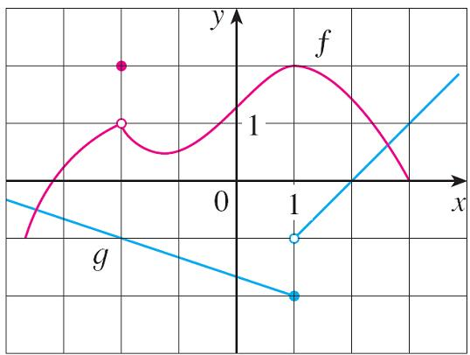
Example 1
Use the Limit Laws and the graphs of f and g in Figure 1 to evaluate the following limits, if they exist.
(a)
(b)
(c)
Figure 1

Slide 8
Example 1(a) – Solution
From the graphs of f and g we see that
Therefore we have
(by Limit Law 1)
(by Limit Law 3)

Slide 9
Example 1(b) – Solution
We see that
But
does not exist because the left
and right limits are different:
So we can’t use Law 4 for the desired limit. But we can use Law 4 for the one-sided limits:
The left and right limits aren’t equal, so
does not exist.

Slide 10
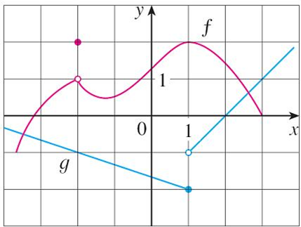
Example 1(c) – Solution
The graphs show that
Because the limit of the denominator is 0, we can’t use Law 5.
The given limit does not exist because the denominator approaches 0 while the numerator approaches a nonzero number.
Figure 1

Slide 11
Properties of Limits (4 of 5)
If we use the Product Law repeatedly with g(x) = f (x), we obtain the following law.
Power Law
6.
Root Law
7.
In applying these seven limit laws, we need to use two special limits:
8.
9.

Slide 12
Properties of Limits (5 of 5)
These limits are obvious from an intuitive point of view (state them in words or draw graphs of y = c and y = x).
If we now put f (x) = x in Law 6 and use Law 9, we get another useful special limit for power functions.
10.
If we put f (x) = x in Law 7 and use Law 9, we get a similar special limit for roots.
11.

Slide 13
Evaluating Limits by Direct Substitution

Slide 14
Evaluating Limits by Direct Substitution (1 of 2)
Direct Substitution Property If f is a polynomial or a rational function and a is in the domain of f, then
Functions that have the Direct Substitution Property are called continuous at a.

Slide 15
Example 3
Find
Solution:
Let
We can’t find the limit by substituting x = 1 because f (1) isn’t defined. Nor can we apply the Quotient Law, because the limit of the denominator is 0.
Instead, we need to do some preliminary algebra. We factor the numerator as a difference of squares:

Slide 16
Example 3 – Solution
The numerator and denominator have a common factor of x − 1. When we take the limit as x approaches 1, we have x ≠ 1 and so x − 1 ≠ 0.
Therefore we can cancel the common factor, x − 1, and then compute the limit by direct substitution as follows:

Slide 17
Evaluating Limits by Direct Substitution (2 of 2)
In general, we have the following useful fact.
If f(x) = g(x) when x ≠ a, then
provided the limits exist.

Slide 18
Using One-Sided Limits

Slide 19
Using One-Sided Limits (1 of 1)
Some limits are best calculated by first finding the left- and right-hand limits.
The following theorem says that a two-sided limit exists if and only if both of the one-sided limits exist and are equal.
1 Theorem
When computing one-sided limits, we use the fact that the Limit Laws also hold for one-sided limits.

Slide 20
Example 7
Show that
Solution:
We know that
Since
for x > 0, we have

Slide 21
Example 7 – Solution
For x < 0 we have
and so
Therefore, by Theorem 1,

Slide 22
The Squeeze Theorem

Slide 23
The Squeeze Theorem (1 of 2)
The following two theorems describe how the limits of functions are related when the values of one function are greater than (or equal to) those of another.
2 Theorem If f(x) ≤ g(x) when x is near a (except possibly at a) and the limits of f and g both exist as x approaches a, then
3 The Squeeze Theorem If f(x) ≤ g(x) ≤ h(x) when x is near a (except possibly at a) and
then

Slide 24
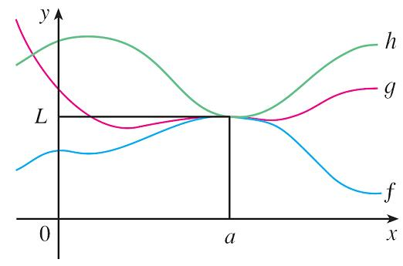
The Squeeze Theorem (2 of 2)
The Squeeze Theorem, which is sometimes called the Sandwich Theorem or the Pinching Theorem, is illustrated by Figure 7.
Figure 7
It says that if g (x) is squeezed between f (x) and h (x) near a, and if f and h have the same limit L at a, then g is forced to have the same limit L at a.

Slide 25
Example 11
Show that
Solution:
First note that we cannot rewrite the limit as the product of the limits
does not exist.
We can find the limit by using the Squeeze Theorem.

Slide 26
Example 11 – Solution (1 of 3)
To apply the Squeeze Theorem we need to find a function f smaller than g(x) = x² sin(1/x) and a function h bigger than g such that both f (x) and h(x) approach 0 as x → 0.
To do this we use our knowledge of the sine function. Because the sine of any number lies between −1 and 1, we can write
4

Slide 27
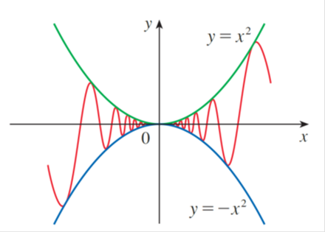
Example 11 – Solution (2 of 3)
Any inequality remains true when multiplied by a positive number. We know that
for all x and so, multiplying each side of the inequalities in (4) by
we get
as illustrated by Figure 8.
Figure 8

Slide 28
Example 11 – Solution (3 of 3)
We know that
Taking
in the Squeeze Theorem,
we obtain

