Slide 1
2
Limits and Derivatives
Copyright © Cengage Learning. All rights reserved.

Slide 2
2.4
The Precise Definition of a Limit
Copyright © Cengage Learning. All rights reserved.

Slide 3
The Precise Definition of a Limit (1 of 17)
The intuitive definition of a limit is inadequate for some purposes because such phrases as “x is close to 2” and “f ( x) gets closer and closer to L” are vague.
In order to be able to prove conclusively that
we must make the definition of a limit precise.

Slide 4
The Precise Definition of a Limit (2 of 17)
To motivate the precise definition of a limit, let’s consider the function
Intuitively, it is clear that when x is close to 3 but x ≠ 3, then f (x) is close to 5,
and so
To obtain more detailed information about how f (x) varies when x is close to 3, we ask the following question:
How close to 3 does x have to be so that f (x) differs from 5 by less than 0.1?

Slide 5
The Precise Definition of a Limit (3 of 17)
The distance from x to 3 is
and the distance from f (x) to 5 is
so our problem is to find a number δ (the Greek letter delta) such that
If
then x ≠ 3, so an equivalent formulation of our problem is to find a
number δ such that

Slide 6
The Precise Definition of a Limit (4 of 17)
Notice that if
that is,
Thus an answer to the problem is given by δ = 0.05; that is, if x is within a distance of 0.05 from 3, then f ( x) will be within a distance of 0.1 from 5.

Slide 7
The Precise Definition of a Limit (5 of 17)
If we change the number 0.1 in our problem to the smaller number 0.01, then by using the same method we find that f ( x) will differ from 5 by less than 0.01
provided that x differs from 3 by less than
Similarly,
The numbers 0.1, 0.01, and 0.001 that we have considered are error tolerances that we might allow.

Slide 8
The Precise Definition of a Limit (6 of 17)
For 5 to be the precise limit of f ( x) as x approaches 3, we must not only be able to bring the difference between f ( x) and 5 below each of these three numbers; we must be able to bring it below any positive number.
And, by the same reasoning, we can! If we write ε (the Greek letter epsilon) for an arbitrary positive number, then we find as before that
1

Slide 9
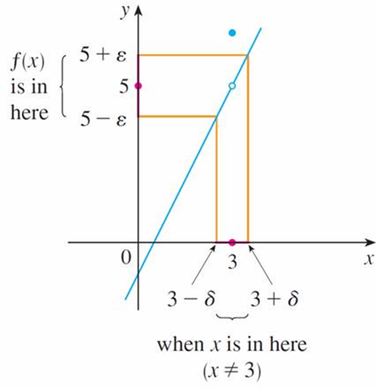
The Precise Definition of a Limit (7 of 17)
This is a precise way of saying that f (x) is close to 5 when x is close to 3 because (1) says that we can make the values of f (x) within an arbitrary distance
ε from 5 by restricting the values of x within a distance
from 3 (but x ≠ 3).
Note that (1) can be rewritten as follows: if
3 − δ < x < 3 + δ (x ≠ 3)
then
5 − ε < f ( x) < 5 + ε
and this is illustrated in Figure 1.
Figure 1

Slide 10
The Precise Definition of a Limit (8 of 17)
By taking the values of x (≠ 3) to lie in the interval (3 − δ, 3 + δ ) we can make the values of f (x) lie in the interval (5 − ε, 5 + ε).
Using (1) as a model, we give a precise definition of a limit.
2 Precise Definition of a Limit Let f be a function defined on some open interval that contains the number a, except possibly at a itself. Then we say that the limit of f(x) as x approaches a is L, and we write
if for every number ε > 0 there is a number δ > 0 such that

Slide 11
The Precise Definition of a Limit (9 of 17)
Since
is the distance from x to a and
is the distance from f ( x) to L,
and since ε can be arbitrarily small, the definition of a limit can be expressed in words as follows:
means that the distance between f ( x) and L can be made arbitrarily small by requiring that the distance from x to a be sufficiently small (but not 0).

Slide 12
The Precise Definition of a Limit (10 of 17)
Alternatively,
means that the values of f (x) can be made as close as we please to L by requiring x to be close enough to a (but not equal to a).

Slide 13
The Precise Definition of a Limit (11 of 17)
We can also reformulate Definition 2 in terms of intervals by observing that the
inequality
is equivalent to −δ < x − a < δ, which in turn can be written
as a − δ < x < a + δ.
Also
is true if and only if x − a ≠ 0, that is, x ≠ a.

Slide 14
The Precise Definition of a Limit (12 of 17)
Similarly, the inequality
is equivalent to the pair of inequalities
L − ε < f ( x) < L + ε. Therefore, in terms of intervals, Definition 2 can be stated
as follows:
means that for every ε > 0 (no matter how small ε is) we can find δ > 0 such that if x lies in the open interval (a − δ, a + δ ) and x ≠ a, then f ( x) lies in the open interval (L − ε, L + ε).

Slide 15
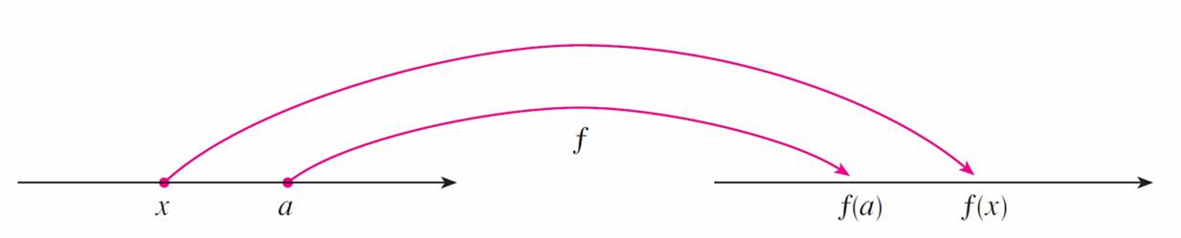
The Precise Definition of a Limit (13 of 17)
We interpret this statement geometrically by representing a function by an
arrow diagram as in Figure 2, where f maps a subset of
onto another subset of
Figure 2

Slide 16
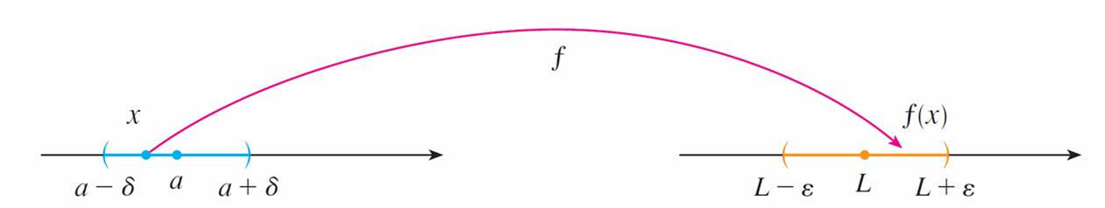
The Precise Definition of a Limit (14 of 17)
The definition of limit says that if any small interval
(L − ε, L + ε) is given around L, then we can find an interval
(a − δ, a + δ ) around a such that f maps all the points in
(a − δ, a + δ ) (except possibly a) into the interval
(L − ε, L + ε). (See Figure 3.)
Figure 3

Slide 17
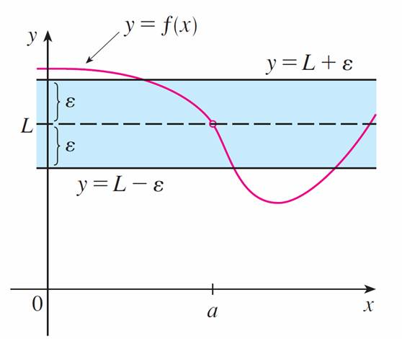
The Precise Definition of a Limit (15 of 17)
Another geometric interpretation of limits can be given in terms of the graph of a function. If ε > 0 is given, then we draw the horizontal lines y = L + ε and y = L − ε and the graph of f. (See Figure 4.)
Figure 4

Slide 18
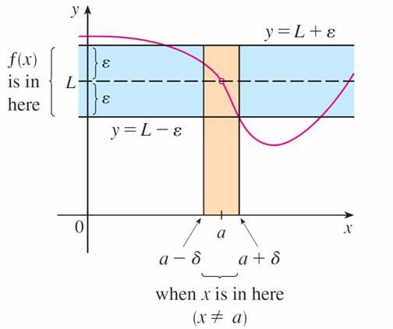
The Precise Definition of a Limit (16 of 17)
If
then we can find a number δ > 0 such that if we restrict
x to lie in the interval (a − δ, a + δ ) and take x ≠ a, then the curve y = f ( x) lies between the lines y = L − ε and y = L + ε (See Figure 5.) You can see that if such a δ has been found, then any smaller δ will also work.
Figure 5

Slide 19
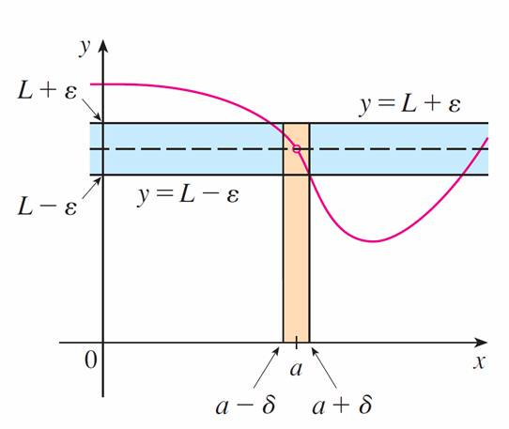
The Precise Definition of a Limit (17 of 17)
It is important to realize that the process illustrated in Figures 4 and 5 must work for every positive number ε, no matter how small it is chosen. Figure 6 shows that if a smaller ε is chosen, then a smaller δ may be required.
Figure 6

Slide 20
Example 1
Since
is a polynomial, we know from the Direct Substitution
Property that
Use a graph to find a number δ such that if x is within δ of 1, then y is within 0.2 of 2, that is,
if
In other words, find a number δ that corresponds to ε = 0.2 in the definition of a
limit for the function
with a = 1 and L = 2.

Slide 21
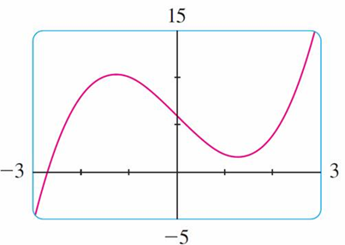
Example 1 – Solution (1 of 4)
A graph of f is shown in Figure 7; we are interested in the region near the point (1, 2).
Notice that we can rewrite the inequality
Figure 7
as
or equivalently

Slide 22
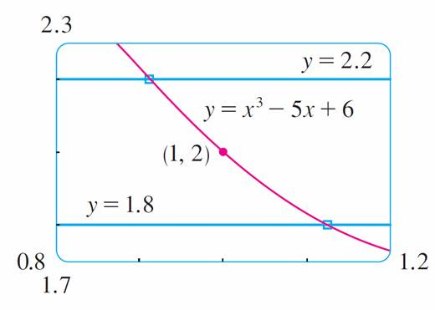
Example 1 – Solution (2 of 4)
So we need to determine the values of x for which the curve
lies between the horizontal lines y = 1.8 and y = 2.2.
Therefore we graph the curves
near the point (1, 2) in Figure 8.
Figure 8

Slide 23
Example 1 – Solution (3 of 4)
We estimate that the x-coordinate of the point of intersection of the line y = 2.2
and the curve
is about 0.911.
Similarly,
intersects the line y = 1.8 when x ≈ 1.124. So,
rounding toward 1 to be safe, we can say that
if
This interval (0.92, 1.12) is not symmetric about x = 1. The distance from x = 1 to the left endpoint is 1 − 0.92 = 0.08 and the distance to the right endpoint is 0.12.

Slide 24
Example 1 – Solution (4 of 4)
We can choose δ to be the smaller of these numbers, that is, δ = 0.08. Then we can rewrite our inequalities in terms of distances as follows:
if
This just says that by keeping x within 0.08 of 1, we are able to keep f (x) within 0.2 of 2.
Although we chose δ = 0.08, any smaller positive value of δ would also have worked.

Slide 25
Example 2
Prove that
Solution:
1. Preliminary analysis of the problem (guessing a value for δ ).
Let ε be a given positive number. We want to find a number δ such that
if
But

Slide 26
Example 2 – Solution (1 of 3)
Therefore we want δ such that
if
that is, if
This suggests that we should choose

Slide 27
Example 2 – Solution (2 of 3)
2. Proof (showing that this δ works). Given ε > 0, choose
If
then
Thus

Slide 28
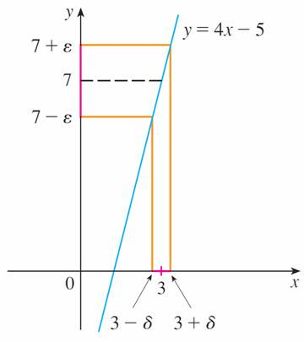
Example 2 – Solution (3 of 3)
Therefore, by the definition of a limit,
This example is illustrated by Figure 9.
Figure 9

Slide 29
One-Sided Limits

Slide 30
One-Sided Limits (1 of 2)
The intuitive definitions of one-sided limits can be precisely reformulated as follows.
3 Precise Definition of Left-Hand Limit
if for every number ε > 0 there is a number δ > 0 such that

Slide 31
One-Sided Limits (2 of 2)
4 Precise Definition of Right-Hand Limit
if for every number ε > 0 there is a number δ > 0 such that

Slide 32
Example 4
Use Definition 4 to prove that

Slide 33
Example 4 – Solution (1 of 2)
​1. G​uessing a value for δ. Let ε be a given positive number. Here a = 0 and L = 0, so we want to find a number δ such that
that is,
or, squaring both sides of the inequality
we get
This suggests that we should choose

Slide 34
Example 4 – Solution (2 of 2)
​2. Showing that this δ works. Given ε > 0, let
If 0 < x < δ, then
so
According to Definition 4, this shows that

Slide 35
The Limit Laws

Slide 36
The Limit Laws (1 of 1)
If
both exist, then

Slide 37
Infinite Limits

Slide 38
Infinite Limits (1 of 4)
Infinite limits can also be defined in a precise way.
6 Precise Definition of an Infinite Limit Let f be a function defined on some open interval that contains the number a, except possibly at a itself. Then
means that for every positive number M there is a positive number δ such that

Slide 39
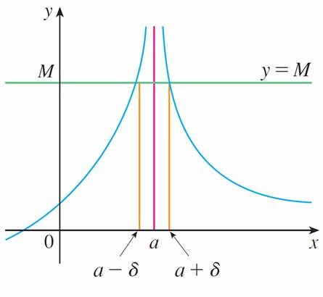
Infinite Limits (2 of 4)
This says that the values of f ( x) can be made arbitrarily large (larger than any given number M) by requiring x to be close enough to a (within a distance δ, where δ depends on M, but with x ≠ a). A geometric illustration is shown in Figure 10.
Figure 10

Slide 40
Infinite Limits (3 of 4)
Given any horizontal line y = M, we can find a number δ > 0 such that if we restrict x to lie in the interval (a − δ, a + δ ) but x ≠ a, then the curve y = f ( x) lies above the line y = M.
You can see that if a larger M is chosen, then a smaller δ may be required.

Slide 41
Example 5
Use Definition 6 to prove that
Solution:
Let M be a given positive number. We want to find a number δ such that
But
So if we choose
then
This shows that

Slide 42
Infinite Limits (4 of 4)
7 Definition Let f be a function defined on some open interval that contains the number a, except possibly at a itself. Then
means that for every negative number N there is a positive number δ such that

