Slide 1
2
Limits and Derivatives
Copyright © Cengage Learning. All rights reserved.

Slide 2
2.5
Continuity
Copyright © Cengage Learning. All rights reserved.

Slide 3
Continuity of a Function

Slide 4
Continuity of a Function (1 of 8)
The limit of a function as x approaches a can often be found simply by calculating the value of the function at a. Functions with this property are called continuous at a.
We will see that the mathematical definition of continuity corresponds closely with the meaning of the word continuity in everyday language. (A continuous process is one that takes place without interruption.)
1 Definition A function f is continuous at a number a if

Slide 5
Continuity of a Function (2 of 8)
Notice that Definition 1 implicitly requires three things if f is continuous at a:
​f (a) is defined (that is, a is in the domain of f )
The definition says that f is continuous at a if f (x) approaches f (a) as x approaches a. Thus a continuous function f has the property that a small change in x produces only a small change in f (x).

Slide 6
Continuity of a Function (3 of 8)
In fact, the change in f (x) can be kept as small as we please by keeping the change in x sufficiently small.
If f is defined near a (in other words, f is defined on an open interval containing a, except perhaps at a), we say that f is discontinuous at a (or f has a discontinuity at a) if f is not continuous at a.
Physical phenomena are usually continuous. For instance, the displacement or velocity of a vehicle varies continuously with time, as does a person’s height. But discontinuities do occur in such situations as electric currents.

Slide 7
Continuity of a Function (4 of 8)
Geometrically, you can think of a function that is continuous at every number in an interval as a function whose graph has no break in it: the graph can be drawn without removing your pen from the paper.

Slide 8
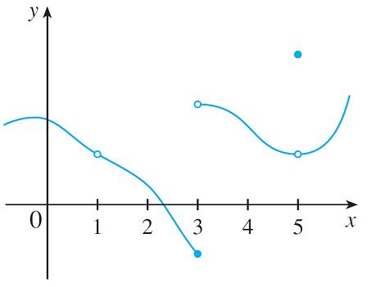
Example 1
Figure 2 shows the graph of a function f. At which numbers is f discontinuous? Why?
Figure 2
Solution:
It looks as if there is a discontinuity when a = 1 because the graph has a break there. The official reason that f is discontinuous at 1 is that f (1) is not defined.

Slide 9
Example 1 – Solution
The graph also has a break when a = 3, but the reason for the discontinuity is
different. Here, f (3) is defined, but
does not exist (because the
left and right limits are different). So f is discontinuous at 3.
What about a = 5? Here, f (5) is defined and
exists (because the left
and right limits are the same).
But
So f is discontinuous at 5.

Slide 10
Example 2
Where are each of the following functions discontinuous?
(a)
(c)
(b)
(d)
Solution:
(a) Notice that f (2) is not defined, so f is discontinuous at 2. Later we’ll see why f is continuous at all other numbers.

Slide 11
Example 2 – Solution (1 of 2)
(b) Here f (2) = 1 is defined and
= 3 exists.
But
so f is not continuous at 2.
(c) Here f (0) = 1 is defined but
does not exist. So f is discontinuous at 0.

Slide 12
Example 2 – Solution (2 of 2)
(d) The greatest integer function
has discontinuities at all of
the integers because
does not exist if n is an integer.

Slide 13
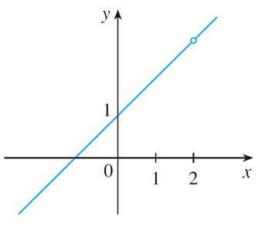
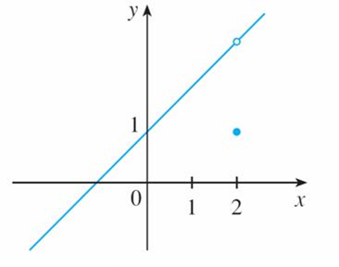
Continuity of a Function (5 of 8)
Figure 3 shows the graphs of the functions in Example 2.
(a) A removable discontinuity
(b) A removable discontinuity
Graphs of the functions in Example 2
Figure 3

Slide 14
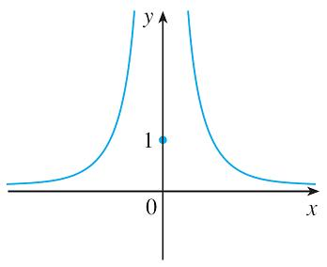
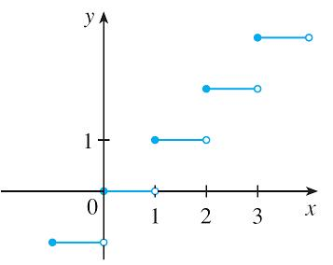
Continuity of a Function (6 of 8)
(c) An infinite discontinuity
(d) Jump discontinuities
Graphs of the functions in Example 2
Figure 3

Slide 15
Continuity of a Function (7 of 8)
In each case the graph can’t be drawn without lifting the pen from the paper because a hole or break or jump occurs in the graph.
The kind of discontinuity illustrated in parts (a) and (b) is called removable because we could remove the discontinuity by redefining f at just the single number 2. [If we redefine f to be 3 at x = 2, then f is equivalent to the function g(x) = x + 1, which is continuous.]
The discontinuity in part (c) is called an infinite discontinuity. The discontinuities in part (d) are called jump discontinuities because the function “jumps” from one value to another.

Slide 16
Continuity of a Function (8 of 8)
2 Definition A function f is continuous from the right at a number a if
and f is continuous from the left at a if
3 Definition A function f is continuous on an interval if it is continuous at every number in the interval. (If f is defined only on one side of an endpoint of the interval, we understand continuous at the endpoint to mean continuous from the right or continuous from the left.)

Slide 17
Properties of Continuous Functions

Slide 18
Properties of Continuous Functions (1 of 8)
Instead of always using Definitions 1, 2, and 3 to verify the continuity of a function, it is often convenient to use the next theorem, which shows how to build up complicated continuous functions from simple ones.
4 Theorem If f and g are continuous at a and c is a constant, then the following functions are also continuous at a:
​f + g
​f − g
​cf
​fg

Slide 19
Properties of Continuous Functions (2 of 8)
It follows from Theorem 4 and Definition 3 that if f and g are continuous on an
interval, then so are the functions f + g, f − g, c f, f g, and (if g is never 0)
The following theorem was stated as the Direct Substitution Property.
5 Theorem
(a) Any polynomial is continuous everywhere; that is, it is continuous on
(b) Any rational function is continuous wherever it is defined; that is, it is continuous on its domain.

Slide 20
Properties of Continuous Functions (3 of 8)
As an illustration of Theorem 5, observe that the volume of a sphere varies
continuously with its radius because the formula
shows that V is a
polynomial function of r.
Likewise, if a ball is thrown vertically into the air with a velocity of 50 ft/s, then
the height of the ball in feet t seconds later is given by the formula
Again this is a polynomial function, so the height is a continuous function of the elapsed time.

Slide 21
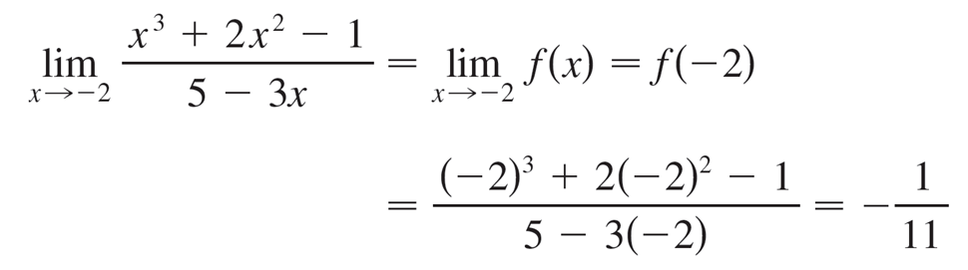
Example 5
Find
Solution:
The function
is rational, so by Theorem 5 it is continuous on its domain, which is
Therefore

Slide 22
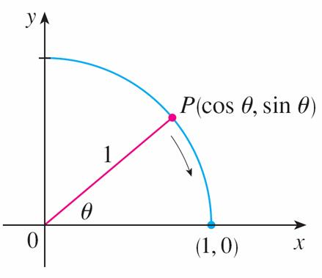
Properties of Continuous Functions (4 of 8)
It turns out that most of the familiar functions are continuous at every number in their domains.
From the appearance of the graphs of the sine and cosine functions, we would certainly guess that they are continuous.
We know from the definitions of sin θ and cos θ that the coordinates of the point P in Figure 5 are (cos θ, sin θ ). As θ → 0, we see that P approaches the point (1, 0) and so cos θ → 1 and sin θ → 0.
Figure 5

Slide 23
Properties of Continuous Functions (5 of 8)
Thus
Since cos 0 = 1 and sin 0 = 0, the equations in (6) assert that the cosine and sine functions are continuous at 0.
The addition formulas for cosine and sine can then be used to deduce that these functions are continuous everywhere.
It follows from part 5 of Theorem 4 that
is continuous except where cos x = 0.

Slide 24
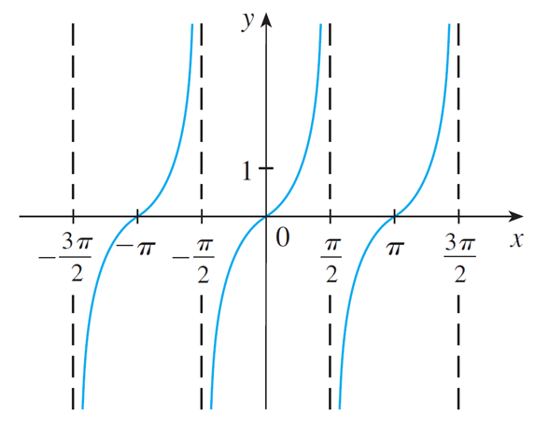
Properties of Continuous Functions (6 of 8)
This happens when x is an odd integer multiple of
so y = tan x has
infinite discontinuities when
and so on (see Figure 6).
y = tan x
Figure 6

Slide 25
Properties of Continuous Functions (7 of 8)
7 Theorem The following types of functions are continuous at every number in their domains:
Polynomials
trigonometric functions
exponential functions
rational functions
root functions
inverse trigonometric functions
logarithmic functions
Another way of combining continuous functions f and g to get a new continuous
function is to form the composite function
This fact is a consequence
of the following theorem.
8 Theorem If f is continuous at b and
then
In other words,

Slide 26
Properties of Continuous Functions (8 of 8)
Intuitively, Theorem 8 is reasonable because if x is close to a, then g(x) is close to b, and since f is continuous at b, if g(x) is close to b, then f (g(x)) is close to f (b).
9 Theorem If g is continuous at a and f is continuous at g(a). then the composite
function
given by
is continuous at a.

Slide 27
The Intermediate Value Theorem

Slide 28
The Intermediate Value Theorem (1 of 7)
An important property of continuous functions is expressed by the following theorem, whose proof is found in more advanced books on calculus.
10 The Intermediate Value Theorem Suppose that f is continuous on the closed interval [a, b] and let N be any number between f(a) and f(b), where f(a) ≠ f(b). Then there exists a number c in (a, b) such that f(c) = N.

Slide 29
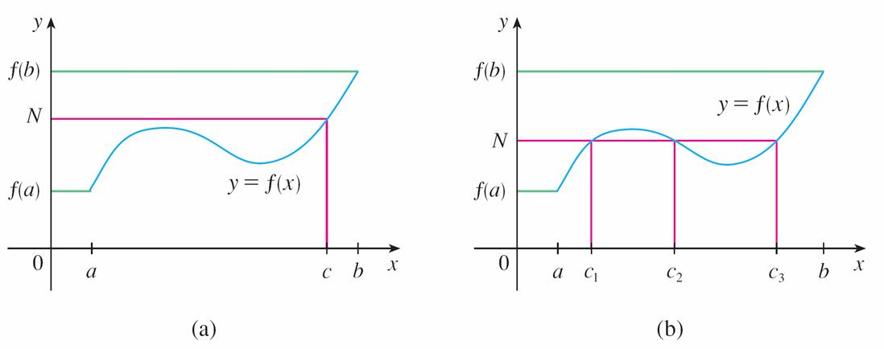
The Intermediate Value Theorem (2 of 7)
The Intermediate Value Theorem states that a continuous function takes on every intermediate value between the function values f (a) and f (b). It is illustrated by Figure 8.
Note that the value N can be taken on once [as in part (a)] or more than once [as in part (b)].
Figure 8

Slide 30
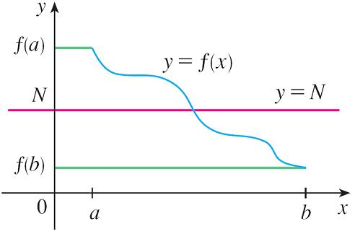
The Intermediate Value Theorem (3 of 7)
If we think of a continuous function as a function whose graph has no hole or break, then it is easy to believe that the Intermediate Value Theorem is true.
In geometric terms it says that if any horizontal line y = N is given between y = f (a) and y = f (b) as in Figure 9, then the graph of f can’t jump over the line. It must intersect y = N somewhere.
Figure 9

Slide 31
The Intermediate Value Theorem (4 of 7)
It is important that the function f in Theorem 10 be continuous. The Intermediate Value Theorem is not true in general for discontinuous functions.

Slide 32
Example 10
Show that there is a solution of the equation
between 1 and 2.
Solution:
Let
We are looking for a solution of the given equation, that is, a number c between 1 and 2 such that f (c) = 0. Therefore we take a = 1, b = 2, and N = 0 in Theorem 10.

Slide 33
Example 10 – Solution (1 of 2)
We have
and
Thus f (1) < 0 < f (2); that is, N = 0 is a number between f (1) and f (2). The function f is continuous since it is a polynomial, so the Intermediate Value Theorem says there is a number c between 1 and 2 such that f (c) = 0.
In other words, the equation
has at least one solution c in the interval (1, 2).

Slide 34
Example 10 – Solution (2 of 2)
In fact, we can locate a solution more precisely by using the Intermediate Value Theorem again. Since
f (1.2) = −0.128 < 0 and f (1.3) = 0.548 > 0
a solution must lie between 1.2 and 1.3. A calculator gives, by trial and error,
f (1.22) = −0.007008 < 0 and f (1.23) = 0.056068 > 0
so a solution lies in the interval (1.22, 1.23).

Slide 35
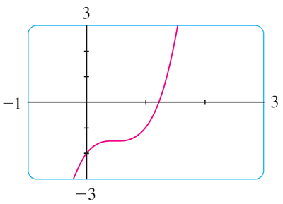
The Intermediate Value Theorem (5 of 7)
We can use a graphing calculator or computer to illustrate the use of the Intermediate Value Theorem.
Figure 10 shows the graph of f in the viewing rectangle [−1, 3] by [−3, 3] and you can see that the graph crosses the x-axis between 1 and 2.
Figure 10

Slide 36
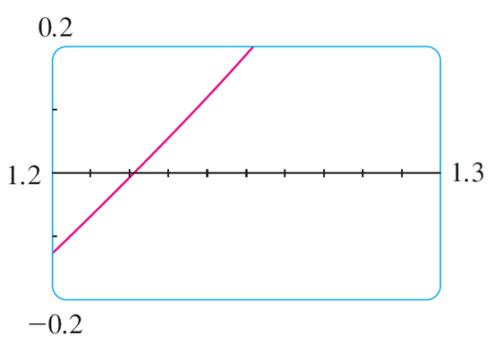
The Intermediate Value Theorem (6 of 7)
Figure 11 shows the result of zooming in to the viewing rectangle [1.2, 1.3] by [−0.2, 0.2].
Figure 11
In fact, the Intermediate Value Theorem plays a role in the very way these graphing devices work.

Slide 37
The Intermediate Value Theorem (7 of 7)
A computer calculates a finite number of points on the graph and turns on the pixels that contain these calculated points.
It assumes that the function is continuous and takes on all the intermediate values between two consecutive points.
The computer therefore “connects the dots” by turning on the intermediate pixels.

