Slide 1
2
Limits and Derivatives
Copyright © Cengage Learning. All rights reserved.

Slide 2
2.6
Limits at Infinity; Horizontal Asymptotes
Copyright © Cengage Learning. All rights reserved.

Slide 3
Limits at Infinity; Horizontal Asymptotes (1 of 1)
In this section we let x become arbitrarily large (positive or negative) and see what happens to y.

Slide 4
Limits at Infinity and Horizontal Asymptotes

Slide 5
Limits at Infinity and Horizontal Asymptotes (1 of 10)
Let’s begin by investigating the behavior of the function f defined by
as x becomes large.

Slide 6
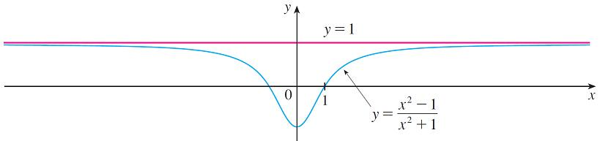
Limits at Infinity and Horizontal Asymptotes (2 of 10)
The table gives values of this function correct to six decimal places, and the graph of f has been drawn by a computer in Figure 1.
x | f (x)
0 | −1
± 1 | 0
± 2 | 0.600000
± 3 | 0.800000
± 4 | 0.882353
± 5 | 0.923077
± 10 | 0.980198
± 50 | 0.999200
± 100 | 0.999800
± 1000 | 0.999998
Figure 1

Slide 7
Limits at Infinity and Horizontal Asymptotes (3 of 10)
You can see that as x grows larger and larger, the values of f (x) get closer and closer to 1. In fact, it seems that we can make the values of f (x) as close as we like to 1 by taking x sufficiently large.
This situation is expressed symbolically by writing

Slide 8
Limits at Infinity and Horizontal Asymptotes (4 of 10)
In general, we use the notation
to indicate that the values of f (x) approach L as x becomes larger and larger.
1 Intuitive Definition of a Limit at Infinity Let f be a function defined on some interval (a, ∞). Then
means that the values of f (x) can be made arbitrarily close to L by requiring x to be sufficiently large.

Slide 9
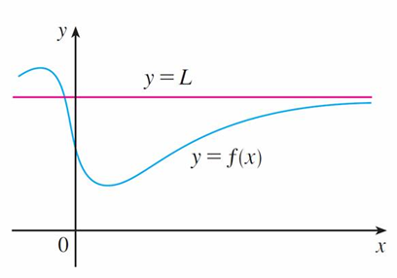
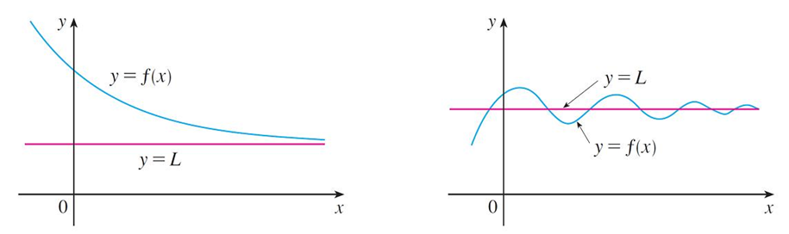
Limits at Infinity and Horizontal Asymptotes (5 of 10)
Another notation for
Geometric illustrations of Definition 1 are shown in Figure 2.
Figure 2

Slide 10
Limits at Infinity and Horizontal Asymptotes (6 of 10)
Notice that there are many ways for the graph of f to approach the line y = L (which is called a horizontal asymptote) as we look to the far right of each graph.

Slide 11
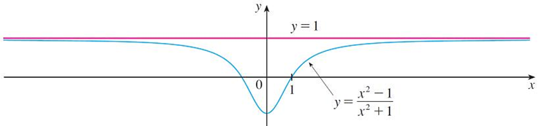
Limits at Infinity and Horizontal Asymptotes (7 of 10)
Referring back to Figure 1, we see that for numerically large negative values of x, the values of f (x) are close to 1.
Figure 1
By letting x decrease through negative values without bound, we can make f (x) as close to 1 as we like.
This is expressed by writing

Slide 12
Limits at Infinity and Horizontal Asymptotes (8 of 10)
The general definition is as follows.
2 Definition Let f be a function defined on some interval (−∞, a). Then
means that the values of f (x) can be made arbitrarily close to L by requiring x to be sufficiently large negative.

Slide 13
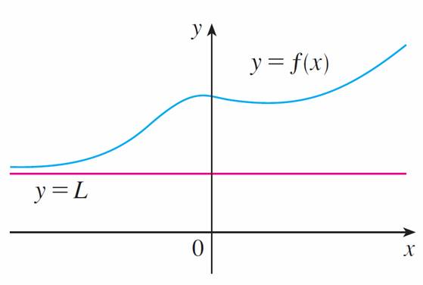
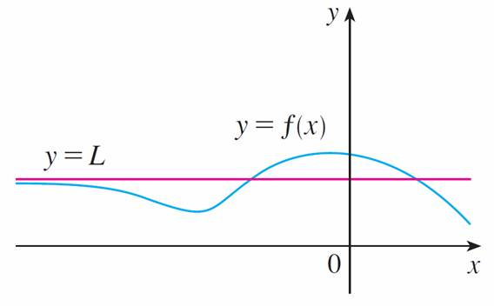
Limits at Infinity and Horizontal Asymptotes (9 of 10)
Definition 2 is illustrated in Figure 3. Notice that the graph approaches the line y = L as we look to the far left of each graph.
Examples illustrating
Figure 3

Slide 14
Limits at Infinity and Horizontal Asymptotes (10 of 10)
3 Definition The line y = L is called a horizontal asymptote of the curve y = f (x) if either

Slide 15
Example 2
Find
Solution:
Observe that when x is large,
is small. For instance,
In fact, by taking x large enough, we can make
as close to 0 as we please.

Slide 16
Example 2 – Solution (1 of 2)
Therefore, according to Definition 1, we have
Similar reasoning shows that when x is large negative,
is small negative, so
we also have

Slide 17
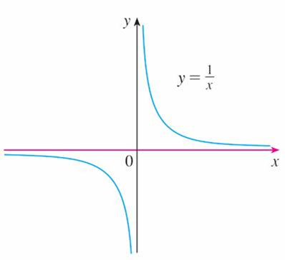
Example 2 – Solution (2 of 2)
It follows that the line y = 0 (the x-axis) is a horizontal asymptote of the curve
(This is a hyperbola; see Figure 6.)
Figure 6

Slide 18
Evaluating Limits at Infinity

Slide 19
Evaluating Limits at Infinity (1 of 1)
5 Theorem If r > 0 is a rational number, then
If r > 0 is a rational number such that
is defined for all x, then

Slide 20
Example 3
Evaluate the following limit and indicate which properties of limits are used at each stage.
Solution:
As x becomes large, both numerator and denominator become large, so it isn’t obvious what happens to their ratio. We need to do some preliminary algebra.
To evaluate the limit at infinity of any rational function, we first divide both the numerator and denominator by the highest power of x that occurs in the denominator. (We may assume that x ≠ 0, since we are interested only in large values of x.)

Slide 21
Example 3 – Solution (1 of 3)
In this case the highest power of x in the denominator is
so we have

Slide 22
Example 3 – Solution (2 of 3)
(by Limit Law 5)
(by 1, 2, and 3)
(by 8 and Theorem 5)

Slide 23
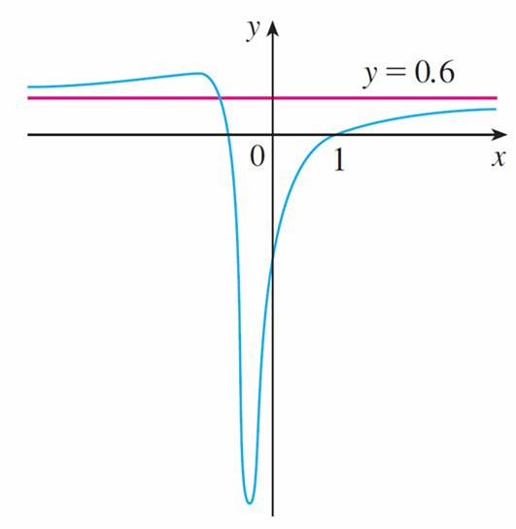
Example 3 – Solution (3 of 3)
A similar calculation shows that the limit as
Figure 7 illustrates the results of these calculations by showing how the graph of the given rational function approaches the horizontal asymptote
Figure 7

Slide 24
Example 4
Find the horizontal asymptotes of the graph of the function
Solution:
Dividing both numerator and denominator by x (which is the highest power of x in the denominator) and using the properties of limits, we have

Slide 25
Example 4 – Solution (1 of 5)

Slide 26
Example 4 – Solution (2 of 5)
Therefore the line
is a horizontal asymptote of the graph of f.
In computing the limit as x → −∞, we must remember that for x < 0, we have

Slide 27
Example 4 – Solution (3 of 5)
So when we divide the numerator by x, for x < 0 we get

Slide 28
Example 4 – Solution (4 of 5)
Therefore

Slide 29
Example 4 – Solution (5 of 5)
Thus the line
is also a horizontal asymptote. See Figure 8.
Figure 8

Slide 30
Infinite Limits at Infinity

Slide 31
Infinite Limits at Infinity (1 of 1)
The notation
is used to indicate that the values of f (x) become large as x becomes large. Similar meanings are attached to the following symbols:

Slide 32
Example 9
Find
Solution:
When x becomes large,
also becomes large. For instance,
In fact, we can make
as big as we like by requiring x to be large enough.
Therefore we can write

Slide 33
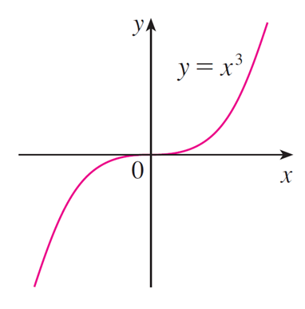
Example 9 – Solution
Similarly, when x is large negative, so is
Thus
These limit statements can also be seen from the graph of
in Figure 11.
Figure 11

Slide 34
Precise Definitions

Slide 35
Precise Definitions (1 of 6)
Definition 1 can be stated precisely as follows.
7 Precise Definition of a Limit at Infinity Let f be a function defined on some interval (a, ∞). Then
means that for every ε > 0 there is a corresponding number N such that
In words, this says that the values of f(x) can be made arbitrarily close to L (within a distance ε, where ε is any positive number) by requiring x to be sufficiently large (larger than N, where N depends on ε).

Slide 36
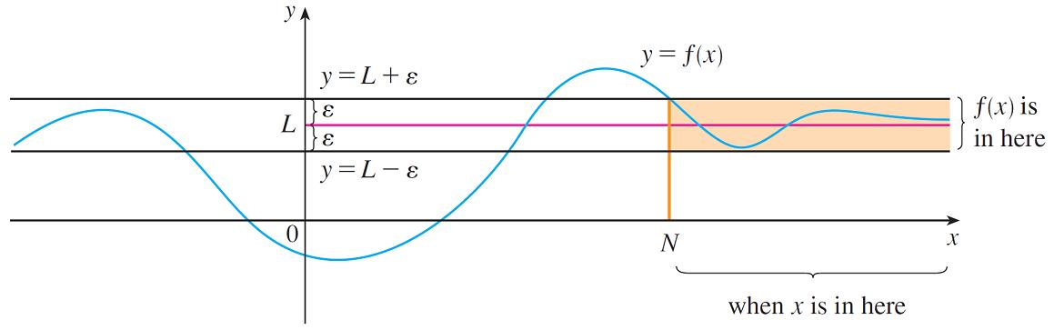
Precise Definitions (2 of 6)
Graphically it says that by keeping x large enough (larger than some number N) we can make the graph of f lie between the given horizontal lines y = L − ε and y = L + ε as in Figure 14.
Figure 14

Slide 37
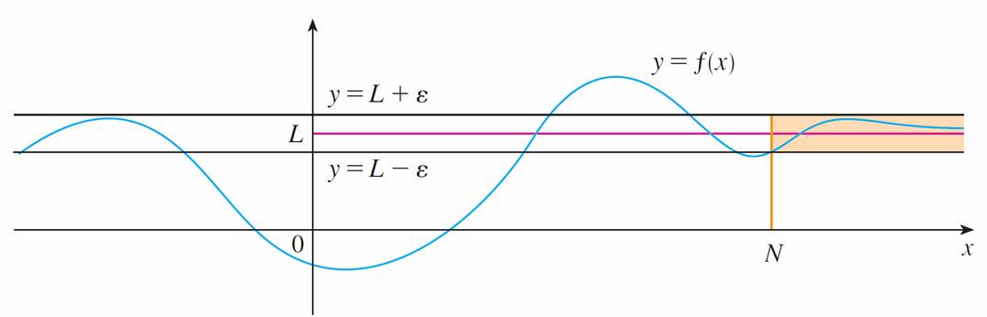
Precise Definitions (3 of 6)
This must be true no matter how small we choose ε. Figure 15 shows that if a smaller value of ε is chosen, then a larger value of N may be required.
Figure 15

Slide 38
Precise Definitions (4 of 6)
8 Definition Let f be a function defined on some interval (−∞, a). Then
means that for every ε > 0 there is a corresponding number N such that

Slide 39
Example 14
Use Definition 7 to prove that
Solution:
Given ε > 0, we want to find N such that
In computing the limit we may assume that x > 0.
Then

Slide 40
Example 14 – Solution (1 of 2)
Let’s choose
Therefore, by Definition 7,

Slide 41
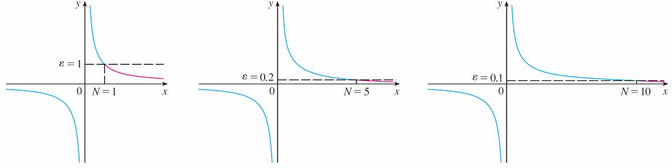
Example 14 – Solution (2 of 2)
Figure 18 illustrates the proof by showing some values of ε and the corresponding values of N.
Figure 18

Slide 42
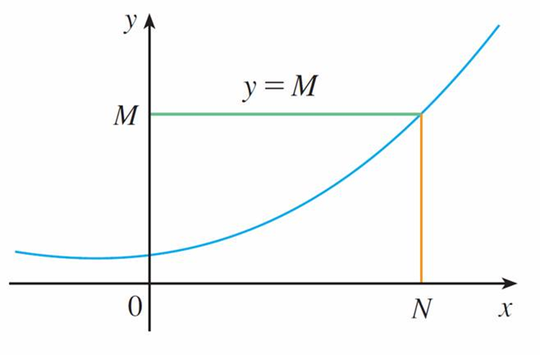
Precise Definitions (5 of 6)
Finally we note that an infinite limit at infinity can be defined as follows. The geometric illustration is given in Figure 19.
Figure 19

Slide 43
Precise Definitions (6 of 6)
9 Precise Definition of an Infinite Limit at Infinity Let f be a function defined on some interval (a, ∞). Then
means that for every positive number M there is a corresponding positive number N such that
Similar definitions apply when the symbol ∞ is replaced by −∞.

