Slide 1
2
Limits and Derivatives
Copyright © Cengage Learning. All rights reserved.

Slide 2
2.7
Derivatives and Rates of Change
Copyright © Cengage Learning. All rights reserved.

Slide 3
Derivatives and Rates of Change (1 of 1)
This special type of limit is called a derivative and we will see that it can be interpreted as a rate of change in any of the natural or social sciences or engineering.

Slide 4
Tangents

Slide 5
Tangents (1 of 8)
If a curve C has equation y = f (x) and we want to find the tangent line to C at the point P (a, f (a)), then we consider a nearby point Q (x, f (x)), where x ≠ a, and compute the slope of the secant line PQ:
Then we let Q approach P along the curve C by letting x approach a.

Slide 6
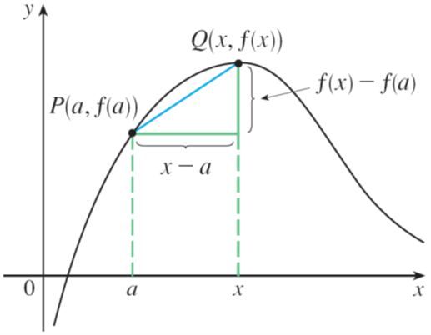
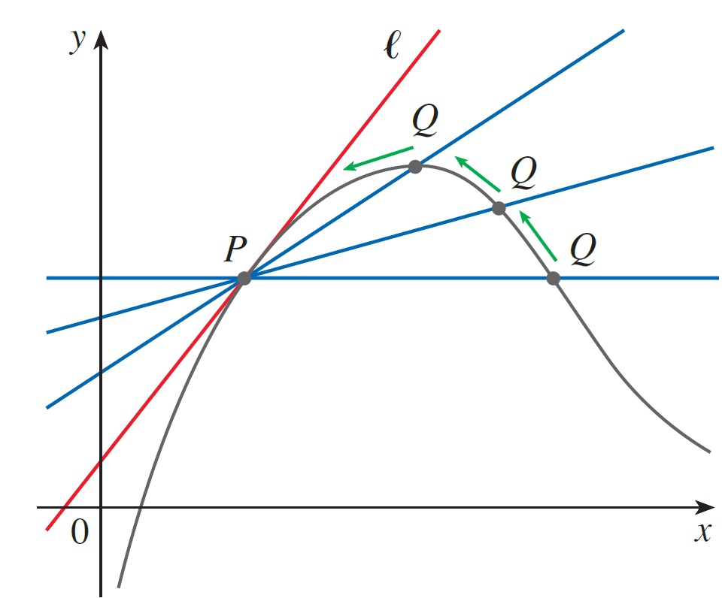
Tangents (2 of 8)
If m_{PQ} approaches a number m, then we define the tangent line ℓ to be the line through P with slope m. (This amounts to saying that the tangent line is the limiting position of the secant line PQ as Q approaches P. See Figure 1.)
Figure 1

Slide 7
Tangents (3 of 8)
1 Definition The tangent line to the curve y = f(x) at the point P(a, f(a)) is the line through P with slope
provided that this limit exists.

Slide 8
Example 1
Find an equation of the tangent line to the parabola
at the point P(1, 1).
Solution:
Here we have a = 1 and
so the slope is

Slide 9
Example 1 – Solution
Using the point-slope form of the equation of a line, we find that an equation of the tangent line at (1, 1) is

Slide 10
Tangents (4 of 8)
We sometimes refer to the slope of the tangent line to a curve at a point as the slope of the curve at the point.
The idea is that if we zoom in far enough toward the point, the curve looks almost like a straight line.

Slide 11
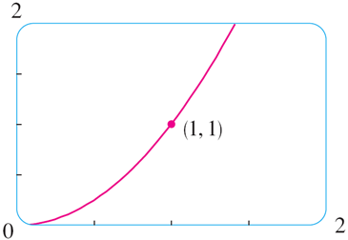
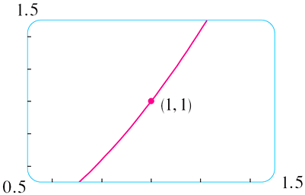
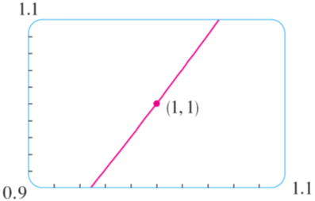
Tangents (5 of 8)
Figure 2 illustrates this procedure for the curve
in Example 1.
Zooming in toward the point (1, 1) on the parabola
Figure 2

Slide 12
Tangents (6 of 8)
The more we zoom in, the more the parabola looks like a line.
In other words, the curve becomes almost indistinguishable from its tangent line.
There is another expression for the slope of a tangent line that is sometimes easier to use.

Slide 13
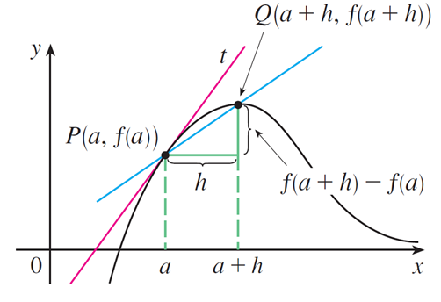
Tangents (7 of 8)
If h = x − a, then x = a + h and so the slope of the secant line PQ is
(See Figure 3 where the case h > 0 is illustrated and Q is to the right of P. If it happened that h < 0, however, Q would be to the left of P.)
Figure 3

Slide 14
Tangents (8 of 8)
Notice that as x approaches a, h approaches 0 (because h = x − a) and so the expression for the slope of the tangent line in Definition 1 becomes
2

Slide 15
Velocities

Slide 16
Velocities (1 of 4)
In general, suppose an object moves along a straight line according to an equation of motion s = f (t), where s is the displacement (directed distance) of the object from the origin at time t.
The function f that describes the motion is called the position function of the object.
In the time interval from t = a to t = a + h the change in position is f (a + h) − f (a).

Slide 17
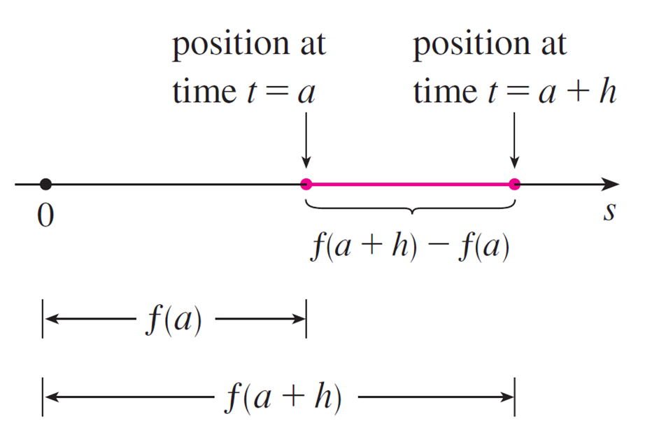
Velocities (2 of 4)
See Figure 5.
Figure 5

Slide 18
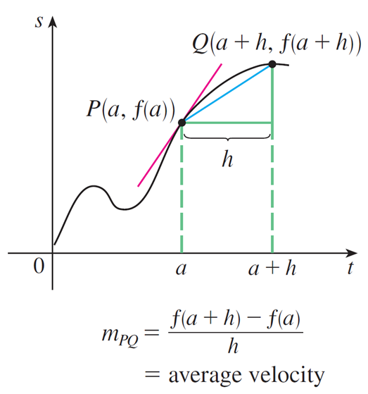
Velocities (3 of 4)
The average velocity over this time interval is
which is the same as the slope of the secant line PQ in Figure 6.
Figure 6

Slide 19
Velocities (4 of 4)
Now suppose we compute the average velocities over shorter and shorter time intervals [a, a + h].
In other words, we let h approach 0. As in the example of the falling ball, we define the velocity (or instantaneous velocity) v (a) at time t = a to be the limit of these average velocities:
3 Definition The instantaneous velocity of an object with position function f (t) at time t = a is
provided that this limit exists.
This means that the velocity at time t = a is equal to the slope of the tangent line at P.

Slide 20
Example 3
Suppose that a ball is dropped from the upper observation deck of the CN Tower, 450 m above the ground.
(a) What is the velocity of the ball after 5 seconds?
(b) How fast is the ball traveling when it hits the ground?
Solution:
Since two different velocities are requested, it’s efficient to start by finding the velocity at a general time t = a.

Slide 21
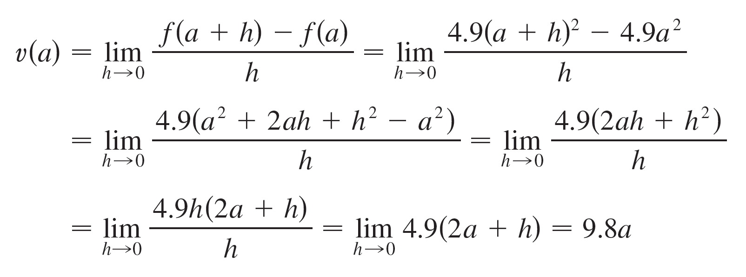
Example 3 – Solution (1 of 4)
Using the equation of motion

Slide 22
Example 3 – Solution (2 of 4)
(a) The velocity after 5 seconds is v(5) = (9.8)(5)
= 49 m/s.

Slide 23
Example 3 – Solution (3 of 4)
(b) Since the observation deck is 450 m above the ground, the ball will hit the ground at the time t when s(t) = 450, that is,
This gives

Slide 24
Example 3 – Solution (4 of 4)
The velocity of the ball as it hits the ground is therefore

Slide 25
Derivatives

Slide 26
Derivatives (1 of 4)
We have seen that the same type of limit arises in finding the slope of a tangent line (Equation 2) or the velocity of an object (Definition 3).
In fact, limits of the form
arise whenever we calculate a rate of change in any of the sciences or engineering, such as a rate of reaction in chemistry or a marginal cost in economics.
Since this type of limit occurs so widely, it is given a special name and notation.

Slide 27
Derivatives (2 of 4)
4 Definition The derivative of a function f at a number a, denoted by
if this limit exists.
If we write x = a + h, then we have h = x − a and h approaches 0 if and only if x approaches a. Therefore an equivalent way of stating the definition of the derivative, as we saw in finding tangent lines, is
5

Slide 28
Example 4
Find the derivative of the function
at the numbers (a) 2 and (b) a.
Solution:
(a) From Definition 4 we have

Slide 29
Example 4 – Solution (1 of 2)
(b)

Slide 30
Example 4 – Solution (2 of 2)
As a check on our work in part (a), notice that if we let a = 2, then

Slide 31
Derivatives (3 of 4)
We defined the tangent line to the curve y = f (x) at the point P (a, f (a)) to be the line that passes through P and has slope m given by Equation 1 or 2.
Since, by Definition 4, this is the same as the derivative
we can now say the following.
The tangent line to y = f (x) at (a, f (a)) is the line through (a, f (a)) whose slope is equal to
the derivative of f at a.

Slide 32
Derivatives (4 of 4)
If we use the point-slope form of the equation of a line, we can write an equation of the tangent line to the curve y = f (x) at the point (a, f (a)):

Slide 33
Rates of Change

Slide 34
Rates of Change (1 of 6)
Suppose y is a quantity that depends on another quantity x. Thus y is a function of x and we write y = f (x).
If x changes from x₁ to x₂, then the change in x (also called the increment of x) is
and the corresponding change in y is

Slide 35
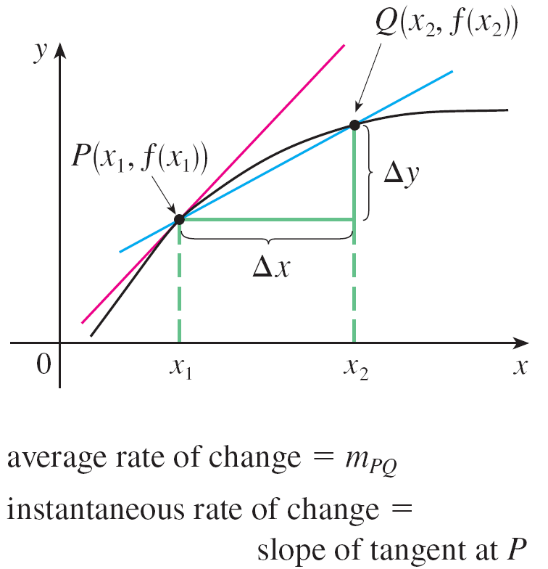
Rates of Change (2 of 6)
The difference quotient
is called the average rate of change of y with respect to x over the interval [x₁, x₂] and can be interpreted as the slope of the secant line PQ in Figure 8.
Figure 8

Slide 36
Rates of Change (3 of 6)
By analogy with velocity, we consider the average rate of change over smaller and smaller intervals by letting x₂ approach x₁ and therefore letting Δx approach 0.
The limit of these average rates of change is called the (instantaneous) rate of change of y with respect to x at x = x₁, which (as in the case of velocity) is interpreted as the slope of the tangent to the curve y = f (x) at P(x₁, f (x₁)):
6
We recognize this limit as being the derivative

Slide 37
Rates of Change (4 of 6)
We know that one interpretation of the derivative
is as the slope of the
tangent line to the curve y = f (x) when x = a. We now have a second interpretation:
The derivative
is the instantaneous rate of change of y = f (x) with respect
to x when x = a.
The connection with the first interpretation is that if we sketch the curve y = f (x), then the instantaneous rate of change is the slope of the tangent to this curve at the point where x = a.

Slide 38
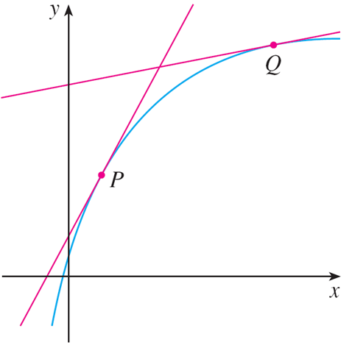
Rates of Change (5 of 6)
This means that when the derivative is large (and therefore the curve is steep, as at the point P in Figure 9), the y-values change rapidly.
The y-values are changing rapidly at P and slowly at Q.
Figure 9

Slide 39
Rates of Change (6 of 6)
When the derivative is small, the curve is relatively flat (as at point Q) and the y-values change slowly.
In particular, if s = f (t) is the position function of a particle that moves along a straight line, then
is the rate of change of the displacement s with respect
to the time t.
In other words,
is the velocity of the particle at time t = a.
The speed of the particle is the absolute value of the velocity, that is,

Slide 40
Example 7
A manufacturer produces bolts of a fabric with a fixed width. The cost of producing x yards of this fabric is C = f (x) dollars.
(a) What is the meaning of the derivative
(b) In practical terms, what does it mean to say that
(c) Which do you think is greater,

Slide 41
Example 7(a) – Solution
The derivative
is the instantaneous rate of change of C with respect to x;
that is,
means the rate of change of the production cost with respect to the
number of yards produced.
Because
the units for
are the same as the units for the difference quotient
Since ΔC is measured in dollars and Δx in yards, it follows that the units for
are dollars per yard.

Slide 42
Example 7(b) – Solution
The statement that
means that, after 1000 yards of fabric have been
manufactured, the rate at which the production cost is increasing is $9/yard. (When x = 1000, C is increasing 9 times as fast as x.)
Since Δx = 1 is small compared with x = 1000, we could use the approximation
and say that the cost of manufacturing the 1000th yard (or the 1001st) is about $9.

Slide 43
Example 7(c) – Solution (1 of 2)
The rate at which the production cost is increasing (per yard) is probably lower when x = 500 than when x = 50 (the cost of making the 500th yard is less than the cost of the 50th yard) because of economies of scale. (The manufacturer makes more efficient use of the fixed costs of production.)
So

Slide 44
Example 7(c) – Solution (2 of 2)
But, as production expands, the resulting large-scale operation might become inefficient and there might be overtime costs.
Thus it is possible that the rate of increase of costs will eventually start to rise.
So it may happen that

