Slide 1
2
Limits and Derivatives
Copyright © Cengage Learning. All rights reserved.

Slide 2
2.8
The Derivative as a Function
Copyright © Cengage Learning. All rights reserved.

Slide 3
The Derivative Function

Slide 4
The Derivative Function (1 of 4)
We have considered the derivative of a function f at a fixed number a:
Here we change our point of view and let the number a vary. If we replace a in Equation 1 by a variable x, we obtain

Slide 5
The Derivative Function (2 of 4)
Given any number x for which this limit exists, we assign to x the number
So we can regard
as a new function, called the derivative of f and defined
by Equation 2.
We know that the value of
can be interpreted geometrically as the
slope of the tangent line to the graph of f at the point (x, f (x)).
The function
is called the derivative of f because it has been “derived” from f by
the limiting operation in Equation 2. The domain of
and may be smaller than the domain of f.

Slide 6
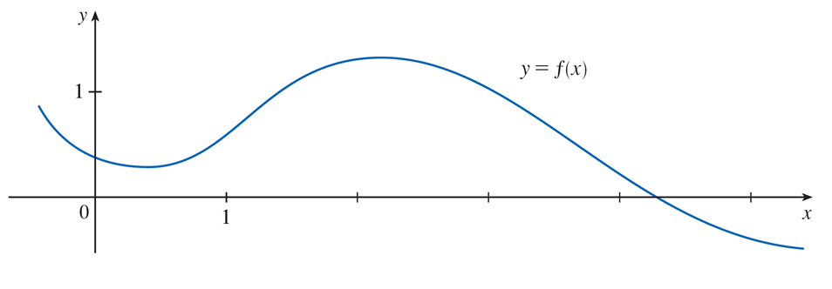
Example 1
The graph of a function f is given in Figure 1. Use it to sketch the graph of the derivative
Figure 1

Slide 7
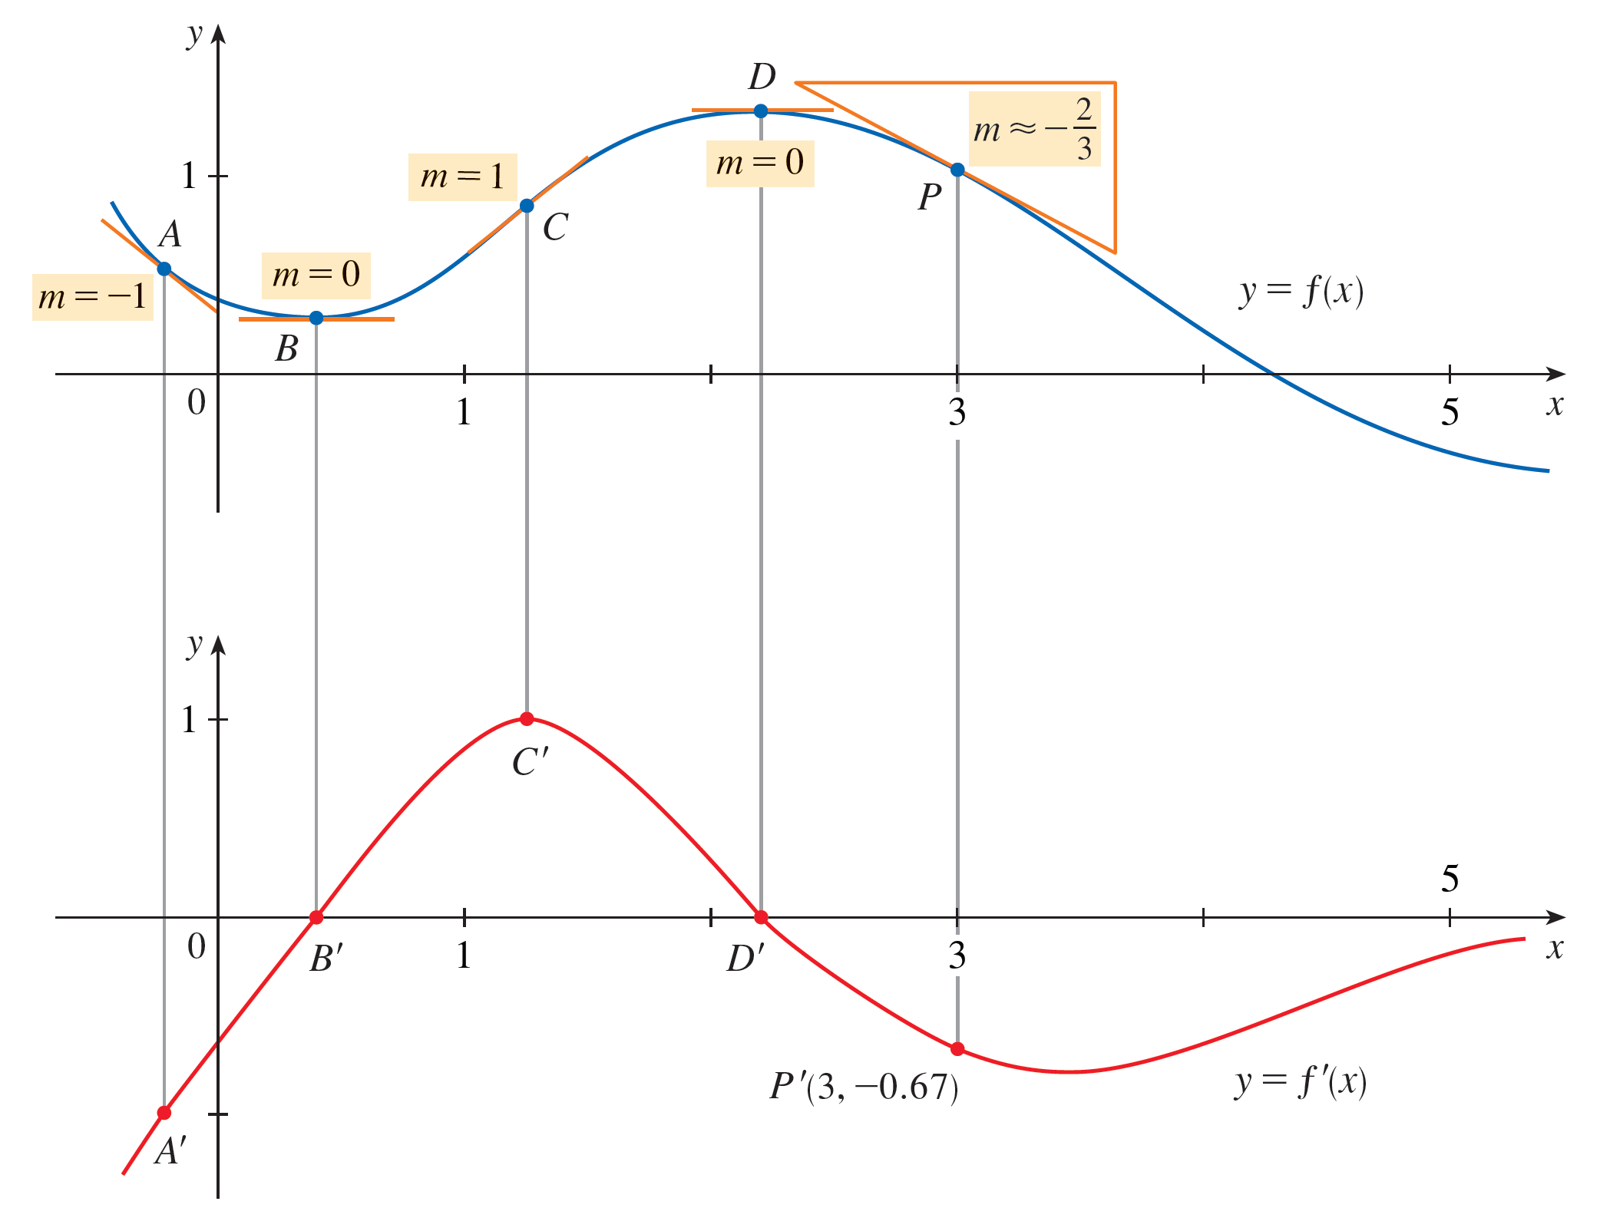
Example 1 – Solution (1 of 3)
We can estimate the value of the derivative at any value of x by drawing the tangent at the point (x, f(x)) and estimating its slope. For instance, for x = 3 we draw the tangent at P in Figure 2 and estimate
its slope to be about
Figure 2

Slide 8
Example 1 – Solution (2 of 3)
This allows us to plot the point
on the graph of
directly beneath P. (The slope of the graph of f becomes the y-value on the graph of f ′.)
The slope of the tagent drawn at A appears to be about −1, so we plot the point A′ with a y-value of −1 on the graph of f ′ (directly beneath A). The tangents at B and D are horizontal, so the derivative is 0 there and the graph of f ′ crosses the x-axis (where y = 0) at the points B′ and D ′, directly beneath B and D.
Between B and D, the graph of f is steepest at C and the tangent line ther appears to have slope 1, so the largest value of f ′(x) between B ′ and D ′ is 1 (at C ′).

Slide 9
Example 1 – Solution (3 of 3)
Notice that between B and D the tangents have positive slope, so
is positive there. (The graph of
is above the x-axis.) But to the right of D the
tangents have negative slope, so
is negative there.

Slide 10
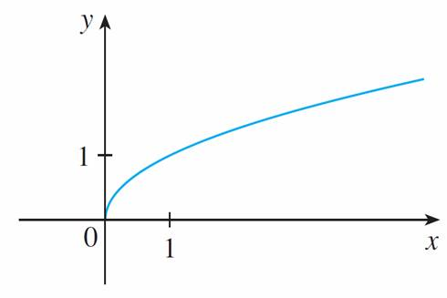
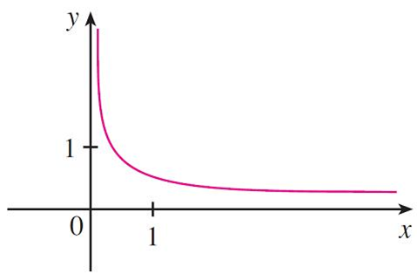
The Derivative Function (3 of 4)
When x is close to 0,
is also close to 0, so
is very large and
this corresponds to the steep tangent lines near (0, 0) in Figure 4(a) and the
large values of
just to the right of 0 in Figure 4(b).
Figure 4

Slide 11
The Derivative Function (4 of 4)
When x is large,
is very small and this corresponds to the flatter tangent lines
at the far right of the graph of f and the horizontal asymptote of the graph of

Slide 12
Other Notations

Slide 13
Other Notations (1 of 4)
If we use the traditional notation y = f(x) to indicate that the independent variable is x and the dependent variable is y, then some common alternative notations for the derivative are as follows:
The symbols D and
are called differentiation operators because they
indicate the operation of differentiation, which is the process of calculating a derivative.

Slide 14
Other Notations (2 of 4)
The symbol
which was introduced by Leibniz, should not be regarded as a
ratio (for the time being); it is simply a synonym for
Nonetheless, it is a
very useful and suggestive notation, especially when used in conjunction with increment notation.
We can rewrite the definition of derivative in Leibniz notation in the form

Slide 15
Other Notations (3 of 4)
If we want to indicate the value of a derivative
in Leibniz notation at a
specific number a, we use the notation
which is a synonym for
3 Definition A function f is differentiable at a if
exists. It is differentiable
on an open interval (a, b) [or (a, ∞) or (−∞, a) or (−∞, ∞)] if it is differentiable at every number in the interval.

Slide 16
Example 5
Where is the function
differentiable?
Solution:
If x > 0, then
and we can choose h small enough that x + h > 0 and hence
Therefore, for x > 0, we have
and so f is differentiable for any x > 0.

Slide 17
Example 5 – Solution (1 of 4)
Similarly, for x < 0 we have
and h can be chosen small enough that
x + h < 0 and so
Therefore, for x < 0,
and so f is differentiable for any x < 0.

Slide 18
Example 5 – Solution (2 of 4)
For x = 0 we have to investigate
Let’s compute the left and right limits separately:
and

Slide 19
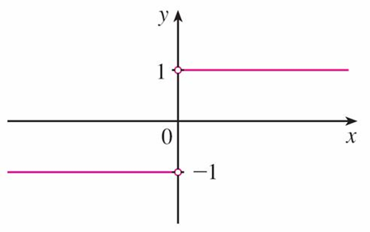
Example 5 – Solution (3 of 4)
Since these limits are different,
does not exist. Thus f is differentiable at all
x except 0.
A formula for
is given by
and its graph is shown in Figure 5(b).
Figure 5(b)

Slide 20
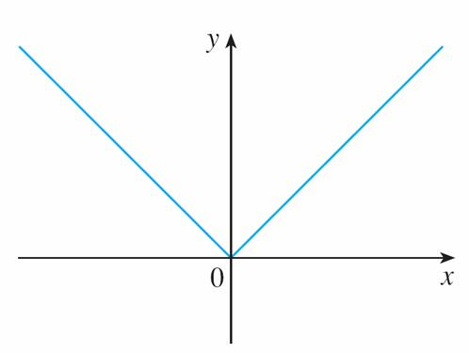
Example 5 – Solution (4 of 4)
The fact that
does not exist is reflected geometrically in the fact that the curve
does not have a tangent line at (0, 0). [See Figure 5(a).]
Figure 5(a)

Slide 21
Other Notations (4 of 4)
Both continuity and differentiability are desirable properties for a function to have. The following theorem shows how these properties are related.
4 Theorem If f is differentiable at a, then f is continuous at a.
Note: The converse of Theorem 4 is false; that is, there are functions that are continuous but not differentiable.

Slide 22
How Can a Function Fail to Be Differentiable?

Slide 23

How Can a Function Fail to Be Differentiable? (1 of 4)
We saw that the function
in Example 5 is not differentiable at 0 and
Figure 5(a) shows that its graph changes direction abruptly when x = 0.
In general, if the graph of a function f has a “corner” or “kink” in it, then the graph of f has no tangent at this point and f is not
differentiable there. [In trying to compute
we find that the left and right limits are different.]
Figure 5(a)

Slide 24
How Can a Function Fail to Be Differentiable? (2 of 4)
Theorem 4 gives another way for a function not to have a derivative. It says that if f is not continuous at a, then f is not differentiable at a. So at any discontinuity (for instance, a jump discontinuity) f fails to be differentiable.
A third possibility is that the curve has a vertical tangent line when x = a; that is, f is continuous at a and

Slide 25
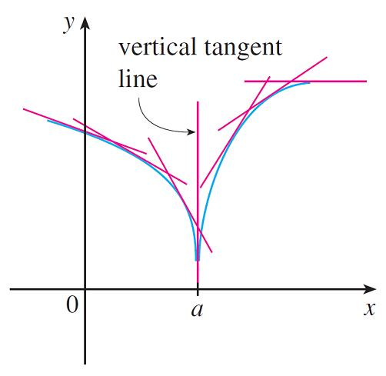
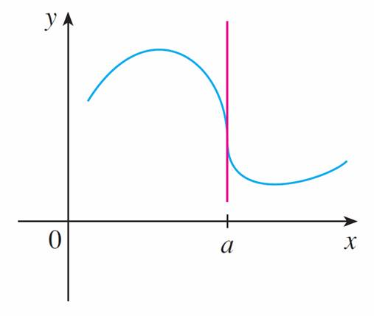
How Can a Function Fail to Be Differentiable? (3 of 4)
This means that the tangent lines become steeper and steeper as x → a. Figure 6 shows one way that this can happen; Figure 7(c) shows another.
A vertical tangent
Figure 6
Figure 7(c)

Slide 26
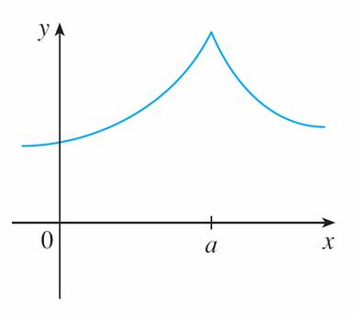
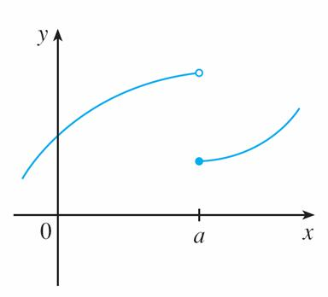
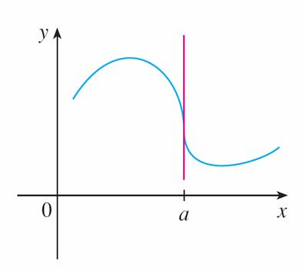
How Can a Function Fail to Be Differentiable? (4 of 4)
Figure 7 illustrates the three possibilities that we have discussed.
(a) A corner
(b) A discontinuity
(c) A vertical tangent
Three ways for f not to be differentiable at a
Figure 7

Slide 27
Higher Derivatives

Slide 28
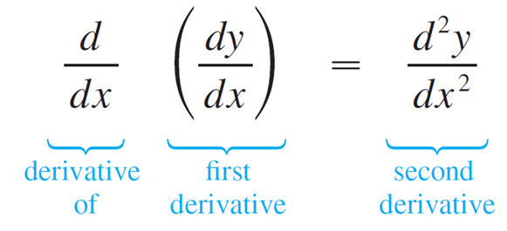
Higher Derivatives (1 of 7)
If f is a differentiable function, then its derivative
is also a function, so
may have a derivative of its own, denoted by
This new function
is called the second derivative of f because it is the derivative of the derivative of f .
Using Leibniz notation, we write the second derivative of y = f(x) as

Slide 29
Example 6
If
find and interpret
Solution:
The first derivative
So the second derivative is

Slide 30
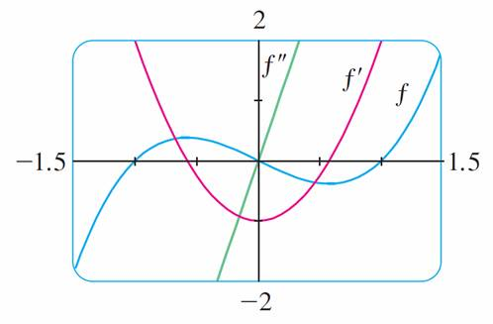
Example 6 – Solution (1 of 2)
The graphs of
are shown in Figure 10.
Figure 10

Slide 31
Example 6 – Solution (2 of 2)
We can interpret
as the slope of the curve
at the point
In other words, it is the rate of change of the slope of the original curve y = f(x).
Notice from Figure 10 that
is negative when
has negative slope
and positive when
has positive slope. So the graphs serve as a
check on our calculations.

Slide 32
Higher Derivatives (2 of 7)
In general, we can interpret a second derivative as a rate of change of a rate of change. The most familiar example of this is acceleration, which we define as follows.
If s = s (t) is the position function of an object that moves in a straight line, we know that its first derivative represents the velocity v (t) of the object as a function of time:

Slide 33
Higher Derivatives (3 of 7)
The instantaneous rate of change of velocity with respect to time is called the acceleration a (t) of the object. Thus the acceleration function is the derivative of the velocity function and is therefore the second derivative of the position function:
or, in Leibniz notation,

Slide 34
Higher Derivatives (4 of 7)
The third derivative
is the derivative of the second derivative:
can be interpreted as the slope of the curve
or as the rate of change of
If y = f(x), then alternative notations for the third derivative are

Slide 35
Higher Derivatives (5 of 7)
We can also interpret the third derivative physically in the case where the function is the position function s = s(t) of an object that moves along a straight line.
Because
the third derivative of the position function is the
derivative of the acceleration function and is called the jerk:

Slide 36
Higher Derivatives (6 of 7)
Thus the jerk j is the rate of change of acceleration.
It is aptly named because a large jerk means a sudden change in acceleration, which causes an abrupt movement.

Slide 37
Higher Derivatives (7 of 7)
The differentiation process can be continued. The fourth derivative
is usually
denoted by
In general, the nth derivative of f is denoted by
and is obtained from f by
differentiating n times.
If y = f (x), we write

