Slide 1
3
Differentiation Rules
Copyright © Cengage Learning. All rights reserved.

Slide 2
3.1
Derivatives of Polynomials and Exponential Functions
Copyright © Cengage Learning. All rights reserved.

Slide 3
Derivatives of Polynomials and Exponential Functions (1 of 1)
In this section we learn how to differentiate constant functions, power functions, polynomials, and exponential functions.

Slide 4
Constant Functions

Slide 5
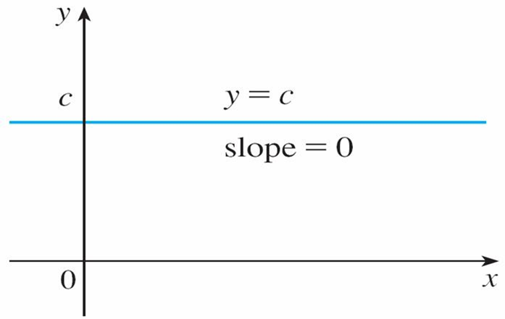
Constant Functions (1 of 2)
Let’s start with the simplest of all functions, the constant function f (x) = c.
The graph of this function is the horizontal line y = c, which has slope 0, so we must have
(See Figure 1.)
The graph of f (x) = c is the line y = c, so
Figure 1

Slide 6
Constant Functions (2 of 2)
A formal proof, from the definition of a derivative, is also easy:
In Leibniz notation, we write this rule as follows.
Derivative of a Constant Function

Slide 7
Power Functions

Slide 8
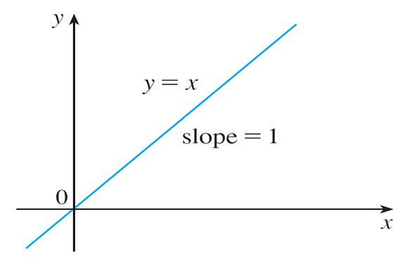
Power Functions (1 of 5)
We next look at the functions
where n is a positive integer.
If n = 1, the graph of f (x) = x is the line y = x, which has slope 1. (See Figure 2.)
The graph of f (x) = x is the line y = x, so
Figure 2

Slide 9
Power Functions (2 of 5)
So
(You can also verify Equation 1 from the definition of a derivative.) We have already investigated the cases n = 2 and n = 3. We found that

Slide 10
Power Functions (3 of 5)
For n = 4 we find the derivative of
as follows:

Slide 11
Power Functions (4 of 5)
Thus
Comparing the equations in (1), (2), and (3), we see a pattern emerging.
It seems to be a reasonable guess that, when n is a positive integer,
This turns out to be true.
The Power Rule If n is a positive integer, then

Slide 12
Example 1
(a) If
(b) If
(c) If
(d)

Slide 13
Power Functions (5 of 5)
The Power Rule (General Version) If n is any real number, then
The Power Rule enables us to find tangent lines without having to resort to the definition of a derivative. It also enables us to find normal lines.
The normal line to a curve C at a point P is the line through P that is perpendicular to the tangent line at P.

Slide 14
New Derivatives from Old

Slide 15
New Derivatives from Old (1 of 3)
When new functions are formed from old functions by addition, subtraction, or multiplication by a constant, their derivatives can be calculated in terms of derivatives of the old functions.
In particular, the following formula says that the derivative of a constant times a function is the constant times the derivative of the function.
The Constant Multiple Rule If c is a constant and f is a differentiable function, then

Slide 16
Example 4
(a)
(b)

Slide 17
New Derivatives from Old (2 of 3)
The next rule tells us that the derivative of a sum (or difference) of functions is the sum (or difference) of the derivatives.
The Sum and Difference Rules If f and g are both differentiable, then
The Sum Rule can be extended to the sum of any number of functions. For instance, using this theorem twice, we get

Slide 18
New Derivatives from Old (3 of 3)
The Constant Multiple Rule, the Sum Rule, and the Difference Rule can be combined with the Power Rule to differentiate any polynomial.

Slide 19
Exponential Functions

Slide 20
Exponential Functions (1 of 7)
Let’s try to compute the derivative of the exponential function
using the definition of a derivative:
The factor
doesn’t depend on h, so we can take it in front of the limit:

Slide 21
Exponential Functions (2 of 7)
Notice that the limit is the value of the derivative of f at 0, that is,
Therefore we have shown that if the exponential function
is differentiable at 0, then it is differentiable everywhere and
This equation says that the rate of change of any exponential function is proportional to the function itself. (The slope is proportional to the height.)

Slide 22
Exponential Functions (3 of 7)
Numerical evidence for the existence of
is given in the table shown below
for the cases b = 2 and b = 3. (Values are stated correct to four decimal places.) It appears that the limits exist and
for b = 2,
for b = 3,

Slide 23
Exponential Functions (4 of 7)
Thus, from Equation 4, we have
Of all possible choices for the base b in Equation 4, the simplest differentiation formula occurs when

Slide 24
Exponential Functions (5 of 7)
In view of the estimates of
for b = 2 and b = 3, it seems reasonable that
there is a number b between 2 and 3 for which
It is traditional to denote this value by the letter e. Thus we have the following definition.
Definition of the Number e
e is the number such that

Slide 25
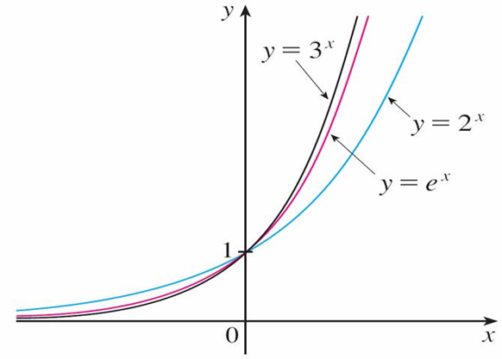
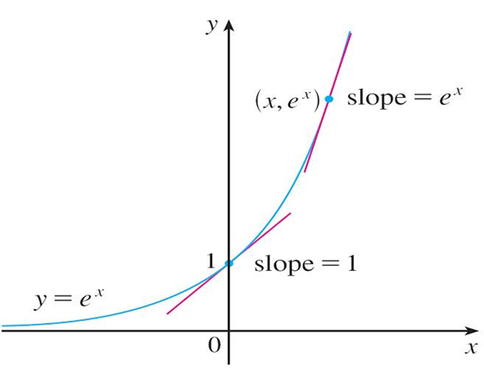
Exponential Functions (6 of 7)
Geometrically, this means that of all the possible exponential functions
the function
is the one whose tangent line at (0, 1) has a slope
that is exactly 1. (See Figures 6 and 7.)
Figure 6
Figure 7

Slide 26
Exponential Functions (7 of 7)
If we put b = e and, therefore,
in Equation 4, it becomes the following
important differentiation formula.
Derivative of the Natural Exponential Function
Thus the exponential function
has the property that it is its own
derivative. The geometrical significance of this fact is that the
slope of a tangent line to the curve
at a point
is equal to the y-coordinate of the point (see Figure 7).

Slide 27
Example 8
If
Solution:
Using the Difference Rule, we have

Slide 28
Example 8 – Solution (1 of 2)
We defined the second derivative as the derivative of

Slide 29
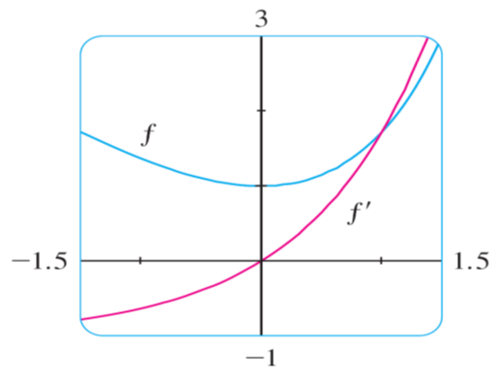
Example 8 – Solution (2 of 2)
The function f and its derivative
are graphed in Figure 8.
Figure 8
Notice that f has a horizontal tangent when x = 0; this corresponds to the fact that
Notice also that, for x > 0,
is positive and f is increasing.
When x < 0,
is negative and f is decreasing.

