Slide 1
3
Differentiation Rules
Copyright © Cengage Learning. All rights reserved.

Slide 2
3.2
The Product and Quotient Rules
Copyright © Cengage Learning. All rights reserved.

Slide 3
The Product Rule

Slide 4
The Product Rule (1 of 6)
By analogy with the Sum and Difference Rules, we might be tempted to guess, as Leibniz did three centuries ago, that the derivative of a product is the product of the derivatives.
We can see, however, that this guess is wrong by looking at a particular example.
Let
Then the Power Rule gives
But

Slide 5
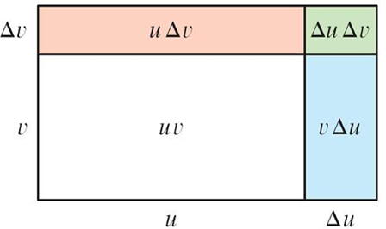
The Product Rule (2 of 6)
The correct formula was discovered by Leibniz (soon after his false start) and is called the Product Rule.
Before stating the Product Rule, let’s see how we might discover it.
We start by assuming that u = f(x) and v = g(x) are both positive differentiable functions. Then we can interpret the product u v as an area of a rectangle (see Figure 1).
The geometry of the Product Rule
Figure 1

Slide 6
The Product Rule (3 of 6)
If x changes by an amount Δx, then the corresponding changes in u and v are
and the new value of the product, (u + Δu)(v + Δv), can be interpreted as the area of the large rectangle in Figure 1 (provided that Δu and Δv happen to be positive).
The change in the area of the rectangle is

Slide 7
The Product Rule (4 of 6)
If we divide by Δx, we get
If we now let Δx → 0, we get the derivative of u v:

Slide 8
The Product Rule (5 of 6)
(Notice that Δu → 0 as Δx → 0 since f is differentiable and therefore continuous.)
Although we started by assuming (for the geometric interpretation) that all the quantities are positive, we notice that Equation 1 is always true. (The algebra is valid whether u, v, Δu, and Δv are positive or negative.)

Slide 9
The Product Rule (6 of 6)
So we have proved Equation 2, known as the Product Rule, for all differentiable functions u and v.
The Product Rule If f and g are both differentiable, then
In words, the Product Rule says that the derivative of a product of two functions is the first function times the derivative of the second function plus the second function times the derivative of the first function.

Slide 10
Example 1
(a) If
(b) Find the nth derivative,
Solution:
(a) By the Product Rule, we have

Slide 11
Example 1 – Solution (1 of 2)
(b) Using the Product Rule a second time, we get

Slide 12
Example 1 – Solution (2 of 2)
Further applications of the Product Rule give
In fact, each successive differentiation adds another term
so

Slide 13
The Quotient Rule

Slide 14
The Quotient Rule (1 of 4)
We find a rule for differentiating the quotient of two differentiable functions u = f(x) and v = g(x) in much the same way that we found the Product Rule.
If x, u, and v change by amounts Δx, Δu, and Δv, then the corresponding
change in the quotient

Slide 15
The Quotient Rule (2 of 4)
so
As Δx → 0, Δv → 0 also, because v = g(x) is differentiable and therefore continuous.
Thus, using the Limit Laws, we get

Slide 16
The Quotient Rule (3 of 4)
The Quotient Rule If f and g are differentiable, then
In words, the Quotient Rule says that the derivative of a quotient is the denominator times the derivative of the numerator minus the numerator times the derivative of the denominator, all divided by the square of the denominator.

Slide 17
Example 4
Let

Slide 18
The Quotient Rule (4 of 4)
Table of Differentiation Formulas

