Slide 1
3
Differentiation Rules
Copyright © Cengage Learning. All rights reserved.

Slide 2
3.3
Derivatives of Trigonometric Functions
Copyright © Cengage Learning. All rights reserved.

Slide 3
Derivatives of Trigonometric Functions
In particular, it is important to remember that when we talk about the function f defined for all real numbers x by
f(x) = sin x
it is understood that sin x means the sine of the angle whose radian measure is x. A similar convention holds for the other trigonometric functions cos, tan, csc, sec, and cot.
All of the trigonometric functions are continuous at every number in their domains.

Slide 4
Derivatives of the Trigonometric Functions

Slide 5
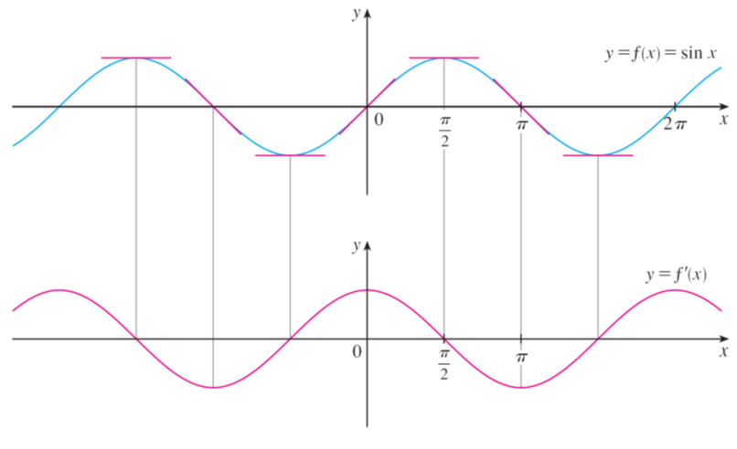
Derivatives of Trigonometric Functions (1 of 9)
If we sketch the graph of the function f (x) = sin x and use the interpretation of
as the slope of the tangent to the sine curve in order to sketch the graph of
then it looks as if the graph of
may be the same as the cosine curve.
(See Figure 1).
Figure 1

Slide 6
Derivatives of Trigonometric Functions (2 of 9)
Let’s try to confirm our guess that if f(x) = sin x, then
From the definition of a derivative, we have

Slide 7
Derivatives of Trigonometric Functions (3 of 9)
Two of these four limits are easy to evaluate. Since we regard x as a constant when computing a limit as h → 0, we have

Slide 8
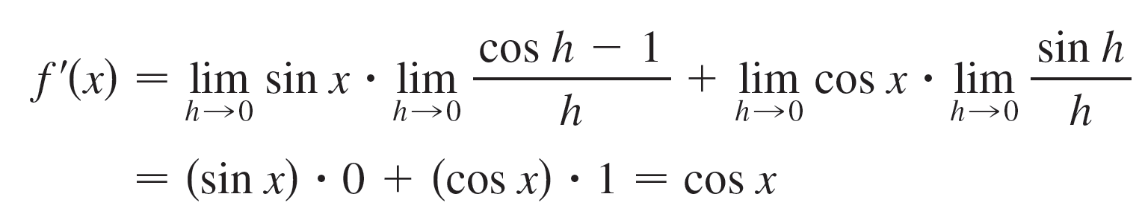
Derivatives of Trigonometric Functions (4 of 9)
Putting these limits into (1), we get
So we have proved the formula for the derivative of the sine function:

Slide 9
Example 1
Differentiate
Solution:
Using the Product Rule and Formula 2, we have

Slide 10
Derivatives of Trigonometric Functions (5 of 9)
Using the same methods as in the proof of Formula 2, one can prove that
The tangent function can also be differentiated by using the definition of a derivative, but it is easier to use the Quotient Rule together with Formulas 2 and 3:

Slide 11
Derivatives of Trigonometric Functions (6 of 9)

Slide 12
Derivatives of Trigonometric Functions (7 of 9)
The derivatives of the remaining trigonometric functions, csc, sec, and cot, can also be found easily using the Quotient Rule.

Slide 13
Derivatives of Trigonometric Functions (8 of 9)
We collect all the differentiation formulas for trigonometric functions in the following table. Remember that they are valid only when x is measured in radians.
Derivatives of Trigonometric Functions

Slide 14
Derivatives of Trigonometric Functions (9 of 9)
Trigonometric functions are often used in modeling real-world phenomena. In particular, vibrations, waves, elastic motions, and other quantities that vary in a periodic manner can be described using trigonometric functions. In the next example we discuss an instance of simple harmonic motion.

Slide 15
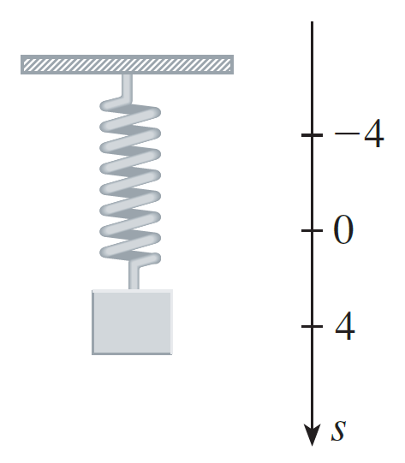
Example 3
An object fastened to the end of a vertical spring is stretched 4 cm beyond its rest position and released at time t = 0. (See Figure 4 and note that the downward direction is positive.) Its position at time t is
s = f (t) = 4 cos t
Find the velocity and acceleration at time t and use them to analyze the motion of the object.
Figure 4

Slide 16
Example 3 – Solution (1 of 3)
The velocity and acceleration are

Slide 17
Example 3 – Solution (2 of 3)
The object oscillates from the lowest point (s = 4 cm) to the highest point (s = −4 cm). The period of the oscillation is 2π, the period of cos t.

Slide 18
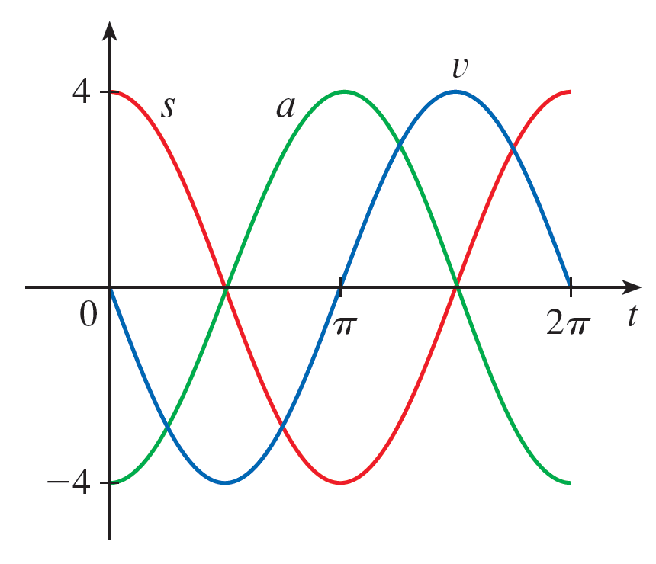
Example 3 – Solution (3 of 3)
The speed is
which is greatest when
that is, when cos t = 0.
So the object moves fastest as it passes through its equilibrium position (s = 0). Its speed is 0 when sin t = 0, that is, at the high and low points.
The acceleration a = −4 cos t = 0 when s = 0. It has greatest magnitude at the high and low points. See the graphs in Figure 5.
Figure 5

Slide 19
Two Special Trigonometric Limits

Slide 20
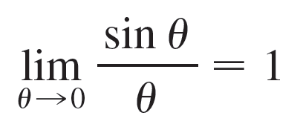
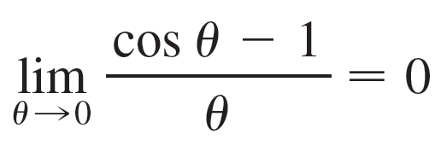
Two Special Trigonometric Limits (1 of 1)
In proving the formula for the derivative of sine we used two special limits, which we now prove.
5
The first special limit we considered concerned the sine function. The following special limit involves cosine.
6

Slide 21
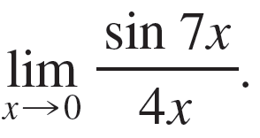
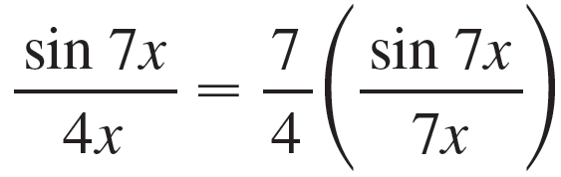

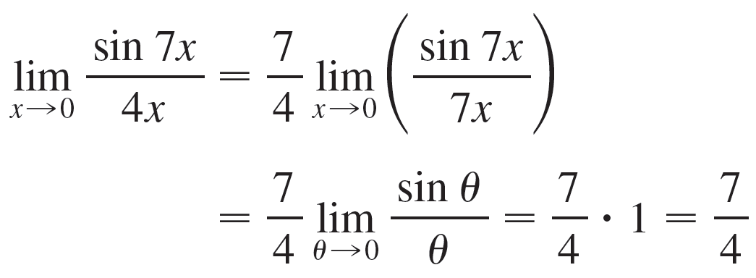
Example 5
Find
Solution:
In order to apply Equation 5, we first rewrite the function by multiplying and dividing by 7:
If we let θ = 7x, then
so by Equation 5 we have

