Slide 1
3
Differentiation Rules
Copyright © Cengage Learning. All rights reserved.

Slide 2
3.5
Implicit Differentiation
Copyright © Cengage Learning. All rights reserved.

Slide 3
Implicitly Defined Functions

Slide 4
Implicitly Defined Functions (1 of 5)
The functions that we have met so far can be described by expressing one variable explicitly in terms of another variable—for example,
or, in general, y = f(x).
Some functions, however, are defined implicitly by a relation between x and y such as
or

Slide 5
Implicitly Defined Functions (2 of 5)
In some cases it is possible to solve such an equation for y as an explicit function (or several functions) of x.
For instance, if we solve Equation 1 for y, we get
so two of the functions determined by the implicit Equation 1 are

Slide 6
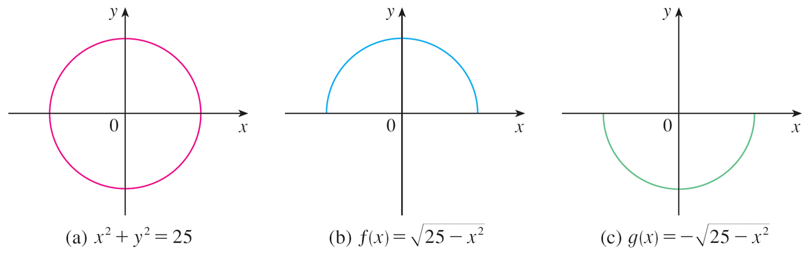
Implicitly Defined Functions (3 of 5)
The graphs of f and g are the upper and lower semicircles of the circle
(See Figure 1.)
Figure 1

Slide 7
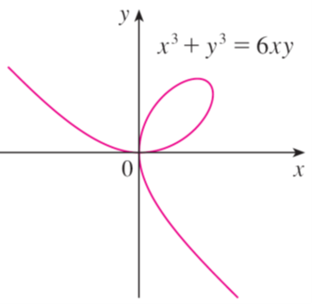
Implicitly Defined Functions (4 of 5)
It’s not easy to solve Equation 2 for y explicitly as a function of x by hand. (Even if we use technology, the resulting expressions are very complicated.)
Nonetheless, (2) is the equation of a curve called the folium of Descartes shown in Figure 2 and it implicitly defines y as several functions of x.
The folium of Descartes
Figure 2

Slide 8
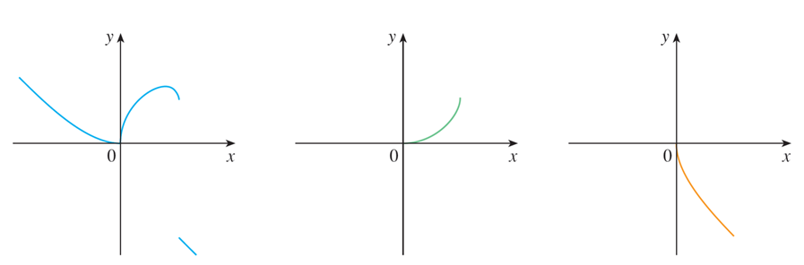
Implicitly Defined Functions (5 of 5)
The graphs of three such functions are shown in Figure 3.
Graphs of three functions defined by the folium of Descartes
Figure 3
When we say that f is a function defined implicitly by Equation 2, we mean that the equation
is true for all values of x in the domain of f.

Slide 9
Implicit Differentiation

Slide 10
Implicit Differentiation (1 of 1)
Fortunately, we don’t need to solve an equation for y in terms of x in order to find the derivative of y. Instead we can use the method of implicit differentiation.
This consists of differentiating both sides of the equation with respect to x and
then solving the resulting equation for dy/dx.
In the examples and exercises of this section it is always assumed that the given equation determines y implicitly as a differentiable function of x so that the method of implicit differentiation can be applied.

Slide 11
Example 1
If
Then find an equation of the tangent to the circle
at the point (3, 4).
Solution 1:
Differentiate both sides of the equation

Slide 12
Example 1 – Solution (1 of 3)
Remembering that y is a function of x and using the Chain Rule, we have
Thus
Now we solve this equation for

Slide 13
Example 1 – Solution (2 of 3)
At the point (3, 4) we have x = 3 and y = 4, so
An equation of the tangent to the circle at (3, 4) is therefore
Solution 2:
Solving the equation
for y, we get
The point (3, 4) lies on the upper semicircle
and so we consider
the function

Slide 14
Example 1 – Solution (3 of 3)
Differentiating f using the Chain Rule, we have
At the point (3, 4) we have
and, as in Solution 1, an equation of the tangent is 3x + 4y = 25.

Slide 15
Second Derivatives of Implicit Functions

Slide 16
Second Derivatives of Implicit Functions ( 1 of 1)
The next example shows how to find the second derivative of a function that is defined implicitly.

Slide 17
Example 4
Find
Solution:
Differentiating the equation implicitly with respect to x, we get
Solving for y′ gives

Slide 18
Example 4 – Solution (1 of 2)
To find y′′ we differentiate this expression for y′ using the Quotient Rule and remembering that y is a function of x:
If we now substitute Equation 3 into this expression, we get

Slide 19
Example 4 – Solution (2 of 2)
But the values of x and y must satisfy the original equation
So the answer simplifies to

