Slide 1
3
Differentiation Rules
Copyright © Cengage Learning. All rights reserved.

Slide 2
3.6
Derivatives of Logarithmic and Inverse Trigonometric Functions
Copyright © Cengage Learning. All rights reserved.

Slide 3
Derivatives of Logarithmic Functions

Slide 4
Derivatives of Logarithmic Functions (1 of 2)
Because the logarithmic function y = log_{b} x is the inverse of the exponential function y = b^{x}, which we know is differentiable from Section 3.1, it follows that the logarithmic function is also differentiable.
We now state and prove the formula for the derivative of a logarithmic function.

Slide 5
Derivatives of Logarithmic Functions (2 of 2)
In general, if we combine Formula 2 with the Chain Rule, we get

Slide 6
Example 2
Find
Solution:
Using (3), we have

Slide 7
Logarithmic Differentiation

Slide 8
Logarithmic Differentiation (1 of 2)
The calculation of derivatives of complicated functions involving products, quotients, or powers can often be simplified by taking logarithms.
The method used in the next example is called logarithmic differentiation.

Slide 9
Example 7
Differentiate
Solution:
We take logarithms of both sides of the equation and use the Laws of Logarithms to simplify:
Differentiating implicitly with respect to x gives

Slide 10
Example 7 – Solution
Solving for
we get
Because we have an explicit expression for y, we can substitute and write

Slide 11
Logarithmic Differentiation (2 of 2)
Steps in Logarithmic Differentiation
Take natural logarithms of both sides of an equation y = f(x) and use the Laws of Logarithms to expand the expression.
Differentiate implicitly with respect to x.
Solve the resulting equation for
and replace y by f (x).
We know that the general version of the Power Rule states that if n is any real number and

Slide 12
The Number e as a Limit

Slide 13
The Number e as a Limit (1 of 5)
If f (x) = ln x, then
We now use this fact to express
the number e as a limit.
From the definition of a derivative as a limit, we have

Slide 14
The Number e as a Limit (2 of 5)
Because
Then, by Theorem 2.5.8,
If f is continuous at b and

Slide 15
The Number e as a Limit (3 of 5)
And the continuity of the exponential function, we have

Slide 16
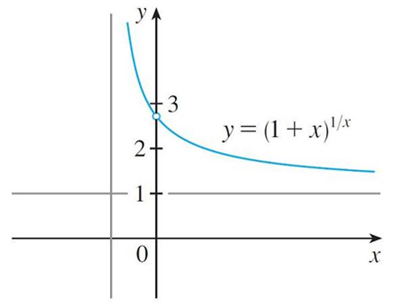
The Number e as a Limit (4 of 5)
Formula 5 is illustrated by the graph of the function
in Figure 4
and a table of values for small values of x. This illustrates the fact that, correct to seven decimal places,
x | (1 + x)^{1/x}
0.1 | 2.59374246
0.01 | 2.70481383
0.001 | 2.71692393
0.0001 | 2.71814593
0.00001 | 2.71826824
0.000001 | 2.71828047
0.0000001 | 2.71828169
0.00000001 | 2.71828181
Figure 4

Slide 17
The Number e as a Limit (5 of 5)
If we put
in Formula 5, then
and so an alternative
expression for e is

Slide 18
Derivatives of Inverse Trigonometric Functions

Slide 19
Derivatives of Inverse Trigonometric Functions (1 of 4)
We know that the definition of the arcsine function:
Differentiating sin y = x implicitly with respect to x, we obtain
Now

Slide 20
Derivatives of Inverse Trigonometric Functions (2 of 4)
Therefore
The formula for the derivative of the arctangent function is derived in a similar
way. If
then tan y = x. Differentiating tan y = x implicitly
with respect to x, we have

Slide 21
Derivatives of Inverse Trigonometric Functions (3 of 4)

Slide 22
Derivatives of Inverse Trigonometric Functions (4 of 4)
The derivatives of the remaining four are given in the following table.
Derivatives of Inverse Trigonometric Functions

Slide 23
Example 9
Differentiate
(a)
(b)
Solution:
(a)

Slide 24
Example 9 – Solution
(b)

