Slide 1
3
Differentiation Rules
Copyright © Cengage Learning. All rights reserved.

Slide 2
3.7
Rates of Change in the Natural and Social Sciences
Copyright © Cengage Learning. All rights reserved.

Slide 3
Rates of Change in the Natural and Social Sciences (1 of 3)
We know that if y = f(x), then the derivative
can be interpreted as the rate of
change of y with respect to x. In this section we examine some of the applications of this idea to physics, chemistry, biology, economics, and other sciences.
We know that the basic idea behind rates of change. If x changes from x₁ to x₂, then the change in x is
and the corresponding change in y is

Slide 4
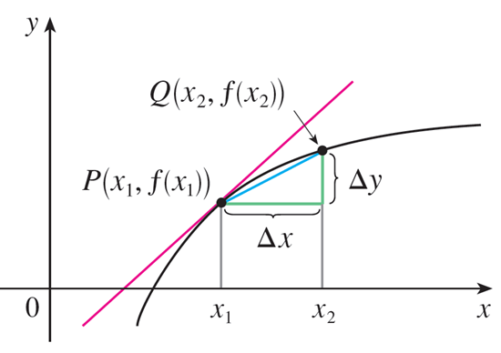
Rates of Change in the Natural and Social Sciences (2 of 3)
The difference quotient
is the average rate of change of y with respect to x over the interval [x₁, x₂] and can be interpreted as the slope of the secant line PQ in Figure 1.
m_{PQ} = average rate of change
m = f ′(x₁) = instantaneous rate of change
Figure 1

Slide 5
Rates of Change in the Natural and Social Sciences (3 of 3)
Its limit as Δx → 0 is the derivative
which can therefore be interpreted as
the instantaneous rate of change of y with respect to x or the slope of the tangent line at P(x₁, f(x₁)).
Using Leibniz notation, we write the process in the form

Slide 6
Physics

Slide 7
Physics (1 of 1)
If s = f(t) is the position function of a particle that is moving in a straight line, then
represents the average velocity over a time period Δt, and
represents the
instantaneous velocity (the rate of change of displacement with respect to time).
The instantaneous rate of change of velocity with respect to time is acceleration:
Now that we know the differentiation formulas, we are able to more easily solve problems involving the motion of objects.

Slide 8
Example 1 (1 of 2)
The position of a particle is given by the equation
where t is measured in seconds and s in meters.
(a) Find the velocity at time t.
(b) What is the velocity after 2 s? After 4 s?
(c) When is the particle at rest?
(d) When is the particle moving forward (that is, in the positive direction)?

Slide 9
Example 1 (2 of 2)
(e) Draw a diagram to represent the motion of the particle.
(f) Find the total distance traveled by the particle during the first five seconds.
(g) Find the acceleration at time t and after 4 s.
(h) Graph the position, velocity, and acceleration functions for 0 ≤ t ≤ 5.
(i) When is the particle speeding up? When is it slowing down?

Slide 10
Example 1 – Solution (1 of 10)
(a) The velocity function is the derivative of the position function:

Slide 11
Example 1 – Solution (2 of 10)
(b) The velocity after 2 s means the instantaneous velocity when t = 2, that is,
The velocity after 4 s is

Slide 12
Example 1 – Solution (3 of 10)
(c) The particle is at rest when v(t) = 0, that is,
and this is true when t = 1 or t = 3.
Thus the particle is at rest after 1 s and after 3 s.

Slide 13
Example 1 – Solution (4 of 10)
(d) The particle moves in the positive direction when v(t) > 0, that is,
This inequality is true when both factors are positive (t > 3) or when both factors are negative (t < 1).
Thus the particle moves in the positive direction in the time intervals t < 1 and t > 3.
It moves backward (in the negative direction) when 1 < t < 3.

Slide 14
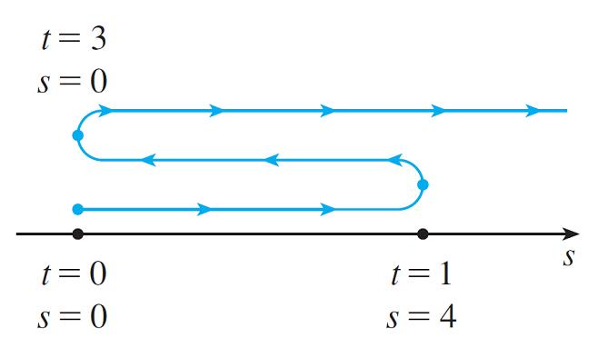
Example 1 – Solution (5 of 10)
(e) Using the information from part (d) we make a schematic sketch in Figure 2 of the motion of the particle back and forth along a line (the s-axis).
Figure 2

Slide 15
Example 1 – Solution (6 of 10)
(f) Because of what we learned in parts (d) and (e), we need to calculate the distances traveled during the time intervals [0, 1], [1, 3], and [3, 5] separately.
The distance traveled in the first second is
From t = 1 to t = 3 the distance traveled is
From t = 3 to t = 5 the distance traveled is
The total distance is 4 + 4 + 20 = 28 m.

Slide 16
Example 1 – Solution (7 of 10)
(g) The acceleration is the derivative of the velocity function:

Slide 17
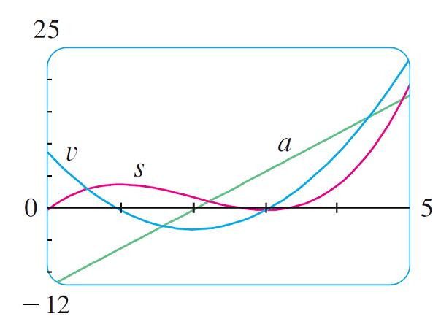
Example 1 – Solution (8 of 10)
(h) Figure 3 shows the graphs of s, v, and a.
Figure 3

Slide 18
Example 1 – Solution (9 of 10)
(i) The particle speeds up when the velocity is positive and increasing (v and a are both positive) and also when the velocity is negative and decreasing (v and a are both negative).
In other words, the particle speeds up when the velocity and acceleration have the same sign. (The particle is pushed in the same direction it is moving.)
From Figure 3 we see that this happens when 1 < t < 2 and when t > 3.

Slide 19
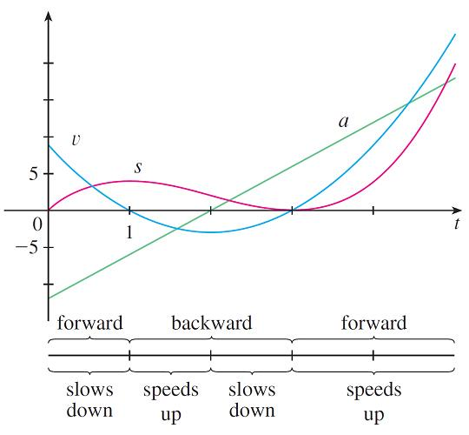
Example 1 – Solution (10 of 10)
The particle slows down when v and a have opposite signs, that is, when 0 ≤ t < 1 and when 2 < t < 3.
Figure 4 summarizes the motion of the particle.
Figure 4

Slide 20
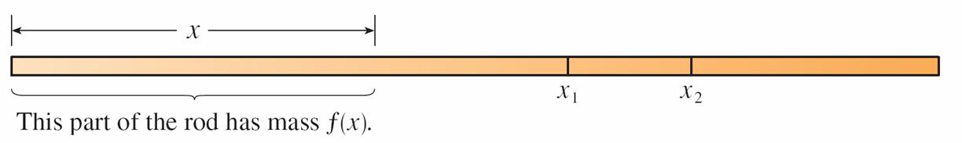
Example 2 (1 of 4)
If a rod or piece of wire is homogeneous, then its linear density is uniform and
is defined as the mass per unit length
and measured in kilograms per
meter.
Suppose, however, that the rod is not homogeneous but that its mass measured from its left end to a point x is m = f(x), as shown in Figure 5.
Figure 5

Slide 21
Example 2 (2 of 4)
The mass of the part of the rod that lies between x = x₁ and x = x₂ is given by Δm = f(x₂) − f(x₁), so the average density of that part of the rod is
If we now let Δx → 0 (that is, x₂ → x₁), we are computing the average density over smaller and smaller intervals.
The linear density ρ at x₁ is the limit of these average densities as Δx → 0; that is, the linear density is the rate of change of mass with respect to length.

Slide 22
Example 2 (3 of 4)
Symbolically,
Thus the linear density of the rod is the derivative of mass with respect to length.
For instance, if
where x is measured in meters and m in
kilograms, then the average density of the part of the rod given by 1 ≤ x ≤ 1.2 is

Slide 23
Example 2 (4 of 4)
≈ 0.48 kg/m
while the density right at x = 1 is

Slide 24
Example 3 (1 of 2)
A current exists whenever electric charges move. Figure 6 shows part of a wire and electrons moving through a plane surface, shaded red.
Figure 6
If ΔQ is the net charge that passes through this surface during a time period Δt, then the average current during this time interval is defined as

Slide 25
Example 3 (2 of 2)
If we take the limit of this average current over smaller and smaller time intervals, we get what is called the current I at a given time t₁:
Thus the current is the rate at which charge flows through a surface. It is measured in units of charge per unit time (often coulombs per second, called amperes).

Slide 26
Chemistry

Slide 27
Example 4 (1 of 5)
A chemical reaction results in the formation of one or more substances (called products) from one or more starting materials (called reactants). For instance, the “equation”
2H₂ + O₂ → 2H₂O
indicates that two molecules of hydrogen and one molecule of oxygen form two molecules of water.
Let’s consider the reaction
A + B → C
where A and B are the reactants and C is the product.

Slide 28
Example 4 (2 of 5)
The concentration of a reactant A is the number of moles
per liter and is denoted by [A].
The concentration varies during a reaction, so [A], [B], and [C] are all functions of time (t).
The average rate of reaction of the product C over a time interval t₁ ≤ t ≤ t₂ is

Slide 29
Example 4 (3 of 5)
But chemists are interested in the instantaneous rate of reaction because it gives information about the mechanism of the chemical reaction. The instantaneous rate of reaction is obtained by taking the limit of the average rate of reaction as the time interval Δt approaches 0:
Since the concentration of the product increases as the reaction proceeds, the
derivative
will be positive, and so the rate of reaction of C is positive.

Slide 30
Example 4 (4 of 5)
The concentrations of the reactants, however, decrease during the reaction, so, to make the rates of reaction of A and B positive numbers, we put minus signs
in front of the derivatives
Since [A] and [B] each decrease at the same rate that [C] increases, we have

Slide 31
Example 4 (5 of 5)
More generally, it turns out that for a reaction of the form
aA + bB → cC + dD
we have
The rate of reaction can be determined from data and graphical methods. In some cases there are explicit formulas for the concentrations as functions of time that enable us to compute the rate of reaction.

Slide 32
Example 5 (1 of 4)
One of the quantities of interest in thermodynamics is compressibility. If a given substance is kept at a constant temperature, then its volume V depends on its pressure P.
We can consider the rate of change of volume with respect to pressure—
namely, the derivative
As P increases, V decreases, so
The compressibility is defined by introducing a minus sign and dividing this derivative by the volume V:

Slide 33
Example 5 (2 of 4)
Thus β measures how fast, per unit volume, the volume of a substance decreases as the pressure on it increases at constant temperature.
For instance, the volume V (in cubic meters) of a sample of air at 25°C was found to be related to the pressure P (in kilopascals) by the equation

Slide 34
Example 5 (3 of 4)
The rate of change of V with respect to P when P = 50 kPa is

Slide 35
Example 5 (4 of 4)
The compressibility at that pressure is

Slide 36
Biology

Slide 37
Example 6 (1 of 6)
Let n = f(t) be the number of individuals in an animal or plant population at time t.
The change in the population size between the times t = t₁ and t = t₂ is Δn = f(t₂) − f(t₁), and so the average rate of growth during the time period t₁ ≤ t ≤ t₂ is
The instantaneous rate of growth is obtained from this average rate of growth by letting the time period Δt approach 0:

Slide 38
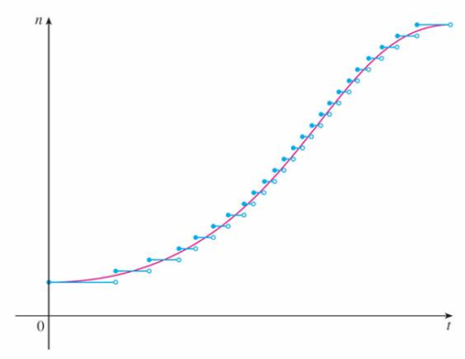
Example 6 (2 of 6)
Strictly speaking, this is not quite accurate because the actual graph of a population function n = f(t) would be a step function that is discontinuous whenever a birth or death occurs and therefore not differentiable.
However, for a large animal or plant population, we can replace the graph by a smooth approximating curve as in Figure 7.
A smooth curve approximating a growth function
Figure 7

Slide 39
Example 6 (3 of 6)
To be more specific, consider a population of bacteria in a homogeneous nutrient medium.
Suppose that by sampling the population at certain intervals it is determined that the population doubles every hour.
If the initial population is n₀ and the time t is measured in hours, then

Slide 40
Example 6 (4 of 6)
and, in general,
The population function is
We have shown that

Slide 41
Example 6 (5 of 6)
So the rate of growth of the bacteria population at time t is
For example, suppose that we start with an initial population of n₀ = 100 bacteria. Then the rate of growth after 4 hours is

Slide 42
Example 6 (6 of 6)
= 1600 ln 2
≈ 1109
This means that, after 4 hours, the bacteria population is growing at a rate of about 1109 bacteria per hour.

Slide 43
Example 7 (1 of 6)
When we consider the flow of blood through a blood vessel, such as a vein or artery, we can model the shape of the blood vessel by a cylindrical tube with radius R and length l as illustrated in Figure 8.
Blood flow in an artery
Figure 8
Because of friction at the walls of the tube, the velocity v of the blood is greatest along the central axis of the tube and decreases as the distance r from the axis increases until v becomes 0 at the wall.

Slide 44
Example 7 (2 of 6)
The relationship between v and r is given by the law of laminar flow, which was experimentally derived by the French physicist Jean Léonard Marie Poiseuille in 1838.
This law states that
where η is the viscosity of the blood and P is the pressure difference between the ends of the tube.
If P and l are constant, then v is a function of r with domain [0, R].

Slide 45
Example 7 (3 of 6)
The average rate of change of the velocity as we move from r = r₁ outward to r = r₂ is given by
and if we let Δr → 0, we obtain the velocity gradient, that is, the instantaneous rate of change of velocity with respect to r :

Slide 46
Example 7 (4 of 6)
Using Equation 1, we obtain
For one of the smaller human arteries we can take η = 0.027, R = 0.008 cm,
l = 2 cm, and
which gives

Slide 47
Example 7 (5 of 6)
At r = 0.02 cm the blood is flowing at a speed of
and the velocity gradient at that point is

Slide 48
Example 7 (6 of 6)
To get a feeling for what this statement means, let’s change our units from centimeters to micrometers (1 cm = 10,000 μm). Then the radius of the artery is 80 μm.
The velocity at the central axis is 11,850 μm/s, which decreases to 11,110 μm/s at a distance of r = 20 μm.
The fact that
means that, when r = 20 μm, the velocity is
decreasing at a rate of about 74 μm/s for each micrometer that we proceed away from the center.

Slide 49
Economics

Slide 50
Example 8 (1 of 6)
Suppose C(x) is the total cost that a company incurs in producing x units of a certain commodity.
The function C is called a cost function. If the number of items produced is increased from x₁ to x₂, then the additional cost is ΔC = C (x₂) − C (x₁), and the average rate of change of the cost is

Slide 51
Example 8 (2 of 6)
The limit of this quantity as Δx → 0, that is, the instantaneous rate of change of cost with respect to the number of items produced, is called the marginal cost by economists:
[Since x often takes on only integer values, it may not make literal sense to let Δx approach 0, but we can always replace C(x) by a smooth approximating function as in Example 6.]

Slide 52
Example 8 (3 of 6)
Taking Δx = 1 and n large (so that Δx is small compared to n), we have
Thus the marginal cost of producing n units is approximately equal to the cost of producing one more unit [the (n + 1)st unit].

Slide 53
Example 8 (4 of 6)
It is often appropriate to represent a total cost function by a polynomial
where a represents the overhead cost (rent, heat, maintenance) and the other terms represent the cost of raw materials, labor, and so on. (The cost of raw materials may be proportional to x, but labor costs might depend partly on higher powers of x because of overtime costs and inefficiencies involved in large-scale operations.)

Slide 54
Example 8 (5 of 6)
For instance, suppose a company has estimated that the cost (in dollars) of producing x items is
Then the marginal cost function is
The marginal cost at the production level of 500 items is

Slide 55
Example 8 (6 of 6)
This gives the rate at which costs are increasing with respect to the production level when x = 500 and predicts the cost of the 501st item.
The actual cost of producing the 501st item is
Notice that

Slide 56
Other Sciences

Slide 57
Other Sciences (1 of 1)
Rates of change occur in all the sciences. A geologist is interested in knowing the rate at which an intruded body of molten rock cools by conduction of heat into surrounding rocks.
An engineer wants to know the rate at which water flows out of a reservoir.
An urban geographer is interested in the rate of change of the population density in a city as the distance from the city center increases.
A meteorologist is concerned with the rate of change of atmospheric pressure with respect to height.

Slide 58
A Single Idea, Many Interpretations

Slide 59
A Single Idea, Many Interpretations (1 of 2)
Velocity, density, current, power, and temperature gradient in physics; rate of reaction and compressibility in chemistry; rate of growth and blood velocity gradient in biology; marginal cost and marginal profit in economics; rate of heat flow in geology; rate of improvement of performance in psychology; rate of spread of a rumor in sociology—these are all special cases of a single mathematical concept, the derivative.
All of these different applications of the derivative illustrate the fact that part of the power of mathematics lies in its abstractness.

Slide 60
A Single Idea, Many Interpretations (2 of 2)
A single abstract mathematical concept (such as the derivative) can have different interpretations in each of the sciences.
When we develop the properties of the mathematical concept once and for all, we can then turn around and apply these results to all of the sciences.
This is much more efficient than developing properties of special concepts in each separate science.

