Slide 1
3
Differentiation Rules
Copyright © Cengage Learning. All rights reserved.

Slide 2
3.8
Exponential Growth and Decay
Copyright © Cengage Learning. All rights reserved.

Slide 3
Exponential Growth and Decay (1 of 5)
In many natural phenomena, quantities grow or decay at a rate proportional to their size. For instance, if y = f (t) is the number of individuals in a population of animals or bacteria at time t, then it seems reasonable to expect that the rate of growth
is proportional to the population f (t); that is,
for some constant k.
Indeed, under ideal conditions (unlimited environment, adequate nutrition, immunity to disease) the mathematical model given by the equation
predicts what actually happens fairly accurately.

Slide 4
Exponential Growth and Decay (2 of 5)
Another example occurs in nuclear physics where the mass of a radioactive substance decays at a rate proportional to the mass.
In chemistry, the rate of a unimolecular first-order reaction is proportional to the concentration of the substance.
In finance, the value of a savings account with continuously compounded interest increases at a rate proportional to that value.

Slide 5
Exponential Growth and Decay (3 of 5)
In general, if y (t) is the value of a quantity y at time t and if the rate of change of y with respect to t is proportional to its size y (t) at any time, then
where k is a constant.
Equation 1 is sometimes called the law of natural growth (if k > 0) or the law of natural decay (if k < 0). It is called a differential equation because it
involves an unknown function y and its derivative

Slide 6
Exponential Growth and Decay (4 of 5)
It’s not hard to think of a solution of Equation 1. This equation asks us to find a function whose derivative is a constant multiple of itself.
Any exponential function of the form
where C is a constant, satisfies

Slide 7
Exponential Growth and Decay (5 of 5)
We will see later that any function that satisfies
must be of the form
To see the significance of the constant C, we observe that
Therefore C is the initial value of the function.
2 Theorem The only solutions of the differential equation
are the exponential functions

Slide 8
Population Growth

Slide 9
Population Growth (1 of 3)
What is the significance of the proportionality constant k? In the context of population growth, where P (t) is the size of a population at time t, we can write
The quantity
is the growth rate divided by the population size; it is called the relative growth rate.

Slide 10
Population Growth (2 of 3)
According to (3), instead of saying “the growth rate is proportional to population size” we could say “the relative growth rate is constant.”
Then Theorem (2) says that a population with constant relative growth rate must grow exponentially.
Notice that the relative growth rate k appears as the coefficient of t in the
exponential function

Slide 11
Population Growth (3 of 3)
For instance, if
and t is measured in years, then the relative growth rate is k = 0.02 and the population grows at a relative rate of 2% per year.
If the population at time 0 is P₀, then the expression for the population is

Slide 12
Example 1
Use the fact that the world population was 2560 million in 19 50 and 3040 million in 19 60 to model the population of the world in the second half of the 20th century. (Assume that the growth rate is proportional to the population size.) What is the relative growth rate? Use the model to estimate the world population in 19 93 and to predict the population in the year 2025.
Solution:
We measure the time t in years and let t = 0 in the year 19 50.

Slide 13
Example 1 – Solution (1 of 3)
We measure the population P (t) in millions of people. Then P (0) = 2560 and P (10) = 3040.
Since we are assuming that
Theorem 2 gives

Slide 14
Example 1 – Solution (2 of 3)
The relative growth rate is about 1.7% per year and the model is
We estimate that the world population in 19 93 was
The model predicts that the population in 2025 will be

Slide 15
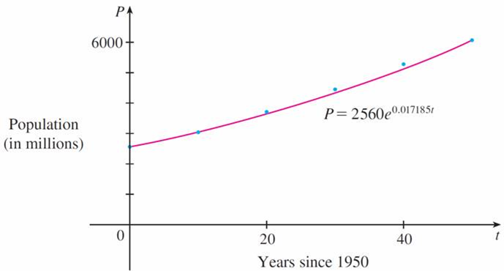
Example 1 – Solution (3 of 3)
The graph in Figure 1 shows that the model is fairly accurate to the end of the 20th century (the dots represent the actual population), so the estimate for 19 93 is quite reliable. But the prediction for 2025 may not be so accurate.
A model for world population growth in the second half of the 20th century
Figure 1

Slide 16
Radioactive Decay

Slide 17
Radioactive Decay (1 of 3)
Radioactive substances decay by spontaneously emitting radiation. If m (t) is the mass remaining from an initial mass m₀ of the substance after time t, then the relative decay rate
has been found experimentally to be constant. (Since
is negative, the
relative decay rate is positive.) It follows that
where k is a negative constant.

Slide 18
Radioactive Decay (2 of 3)
In other words, radioactive substances decay at a rate proportional to the remaining mass. This means that we can use Theorem 2 to show that the mass decays exponentially:
Physicists express the rate of decay in terms of half-life, the time required for half of any given quantity to decay.

Slide 19
Example 2
The half-life of radium-226 is 1590 years.
(a) A sample of radium-226 has a mass of 100 mg. Find a formula for the mass of the sample that remains after t years.
(b) Find the mass remaining after 1000 years correct to the nearest milligram.
(c) When will the mass be reduced to 30 mg?
Solution:
(a) Let m(t) be the mass of radium-226 (in milligrams) that remains after t years.

Slide 20
Example 2 – Solution (1 of 4)
Then
and m(0) = 100, so Theorem 2 gives
In order to determine the value of k, we use the fact that
and

Slide 21
Example 2 – Solution (2 of 4)
Therefore
We could use the fact that
to write the expression for m (t) in the
alternative form

Slide 22
Example 2 – Solution (3 of 4)
(b) The mass remaining after 1000 years is
(c) We want to find the value of t such that m (t) = 30, that is,
We solve this equation for t by taking the natural logarithm of both sides:

Slide 23
Example 2 – Solution (4 of 4)
Thus

Slide 24
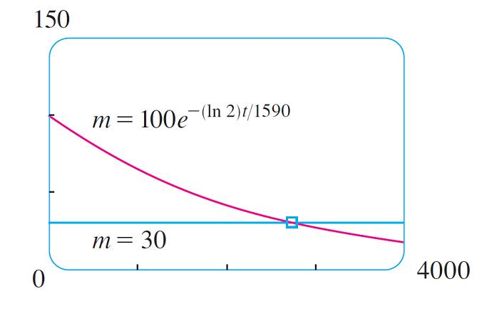
Radioactive Decay (3 of 3)
As a check on our work in Example 2, we use a graphing device to draw the graph of m (t) in Figure 2 together with the horizontal line m = 30. These curves intersect when t ≈ 2800, and this agrees with the answer to part (c).
Figure 2

Slide 25
Newton’s Law of Cooling

Slide 26
Newton’s Law of Cooling (1 of 3)
Newton’s Law of Cooling states that the rate of cooling of an object is proportional to the temperature difference between the object and its surroundings, provided that this difference is not too large. (This law also applies to warming.)
If we let T (t) be the temperature of the object at time t and T_{s} be the temperature of the surroundings, then we can formulate Newton’s Law of Cooling as a differential equation:
where k is a constant.

Slide 27
Newton’s Law of Cooling (2 of 3)
This equation is not quite the same as Equation 1, so we make the change of variable y (t) = T (t) − T_{s}. Because T_{s} is constant, we have
and so the equation becomes
We can then use Theorem 2 to find an expression for y, from which we can find T.

Slide 28
Example 3
A bottle of iced tea at room temperature (72°F) is placed in a refrigerator where the temperature is 44°F. After half an hour the tea has cooled to 61°F.
(a) What is the temperature of the tea after another half hour?
(b) How long does it take for the tea to cool to 50°F?
Solution:
(a) Let T (t) be the temperature of the tea after t minutes.

Slide 29
Example 3 – Solution (1 of 4)
The surrounding temperature is T_{s} = 44°F, so Newton’s Law of Cooling states that
If we let y = T − 44, then y (0) = T (0) − 44 = 72 − 44 = 28, so y satisfies
and by (2) we have

Slide 30
Example 3 – Solution (2 of 4)
We are given that T(30) = 61, so y(30) = 61 − 44 = 17 and
Taking logarithms, we have

Slide 31
Example 3 – Solution (3 of 4)
Thus
So after another half hour the tea has cooled to about 54° F.

Slide 32
Example 3 – Solution (4 of 4)
(b) We have T(t) = 50 when
The tea cools to 50°F after about 1 hour 33 minutes.

Slide 33
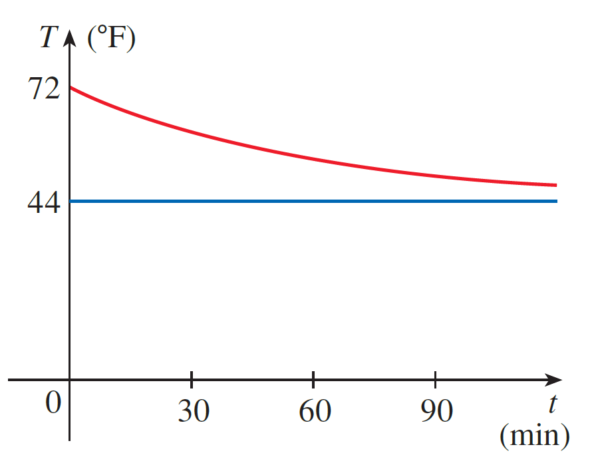
Newton’s Law of Cooling (3 of 3)
Notice that in Example 3, we have
which is to be expected. The graph of the temperature function is shown in Figure 3.
Figure 3

Slide 34
Continuously Compounded Interest

Slide 35
Example 4 (1 of 6)
If $5000 is invested at 2% interest, compounded annually, then after 1 year the investment is worth $5000(1.02) = $5100.00, after 2 years it’s worth
$[5000(1.02)](1.02) = $5202.00, and after t years it’s worth
In general, if an amount A₀ is invested at an interest rate r (r = 0.02 in this
example), then after t years it’s worth
Usually, interest is compounded more frequently, say, n times a year.

Slide 36
Example 4 (2 of 6)
Then in each compounding period the interest rate is
and there are nt
compounding periods in t years, so the value of the investment is
For instance, after 3 years at 2% interest a $5000 investment will be worth

Slide 37
Example 4 (3 of 6)
You can see that the interest paid increases as the number of compounding periods (n) increases. If we let n → ∞, then we will be compounding the interest continuously and the value of the investment will be

Slide 38
Example 4 (4 of 6)
But the limit in this expression is equal to the number e.

Slide 39
Example 4 (5 of 6)
So with continuous compounding of interest at interest rate r, the amount after t years is
If we differentiate this equation, we get
which says that, with continuous compounding of interest, the rate of increase of an investment is proportional to its size.

Slide 40
Example 4 (6 of 6)
Returning to the example of $5000 invested for 3 years at 2% interest, we see that with continuous compounding of interest the value of the investment will be
Notice how close this is to the amount we calculated for daily compounding, $5309.17. But the amount is easier to compute if we use continuous compounding.

