Slide 1
3
Differentiation Rules
Copyright © Cengage Learning. All rights reserved.

Slide 2
3.11
Hyperbolic Functions
Copyright © Cengage Learning. All rights reserved.

Slide 3
Hyperbolic Functions and Their Derivatives

Slide 4
Hyperbolic Functions and Their Derivatives (1 of 5)
Certain combinations of the exponential functions
arise so frequently in mathematics and its applications that they deserve to be given special names.
In many ways they are analogous to the trigonometric functions, and they have the same relationship to the hyperbola that the trigonometric functions have to the circle.

Slide 5
Hyperbolic Functions and Their Derivatives (2 of 5)
For this reason they are collectively called hyperbolic functions and individually called hyperbolic sine, hyperbolic cosine, and so on.
Definition of the Hyperbolic Functions

Slide 6
Hyperbolic Functions and Their Derivatives (3 of 5)
The hyperbolic functions satisfy a number of identities that are similar to well-known trigonometric identities.
We list some of them here and leave most of the proofs to the exercises.
Hyperbolic Identities

Slide 7
Example 1
Prove (a)
(b)
Solution:
(a)

Slide 8
Example 1 – Solution
(b) We start with the identity proved in part (a):
If we divide both sides by
we get
or

Slide 9
Hyperbolic Functions and Their Derivatives (4 of 5)
The derivatives of the hyperbolic functions are easily computed. For example,

Slide 10
Hyperbolic Functions and Their Derivatives (5 of 5)
We list the differentiation formulas for the hyperbolic functions as Table 1.
1 Derivatives of Hyperbolic Functions

Slide 11
Example 2
If
Solution: Using (1) and the Chain Rule, we have

Slide 12
Inverse Hyperbolic Functions and Their Derivatives

Slide 13
Inverse Hyperbolic Functions and Their Derivatives (1 of 5)
The sin h and tanh are one-to-one functions and so they have inverse functions
denoted by
The cos h is not one-to-one, but when restricted
to the domain
it becomes one-to-one.
The inverse hyperbolic cosine function is defined as the inverse of this restricted function.
2

Slide 14
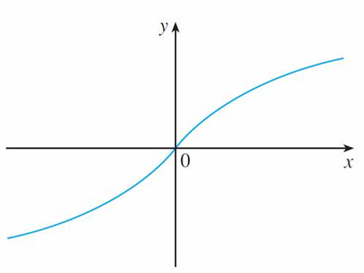
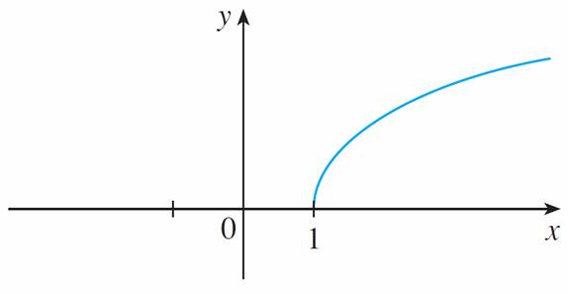
Inverse Hyperbolic Functions and Their Derivatives (2 of 5)
We can sketch the graphs of
in Figures 8, 9, and 10.
Figure 8
Figure 9

Slide 15
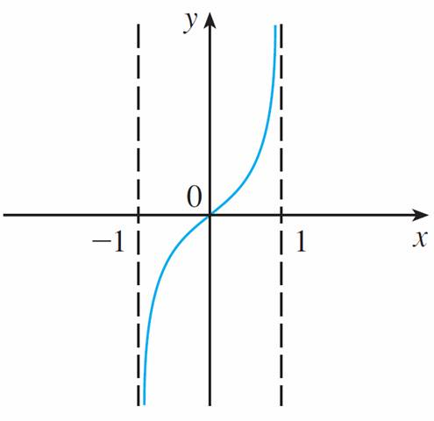
Inverse Hyperbolic Functions and Their Derivatives (3 of 5)
Figure 10

Slide 16
Inverse Hyperbolic Functions and Their Derivatives (4 of 5)
Since the hyperbolic functions are defined in terms of exponential functions, it’s not surprising to learn that the inverse hyperbolic functions can be expressed in terms of logarithms.
In particular, we have:

Slide 17
Example 3
Show that
Solution:
Let
so
or, multiplying by

Slide 18
Example 3 – Solution (1 of 2)
This is really a quadratic equation in
Solving by the quadratic formula, we get
Note that

Slide 19
Example 3 – Solution (2 of 2)
Thus the minus sign is inadmissible and we have
Therefore
This shows that

Slide 20
Inverse Hyperbolic Functions and Their Derivatives (5 of 5)
6 Derivatives of Inverse Hyperbolic Functions
The inverse hyperbolic functions are all differentiable because the hyperbolic functions are differentiable.

Slide 21
Example 4
Prove that
Solution:
Let
Then sin h y = x. If we differentiate this equation implicitly
with respect to x, we get

Slide 22
Example 4 – Solution
Since
and cos h y ≥ 0, we have

