Slide 1
4
Applications of Differentiation
Copyright © Cengage Learning. All rights reserved.

Slide 2
4.1
Maximum and Minimum Values
Copyright © Cengage Learning. All rights reserved.

Slide 3
Maximum and Minimum Values (1 of 1)
Some of the most important applications of differential calculus are optimization problems, in which we are required to find the optimal (best) way of doing something.
These problems can be reduced to finding the maximum or minimum values of a function. Let’s first explain exactly what we mean by maximum and minimum values.

Slide 4
Absolute and Local Extreme Values

Slide 5
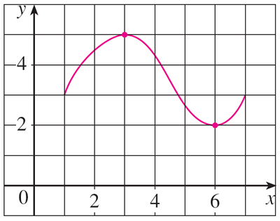
Absolute and Local Extreme Values (1 of 11)
We see that the highest point on the graph of the function f shown in Figure 1 is the point (3, 5).
Figure 1
In other words, the largest value of f is f(3) = 5. Likewise, the smallest value is f(6) = 2.

Slide 6
Absolute and Local Extreme Values (2 of 11)
We say that f (3) = 5 is the absolute maximum of f and f (6) = 2 is the absolute minimum. In general, we use the following definition.
1 Definition Let c be a number in the domain D of a function f. Then f(c) is the
absolute maximum value of f on D if f (c) ≥ f (x) for all x in D.
absolute minimum value of f on D if f (c) ≤ f (x) for all x in D.
An absolute maximum or minimum is sometimes called a global maximum or minimum. The maximum and minimum values of f are called extreme values of f.

Slide 7
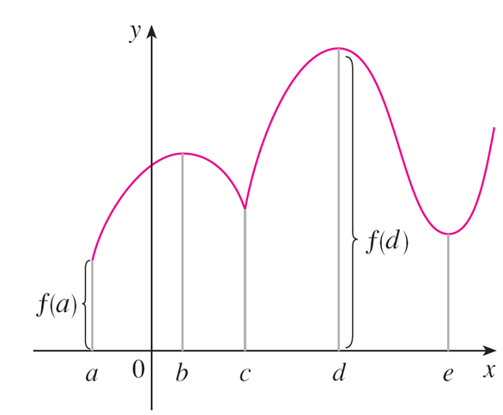
Absolute and Local Extreme Values (3 of 11)
Figure 2 shows the graph of a function f with absolute maximum at d and absolute minimum at a.
Note that (d, f (d)) is the highest point on the graph and (a, f (a)) is the lowest point.
In Figure 2, if we consider only values of x near b [for instance, if we restrict our attention to the interval (a, c)], then f(b) is the largest of those values of f (x) and is called a local maximum value of f.
Abs min f(a), abs max f(d), loc min f(c), f(e), loc max f(b), f(d)
Figure 2

Slide 8
Absolute and Local Extreme Values (4 of 11)
Likewise, f(c) is called a local minimum value of f because f(c) ≤ f(x) for x near c [in the interval (b, d), for instance].
The function f also has a local minimum at e. In general, we have the following definition.
2 Definition The number f(c) is a
local maximum value of f if f(c) ≥ f(x) when x is near c.
local minimum value of f if f(c) ≤ f(x) when x is near c.
In Definition 2 (and elsewhere), if we say that something is true near c, we mean that it is true on some open interval containing c.

Slide 9
Absolute and Local Extreme Values (5 of 12)
For instance, in Figure 3 we see that f (4) = 5 is a local minimum because it’s the smallest value of f on the interval I.
Figure 3

Slide 10
Absolute and Local Extreme Values (6 of 12)
It’s not the absolute minimum because f (x) takes smaller values when x is near 12 (in the interval K, for instance).
In fact f (12) = 3 is both a local minimum and the absolute minimum.
Similarly, f (8) = 7 is a local maximum, but not the absolute maximum because f takes larger values near 1.

Slide 11
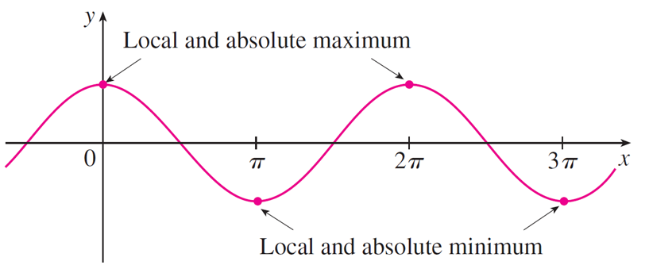
Example 2
The function f (x) = cos x takes on its (local and absolute) maximum value of 1 infinitely many times, because cos 2nπ = 1 for any integer n and −1 ≤ cos x ≤ 1 for all x. (See Figure 5.)
y = cos x
Figure 5
Likewise, cos(2n + 1)π = −1 is its minimum value, where n is any integer.

Slide 12
Absolute and Local Extreme Values (7 of 11)
The following theorem gives conditions under which a function is guaranteed to possess extreme values.
3 The Extreme Value Theorem If f is continuous on a closed interval [a, b], then f attains an absolute maximum value f (c) and an absolute minimum value f (d) at some numbers c and d in [a, b].

Slide 13
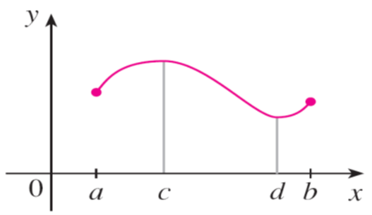
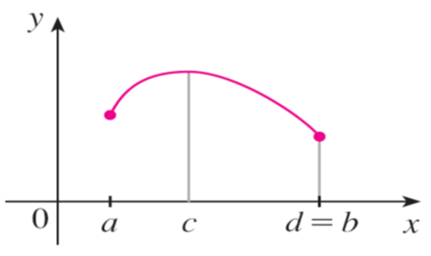
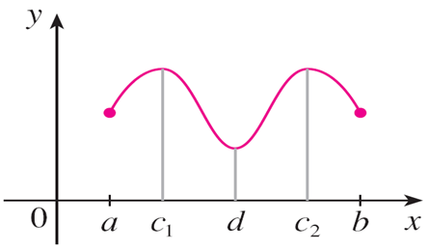
Absolute and Local Extreme Values (8 of 11)
The Extreme Value Theorem is illustrated in Figure 8.
Functions continuous on a closed interval always attain extreme values.
Figure 8
Note that an extreme value can be taken on more than once.

Slide 14
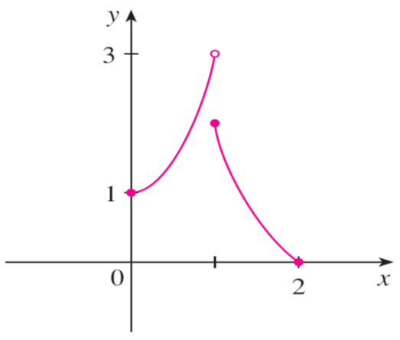
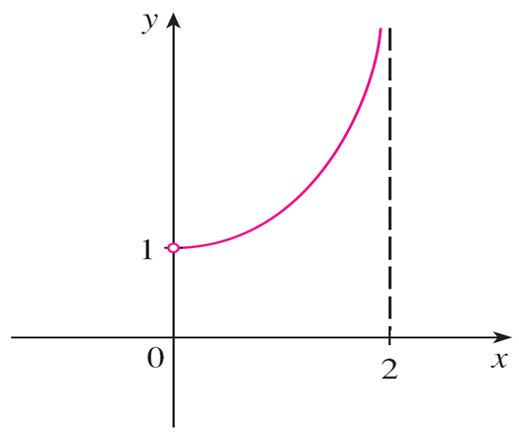
Absolute and Local Extreme Values (9 of 11)
Figures 9 and 10 show that a function need not possess extreme values if either hypothesis (continuity or closed interval) is omitted from the Extreme Value Theorem.
This function has minimum value f (2) = 0, but no maximum value.
This continuous function g has no maximum or minimum.
Figure 9
Figure 10

Slide 15
Absolute and Local Extreme Values (10 of 11)
The function f whose graph is shown in Figure 9 is defined on the closed
interval [0, 2] but has no maximum value. (Notice that the range of f is
The function takes on values arbitrarily close to 3, but never actually attains the value 3.)
This does not contradict the Extreme Value Theorem because f is not continuous.

Slide 16

Absolute and Local Extreme Values (11 of 11)
The function g shown in Figure 10 is continuous on the open interval (0, 2) but has neither a maximum nor a minimum value. [The range of g is (1, ∞). The function takes on arbitrarily large values.]
This does not contradict the Extreme Value Theorem because the interval (0, 2) is not closed.
This continuous function g has no maximum or minimum.
Figure 10

Slide 17
Critical Numbers and the Closed Interval Method

Slide 18
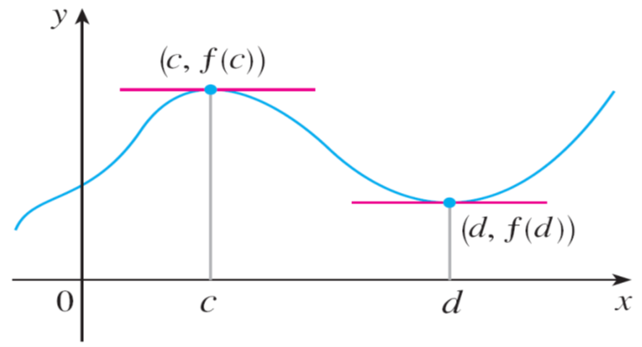
Critical Numbers and the Closed Interval Method (1 of 5)
The Extreme Value Theorem says that a continuous function on a closed interval has a maximum value and a minimum value, but it does not tell us how to find these extreme values.
Figure 11 shows the graph of a function f with a local maximum at c and a local minimum at d.
Figure 11

Slide 19
Critical Numbers and the Closed Interval Method (2 of 5)
It appears that at the maximum and minimum points the tangent lines are horizontal and therefore each has slope 0.
We know that the derivative is the slope of the tangent line, so it appears that
The following theorem says that this is always true for
differentiable functions.
4 Fermat’s Theorem If f has a local maximum or minimum at c, and if
exists, then

Slide 20
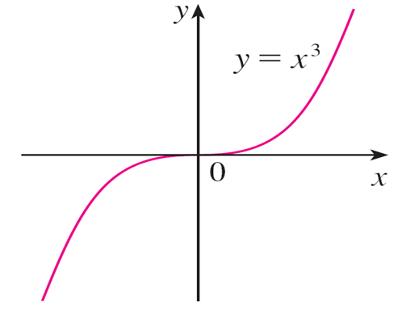
Example 5 (1 of 2)
If
But f has no maximum or minimum at 0, as you can see from its graph in Figure 12.
but ƒ has no maximum or minimum.
Figure 12

Slide 21
Example 5 (2 of 2)
The fact that
simply means that the curve
has a horizontal
tangent at (0, 0).
Instead of having a maximum or minimum at (0, 0), the curve crosses its horizontal tangent there.

Slide 22
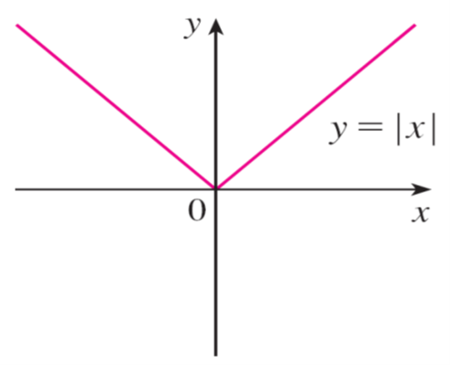
Example 6
The function
has its (local and absolute) minimum value at 0, but
that value can’t be found by setting
does not exist. (See
Figure 13.)
then f (0) = 0 is a minimum value, but
does not exist.
Figure 13

Slide 23
Critical Numbers and the Closed Interval Method (3 of 5)
Examples 5 and 6 show that we must be careful when using Fermat’s Theorem.
Example 5 demonstrates that even when
there need not be a maximum
or minimum at c. (In other words, the converse of Fermat’s Theorem is false in general.)
Furthermore, there may be an extreme value even when
does not exist (as
in Example 6).

Slide 24
Critical Numbers and the Closed Interval Method (4 of 5)
Fermat’s Theorem does suggest that we should at least start looking for extreme
values of f at the numbers c where
does not exist. Such
numbers are given a special name.
6 Definition A critical number of a function f is a number c in the domain of f
such that either
does not exist.
In terms of critical numbers, Fermat’s Theorem can be rephrased as follows.
7 If f has a local maximum or minimum at c, then c is a critical number of f.

Slide 25
Critical Numbers and the Closed Interval Method (5 of 5)
To find an absolute maximum or minimum of a continuous function on a closed interval, we note that either it is local or it occurs at an endpoint of the interval.
Thus the following three-step procedure always works.
The Closed Interval Method To find the absolute maximum and minimum values of a continuous function f on a closed interval [a, b]:
1. Find the values of f at the critical numbers of f in (a, b).
2. Find the values of f at the endpoints of the interval.
3. The largest of the values from Steps 1 and 2 is the absolute maximum value; the smallest of these values is the absolute minimum value.

