Slide 1
4
Applications of Differentiation
Copyright © Cengage Learning. All rights reserved.

Slide 2
4.2
The Mean Value Theorem
Copyright © Cengage Learning. All rights reserved.

Slide 3
The Mean Value Theorem (1 of 1)
We will see that many of the results depend on one central fact, which is called the Mean Value Theorem.

Slide 4
Rolle’s Theorem

Slide 5
Rolle’s Theorem (1 of 3)
To arrive at the Mean Value Theorem we first need the following result.
Rolle’s Theorem Let f be a function that satisfies the following three hypotheses:
1. f is continuous on the closed interval [a, b].
2. f is differentiable on the open interval (a, b).
3. f (a) = f (b)
Then there is a number c in (a, b) such that
Before giving the proof let’s take a look at the graphs of some typical functions that satisfy the three hypotheses.

Slide 6
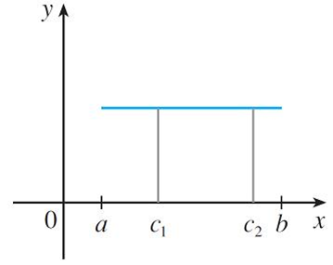
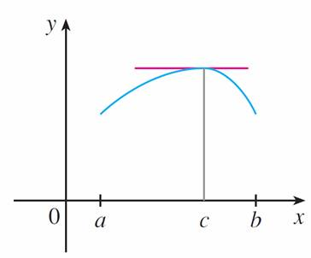
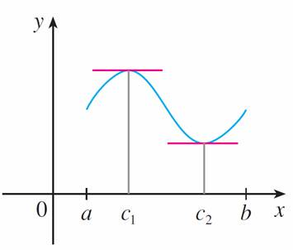
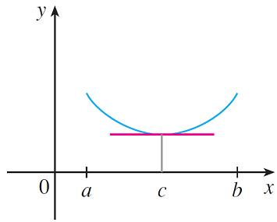
Rolle’s Theorem (2 of 3)
Figure 1 shows the graphs of four such functions.
(a)
(b)
(c)
(d)
Figure 1

Slide 7
Rolle’s Theorem (3 of 3)
In each case it appears that there is at least one point (c, f (c)) on the graph where the tangent is horizontal and therefore
Thus Rolle’s Theorem is plausible.

Slide 8
Example 2
Prove that the equation
has exactly one real solution.
Solution:
First we use the Intermediate Value Theorem to show that a root exists. Let
Then f (0) = −1 < 0 and f (1) = 1 > 0.
Since f is a polynomial, it is continuous, so the Intermediate Value Theorem states that there is a number c between 0 and 1 such that f (c) = 0.
Thus the given equation has a root.

Slide 9
Example 2 – Solution (1 of 2)
To show that the equation has no other real solution, we use Rolle’s Theorem and argue by contradiction.
Suppose that it had two solutions a and b. Then f (a) = 0 = f (b) and, since f is a polynomial, it is differentiable on (a, b) and continuous on [a, b].
Thus, by Rolle’s Theorem, there is a number c between a and b such that

Slide 10
Example 2 – Solution (2 of 2)
But
so
can never be 0. This gives a contradiction.
Therefore the equation can’t have two real roots.

Slide 11
The Mean Value Theorem

Slide 12
The Mean Value Theorem (1 of 6)
Our main use of Rolle’s Theorem is in proving the following important theorem, which was first stated by another French mathematician, Joseph-Louis Lagrange.
The Mean Value Theorem Let f be a function that satisfies the following hypotheses:
1. f is continuous on the closed interval [a, b].
2. f is differentiable on the open interval (a, b).
Then there is a number c in (a, b) such that
or, equivalently,

Slide 13
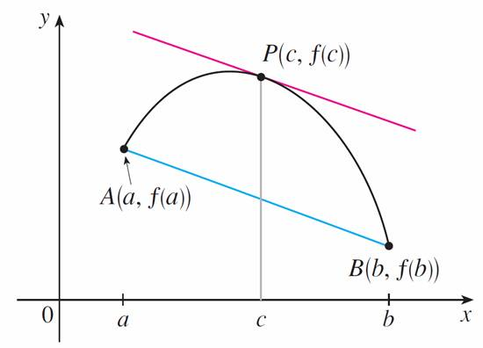
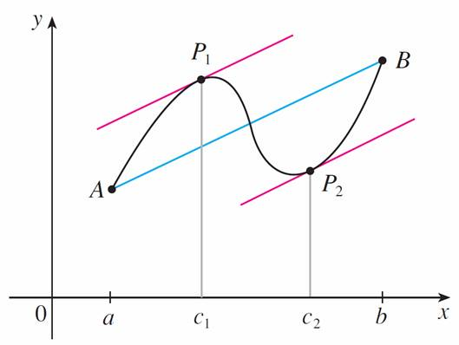
The Mean Value Theorem (2 of 6)
Before proving this theorem, we can see that it is reasonable by interpreting it geometrically. Figures 3 and 4 show the points A (a, f (a)) and B (b, f (b)) on the graphs of two differentiable functions.
Figure 3
Figure 4

Slide 14
The Mean Value Theorem (3 of 6)
The slope of the secant line AB is
which is the same expression as on the right side of Equation 1.

Slide 15
The Mean Value Theorem (4 of 6)
Since
is the slope of the tangent line at the point (c, f (c)), the Mean Value
Theorem, in the form given by Equation 1, says that there is at least one point P (c, f (c)) on the graph where the slope of the tangent line is the same as the slope of the secant line AB.
In other words, there is a point P where the tangent line is parallel to the secant line AB.

Slide 16
Example 3 (1 of 3)
To illustrate the Mean Value Theorem with a specific function, let’s consider
Since f is a polynomial, it is continuous and differentiable for all x, so it is certainly continuous on [0, 2] and differentiable on (0, 2).
Therefore, by the Mean Value Theorem, there is a number c in (0, 2) such that

Slide 17
Example 3 (2 of 3)
Now f (2) = 6,
f (0) = 0, and
so this equation becomes
which gives
But c must lie in (0, 2), so

Slide 18
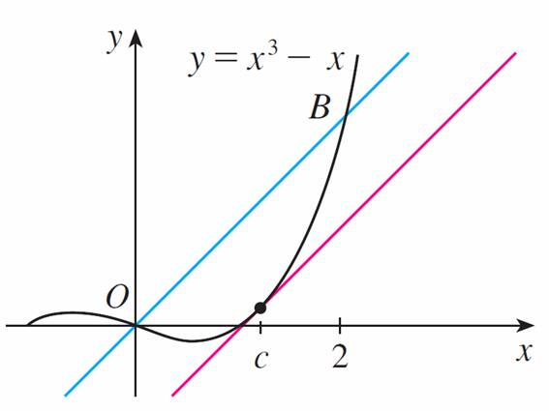
Example 3 (3 of 3)
Figure 6 illustrates this calculation:
the tangent line at this value of c is parallel to the secant line O B.
Figure 6

Slide 19
Example 5
Suppose that f (0) = −3 and
for all values of x. How large can f(2)
possibly be?
Solution:
We are given that f is differentiable (and therefore continuous) everywhere.
In particular, we can apply the Mean Value Theorem on the interval [0, 2]. There exists a number c such that

Slide 20
Example 5 – Solution
So
We are given that
for all x, so in particular we know that
Multiplying both sides of this inequality by 2, we have
The largest possible value for f(2) is 7.

Slide 21
The Mean Value Theorem (5 of 6)
The Mean Value Theorem can be used to establish some of the basic facts of differential calculus.
One of these basic facts is the following theorem.
5 Theorem If
for all x in an interval (a, b), then f is constant on (a, b).
7 Corollary If
for all x in an interval (a, b), then f − g is constant on
(a, b); that is, f (x) = g(x) + c where c is a constant.

Slide 22
The Mean Value Theorem (6 of 6)
Note
Care must be taken in applying Theorem 5. Let
The domain of f is
for all x in D. But f is obviously not
a constant function.
This does not contradict Theorem 5 because D is not an interval.

