Slide 1
4
Applications of Differentiation
Copyright © Cengage Learning. All rights reserved.

Slide 2
4.3
What Derivatives Tell Us about the Shape of a Graph
Copyright © Cengage Learning. All rights reserved.

Slide 3
What Does f ′ Say About f ?

Slide 4
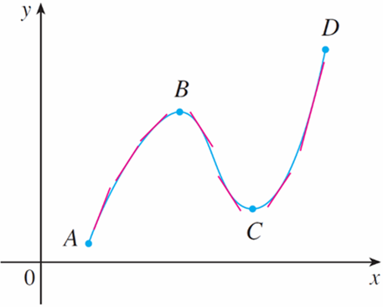
What Does f ′ Say About f ? (1 of 2)
To see how the derivative of f can tell us where a function is increasing or decreasing, look at Figure 1.
Figure 1
Between A and B and between C and D, the tangent lines have positive slope
and so

Slide 5
What Does f ′ Say About f ? (2 of 2)
Between B and C the tangent lines have negative slope and so
Thus it appears that f increases when
is positive and decreases when
is negative.
To prove that this is always the case, we use the Mean Value Theorem.
Increasing/Decreasing Test
(a) If
on an interval, then f is increasing on that interval.
(b) If
on an interval, then f is decreasing on that interval.

Slide 6
Example 1
Find where the function
is increasing and where it is
decreasing.
Solution:
We start by differentiating f :
To use the I/D Test we have to know where
To solve these inequalities we first find where
namely at x = 0, 2, and −1.

Slide 7
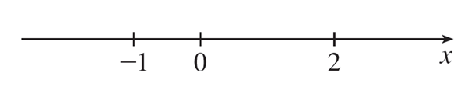
Example 1 – Solution (1 of 3)
These are the critical numbers of f, and they divide the domain into four intervals (see the number line in Figure 2).
Figure 2
Within each interval,
must be always positive or always negative.
We can determine which is the case for each interval from the signs of the
three factors of
namely, 12x, x − 2, and x + 1, as shown in the chart.

Slide 8
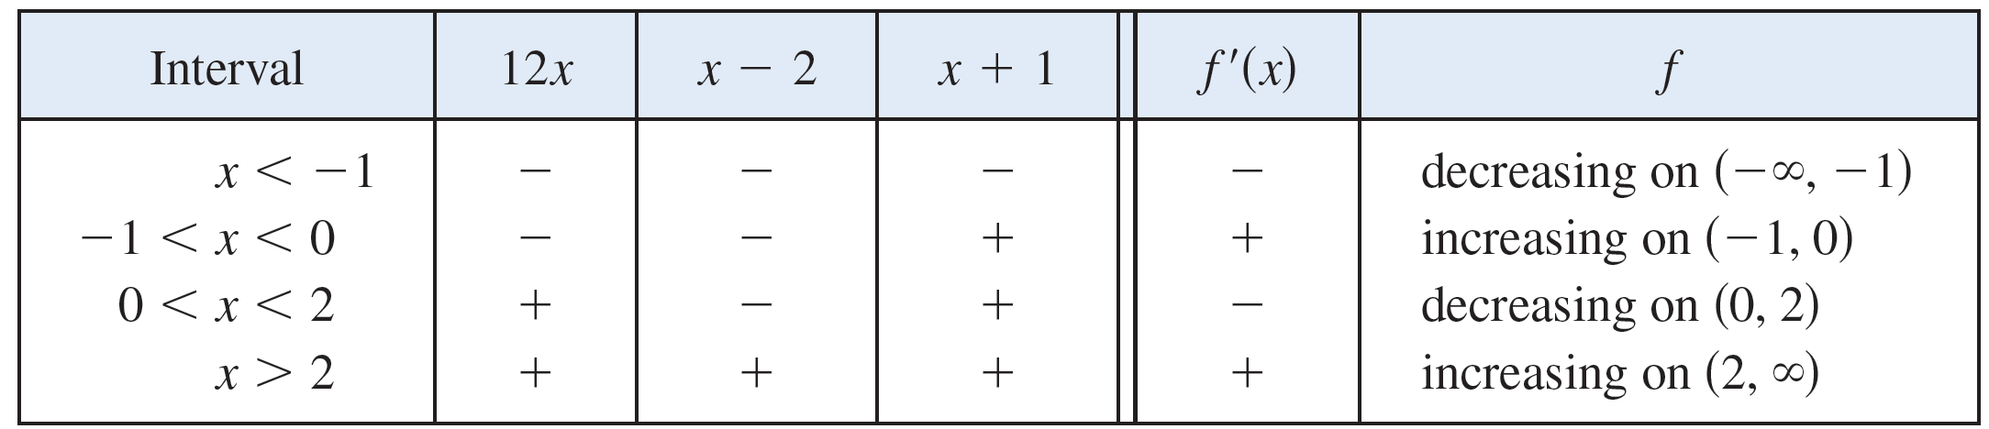
Example 1 – Solution (2 of 3)
A plus sign indicates that the given expression is positive, and a minus sign indicates that it is negative. The last column of the chart gives the conclusion based on the I/D Test.
For instance,
for 0 < x < 2, so f is decreasing on (0, 2). (It would also be
true to say that f is decreasing on the closed interval [0, 2].)

Slide 9
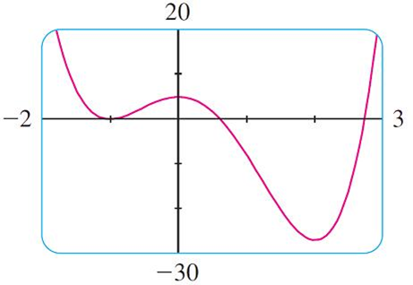
Example 1 – Solution (3 of 3)
The graph of f shown in Figure 3 confirms the information in the chart.
Figure 3

Slide 10
The First Derivative Test

Slide 11
The First Derivative Test (1 of 3)
You can see from Figure 3 that f (0) = 5 is a local maximum value of f because f increases on (−1, 0) and decreases on (0, 2). Or, in terms of derivatives,
In other words, the sign of
changes from positive to negative at 0. This
observation is the basis of the following test.
The First Derivative Test Suppose that c is a critical number of a continuous function f.
(a) If
changes from positive to negative at c, then f has a local maximum at c.
(b) If
changes from negative to positive at c, then f has a local minimum at c.
(c) If
is positive to the left and right of c, or negative to the left and right of c,
then f has no local maximum or minimum at c.

Slide 12
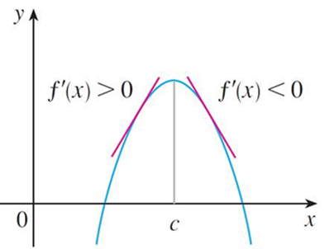
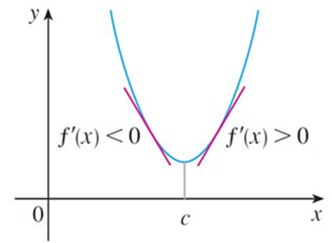
The First Derivative Test (2 of 3)
The First Derivative Test is a consequence of the I/D Test. In part (a), for
instance, since the sign of
changes from positive to negative at c, f is
increasing to the left of c and decreasing to the right of c. It follows that f has a local maximum at c.
It is easy to remember the First Derivative Test by visualizing diagrams such as those in Figure 4.
Local maximum at c
Local minimum at c
Figure 4(a)
Figure 4(b)

Slide 13
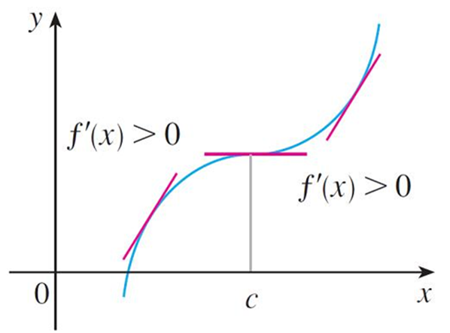
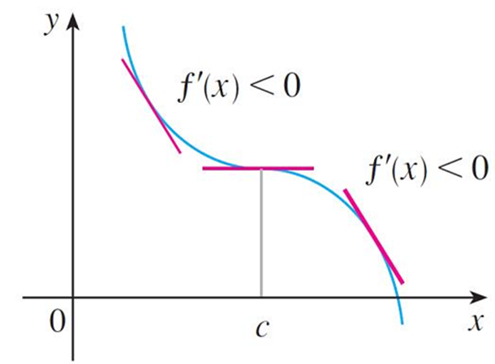
The First Derivative Test (3 of 3)
No maximum or minimum at c
No maximum or minimum at c
Figure 3(c)
Figure 3(d)

Slide 14
Example 3
Find the local maximum and minimum values of the function
Solution:
We start by finding the critical numbers. The derivative is:
The solutions of this equation are

Slide 15
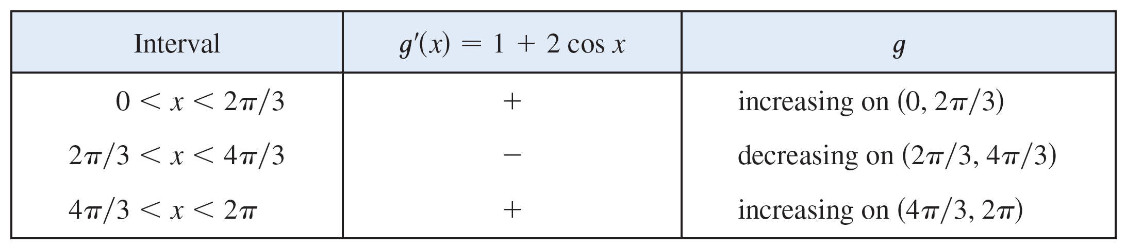
Example 3 – Solution (1 of 4)
Because g is differentiable everywhere, the only critical numbers are
We split the domain into intervals according to the critical numbers. Within each interval,
is either always positive or always negative and so
we analyze g in the following chart.

Slide 16
Example 3 – Solution (2 of 4)
Because
changes from positive to negative at
the First Derivative
Test tells us that there is a local maximum at
and the local maximum value is

Slide 17
Example 3 – Solution (3 of 4)
Likewise
changes from negative to positive at
and so
is a local minimum value.

Slide 18
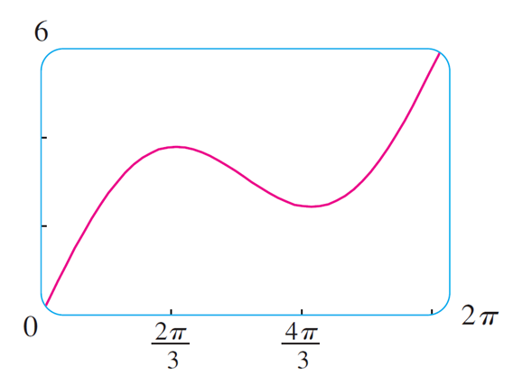
Example 3 – Solution (4 of 4)
The graph of g in Figure 5 supports our conclusion.
g(x) = x + 2 sin x
Figure 5

Slide 19
What Does f″ Say About f ?

Slide 20
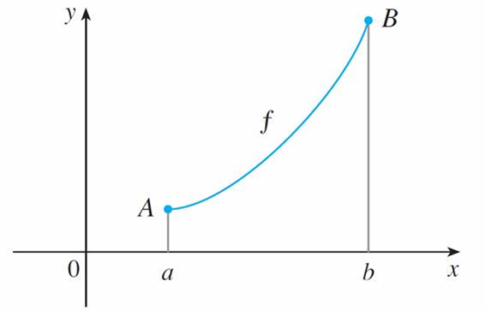
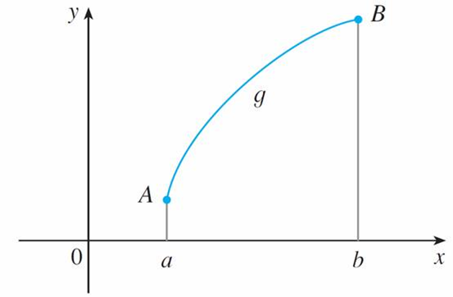
What Does f″ Say About f ? (1 of 7)
Figure 6 shows the graphs of two increasing functions on (a, b). Both graphs join point A to point B but they look different because they bend in different directions.
Figure 6(a)
Figure 6(b)

Slide 21
What Does f″ Say About f ? (2 of 7)
In Figure 7 tangents to these curves have been drawn at several points. In (a) the curve lies above the tangents and f is called concave upward on (a, b). In (b) the curve lies below the tangents and g is called concave downward on (a, b).
Concave upward
Concave downward
Figure 7(a)
Figure 7(b)

Slide 22
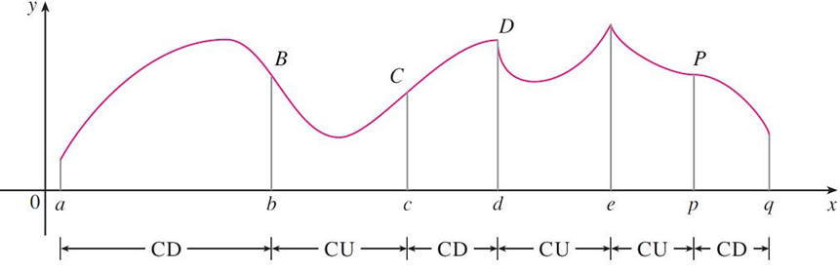
What Does f″ Say About f ? (3 of 7)
Definition If the graph of f lies above all of its tangents on an interval I, then f is called concave upward on I. If the graph of f lies below all of its tangents on I, then f is called concave downward on I.
Figure 8 shows the graph of a function that is concave upward (C U) on the intervals (b, c), (d, e), and (e, p) and concave downward (C D) on the intervals (a, b), (c, d ), and (p, q).
Figure 8

Slide 23
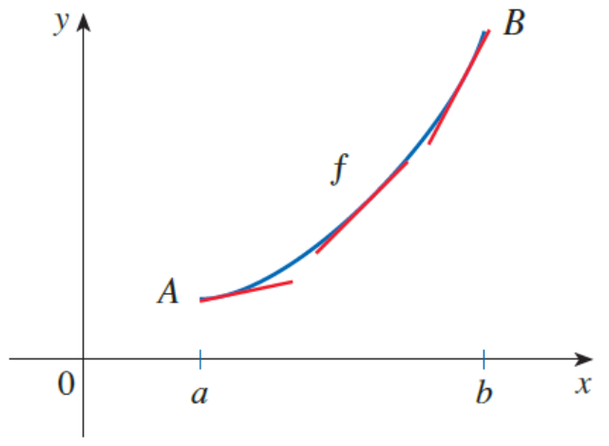
What Does f″ Say About f ? (4 of 7)
Let’s see how the second derivative helps determine the intervals of concavity. Looking at Figure 7(a), you can see that, going from left to right, the slope of the tangent increases.
Concave upward
Figure 7(a)

Slide 24
What Does f″ Say About f ? (5 of 7)
This means that the derivative
is an increasing function and therefore its
derivative
is positive.
Likewise, in Figure 7(b) the slope of the tangent decreases from left to right, so
decreases and therefore
is negative.
Concave downward
Figure 7(b)

Slide 25
What Does f″ Say About f ? (6 of 7)
This reasoning can be reversed and suggests that the following theorem is true.
Concavity Test
(a) If
on an interval I, then the graph of f is concave upward on I.
(b) If
on an interval I, then the graph of f is concave downward on I.

Slide 26
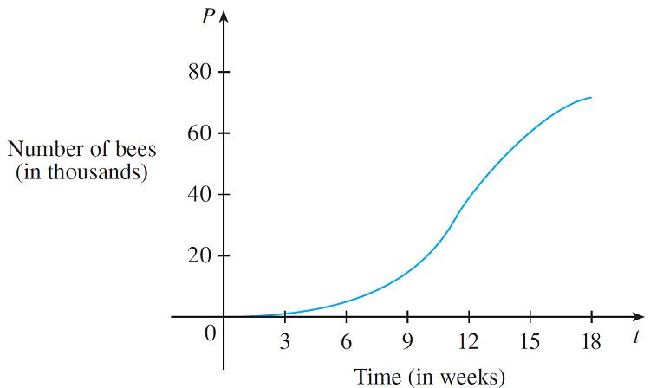
Example 4
Figure 9 shows a population graph for honeybees raised in an apiary. How does the rate of population growth change over time? When is this rate highest?
Over what intervals is P concave upward or concave downward?
Figure 9

Slide 27
Example 4 – Solution
By looking at the slope of the curve as t increases, we see that the rate of growth of the population is initially very small, then gets larger until it reaches a maximum at about t =12 weeks, and decreases as the population begins to level off.
As the population approaches its maximum value of about 75,000 (called the
carrying capacity), the rate of increase,
approaches 0.
The curve appears to be concave upward on (0, 12) and concave downward on (12, 18).

Slide 28
What Does f″ Say About f ? (7 of 7)
Definition A point P on a curve y = f(x) is called an inflection point if f is continuous there and the curve changes from concave upward to concave downward or from concave downward to concave upward at P.

Slide 29
The Second Derivative Test

Slide 30
The Second Derivative Test (1 of 1)
The Second Derivative Test Suppose
is continuous near c.
(a) If
then f has a local minimum at c.
(b) If
then f has a local maximum at c.

Slide 31
Example 6
Discuss the curve
with respect to concavity, points of inflection, and
local maxima and minima.
Solution:

Slide 32
Example 6 – Solution (1 of 3)
To find the critical numbers we set
and obtain x = 0 and x = 3.
To use the Second Derivative Test we evaluate
at these critical numbers:
Since
is a local minimum.

Slide 33
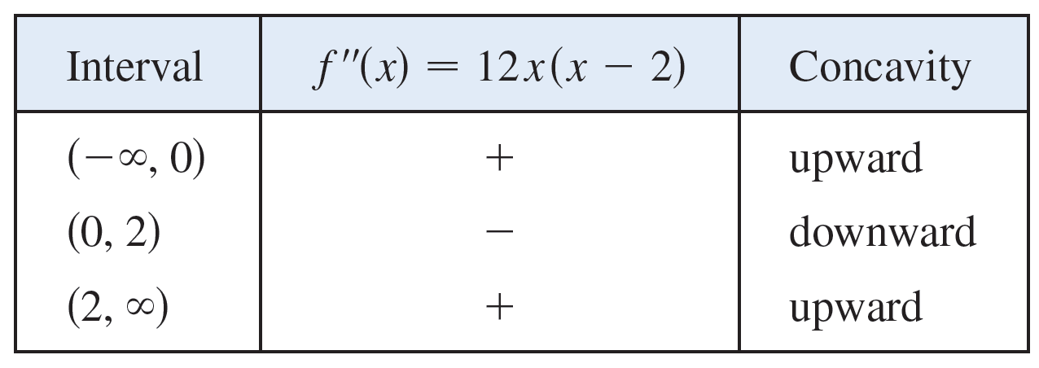
Example 6 – Solution (2 of 3)
Because
the Second Derivative Test gives no information about the
critical number 0.
But since
for x < 0 and also for 0 < x < 3, the First Derivative Test
tells us that f does not have a local maximum or minimum at 0.
Since
when x = 0 or 2, we divide the real line into intervals with these
numbers as endpoints and complete the following chart.

Slide 34
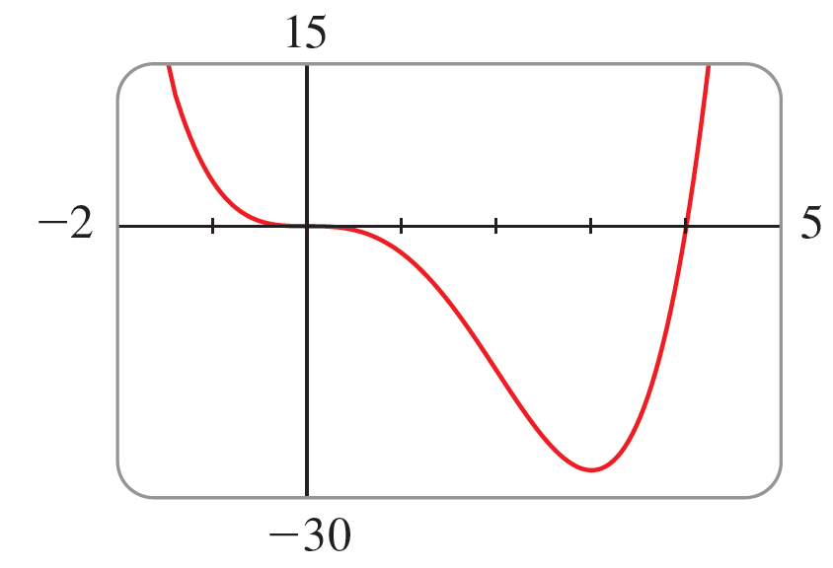
Example 6 – Solution (3 of 3)
The point (0, 0) is an inflection point because the curve changes from concave upward to concave downward there.
Also (2, −16) is an inflection point since the curve changes from concave downward to concave upward there.
The graph of
in Figure 12 supports our conclusions.
Figure 12

Slide 35
Curve Sketching

Slide 36
Curve Sketching (1 of 1)
We now use the information we obtain from the first and second derivatives to sketch the graph of a function.

Slide 37
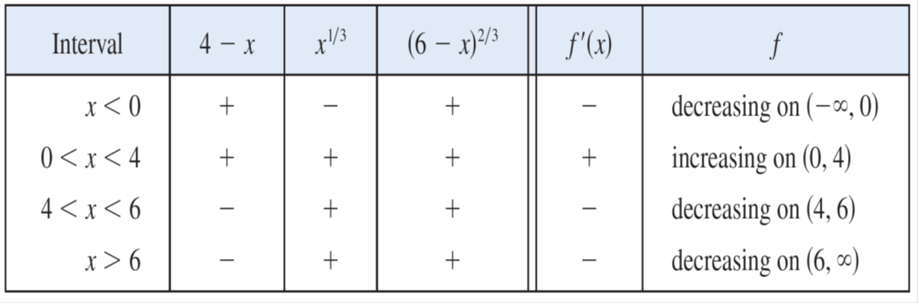
Example 7
Sketch the graph of the function
Solution:
Calculation of the first two derivatives gives
Since
does not exist when x = 0 or x = 6, the
critical numbers are 0, 4 and 6.

Slide 38
Example 7 – Solution (1 of 3)
To find the local extreme values we use the First Derivative Test.
Since
changes from negative to positive at 0, f(0) = 0 is a local minimum.
Since
changes from positive to negative at 4,
a local maximum.
The sign of
does not change at 6, so there is no minimum or maximum there.
(The Second Derivative Test could be used at 4 but not at 0 or 6 since
does not exist at either of these numbers.)

Slide 39
Example 7 – Solution (2 of 3)
Looking at the expression for
and noting that
for all x, we have
for x < 0 and for 0 < x < 6 and
So f is concave downward on (−∞, 0) and (0, 6) and concave upward on (6, ∞), and the only inflection point is (6, 0).

Slide 40
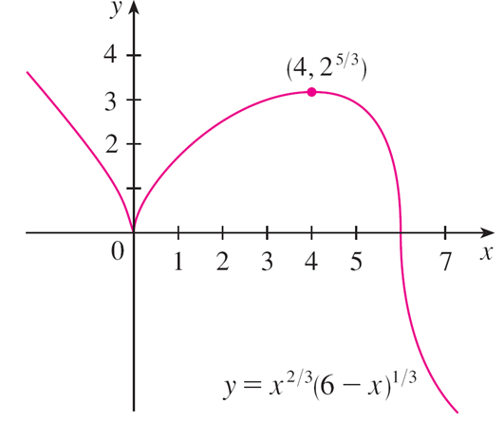
Example 7 – Solution (3 of 3)
Using all of the information we gathered about f from its first and second derivatives, we sketch the graph in Figure 13.
Figure 13

