Slide 1
4
Applications of Differentiation
Copyright © Cengage Learning. All rights reserved.

Slide 2
4.5
Summary of Curve Sketching
Copyright © Cengage Learning. All rights reserved.

Slide 3
Guidelines for Sketching a Curve

Slide 4
Guidelines for Sketching a Curve (1 of 11)
The following checklist is intended as a guide to sketching a curve y = f (x) by hand. Not every item is relevant to every function. (For instance, a given curve might not have an asymptote or possess symmetry.)
But the guidelines provide all the information you need to make a sketch that displays the most important aspects of the function.
A. Domain It’s often useful to start by determining the domain D of f, that is, the set of values of x for which f (x) is defined.

Slide 5
Guidelines for Sketching a Curve (2 of 11)
B. Intercepts The y-intercept is f (0) and this tells us where the curve intersects the y-axis. To find the x-intercepts, we set y = 0 and solve for x. (You can omit this step if the equation is difficult to solve.)
C. Symmetry
(i) If f (−x) = f (x) for all x in D, that is, the equation of the curve is unchanged when x is replaced by −x, then f is an even function and the curve is symmetric about the y-axis.

Slide 6
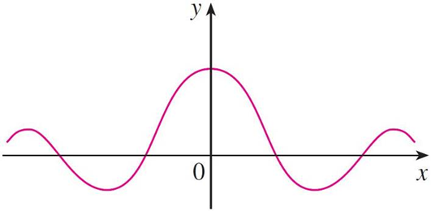
Guidelines for Sketching a Curve (3 of 11)
This means that our work is cut in half. If we know what the curve looks like for x ≥ 0, then we need only reflect about the y-axis to obtain the complete curve [see Figure 3(a)].
Even function: reflectional symmetry
Figure 3(a)
Here are some examples:

Slide 7
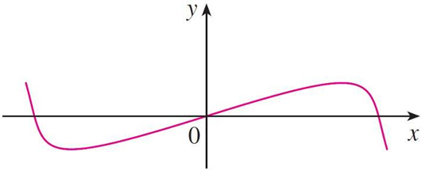
Guidelines for Sketching a Curve (4 of 11)
(ii) If f (−x) = −f (x) for all x in D, then f is an odd function and the curve is symmetric about the origin. Again we can obtain the complete curve if we know what it looks like for x ≥ 0.
[Rotate 180° about the origin; see Figure 3(b).]
Odd function: rotational symmetry
Figure 3(b)
Some simple examples of odd functions are

Slide 8
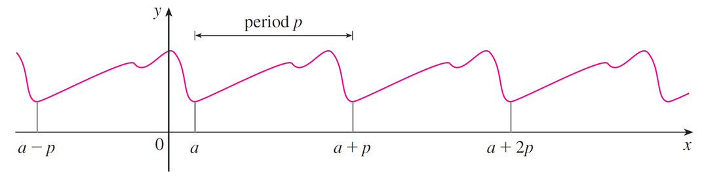
Guidelines for Sketching a Curve (5 of 11)
(iii) If f (x + p) = f (x) for all x in D, where p is a positive constant, then f is called a periodic function and the smallest such number p is called the period.
For instance, y = sin x has period 2π and y = tan x has period π. If we know what the graph looks like in an interval of length p, then we can use translation to sketch the entire graph (see Figure 4).
Periodic function: translational symmetry
Figure 4

Slide 9
Guidelines for Sketching a Curve (6 of 11)
D. Asymptotes
(i) Horizontal Asymptotes. If either
then the line
y = L is a horizontal asymptote of the curve y = f (x).
If it turns out that
then we do not have an asymptote to
the right, but this fact is still useful information for sketching the curve.

Slide 10
Guidelines for Sketching a Curve (7 of 11)
(ii) Vertical Asymptotes. The line x = a is a vertical asymptote if at least one of the following statements is true:
(For rational functions you can locate the vertical asymptotes by equating the denominator to 0 after canceling any common factors. But for other functions this method does not apply.)

Slide 11
Guidelines for Sketching a Curve (8 of 11)
Furthermore, in sketching the curve it is very useful to know exactly which of the statements in (1) is true.
If f (a) is not defined but a is an endpoint of the domain of f, then you should
compute
whether or not this limit is infinite.
(iii) Slant Asymptotes.
E. Intervals of Increase or Decrease Use the I/D Test. Compute
and find the intervals on which
is positive (f is increasing) and the intervals on
which
is negative (f is decreasing).

Slide 12
Guidelines for Sketching a Curve (9 of 11)
F. Local Maximum and Minimum Values Find the critical numbers of f [the numbers c where
does not exist]. Then use the First Derivative
Test. If
changes from positive to negative at a critical number c, then f (c) is a
local maximum.
changes from negative to positive at c, then f (c) is a local minimum.
Although it is usually preferable to use the First Derivative Test, you can use the Second Derivative Test if
Then
implies that f (c) is a local minimum, whereas
implies that f (c) is a local maximum.

Slide 13
Guidelines for Sketching a Curve (10 of 11)
G. Concavity and Points of Inflection Compute
and use the Concavity
Test. The curve is concave upward where
and concave downward where
Inflection points occur where the direction of concavity changes.
H. Sketch the Curve Using the information in items A–G, draw the graph. Sketch the asymptotes as dashed lines. Plot the intercepts, maximum and minimum points, and inflection points.

Slide 14
Guidelines for Sketching a Curve (11 of 11)
Then make the curve pass through these points, rising and falling according to E, with concavity according to G, and approaching the asymptotes.
If additional accuracy is desired near any point, you can compute the value of the derivative there. The tangent indicates the direction in which the curve proceeds.

Slide 15
Example 1 (1 of 6)
Use the guidelines to sketch the curve
A. Domain The domain is
B. Intercepts The x- and y-intercepts are both 0.
C. Symmetry Since f (−x) = f (x), the function f is even. The curve is symmetric about the y-axis.

Slide 16
Example 1 (2 of 6)
D. Asymptotes
Therefore the line y = 2 is a horizontal asymptote.
Since the denominator is 0 when x = ±1, we compute the following limits:

Slide 17
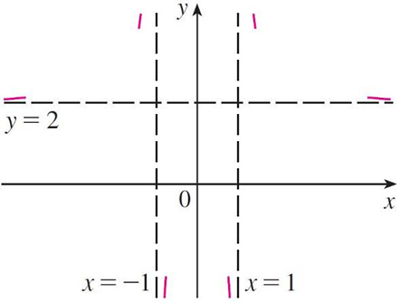
Example 1 (3 of 6)
Therefore the lines x = 1 and x = −1 are vertical asymptotes.
This information about limits and asymptotes enables us to draw the preliminary sketch in Figure 5, showing the parts of the curve near the asymptotes.
Preliminary sketch
Figure 5

Slide 18
Example 1 (4 of 6)
E. Intervals of Increase or Decrease
Since
f is increasing on (−∞, −1) and (−1, 0) and decreasing on (0, 1) and (1, ∞).
F. Local Maximum or Minimum Values The only critical number is x = 0.
Since
changes from positive to negative at 0, f (0) = 0 is a local maximum
by the First Derivative Test.

Slide 19
Example 1 (5 of 6)
G. Concavity and Points of Inflection
Since
for all x, we have
and
Thus the curve is concave upward on the intervals
(−∞, −1) and (1, ∞) and concave downward on (−1, 1). It has no point of inflection since 1 and −1 are not in the domain of f.

Slide 20
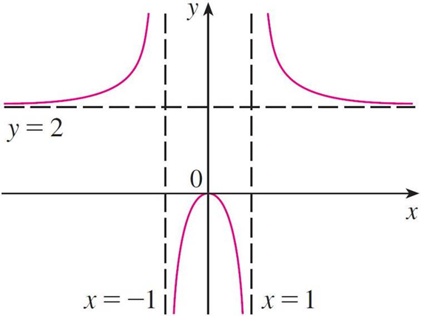
Example 1 (6 of 6)
H. Sketch the Curve Using the information in E–G, we finish the sketch in Figure 6.
Figure 6

Slide 21
Slant Asymptotes

Slide 22
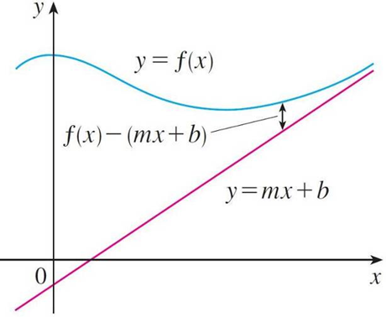
Slant Asymptotes (1 of 2)
Some curves have asymptotes that are oblique, that is, neither horizontal nor vertical. If
where m ≠ 0, then the line y = mx + b is called a slant asymptote because the vertical distance between the curve y = f (x) and the line y = mx + b approaches 0, as in Figure 12.
(A similar situation exists if we let x → −∞.)
Figure 12

Slide 23
Slant Asymptotes (2 of 2)
In the case of rational functions, slant asymptotes occur when the degree of the numerator is one more than the degree of the denominator.
In such a case the equation of the slant asymptote can be found by long division as in the next example.

Slide 24
Example 6 (1 of 6)
Sketch the graph of
A. Domain The domain is
B. Intercepts The x- and y-intercepts are both 0.
C. Symmetry Since f (−x) = −f (x), f is odd and its graph is symmetric about the origin.
D. Asymptotes Since
is never 0, there is no vertical asymptote. Since
there is no
horizontal asymptote.

Slide 25
Example 6 (2 of 6)
But long division gives
This equation suggests that y = x is a candidate for a slant asymptote.
In fact,

Slide 26
Example 6 (3 of 6)
So the line y = x is a slant asymptote.
E. Intervals of Increase or Decrease
Since
for all x (except 0), f is increasing on (−∞, ∞).
F. Local Maximum or Minimum Values Although
does not change sign at 0, so there is no local maximum or minimum.

Slide 27
Example 6 (4 of 6)
G. Concavity and Points of Inflection

Slide 28
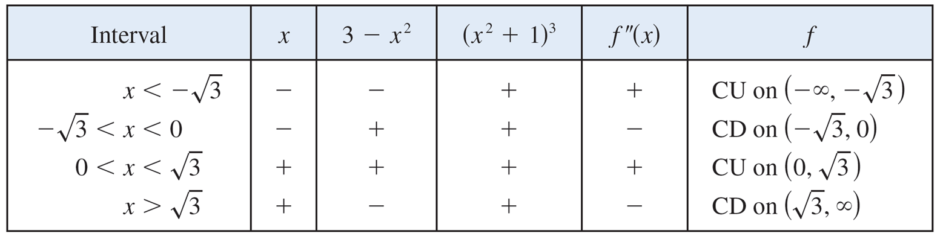
Example 6 (5 of 6)
Since
we set up the following chart:
The points of inflection are

Slide 29
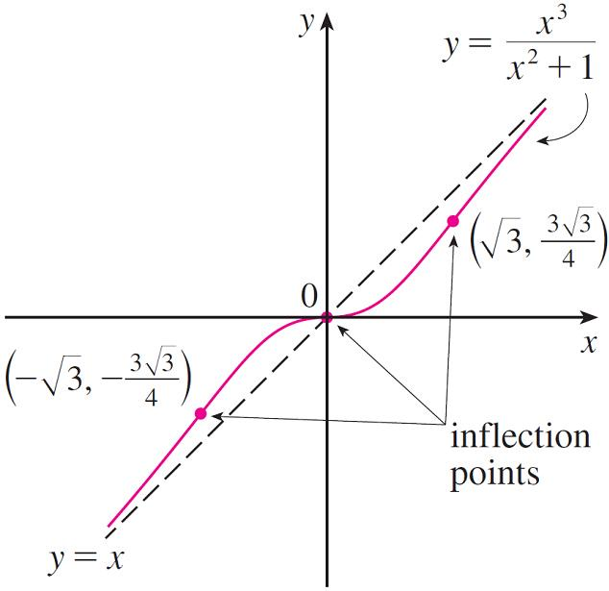
Example 6 (6 of 6)
H. Sketch the Curve The graph of f is sketched in Figure 13.
Figure 13

