Slide 1
4
Applications of Differentiation
Copyright © Cengage Learning. All rights reserved.

Slide 2
4.6
Graphing with Calculus and Technology
Copyright © Cengage Learning. All rights reserved.

Slide 3
Graphing with Calculus and Technology (1 of 1)
In this section we start with a graph produced by a graphing calculator or computer and then we refine it.
We use calculus to make sure that we reveal all the important aspects of the curve.
And with the use of graphing devices we can tackle curves that would be far too complicated to consider without technology. The theme is the interaction between calculus and calculators.

Slide 4
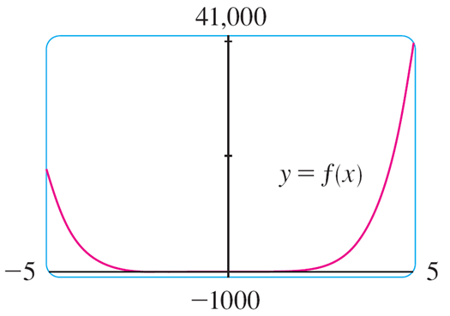
Example 1
Graph the polynomial
Use the graphs of
to estimate all maximum and minimum points and intervals of concavity.
Solution:
If we specify a domain but not a range, graphing software will often deduce a suitable range from the values computed.
Figure 1 shows a plot that may result if we specify that −5 ≤ x ≤ 5.
Figure 1

Slide 5
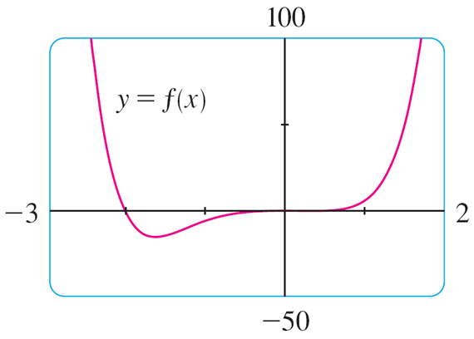
Example 1 – Solution (1 of 6)
Although this viewing rectangle is useful for showing that the asymptotic
behavior (or end behavior) is the same as for
it is obviously hiding
some finer detail.
So we change to the viewing rectangle [−3, 2] by [−50, 100] shown in Figure 2.
Figure 2

Slide 6
Example 1 – Solution (2 of 6)
Most graphing calculators and graphing software allow us to “trace” along a curve and see approximate coordinates of points. (Some also have features to identify the approximate locations of local maximum and minimum points.)
Here it appears that there is an absolute minimum value of about −15.33 when x ≈ −1.62 and f is decreasing on (−∞, −1.62) and increasing on (−1.62, ∞).
Also there appears to be a horizontal tangent at the origin and inflection points when x = 0 and when x is somewhere between −2 and −1.
Now let’s try to confirm these impressions using calculus. We differentiate and get

Slide 7
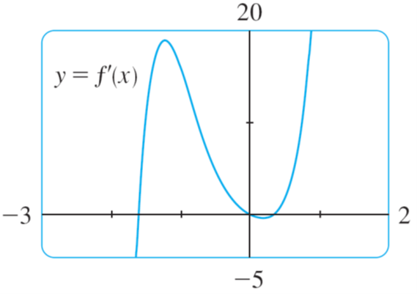
Example 1 – Solution (3 of 6)
When we graph
in Figure 3 we see that
changes from negative to
positive when x ≈ –1.62; this confirms (by the First Derivative Test) the minimum value that we found earlier. But, perhaps to our surprise, we also notice that
changes from positive to negative when x = 0 and from negative to positive
when x ≈ 0.35.
Figure 3

Slide 8
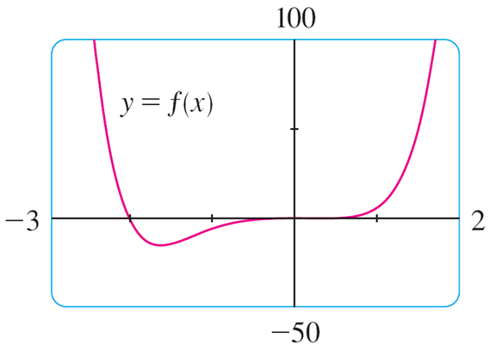
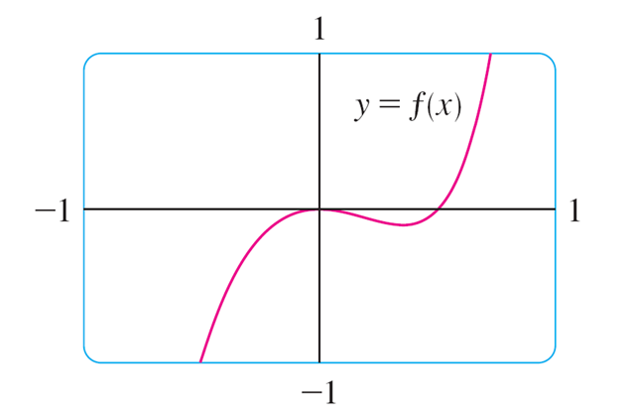
Example 1 – Solution (4 of 6)
This means that f has a local maximum at 0 and a local minimum when x ≈ 0.35, but these were hidden in Figure 2. Indeed, if we now zoom in toward the origin in Figure 4, we see what we missed before: a local maximum value of 0 when x = 0 and a local minimum value of about −0.1 when x ≈ 0.35.
Figure 2
Figure 4

Slide 9
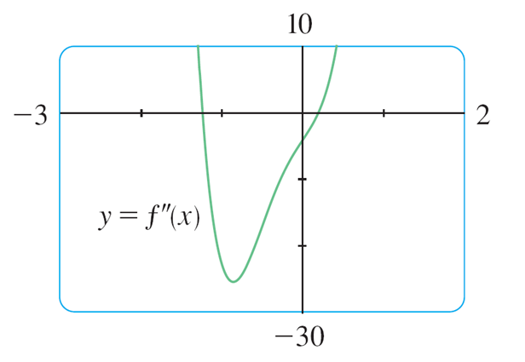
Example 1 – Solution (5 of 6)
What about concavity and inflection points?
From Figures 2 and 4 there appear to be inflection points when x is a little to the left of −1 and when x is a little to the right of 0. But it’s difficult to determine
inflection points from the graph of f, so we graph the second derivative
In Figure 5.
Figure 5

Slide 10
Example 1 – Solution (6 of 6)
We see that
changes from positive to negative when x ≈ −1.23 and from
negative to positive when x ≈ 0.19.
So, correct to two decimal places, f is concave upward on (−∞, −1.23) and (0.19, ∞) and concave downward on (−1.23, 0.19).
The inflection points are (−1.23, −10.18) and (0.19, −0.05).
We have discovered that no single graph reveals all the important features of this polynomial. But Figures 2 and 4, when taken together, do provide an accurate picture.

