Slide 1
4
Applications of Differentiation
Copyright © Cengage Learning. All rights reserved.

Slide 2
4.7
Optimization Problems
Copyright © Cengage Learning. All rights reserved.

Slide 3
Optimization Problems (1 of 5)
In solving such practical problems the greatest challenge is often to convert the word problem into a mathematical optimization problem by setting up the function that is to be maximized or minimized.
Let’s recall the problem-solving principles.

Slide 4
Optimization Problems (2 of 5)
Steps In Solving Optimization Problems
1. Understand the Problem The first step is to read the problem carefully until it is clearly understood. Ask yourself: What is the unknown? What are the given quantities? What are the given conditions?
2. Draw a Diagram In most problems it is useful to draw a diagram and identify the given and required quantities on the diagram.
3. Introduce Notation Assign a symbol to the quantity that is to be maximized or minimized (let’s call it Q for now).

Slide 5
Optimization Problems (3 of 5)
Also select symbols (a, b, c, . . . , x, y) for other unknown quantities and label the diagram with these symbols. It may help to use initials as suggestive symbols—for example, A for area, h for height, t for time.
4. Express Q in terms of some of the other symbols from Step 3.
5. If Q has been expressed as a function of more than one variable in Step 4, use the given information to find relationships (in the form of equations) among these variables. Then use these equations to eliminate all but one of the variables in the expression for Q.

Slide 6
Optimization Problems (4 of 5)
Thus Q will be expressed as a function of one variable x, say, Q = f (x). Write the domain of this function in the given context.
6. Use the previous methods to find the absolute maximum or minimum value of f. In particular, if the domain of f is a closed interval, then the Closed Interval Method can be used.

Slide 7
Example 1
A farmer has 2400 ft of fencing and wants to fence off a rectangular field that borders a straight river. He needs no fence along the river. What are the dimensions of the field that has the largest area?

Slide 8
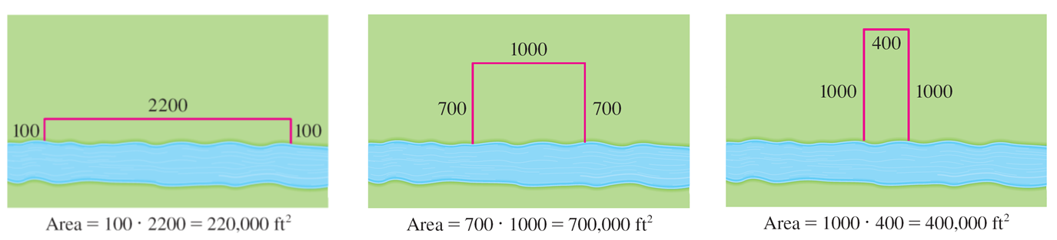
Example 1 – Solution (1 of 5)
In order to get a feeling for what is happening in this problem, let’s experiment with some special cases. Figure 1 (not to scale) shows three possible ways of laying out the 2400 ft of fencing.
Figure 1

Slide 9
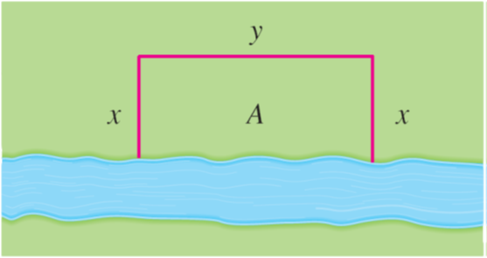
Example 1 – Solution (2 of 5)
We see that when we try shallow, wide fields or deep, narrow fields, we get relatively small areas. It seems plausible that there is some intermediate configuration that produces the largest area.
Figure 2 illustrates the general case. We wish to maximize the area A of the rectangle.
Figure 2

Slide 10
Example 1 – Solution (3 of 5)
Let x and y be the depth and width of the rectangle (in feet). Then we express A in terms of x and y:
A = xy
We want to express A as a function of just one variable, so we eliminate y by expressing it in terms of x. To do this we use the given information that the total length of the fencing is 2400 ft.
Thus
2x + y = 2400
From this equation we have y = 2400 − 2x, which gives

Slide 11
Example 1 – Solution (4 of 5)
Note that the largest x can be is 1200 (this uses all the fence for the depth and none for the width) and x can’t be negative, so the function that we wish to maximize is
The derivative is
so to find the critical numbers we solve the
equation
2400 − 4x = 0
which gives x = 600.
The maximum value of A must occur either at this critical number or at an endpoint of the interval.

Slide 12
Example 1 – Solution (5 of 5)
Since A(0) = 0, A(600) = 720,000, and A(1200) = 0, the Closed Interval Method gives the maximum value as A(600) = 720,000.
[Alternatively, we could have observed that
for all x, so A is
always concave downward and the local maximum at x = 600 must be an absolute maximum.]
The corresponding y-value is y = 2400 − 2(600) = 1200; so the rectangular field should be 600 ft deep and 1200 ft wide.

Slide 13
Optimization Problems (5 of 5)
First Derivative Test for Absolute Extreme Values Suppose that c is a critical number of a continuous function f defined on an interval.
(a) If
for all x < c and
for all x > c, then f(c) is the absolute
maximum value of f.
(b) If
for all x < c and
for all x > c, then f(c) is the absolute
minimum value of f.

Slide 14
Applications to Business and Economics

Slide 15
Applications to Business and Economics (1 of 3)
We know that if C(x), the cost function, is the cost of producing x units of a certain product, then the marginal cost is the rate of change of C with respect to x.
In other words, the marginal cost function is the derivative,
of the cost
function.
Now let’s consider marketing. Let p(x) be the price per unit that the company can charge if it sells x units.
Then p is called the demand function (or price function) and we would expect it to be a decreasing function of x. (More units sold corresponds to a lower price.)

Slide 16
Applications to Business and Economics (2 of 3)
If x units are sold and the price per unit is p(x), then the total revenue is
R(x) = quantity × price = x p(x)
and R is called the revenue function.
The derivative
of the revenue function is called the marginal revenue
function and it is the rate of change of revenue with respect to the number of units sold.

Slide 17
Applications to Business and Economics (3 of 3)
If x units are sold, then the total profit is
P(x) = R(x) − C(x)
and P is called the profit function.
The marginal profit function is
the derivative of the profit function.

Slide 18
Example 6
A store has been selling 200 TV monitors a week at $350 each. A market survey indicates that for each $10 rebate offered to buyers, the number of monitors sold will increase by 20 a week. Find the demand function and the revenue function. How large a rebate should the store offer to maximize revenue?
Solution:
If x is the number of monitors sold per week, then the weekly increase in sales is x − 200.
For each increase of 20 units sold, the price is decreased by $10.

Slide 19
Example 6 – Solution (1 of 2)
So for each additional unit sold, the decrease in price will be
and the demand function is
The revenue function is
Since
we see that
This value of x gives an absolute maximum by the First Derivative Test (or simply by observing that the graph of R is a parabola that opens downward).

Slide 20
Example 6 – Solution (2 of 2)
The corresponding price is
and the rebate is 350 − 225 = 125.
Therefore, to maximize revenue, the store should offer a rebate of $125.

