Slide 1
4
Applications of Differentiation
Copyright © Cengage Learning. All rights reserved.

Slide 2
4.8
Newton’s Method
Copyright © Cengage Learning. All rights reserved.

Slide 3
Newton’s Method (1 of 8)
Suppose that a car dealer offers to sell you a car for $18,000 or for payments of $375 per month for five years. You would like to know what monthly interest rate the dealer is, in effect, charging you.
To find the answer, you have to solve the equation
We can find an approximate solution to Equation 1 by plotting the left side of the equation and finding the x-intercepts.

Slide 4
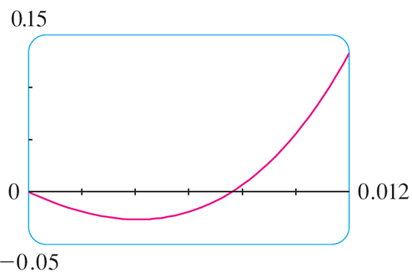
Newton’s Method (2 of 8)
Using a graphing calculator (or computer), and after experimenting with viewing rectangles, we produce the graph in Figure 1.
Figure 1
We see that in addition to the solution x = 0, which doesn’t interest us, there is a solution between 0.007 and 0.008. Zooming in that the x-intercept is approximately 0.0076.
If we need more accuracy than graphing provides, we can use a calculator or computer algebra system to solve the equation numerically.

Slide 5
Newton’s Method (3 of 8)
If we do so, we find that the solution, correct to nine decimal places, is 0.007628603.
How do these devices solve equations? They use a variety of methods, but most of them make some use of Newton’s method, also called the Newton-Raphson method.
We will explain how this method works, partly to show what happens inside a calculator or computer, and partly as an application of the idea of linear approximation.

Slide 6
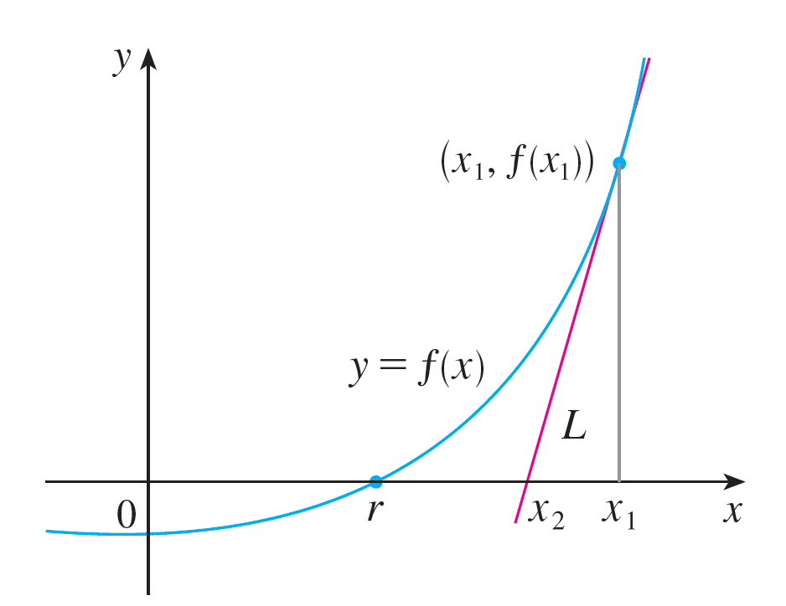
Newton’s Method (4 of 8)
The geometry behind Newton’s method is shown in Figure 2, where the solution that we are trying to find is labeled r in the figure.
Figure 2
We start with a first approximation x₁, which is obtained by guessing, or from a rough sketch of the graph of f, or from a computer-generated graph of f.

Slide 7
Newton’s Method (5 of 8)
Consider the tangent line L to the curve y = f (x) at the point (x₁, f (x₁)) and look at the x-intercept of L, labeled x₂.
The idea behind Newton’s method is that the tangent line is close to the curve and so its x-intercept, x₂, is close to the x-intercept of the curve (namely, the root r that we are seeking). Because the tangent is a line, we can easily find its x-intercept.
To find a formula for x₂ in terms of x₁ we use the fact that the slope of L is
so its equation is

Slide 8
Newton’s Method (6 of 8)
Since the x-intercept of L is x₂, we know that the point (x₂, 0) is on the line, and so
If
we can solve this equation for x₂:
We use x₂ as a second approximation to r.
Next we repeat this procedure with x₁ replaced by the second approximation x₂, using the tangent line at (x₂, f (x₂)).

Slide 9
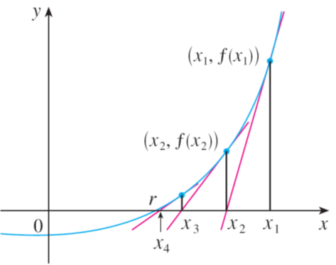
Newton’s Method (7 of 8)
This gives a third approximation:
If we keep repeating this process, we obtain a sequence of approximations x₁, x₂, x₃, x₄, . . . as shown in Figure 3.
Figure 3

Slide 10
Newton’s Method (8 of 8)
In general, if the nth approximation is x_{n} and
then the next
approximation is given by
If the numbers x_{n} become closer and closer to r as n becomes large, then we say that the sequence converges to r and we write

Slide 11
Example 1
Starting with x₁ = 2, find the third approximation x₃ to the solution of the equation
Solution:
We apply Newton’s method with.
Newton himself used this equation to illustrate his method and he chose x₁ = 2 after some experimentation because f\(1) = −6, f (2) = −1, and f (3) = 16.

Slide 12
Example 1 – Solution (1 of 2)
Equation 2 becomes
With n = 1 we have

Slide 13
Example 1 – Solution (2 of 2)
Then with n = 2 we obtain
It turns out that this third approximation x₃ ≈ 2.0946 is accurate to four decimal places.

