Slide 1
4
Applications of Differentiation
Copyright © Cengage Learning. All rights reserved.

Slide 2
4.9
Antiderivatives
Copyright © Cengage Learning. All rights reserved.

Slide 3
Antiderivatives (1 of 1)
A physicist who knows the velocity of a particle might wish to know its position at a given time.
An engineer who can measure the variable rate at which water is leaking from a tank wants to know the amount leaked over a certain time period.
A biologist who knows the rate at which a bacteria population is increasing might want to deduce what the size of the population will be at some future time.
In each case, the problem is to find a function whose derivative is a known function.

Slide 4
The Antiderivative of a Function

Slide 5
The Antiderivative of a Function (1 of 4)
If we have a function F whose derivative is the function f, then F is called an antiderivative of f.
Definition A function F is called an antiderivative of f on an interval I if
for all x in I.

Slide 6
The Antiderivative of a Function (2 of 4)
For instance, let
It isn’t difficult to discover an antiderivative of f if we
keep the Power Rule in mind. In fact, if
But the function
Therefore both F and G are antiderivatives of f.
Indeed, any function of the form
where C is a constant, is an
antiderivative of f.

Slide 7
The Antiderivative of a Function (3 of 4)
The following theorem says that f has no other antiderivative.
1 Theorem If F is an antiderivative of f on an interval I, then the most general antiderivative of f on I is
F(x) + C
where C is an arbitrary constant.
Going back to the function
we see that the general antiderivative of f is

Slide 8
The Antiderivative of a Function (4 of 4)
By assigning specific values to the constant C, we obtain a family of functions whose graphs are vertical translates of one another (see Figure 1).
This makes sense because each curve must have the same slope at any given value of x.
Members of the family of antiderivatives of
Figure 1

Slide 9
Example 1
Find the most general antiderivative of each of the following functions.
(a) f (x) = sin x
(b)
(c)
Solution:
(a) If F(x) = −cos x, then
so an antiderivative of sin x is −cos x.
By Theorem 1, the most general antiderivative is G(x) = −cos x + C.

Slide 10
Example 1 – Solution (1 of 3)
(b) We know that
So on the interval (0, ∞) the general antiderivative of
is ln x + C. We also
learned that
for all x ≠ 0. Theorem 1 then tells us that the general antiderivative of
on any interval that doesn’t contain 0. In particular, this
is true on each of the intervals (−∞, 0) and (0, ∞).

Slide 11
Example 1 – Solution (2 of 3)
So the general antiderivative of f is
(c) We use the Power Rule to discover an antiderivative of
In fact, if n ≠ −1, then
Therefore the general antiderivative of

Slide 12
Example 1 – Solution (3 of 3)
This is valid for n ≥ 0 since then
is defined on an interval. If n is
negative (but n ≠ −1), it is valid on any interval that doesn’t contain 0.

Slide 13
Antidifferentiation Formulas

Slide 14
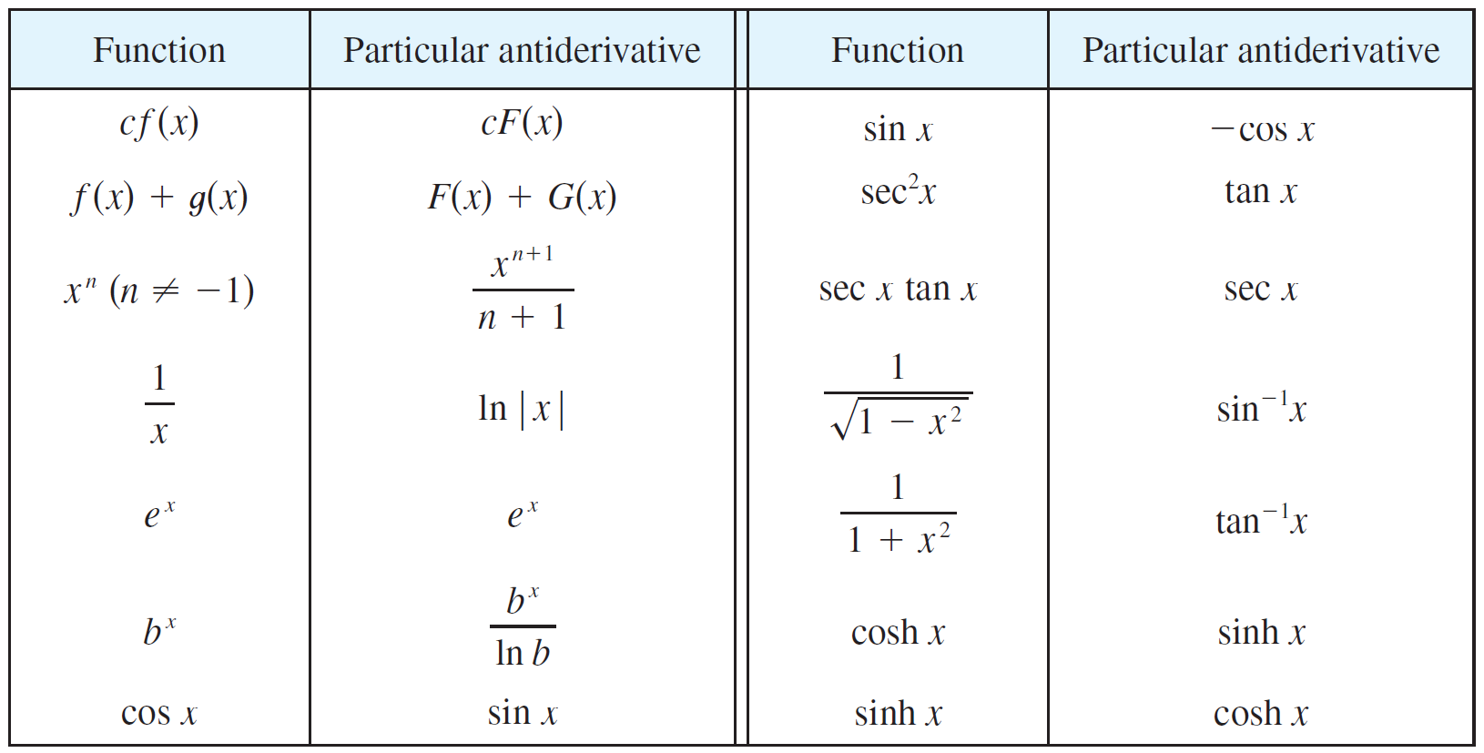
Antidifferentiation Formulas (1 of 3)
As in Example 1, every differentiation formula, when read from right to left, gives rise to an antidifferentiation formula. In Table 2 we list some particular antiderivatives.
2 Table of Antidifferentiation Formulas
To obtain the most general antiderivative from the particular ones in Table 2, we have to add a constant (or constants), as in Example 1.

Slide 15
Antidifferentiation Formulas (2 of 3)
Each formula in the table is true because the derivative of the function in the right column appears in the left column.
In particular, the first formula says that the antiderivative of a constant times a function is the constant times the antiderivative of the function.
The second formula says that the antiderivative of a sum is the sum of the
antiderivatives. (We use the notation

Slide 16
Example 2
Find all functions g such that
Solution:
We first rewrite the given function as follows:
Thus we want to find an antiderivative of

Slide 17
Example 2 – Solution
Using the formulas in Table 2 together with Theorem 1, we obtain

Slide 18
Antidifferentiation Formulas (3 of 3)
An equation that involves the derivatives of a function is called a differential equation.
The general solution of a differential equation involves an arbitrary constant (or constants) as in Example 2.
However, there may be some extra conditions given that will determine the constants and therefore uniquely specify the solution.

Slide 19
Graphing Antiderivatives

Slide 20
Graphing Antiderivatives (1 of 1)
If we are given the graph of a function f, it seems reasonable that we should be able to sketch the graph of an antiderivative F.
Suppose, for instance, that we are given that F(0) = 1. Then we have a place to start, the point (0,1), and the direction in which we move our pencil is given at each stage by the derivative
In the next example we use the principles of this chapter to show how to graph F even when we don’t have a formula for f. This would be the case, for instance, when f (x) is determined by experimental data.

Slide 21
Example 5
The graph of a function f is given in Figure 3. Make a rough sketch of an antiderivative F, given that F(0) = 2.
Figure 3

Slide 22
Example 5 – Solution (1 of 2)
We are guided by the fact that the slope of y = F(x) is f (x). We start at the point (0, 2) and draw F as an initially decreasing function since f (x) is negative when 0 < x < 1.
Notice that f (1) = f (3) = 0, so F has horizontal tangents when x = 1 and x = 3. For 1 < x < 3, f (x) is positive and so F is increasing. We see that F has a local minimum when x = 1 and a local maximum when x = 3.
For x > 3, f (x) is negative and so F is decreasing on (3, ∞).
Since
the graph of F becomes flatter as
Also notice that
changes from positive to negative at x = 2 and from negative to positive at x = 4, so F has inflection points when x = 2 and x = 4.

Slide 23
Example 5 – Solution (2 of 2)
We use this information to sketch the graph of the antiderivative in Figure 4.
Figure 4

Slide 24
Linear Motion

Slide 25
Linear Motion (1 of 1)
Antidifferentiation is particularly useful in analyzing the motion of an object moving in a straight line. We know if the object has position function s = f(t),
then the velocity function is
This means that the position function is an antiderivative of the velocity function.
Likewise, the acceleration function is
so the velocity function is an
antiderivative of the acceleration.
If the acceleration and the initial values s(0) and v(0) are known, then the position function can be found by antidifferentiating twice.

Slide 26
Example 6
A particle moves in a straight line and has acceleration given by a(t) = 6t + 4. Its initial velocity is v(0) = −6 cm/s and its initial displacement is s(0) = 9 cm. Find its position function s(t).
Solution:
Since
antidifferentiation gives

Slide 27
Example 6 – Solution
Note that v(0) = C. But we are given that v(0) = −6, so C = −6 and
Since
s is the antiderivative of v:
This gives s(0) = D. We are given that s(0) = 9, so D = 9 and the required position function is

