Slide 1
Calculus for Life Science
Xiuquan Wang
Department of Mathematics and Computer Science
Tougaloo College

Slide 2
Basic Information: Syllabus
Introduction
Why Calculus is needed for Biology
Mathematics Models
Linear Models
Best Square Analysis
Allometric Model
Discrete Dynamic Models

Slide 3
Design of the Course
Lecture
developing skills through mental activity
Computer Lab
Manage more complex (realistic) problems and data ﬁtting
Use Excel to help solve these problems
Lab Report

Slide 4
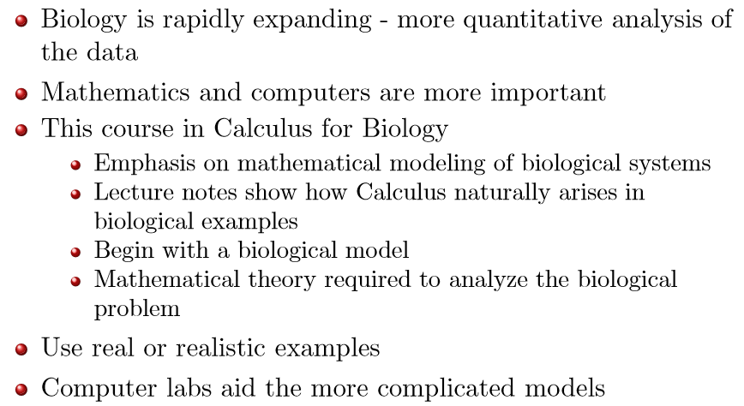
Introduction Why Calculus is Needed for Biology

Slide 5
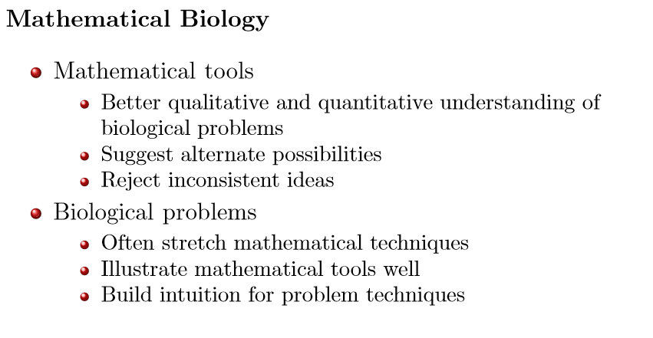
Introduction – Mathematical Biology

Slide 6
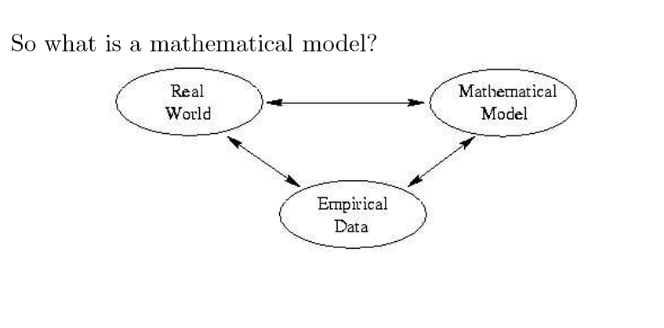
Introduction – Mathematical Model

Slide 7
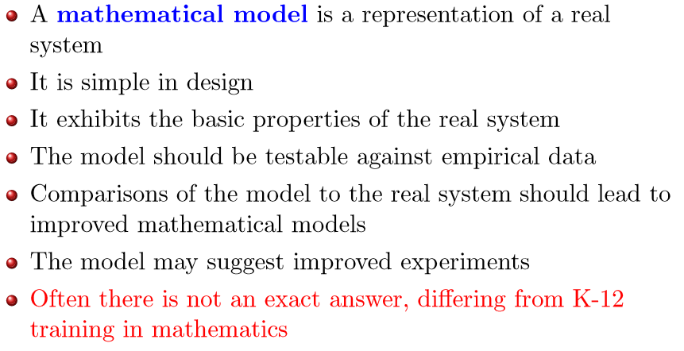
Introduction – Mathematical Model

Slide 8
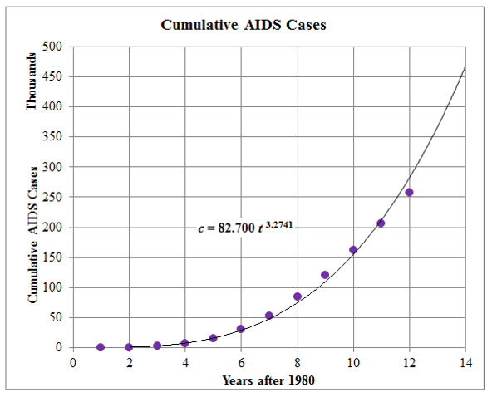
Example – AIDS
Biological Information
The numbers of AIDS cases grew and spread rapidly in the early years

Slide 9
AIDS - Allometric Model
Mathematical Model
Power Law Model with two parameters
Modeling complex biological phenomena
Easily analyzed with Least Square Analysis
Simple solution with exponentials
Solution ﬁt to data
Parameter values indicate
Easily make some predictions.

Slide 10
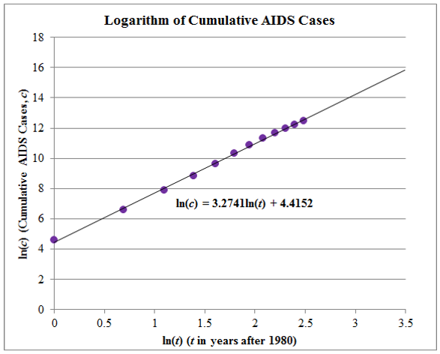
AIDS Data Analysis
the data are flattening for the later years suggesting a diminished rate of increase.

Slide 11
Linear Models
Outline
Linear Model
Chirping Crickets and Temperature
Equations of Lines
Slope – Intercept
Point - Slope
Metric System Conversion
Juvenile Height

Slide 12
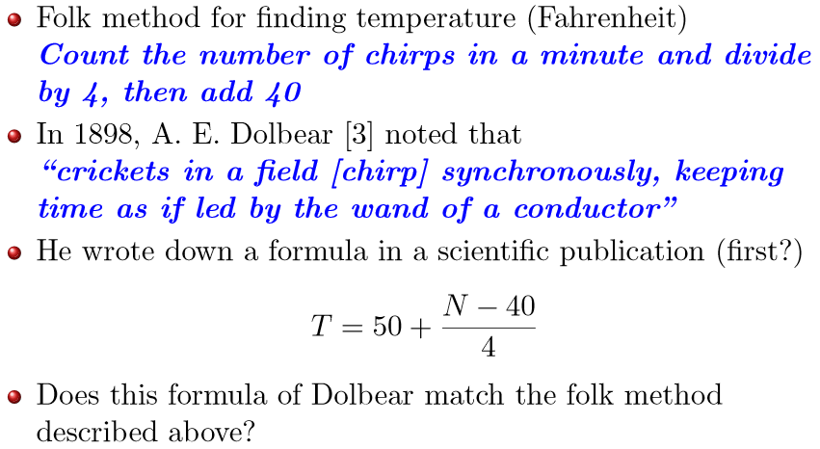
Linear Model Chirping Crickets and Temperature

Slide 13
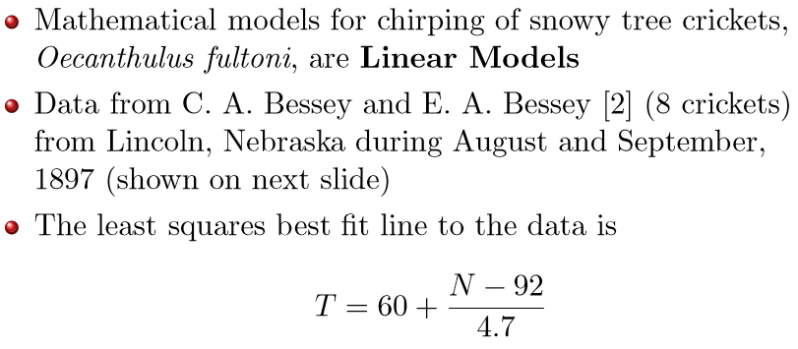
Data Fitting Linear Model

Slide 14
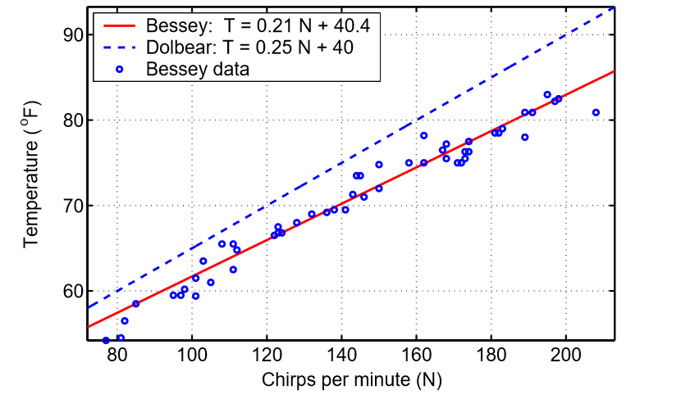
Bessey Data and Linear Models

Slide 15
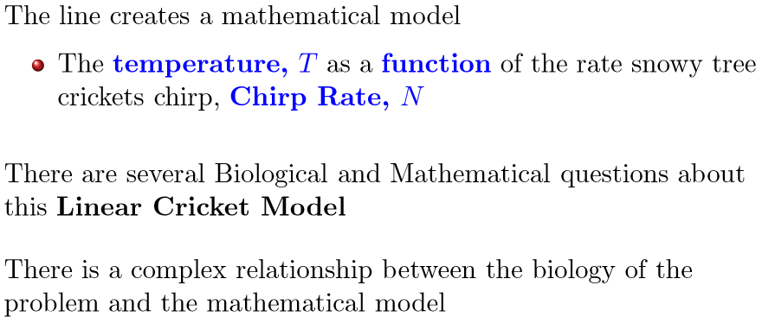
Cricket Equation as a Linear Model

Slide 16
Biological Questions about the Cricket Model
How well does the line that you found fitting the Bessey & Bessey data agree with the Dolbear model given above?
When can this model be applied from a practical perspective?
Over what range of temperatures is this model valid?
How accurate is the model and how might the accuracy be improved?

Slide 17
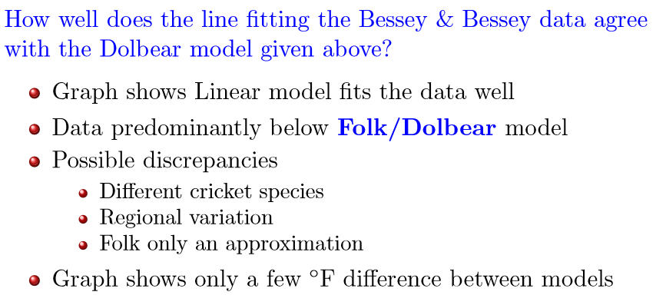
Biological Questions – Cricket Model

Slide 18
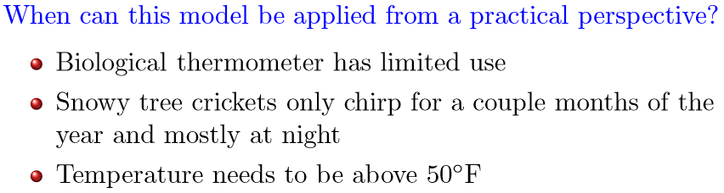
Biological Questions – Cricket Model

Slide 19
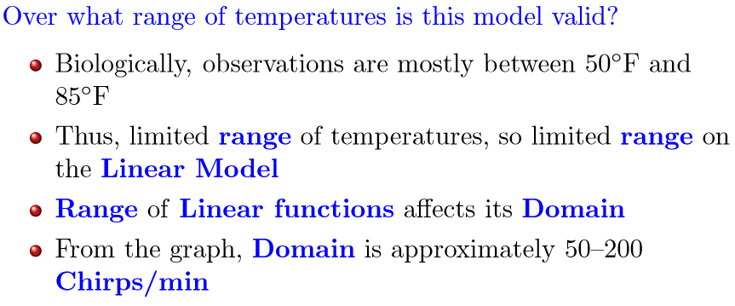
Biological Questions – Cricket Model

Slide 20
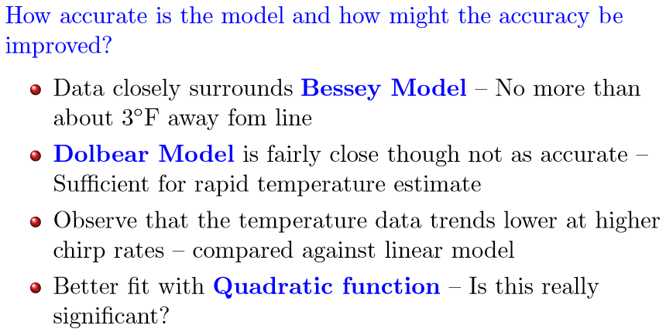
Biological Questions – Cricket Model

Slide 21
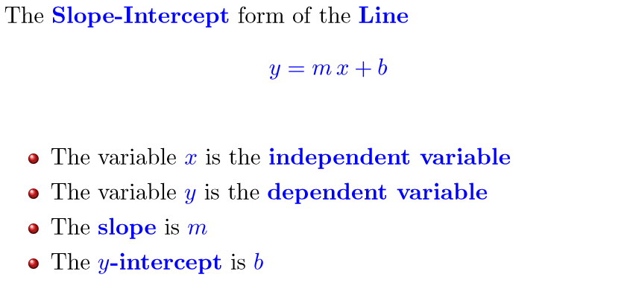
Equation of Line Slope-Intercept Form

Slide 22
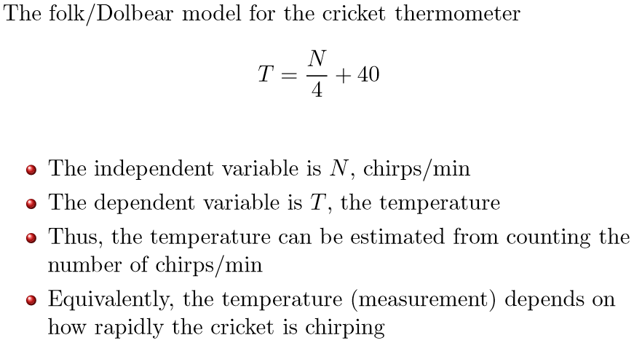
Equation of Line Cricket-Thermometer

Slide 23
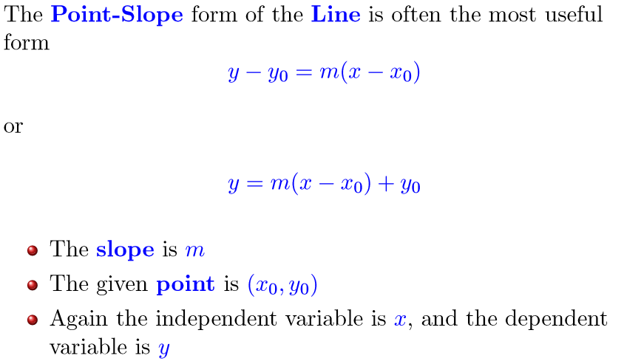
Equation of Line – Point-Slope Form

Slide 24

Metric System Conversion

Slide 25
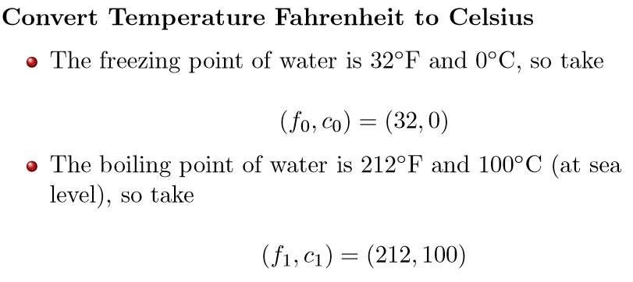
Example – Temperature

Slide 26
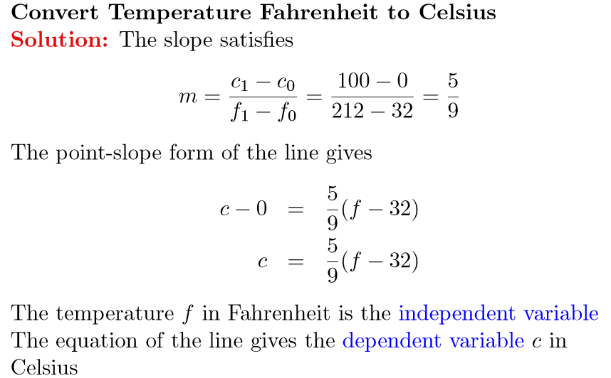
Example – Temperature

Slide 27
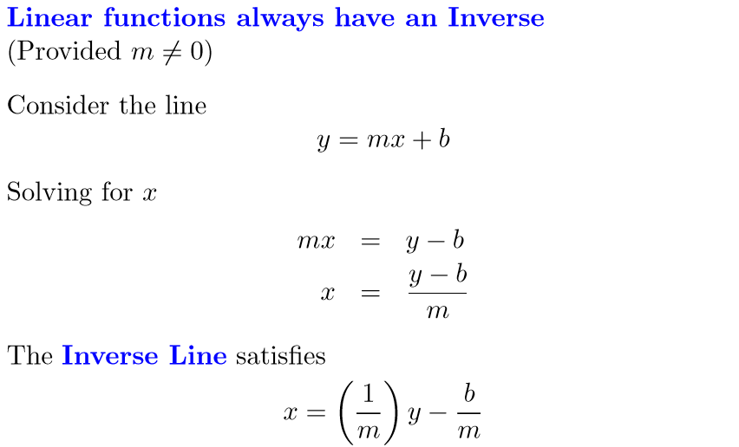
Inverse Linear Function

Slide 28
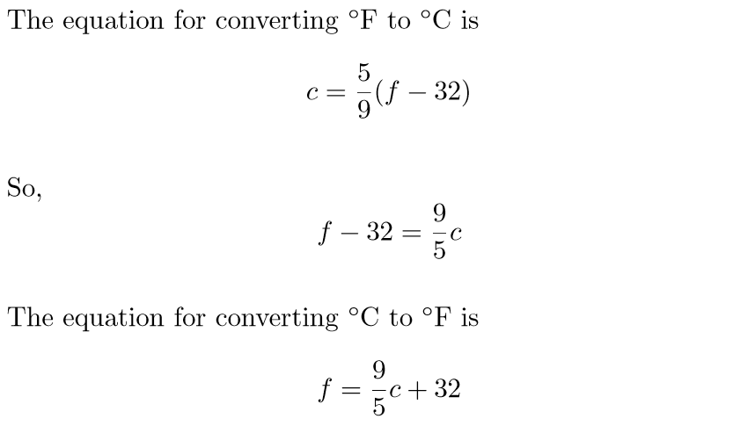
Example - Inverse Line

Slide 29
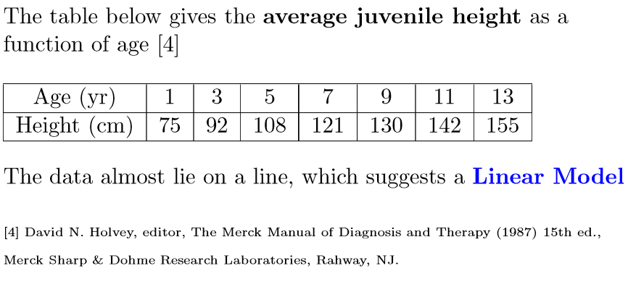
Juvenile Height – Data

Slide 30
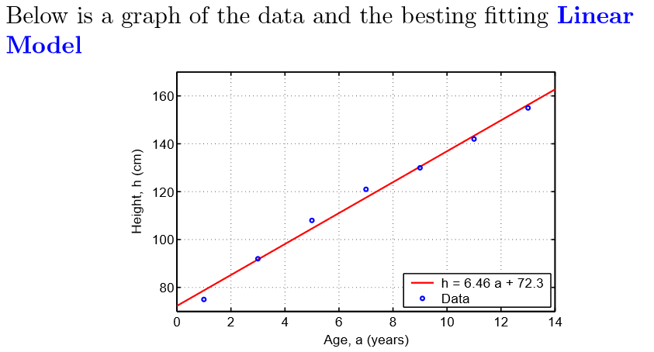
Juvenile Height – Graph

Slide 31
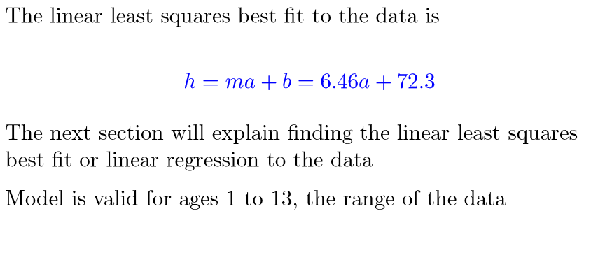
Juvenile Height – Linear Model

Slide 32
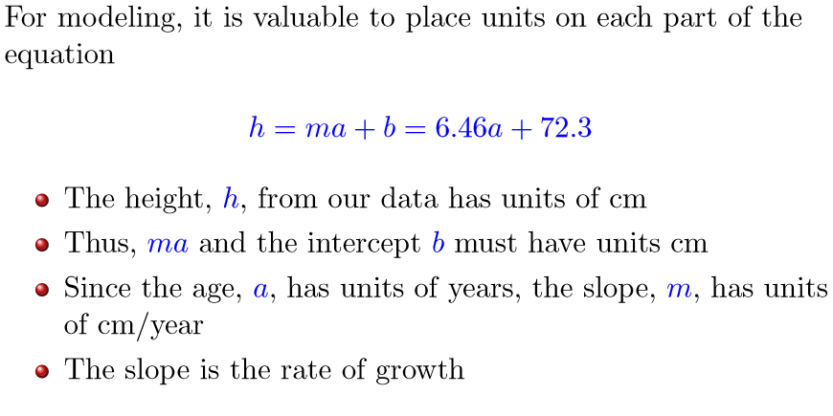
Juvenile Height – Linear Model

Slide 33
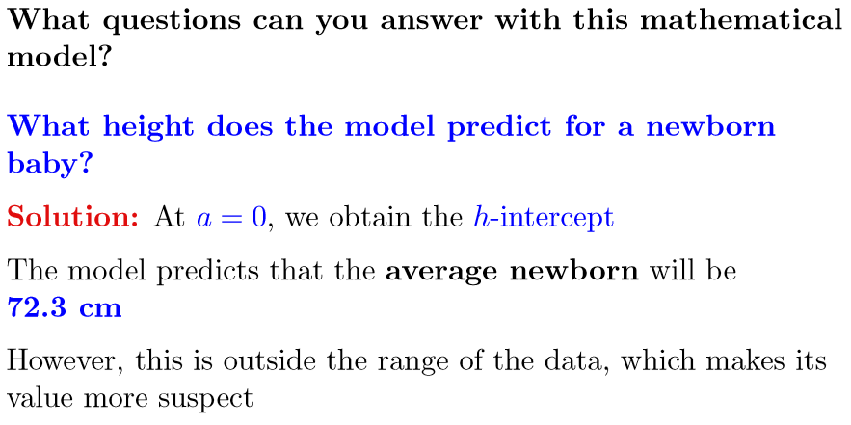
Juvenile Height – Linear Model

Slide 34
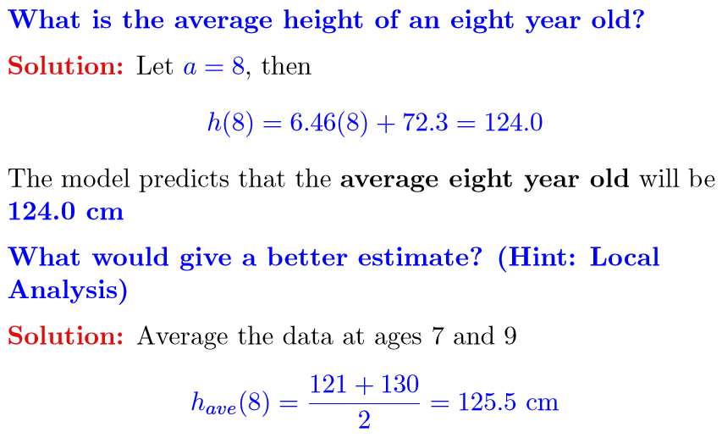
Juvenile Height – Linear Model

Slide 35
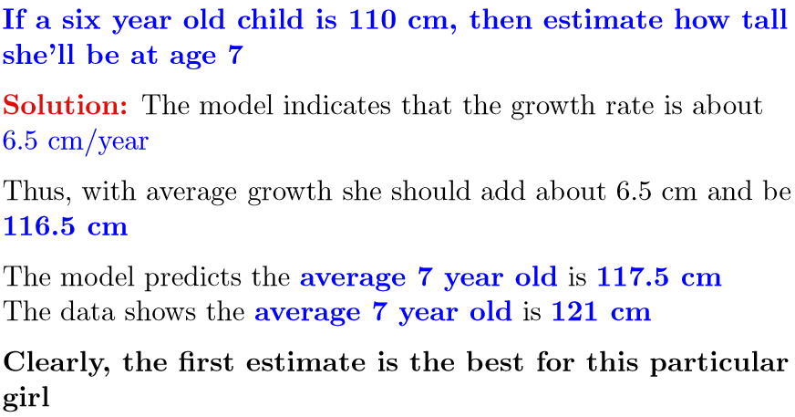
Juvenile Height – Linear Model

Slide 36
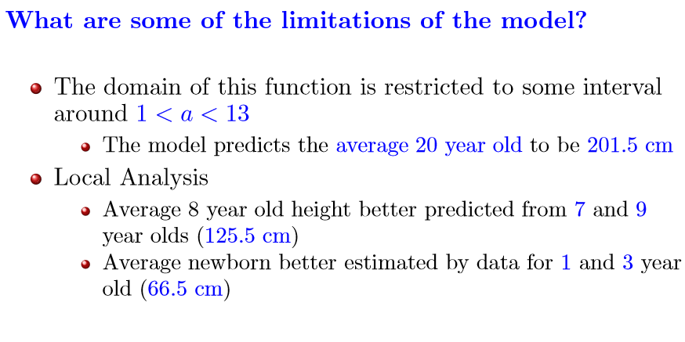
Juvenile Height – Model Limitations

Slide 37
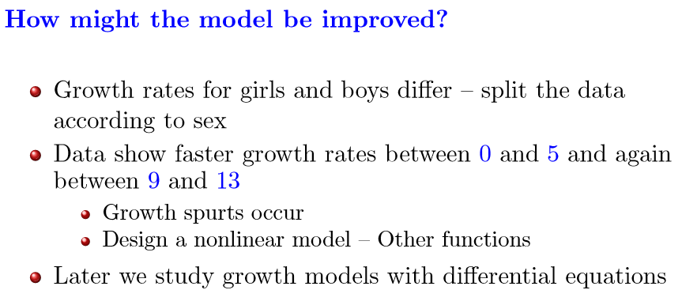
Juvenile Height – Model Improvements

