Slide 1
Application Of Markov chain Monte Carlo on Football Data
By: Lajarius Black
Advisor: Xiuquan Wang
Date: April 1st, 2019

Slide 2
Content
Introduction
Methods
Markov Chain
Application
The Markov Chain for NFL Drive
Conclusions
Future Work
Monte Carlo
Markov Chain Monte Carlo (MCMC)
Metropolis-Hastings

Slide 3
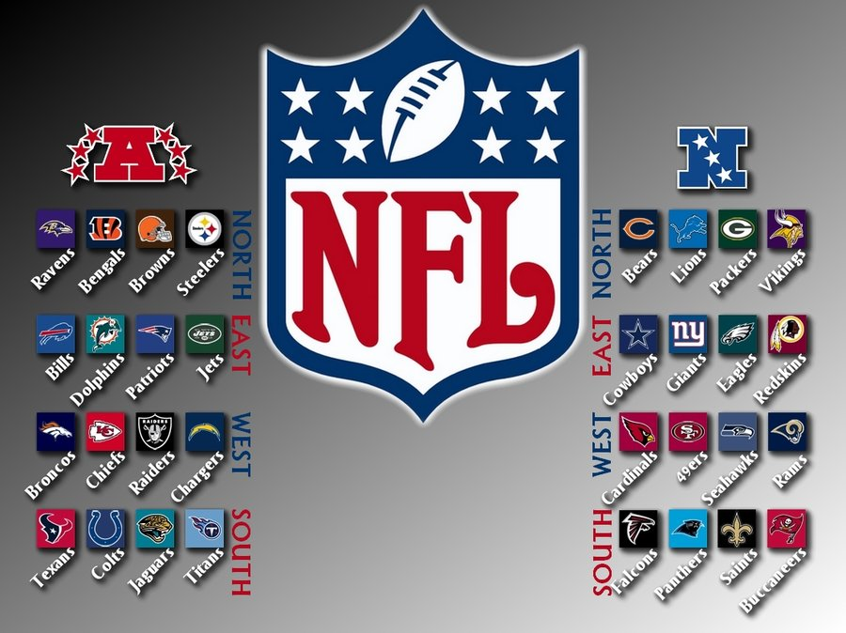
Introduction
American Football and Data Science.
An interesting combination
Goal
To extract and infer knowledge from football data
Through the knowledge of Markov Chain, Monte Carlo, and MCMC, this goal is ready to be accomplished
Data
NFL Play by Play data from 2009 to 2015 seasons

Slide 4
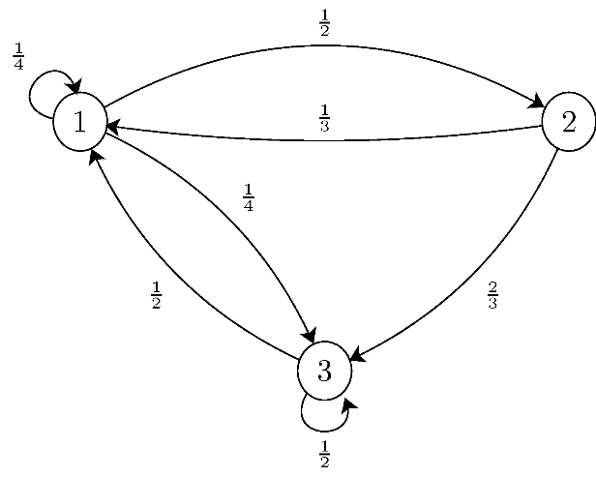
Method
A Markov Chain is a stochastic model that describes a sequence of possible events in which the probability of those events depends on the state of the previous event.
The Markov Chain is apart of the Markov Process, a “memoryless” property of the stochastic process.
The equation for the Markov Chain is :
$$P\left(X_{n} | X_{1},X_{2},…,X_{n−1}\right)=P\left(X_{n} | X_{n−1}\right)$$
State | 1 | 2 | 3
1 | 0.25 | 0.5 | 0.25
2 | 0.33 | 0 | 0.67
3 | 0.5 | 0 | 0.5

Slide 5
Markov Chain Connection to Football
An NFL game is nothing more than a series of drives.
Each drive comes with a different outcome (e.g., touchdown, fumble, etc.) that can represent the current state of the game.
Consecutive drives thus represent transitions from one state to the other.
A very convenient way to describe the drives (states) transitions of a system is through Markov chains
The last drive will then represent the entire football game and the state of the game

Slide 6
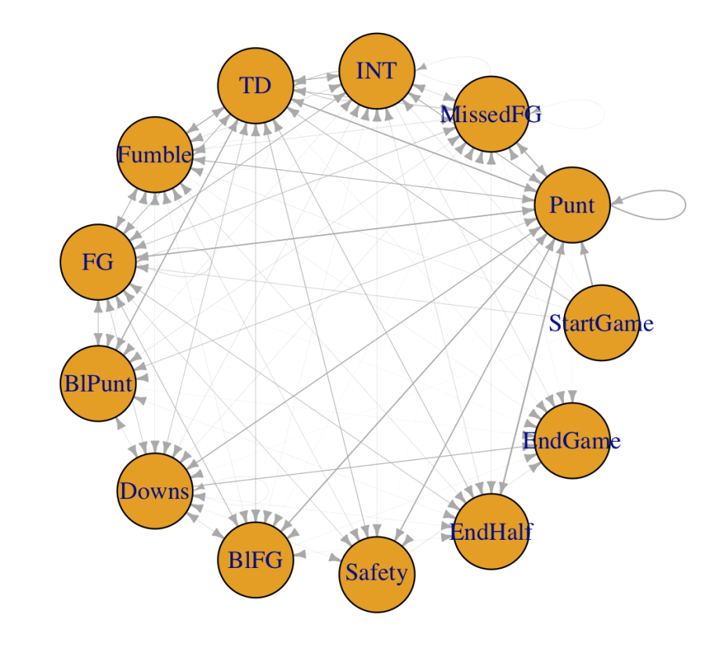
The MC for NFL Drive Network
A Markov Chain is nothing more than a network capturing the various states of a system and the transitions between them.
Game states can be a Touchdown, Field goal, Punt, Fumble etc.
We have a sink node, i.e., a node that is the end state of the system, namely, “End of Game”, and a source node, or the beginning state, “Start of Game”.
The transition probabilities can be identified using play-by-play data.

Slide 7
The MC for NFL Drive Network
Game Analysis with using Markov Chain
The nodes in the network to the left represent the various states of an NFL game
the directed edges represent the transitions between the various states.
The weight of each edge corresponds to the transition probability and this is further captured in the width of the edge.
The same information can be presented alternatively through the transition matrix:

Slide 8
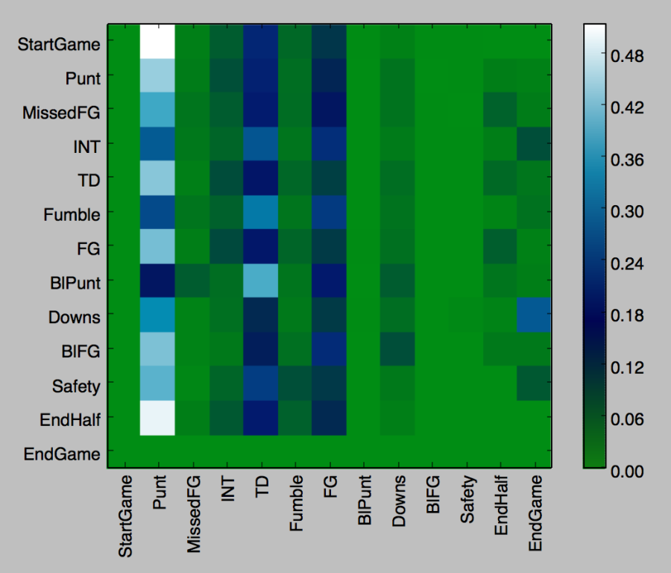
transition matrix
Game Analysis with using Markov Chain
The nodes in the network above represent the various states of an Football game
the directed edges represent the transitions between the various states.
The weight of each edge corresponds to the transition probability and this is further captured in the width of the edge.
The same information can be presented alternatively through the transition matrix:

Slide 9
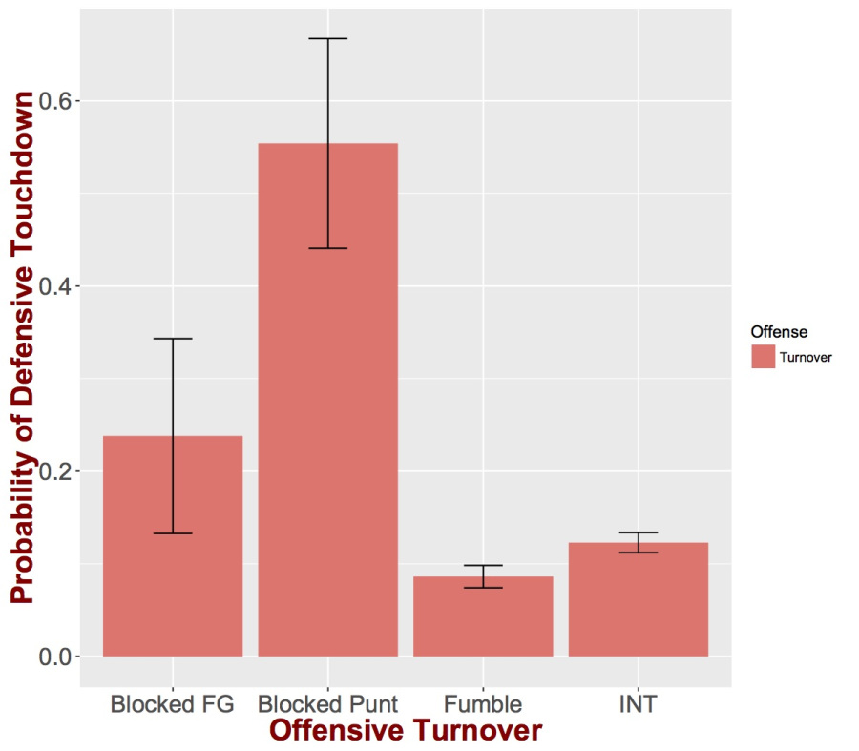
Football Data Analysis
From the states of the last diagram, the only scoring ones for the offense are the touchdown and field goal.
Some of the states representing offensive turnovers can potentially be scoring states for the defense
the probability of an offensive turnover leading to a defense score (i.e., touchdown) can be seen on the graph to the left
blocked punt or FG have the highest chance of being returned for a touchdown by the defense.
these are also the states that are less possible to begin with, and hence, the large confidence intervals associated with them.

Slide 10
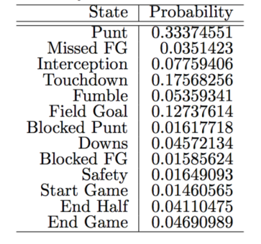
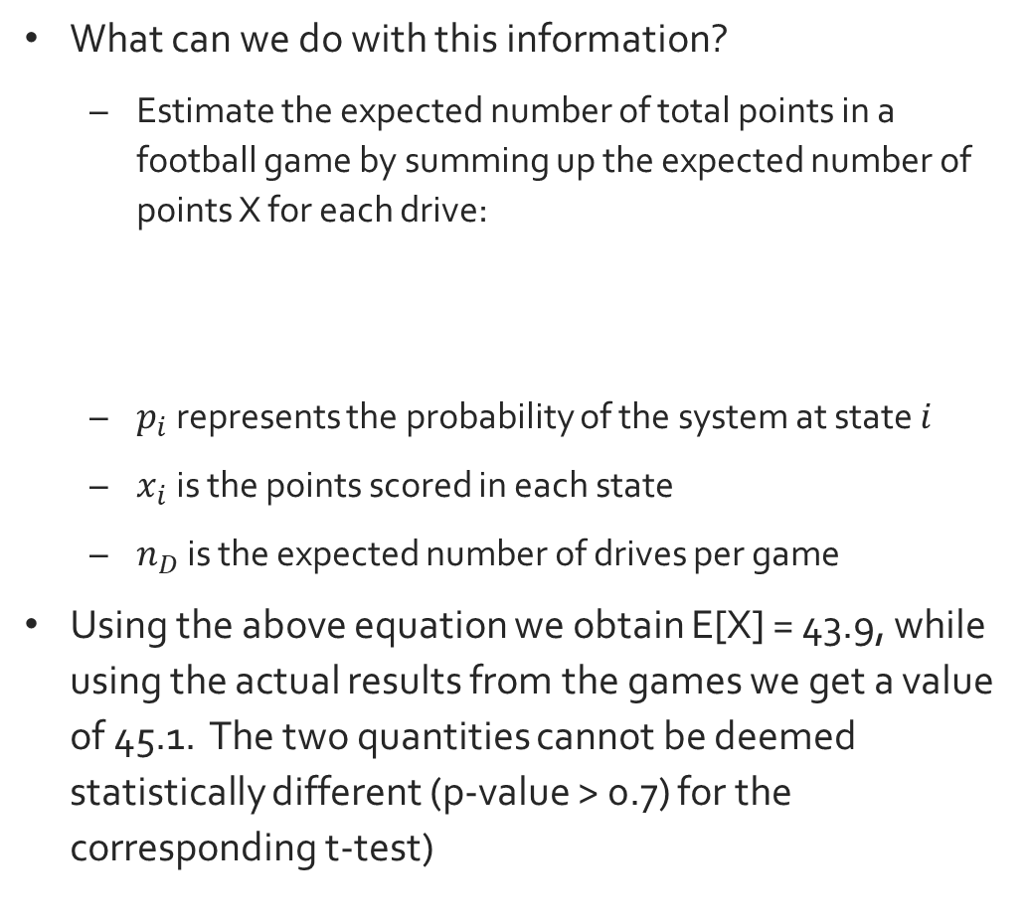

Steady State of Markov Chain
What can we do with this information?
Estimate the expected number of total points in a football game by summing up the expected number of points X for each drive:
$p_{i}$ represents the probability of the system at state $i$
$x_{i}$ is the points scored in each state
$n_{D}$ is the expected number of drives per game
Using the above equation we obtain E[X] = 43.9, while using the actual results from the games we get a value of 45.1. The two quantities cannot be deemed statistically different (p-value > 0.7) for the corresponding t-test)
$$E\left[X\right]=n_{D}\sum_{i}{p_{i} x_{i}}$$

Slide 11
Conclusions
Markov chains are a strong tool in the arsenal of a computational sports analyst that can be used also for prediction.
There are different ways to do this and the most straightforward is to simply analyze the game data.
We can analyze the network to identify interesting patterns such as the one mentioned at the beginning

Slide 12
Future Works
Monte Carlo
A broad class of algorithms that uses random sampling to get data
Markov Chain Monte Carlo (MCMC)
A collection of techniques to sample a probability distribution π in a very high-dimensional space by making a Markov Chain that has π as its stationary distribution.
Metropolis-Hastings Algorithm
A common and popular method that is used to get results in MCMC

Slide 13
Bibliography
Andrieu, Christophe, Nando De Freitas, Arnaud Doucet, Michael I. Jordan. An Introduction to MCMC for Machine Learning. The Netherlands. Kluwer Academic Publishers. 2003.
Edwards, D. (n.d.). Monte Carlo Integration. [pdf] Salt Lake City, pp.10-14. Available at: http://www.cs.utah.edu/~edwards/research/mcIntegration.pdf [Accessed 25 Oct. 2018].
Holmes-Cerfon, M. (2002). Monte-Carlo methods. [pdf] pp.1-8. Available at: https://cims.nyu.edu/~holmes/teaching/asa15/Lecture6.pdf [Accessed 2 Oct. 2018].
Kroese, D. (n.d.). Why the Monte Carlo Method is so important today. [ebook] pp.3-5. Available at: https://people.smp.uq.edu.au/DirkKroese/ps/whyMCM_fin.pdf [Accessed 8 Nov. 2018].
Pascoal, A. (n.d.). Markov Chains. pp.1-15.
Rouse, Magaret. “What Is Probability? - Definition from WhatIs.com.” WhatIs.com, whatis.techtarget.com/definition/probability.
Vitutor.com. (n.d.). Probability Properties. [online] Available at: https://www.vitutor.com/statistics/probability/properties_probability.html [Accessed 17 Aug. 2018].

Slide 14

Any Questions, Comments or Concerns

