Slide 1

A Statistical Approach for Stock Data Analysis
By: Dedrick Barkley
Advisor: Dr. X. Wang

Slide 2
Outline
Introduction
Goal and its Process
Statistical Approach
Central Limit Theorem
Toy Example
Large Number Theorem
Program Language
Future Work

Slide 3
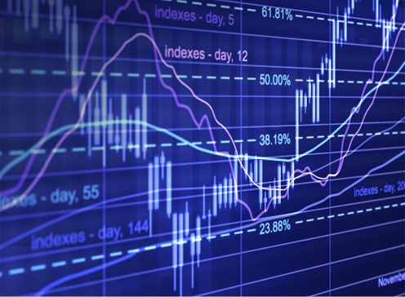
Introduction
What's a stock?
Stocks are an investment in a company and that company's profits.
Investors buy stock to earn a return on their investment.
why should you own them?
stocks are a way to build wealth.
Over the long term, the average annual stock market return is 10%; that average falls to between 7% and 8% after adjusting for inflation. That means $1,000 invested in stocks 30 years ago would be worth over $8,000 today.
How do they work?
Companies to issue shares in their stock through a process called an initial public offering, or IPO. Once a company’s stock is on the market, it can be bought and sold among investors.
how to invest in stocks?

Slide 4
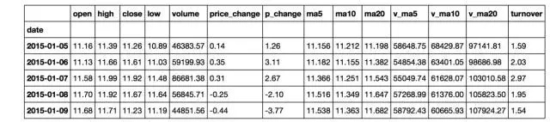
Price related factors
Current Price: Open, Close, High and Low
Price Change: Price_change, p_change
Average price: ma5, ma10, ma20
(ma5: moving average in 5 days = sum of first 5 day prices/5)
Volume related factors:
Volume
Turnover rate: volume / total number of shares issued × 100%
Average volume: v_ma5, v_ma10, v_ma20
(v_ma5: moving average of Volumn in 5 days = sum of first 5 day Volumes/5)

Slide 5
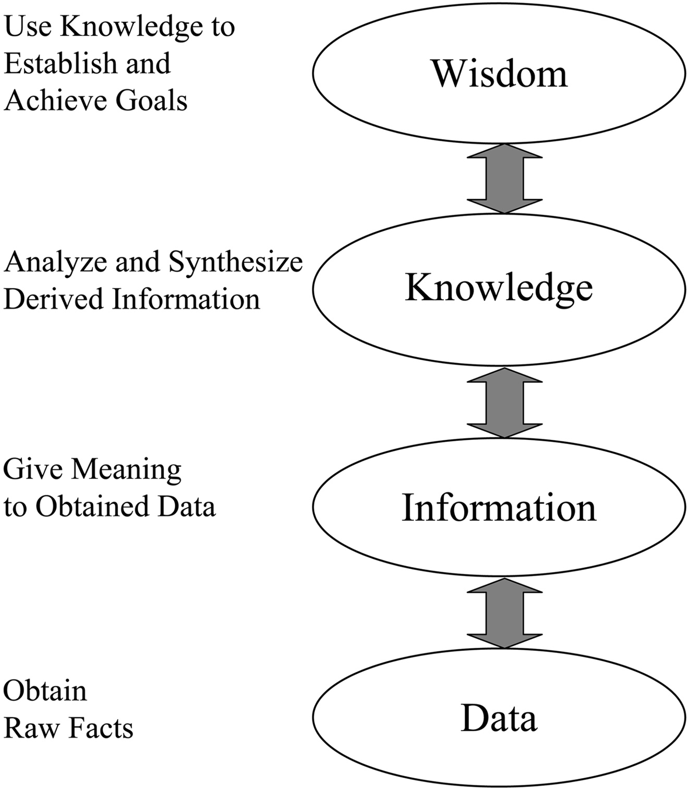
Goal and its Process
How can we identify features that are most informative of Stock

Slide 6
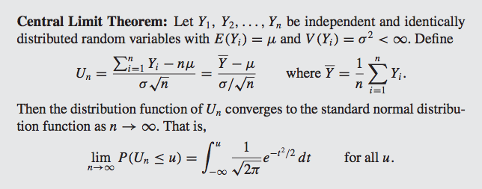
Statistical Approach

Slide 7
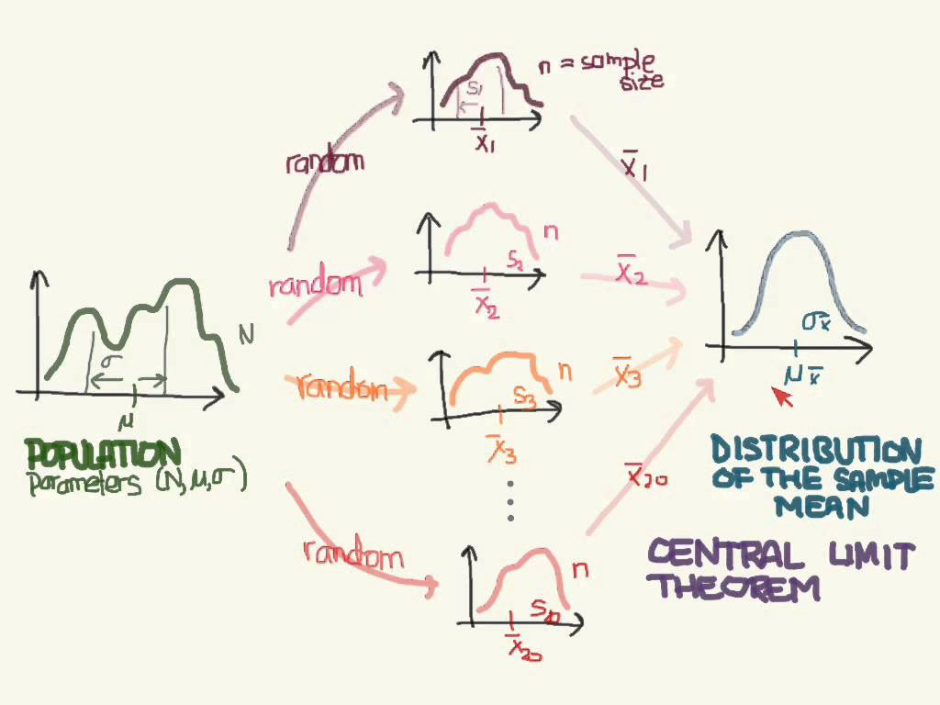
Algorithm:
Population: Each feature
Sampling with bootstrap
Calculate Mean and SD
Pick those features with large SDs.
Feature with Large SD means most informative.

Slide 8
Toy Example
Gender | Education | Race | Financial status/ Output
Male | College or Above | White | Middle class or above (1)
Male | College or Above | other | Middle class or above (1)
Female | High School | other | Middle class or above (1)
Male | High School | White | Lower class (0)
Female | High School | other | Lower class (0)
Female | College or Above | white | Middle class or above (1)
Male | College or Above | white | Middle class or above (1)
Male | High School | other | Middle class or above (1)
Female | High School | other | Lower class (0)
Female | College or Above | white | Middle class or above (1)
Female | High School | other | Lower class (0)
Male | College or Above | white | Middle class or above (1)
Male | High School | white | Lower class (0)
Female | College or Above | other | Middle class or above (1)

Slide 9
Gender
Education
Race
Male | Female
Middle above (1) | Lower class (0)
Middle above (1) | Lower class (0)
Lower class (0) | Middle above (1)
Middle above (1) | Lower class (0)
Middle above (1) | Middle above (1)
Middle above (1) | Lower class (0)
Lower class (0) | Middle above (1)
High School | College or Above
Lower class (0) | Middle above (1)
Lower class (0) | Middle above (1)
Lower class (0) | Middle above (1)
Middle above (0) | Middle above (1)
Lower class (0) | Middle above (1)
Lower class (0) | Middle above (1)
Lower class (0) | Middle above (1)
White | Other
Middle above (1) | Middle above (1)
Lower class (0) | Lower class (0)
Middle above (1) | Lower class (0)
Middle above (1) | Middle above
Middle above (1) | Lower class (0)
Middle above (1) | Lower class (0)
Lower class (0) | Middle Class (1)
We can conclude base off our data that education has the strongest effect on the financial status of a individual

Slide 10
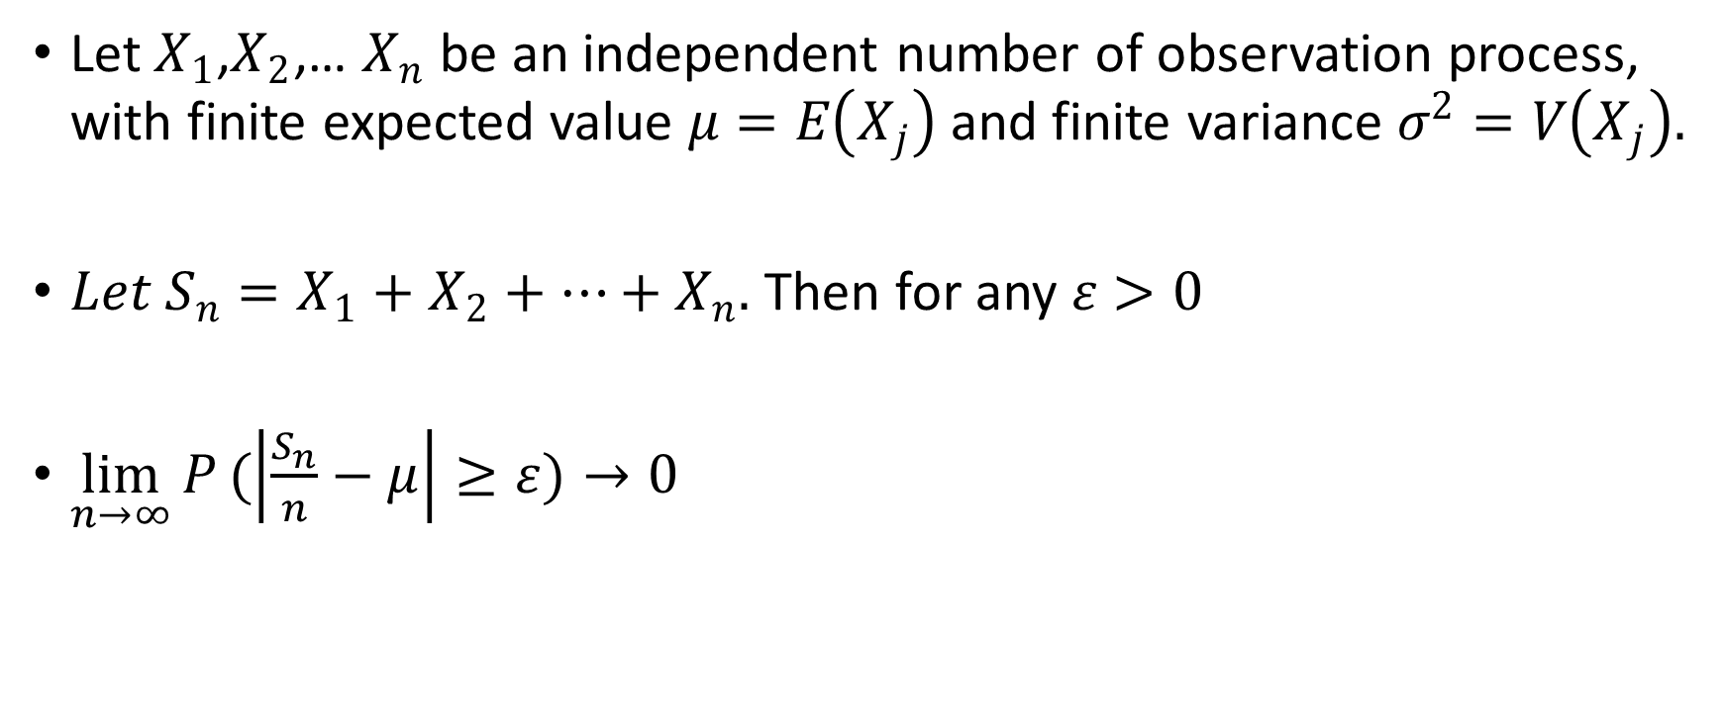
Law of Large Numbers
Let${ X}_{1}$,$X_{2}$,… $X_{n}$ be an independent number of observation process, with finite expected value $μ=E\left(X_{j}\right)$ and finite variance $σ^{2}=V\left(X_{j}\right).$
$Let S_{n}=X_{1}+X_{2}+…+X_{n}.$ Then for any $ε>0$
$\lim_{n→∞}{P}(\left|\frac{S_{n}}{n}−μ\right|≥ε)→0$

Slide 11
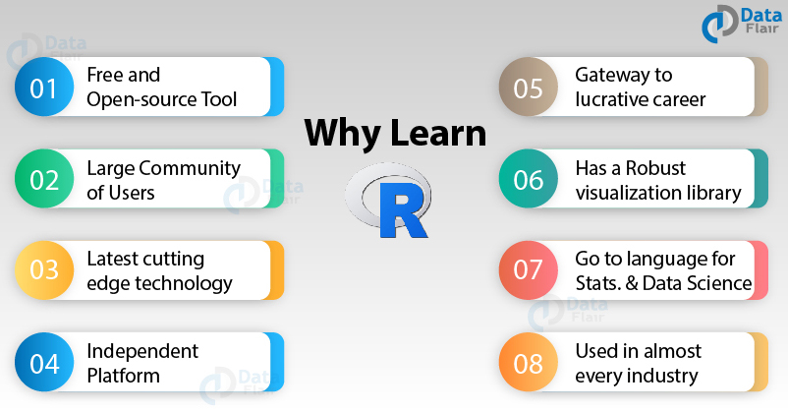

Slide 12
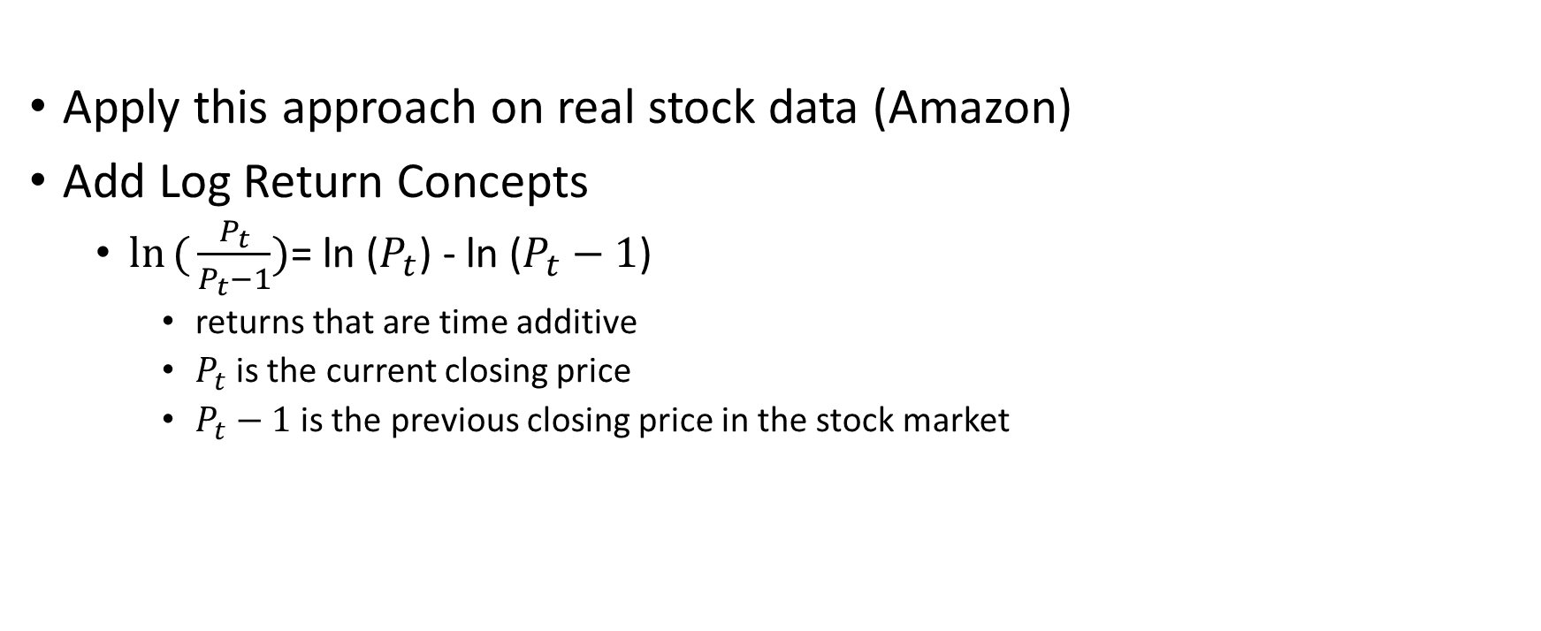
Future Work
Apply this approach on real stock data (Amazon)
Add Log Return Concepts
$\ln{({\frac{P_{t}}{P_{t}−1}}})$= ln ($P_{t}$) - ln ($P_{t}−1$)
returns that are time additive
$P_{t}$is the current closing price
$P_{t}−1$is the previous closing price in the stock market

Slide 13
Acknowledgments
Dr. Xiuquan Wang
Tougaloo College

Slide 14

Question?
This Photo by Unknown Author is licensed under CC BY-NC

