Slide 1
CPE334 Operating Systems Lecture 3: Scheduling
Lecturer:
Stephen John Turner
stephen.tur@kmutt.ac.th
Tel: 02-470-9378 Office: 1027

Slide 2
Scheduling
Scheduling = The process of deciding how to commit resources between a variety of possible tasks
It is not a new concept – Assembly lines and many other human constructions require scheduling
For a computer system, scheduling is a matter of sharing resources among multiple processes
Context-switch between processes
low-level mechanisms (previous lecture)
high-level policies (this lecture)

Slide 3
Workload
Processes running in the system, collectively called the workload
Assume the following for the processes/jobs running in the system (for now)
All jobs only use the CPU (i.e. they perform no I/O)
The run-time of each job is known

Slide 4
Scheduling Metrics
Metrics are used to measure scheduling policies’ performance and fairness
Sometime optimizing performance may prevent a few jobs from running, thus decreasing fairness
For now, let’s assume that we will use just one metric, turnaround time
The turnaround time is defined as the time at which the job completes minus the time at which the job arrived in the system
T_{turnaround} = T_{completion} − T_{arrival}
If all jobs arrive at the same time
T_{arrival} = 0 and T_{turnaround} = T_{completion}
Notes:
Turnaround time is a performance metric

Slide 5
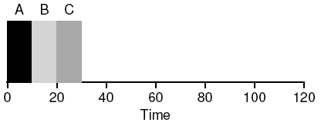
First In, First Out (FIFO) (First Come, First Served)
Imagine three jobs arrive in the system, A, B, and C, at the same time (T_{arrival} = 0)
FIFO has to put some job first, let’s assume A -> B -> C
Assume also that each job runs for 10 seconds
What will the average turnaround time be for these jobs?
(10+20+30)/3 = 20 seconds

Slide 6
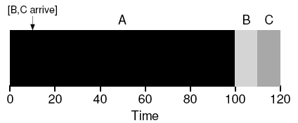
FIFO’s Drawback
Let’s again assume three jobs (A, B, and C), but this time A runs for 100 seconds while B and C run for 10 each
Problem: a number of relatively-short potential consumers of a resource get queued behind a heavyweight resource consumer
(100+110+120)/3 = 110

Slide 7
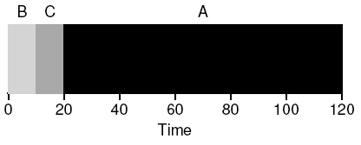
Shortest Job First (SJF)
Policy: Run the shortest job first, then the next shortest, and so on
Average turnaround time becomes 50
Given assumptions about jobs all arriving at the same time, SJF is indeed optimal
(10+20+120)/3 = 50

Slide 8
More Realistic Situations
What if jobs can arrive at any time instead of all at once and can run for different lengths
A arrives at t = 0 and needs to run for 100 seconds
B and C arrive at t = 10 and each needs to run for 10 seconds
What is turnaround time?
(100+(110-10)+(120-10))/3= 103.33
What can a scheduler do?

Slide 9
Shortest Time-to-Completion First (STCF)
With mechanisms like timer interrupts and context switching, the scheduler can preempt job A and decide to run another job
SJF is a non-preemptive scheduler
All modern schedulers are preemptive
STCF also known as Preemptive Shortest Job First (PSJF) – any time a new job enters the system
STCF/PSJF determines of the remaining jobs and new job, which has the least time left
then schedules that one

Slide 10
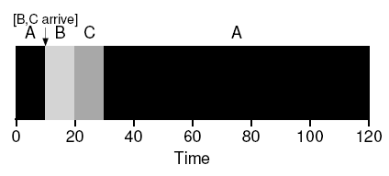
STCF’s example
A arrives at t = 0 and needs 100 secs, B and C arrive at t = 10, each need 10 secs
Average turnaround time (120+10+20)/3 = 50
In batch scheduling, this make sense
However, in time-sharing machines where users sit at a terminal and demand interactive performance, a new metric is introduced: response time
Notes:
If three jobs arrive at the same time, for example, the third job has to wait for the previous two jobs to run in their entirety before being scheduled just once – while great for turnaround time, this approach is quite bad for response time and interactivity
Imagine sitting at a terminal, typing, and having to wait 10 seconds to see a response from the system just because some other job got scheduled in front of yours: not too pleasant

Slide 11
Response Time
Response time is the time from when the job arrives in a system to the first time it is scheduled
T_{response} = T_{firstrun} − T_{arrival}
A arrives at t = 0 and needs 100 secs, B and C arrive at t = 10, each needs 10 secs
Using STCF, what is T_{response} = ?
T_{response} = (0+0+10)/3 = 3.33 –> not so good
How can we build a scheduler that is sensitive to response time?

Slide 12
Round Robin (RR)
Instead of running jobs to completion, RR
runs a job for a time slice
then switches to the next job in the run queue
repeatedly does so until all jobs are finished
RR is considered ‘fair’, as it evenly divides the CPU among active processes on a small time scale
Note that the length of a time slice must be a multiple of the timer-interrupt period
If the timer interrupts every 10 milliseconds, the time slice could be 10, 20, or any other multiple of 10 ms

Slide 13
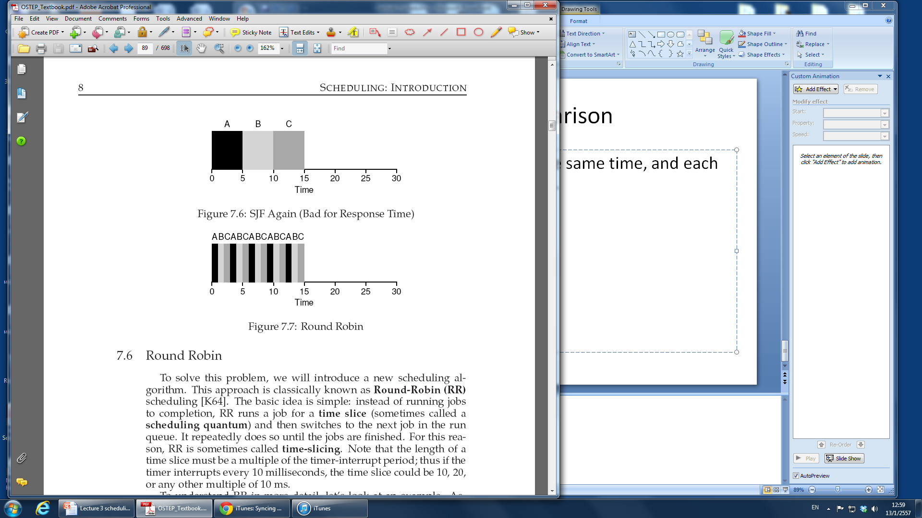
Comparison of Response Time
A, B, and C arrive at the same time, and each needs to run for 5 secs
SJF average response time = (0+5+10)/3 = 5
RR average response time = (0+1+2)/3 = 1

Slide 14
Time Slice
The shorter it is, the better the performance of RR under the response time metric
If the time slice is too short, the cost of context switching will dominate performance
Design Choice:
Making it long enough to amortize the cost of context switching
Not too long that the system is no longer responsive

Slide 15
Amortization
The length of the time slice is critical for RR performance
Overhead = a fixed cost to some operation
Incurring overhead less often, the total cost to the system is reduced
For example
Time slice is set to 10 ms, and the context-switch cost is 1 ms
10% of time is spent context switching (overhead of 10%)
Amortize the cost by increasing the time slice to 100 ms and less than 1% of time is spent context switching (overhead of 1%)
Notes:
Note that the cost of context switching does not arise solely from the OS actions of saving and restoring a few registers
When programs run, they build up a great deal of state in CPU caches, TLBs, branch predictors, and other on-chip hardware
Switching to another job causes this state to be flushed and new state relevant to the currently-running job to be brought in, which may exact a noticeable performance cost

Slide 16
Turnaround Time vs. Response Time
Two families of algorithms
Runs the shortest job remaining and optimizes turnaround time (SJF and STCF) -> bad response time
Alternates between all jobs and optimizes response time (RR) -> bad turnaround time
Trade-off is thus common in system design
Next: we will consider
Jobs with I/O
Jobs with unknown execution time
Notes:
Two families of algorithm – the first runs the shortest job remaining and thus optimizes turnaround time, the second alternates between all jobs and thus optimizes response time

Slide 17
Incorporating I/O
When a job initiates an I/O request, it will not be needing CPU
It is blocked waiting for I/O completion
The scheduler schedules another job on the CPU
When the I/O completes:
An interrupt is raised
The OS moves the process back to the ready state

Slide 18
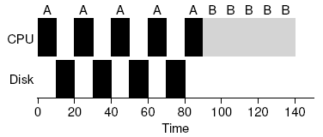
An Example With I/O Requests (1)
Jobs A and B each needs 50 ms of CPU time
A uses the CPU for 10 ms and then issues an I/O request (assume I/O takes 10 ms)
B uses the CPU for 50 ms and performs no I/O
Run A first, then B after, will result in a poor performance

Slide 19
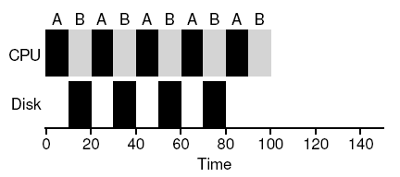
An Example With I/O Requests (2)
A common approach is to treat each 10 ms sub-job of A as an independent job
When the system starts, its choice is whether to schedule a 10 ms A job or a 50 ms B job
By treating each CPU burst as a job, the scheduler can make sure processes that are “interactive” get run frequently
Notes:
With STCF, the choice is clear:
Choose the shorter one, in this case A
Then, when the first sub-job of A has completed, only B is left, and it begins running
Then a new sub-job of A is submitted, and it preempts B and runs for 10 ms
Doing so allows for overlap to occur, with the CPU being used by one process while waiting for the I/O of another process to complete;
The system is thus better utilized
By treating each CPU burst as a job, the scheduler makes sure processes that are “interactive” get run frequently
While those interactive jobs are performing I/O, other CPU-intensive jobs run, thus better utilizing the processor

Slide 20
The Question
The OS usually knows very little about the length of each job
Thus, how can we build an approach that behaves like SJF/STCF without such a priori knowledge?
Answer: The Multi-Level Feedback Queue

Slide 21
The Multi-Level Feedback Queue (MLFQ)
Two goals
Optimize turnaround time for CPU-bound jobs
Minimize response time to allow a system to be responsive to interactive users
MLFQ: Basic concept
Implement a number of distinct queues of different priority levels
At any given time, a job that is ready to run is on a single queue
MLFQ uses priorities to decide which queue should be selected
RR is used among jobs in the same queue
The key to MLFQ scheduling lies in how the scheduler sets queue priorities

Slide 22
MLFQ Rules
MLFQ varies the priority of a job based on its observed behavior
If a job repeatedly waits for input from the keyboard, the priority is high (behaves like an interactive process)
If a job uses the CPU intensively for long periods of time, MLFQ will reduce its priority
MLFQ tries to learn about processes as they run, and use the history of the job to predict its future behavior
We arrive at the first two basic rules for MLFQ:
Rule 1: If Priority(A) > Priority(B), A runs (B doesn’t)
Rule 2: If Priority(A) = Priority(B), A & B run in RR

Slide 23
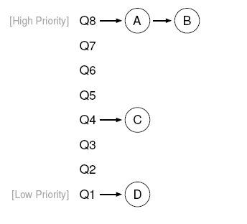
MLFQ Example
From the rules, the scheduler would just alternate time slices between A and B because they are the highest priority jobs in the system

Slide 24
How to Change Priority
Rule 3: When a job enters the system, it is placed at the highest priority (the topmost queue)
Rule 4a: If a job uses up an entire time slice while running, its priority is reduced (i.e. it moves down one queue)
Rule 4b: If a job gives up the CPU before the time slice is up, it stays at the same priority level

Slide 25
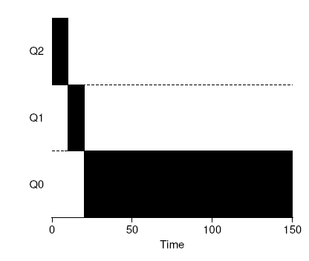
One Long Running Job
Start in Q2
Reduce to Q1
Then to Q0
Notes:
MLFQ doesn’t know whether a job will be a short job or a long-running job
It first assumes it might be a short job, thus giving the job high priority
If it actually is a short job, it will run quickly and complete
If it is not a short job, it will slowly move down the queues, and thus soon prove itself to be a long-running more batch-like process
In this manner, MLFQ approximates SJF

Slide 26
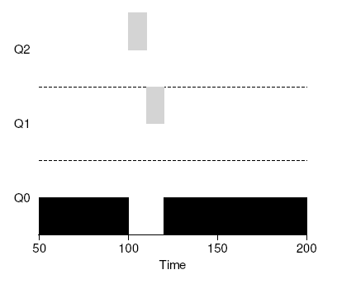
Two Jobs
Grey: a short interactive job arrived at time T=100
Black: a long compute intensive job

Slide 27
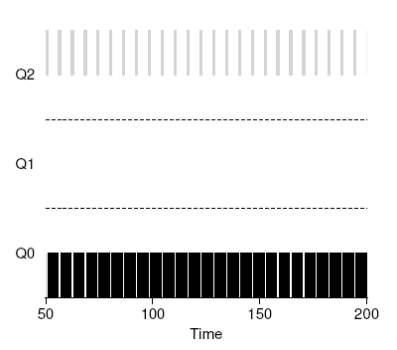
A Mixed I/O-Intensive and CPU-Intensive Workload
Grey: an interactive job
Black: a batch job
Notes:
An example of how this works, with an interactive job B (shown in gray) that needs the CPU only for 1 ms before performing an I/O competing for the CPU with a long-running batch job A (shown in black)
The MLFQ approach keeps B at the highest priority because B keeps releasing the CPU – if B is an interactive job, MLFQ further achieves its goal of running interactive jobs quickly

Slide 28
Problems with the Current MLFQ
Starvation
If too many interactive jobs, long-running jobs may never receive any CPU time
A program can trick the scheduler to give it more than fair share of the resource
A program may change its behavior over time
CPU-bound may transition to a phase of interactivity
With our current approach, such a job would not be treated like the other interactive jobs in the system
Notes:
Before the time slice is over, issue an I/O operation (to some file you don’t care about) and thus relinquish the CPU – doing so allows you to remain in the same queue, and thus gain a higher percentage of the CPU
In fact, if done just right (e.g. by running for 99% of the time slice before relinquishing the CPU), a job could get most available CPU time

Slide 29
The Priority Boost
Periodically boost the priority of all the jobs in system
Rule 5: After some time period S, move all the jobs in the system to the topmost queue
This rule fixes the starvation problem
If a CPU-bound job has become interactive, the scheduler can give it the priority boost
What should S be set to?
If too high, long-running jobs could starve
If too low, interactive jobs may not get a proper share of the CPU

Slide 30
Better Accounting
To guarantee the fairness, Rule #4 should be re-written
Rule 4: Once a job uses up its time allotment at a given level (regardless of how many times it has given up the CPU), its priority is reduced (i.e. it moves down one queue)
Notes:
Instead of forgetting how much of a time slice a process used at a given level, the scheduler should keep track – once a process has used its allotment, it is demoted to the next priority queue
Whether it uses the time slice in one long burst or many small ones does not matter

Slide 31
How to Parameterize such a Scheduler
How many queues should there be?
How big should the time slice be per queue?
How often should priority be boosted in order to avoid starvation and account for changes in behavior?
Some experience with workloads and subsequent tuning of the scheduler will lead to a satisfactory balance
Use maths formula to adjust and/or manually done by a system administrator
Notes:
MLFQ variants allow for varying time-slice length across the different queues
The high-priority queues are usually given shorter time slices.

Slide 32
The Final Rules
Rule 1: If Priority(A) > Priority(B), A runs (B doesn’t)
Rule 2: If Priority(A) = Priority(B), A & B run in RR
Rule 3: When a job enters the system, it is placed at the highest priority (the topmost queue)
Rule 4: Once a job uses up its time allotment at a given level (regardless of how many times it has given up the CPU), its priority is reduced (i.e. it moves down one queue)
Rule 5: After some time period S, move all the jobs in the system to the topmost queue

Slide 33
MLFQ Summary
MLFQ varies the priority of a job based on its observed behavior, but requires parameterization
MLFQ is used in
BSD UNIX derivatives
Solaris
Windows NT and subsequent Windows operating systems
An alternative to MLFQ is Proportional-Share Scheduling, also known as Lottery Scheduling

Slide 34
Proportional-Share Scheduling
Instead of optimizing for turnaround or response time, just guarantee that each job obtains a certain percentage of CPU time
Lottery scheduling
Hold a lottery to determine which process should go next
Processes that should run more often should be given more chances to win the lottery
Uses randomness – randomized approaches are often a robust and simple way to schedule things
Avoids corner-cases
Lightweight (little state to track things)
Fast
Notes:
Random is good because:
Random often avoids strange corner-case behaviors that a more traditional algorithm may have trouble handling
For example, consider LRU page replacement – while often a good replacement algorithm, LRU performs pessimally for some cyclic-sequential workloads
Random, on the other hand, has no such worst case
Random also is lightweight, requiring little state to track alternatives
In a traditional fair-share scheduling algorithm, tracking how much CPU each process has received requires per-process accounting, which must be updated after running each process
Doing so randomly necessitates only the most minimal of per-process state
Random can be fast
As long as generating a random number is quick, making the decision is also, and thus random can be used in a number of places where speed is required.

Slide 35
Tickets Represent Your Share
Introduce the concept of tickets
Represent the shares that processes should get
Imagine processes A and B
If A has 75 tickets and B has 25,
A is to receive 75% of the CPU and B 25%
Lottery scheduling achieves this probabilistically (not deterministically) by holding a lottery often (every time slice)

Slide 36
Holding a Lottery
The scheduler must know how many total tickets there are, e.g. 100
The scheduler then picks a winning ticket, e.g. between 0 to 99
The scheduler then loads the state of that winning process and runs it
e.g. If A hold tickets 0-74, B 75-99
Draw: 63 85 70 39 76 17 29 41 36 39 10 99 68 83 63 62 43 0 49 49
Schedule: A B A A B A A A A A A B A B A A A A A A
Notes:
Assuming A holds tickets 0 through 74 and B 75 through 99, the winning ticket simply determines whether A or B runs

Slide 37
Ticket Mechanisms: Ticket Currency
“Currency” allows a user with a set of tickets to allocate tickets among their own jobs
The system then automatically converts the currency into the correct global value
e.g. A and B have each been given 100 tickets
A is running two jobs, A1 and A2, and gives them each 500 tickets (out of 1000 total) in User A’s own currency
B is running only 1 job and gives it 10 tickets (out of 10 total)
The system will convert
500 tickets from A1 and A2 to 50 each in the global currency
10 tickets from B1 to 100 tickets in the global currency
The lottery will be held over the global ticket currency (200 total) to determine which job runs

Slide 38
Ticket Mechanisms: Ticket Transfer
“Transfers” allow a process to temporarily hand off its tickets to another process
Useful in client-server computing
A client process sends a message to a server asking it to do some work on the client’s behalf
To speed up the work, the client can pass the tickets to the server in order to process its own request
When finished, the server transfers the tickets back
Notes:
Ticket transfer
This ability is especially useful in a client/server setting, where a client process sends a message to a server asking it to do some work on the client’s behalf
To speed up the work, the client can pass the tickets to the server and thus try to maximize the performance of the server while the server is handling the client’s request
When finished, the server then transfers the tickets back to the client and all is as before

Slide 39
Ticket Mechanisms: Ticket Inflation
“Inflation” allows a process to temporarily raise or drop its ticket value
Can be applied in an environment where a group of processes trust one another
If any one process knows it needs more CPU time, it can boost its ticket value without communicating with any other processes

Slide 40
Implementation
A good random number generator to pick the winning ticket
A simple data structure to track the processes, and the total number of tickets

Slide 41
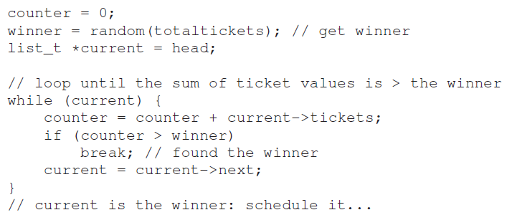
Assume a process linked-list
head -> ( A | 100 ) -> ( B | 50 ) -> ( C | 250 ) -> null
A has 100 tickets (0-99), B has 50 tickets (100-149), C has 250 tickets (150-399), total number = 400
Notes:
First have to pick a random number (the winner) from the total number of tickets (400)
Let’s say we pick the number 300
Then, we simply traverse the list, with a simple counter used to help us find the winner
All the code does is walk the list of processes, adding their ticket value to counter until the value exceeds winner
Once that is the case, the current list element is the winning process
Schedule the winner (we would break out of the loop with current pointing at process C as the winner)
To make this most efficient, it might generally be best to organize the list in sorted order, from the highest number of tickets to the lowest, e.g. C has 250 tickets (0-249), A has 100 tickets (250-349), B has 50 tickets (350-399)

Slide 42
How to Assign Tickets to Jobs
How the system behaves is strongly dependent on how tickets are assigned
One approach is to assume that the users know best
Each user is handed some number of tickets
A user allocates tickets to any jobs as desired
Fancy algorithms can also be used

Slide 43
Summary
MLFQ varies the priority of a job based on its observed behavior
Tries to optimize turnaround time for CPU-bound jobs and minimize response time for interactive jobs
Requires parameterization to achieve a good balance
Lottery Scheduling uses randomness in a clever way to achieve proportional share
However, it leaves open the hard problem of ticket assignment
General-purpose schedulers such as MLFQ are thus used more widely

