Slide 1
P R O J E C T P R O P O S A L
How to be an Ethical Consumer
Presented by:
Andi Liao, Yuqian Gong, Xiuyuan Zhang
2018. 01. 23

Slide 2
An Intro to our project
# Who made my clothes?
# What is my sweater made out of? Is it bad for the planet? Is it cruelty-free?
# Is xxx brand treating their workers (not just their employees in fancy office buildings in the U.S.) fairly?
# How do I know that, if xxx brand says that they are an ethical and eco-friendly company, it is true?
“Shoppers have the right to know that their money is not supporting exploitation, human rights abuses and environmental destruction.
- Fashion Transparency Index, April 2016

Slide 3
Which leads us to
design a web application that:
answers (or the data leads to the answers) to questions concerning ethical consumerism
integrates
users to search a brand of their interests and get feedback on this brand’s ethical performance
allows
to interested visitors the importance of being an ethical consumer and where to start
introduces

Slide 4
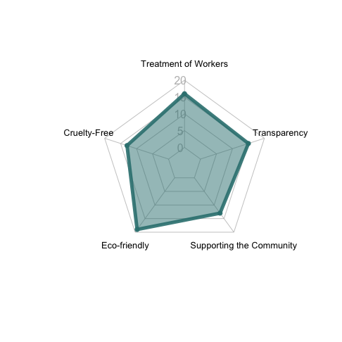
To quantify
“ethical consumerism”
A simulation of the five dimensions

Slide 5
Goal
Features
Credible
Data
Sources
Search:
Zara
Transparency Score: 4
Relative ranking: 14
Keyword: supply chain
Relevant Links: www.zara.com
Excellent
User
Experience

Slide 6
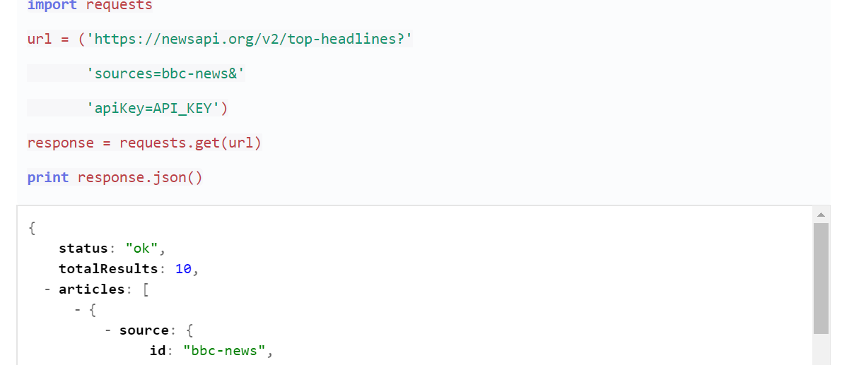
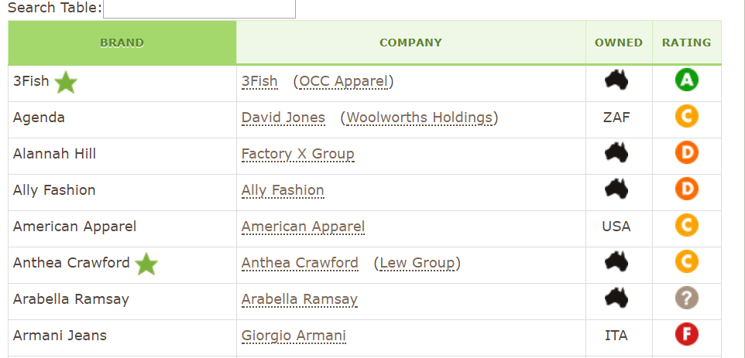
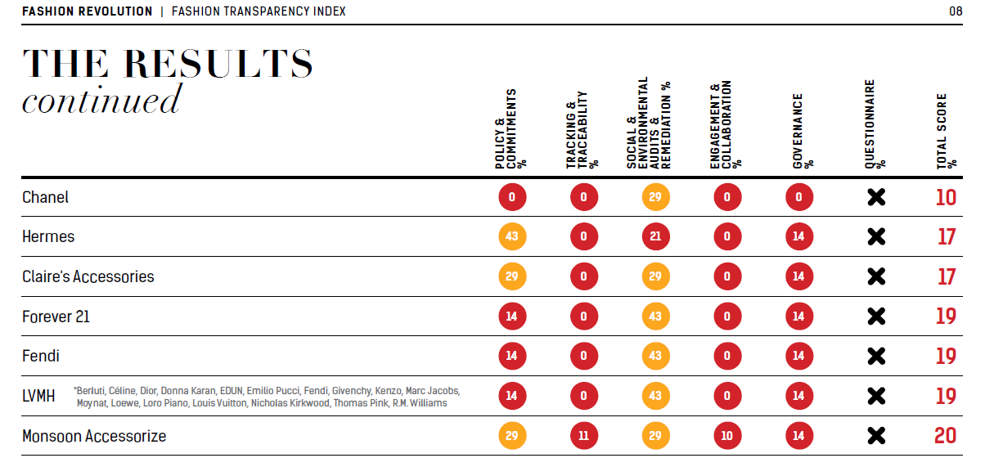
Data Sources
Keyword search for brand news
e.g. Yahoo News + Everlane + donate
News API
Rankings/ Scores from databases
e.g. Shop Ethical
Websites
Credible ethical fashion reports
e.g. Fashion transparency index
Reports

Slide 7
Tools
NLP
Pandas/SQL
Sentiment analysis
for news
Construct
Brand databases
Bokeh/Pygal
Django
Visualize
Index
Build
Website

Slide 8
Project Timeline
Logistics through the project
Getting domain name
Updating git repository,
Consulting with instructor and TAs
Jan 29th
Feb 05th
Feb 19th
Final
Data collection
* Web crawling
Data cleaning
Data integration
Statistical analysis
Generating insights
Data visualization
Web design
Interface design
Testing
Maintaining
Modifying
Improving

Slide 9
Potential challenges
Data collection:
# Find datasets for every dimension from credible sources
# Identify the number of negative news and lawsuits for each brand from the news collected through News API
# Crawl from cell phone App (Good On You)
Data integration:
# Dirty, incomplete and incompatible data
# Difficult to be integrated and merged
Others:
# Potential dimensions

Slide 10
P R O J E C T P R O P O S A L
Any question or suggestion?
2018. 01. 23

