Slide 1
Efficient execution of structured LLM agents
compiler-generated prompt has inherent heterogeneity
Recovering and exploiting the heterogeneity unlocks efficient KV cache management

Slide 2
Problem
Agent-serving systems such as PBKV, Pythia, CacheScout, and KVFlow improve KV-cache management by exploiting knowledge of future agent execution. They obtain this information from execution histories, workflow descriptions, or external annotations.
Meanwhile, agent frameworks increasingly allow developers to express LLM calls in code, which the compiler or runtime lowers code into model prompt. These generated prompts are not free text, they have systematic structure given by runtime/compiler.
Existing serving engine treats compiler-generated prompt as opaque request. This creates a gap between the program that generates requests and the information available to serve them efficiently.

Slide 3
Insights
Components within a compiler-generated prompt have different sharing scopes and lifetimes. Some components may remain fixed across invocations, some are shared across call sites, and some can grow or be replaced as execution progresses.
Compiler-generated prompts carry implicit program semantics. Their structure reflects the program constructs that produced them, making requests themselves a source of information about agent execution.
The heterogeneity within the prompt and agent execution information provide new signals for KV-cache management. More efficient KV reuse depends on understanding how prompt components evolve and anticipating future access patterns.

Slide 4
Example of heterogeneity within prompt
(This is a LLM callsite in code agent)
def implement(spec: str, plan: Plan, advice: str, attempts: list[Attempt]) -> str by llm();
Prompt region (in order) | Lifetime | Change between successive calls
header | Program constant | sem docstrings, type schemas, output format
spec | whole Session | Rarely changes
plan | One Planner round | Replaced each round
advice | One call | Changes each call: comes from per-round’s diagnosis
attempts | Whole session, append-only | Adds one entry; old entries remain byte-identical
We put “plan” and “advice” before “attempts”; when they change, the reusage prefix of “attempts” is contaminated

Slide 5
Identifying heterogeneity in prompt
We identify the heterogeneity by analyzing past traces. First, each text request is converted back to its callsite signature and bindings. Then we analyze the traces along two dimensions:
Intra-callsite evolution: For each binding, we compare its value across consecutive calls of the same callsite within a session and count same, extend, and fresh transitions.
Cross-callsites sharing: We check whether another callsite in the same session already carried the same value, or a prefix that the current value extends.
Finally, we obtain an evolution pattern for each binding and classify it as one of:
Constant: The same literal recurs across sessions;
Copied: The value is reused from an earlier call in the same session
Extended: Each new value grows from the previous one by appending
Volatile: The value is fresh on most calls, doesn’t get reused.
Orthogonally, a binding shared by multiple callsites and not volatile is marked cross-stable.
IR: request→{callsite, bindings, provenance, lifetime, sharing, future reuse}

Slide 6
Recover Agent Structure As time-annotated probabilistic state machine
Serving engine observed LLM calling traces, after resolved by re-lowering, we obtain a chain of calls.
Calling traces are first recorded as prefix tree with branching frequency, inter-call gaps and execution time gap.
The prefix tree will be folded into state machine using Alergia-style state merge.
𝒜 = (Q, P, q₀, F, 𝒯)
Q — set of states; each state q ∈ Q is an LLM callsite (signature, instance)
P : Q × Q → [0,1] — transition probability between callsites
q₀ ∈ Q — entrance callsite
F : Q → [0,1] — probability that the agent terminates at state q; F(q) + Σq′ P(q, q′) = 1
𝒯 = { Dexec(q), Dgap(q, q′) } — timing annotations
  Dexec(q): execution-time distribution of callsite q
  Dgap(q, q′): inter-call gap between completion of q and invocation of successor q′

Slide 7
Schedule KV cache efficiently
Schedule KV cache involves 2 layers of management:
Prompt Re-layout: Stable first, shared first.
Reorder each callsite's bindings by prefix lifetime: constant → copied → extended → volatile
If a binding is shared by multiple callsites (cross-stable), move it to the front and the static header behind it, so different callsites share one prefix.
KV management: prefetch by deadline, protect reuse, evict volatile.
Predict the next call's prompt from the learned rules and agent structures; promote its host-resident prefix before the deadline, reclaiming only retired cache.
Device eviction in four bands: retired < transient < unclassified < planned; Evict retired kvcache first, planned kvcache are ranked by predicted reuse time.
Host tier stays LRU as the safety net.
Notes:
Named bindings enable reordering without changing parameter identity; observed stability, sharing, and growth guide the serialization order for better prefix reuse.

Slide 8
Eval
Serving Stack
RTX 3090 (24 GB), Qwen3-8B in bf16, device cache pool 4.7 GB
Code Agent (Human Eval dataset); Fact Check (HoVer dataset)
Baselines:
SGLang with standard HiCache.
CacheScout (arXiv 2608.14624): opaque baseline. Predict future LLM calls based on prompt fingerprint and Markov Model. (horizon 3, prefetch threshold 0.5)
Re-layout only: LRU eviction plus our relowering-driven prompt re-layout.
Planner only: our KV manager on the original layout.

Slide 9
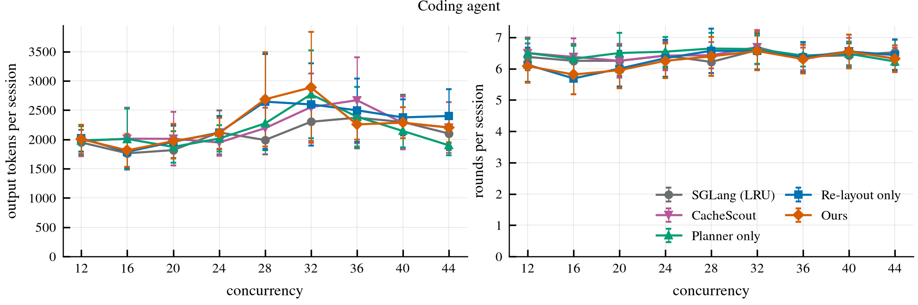
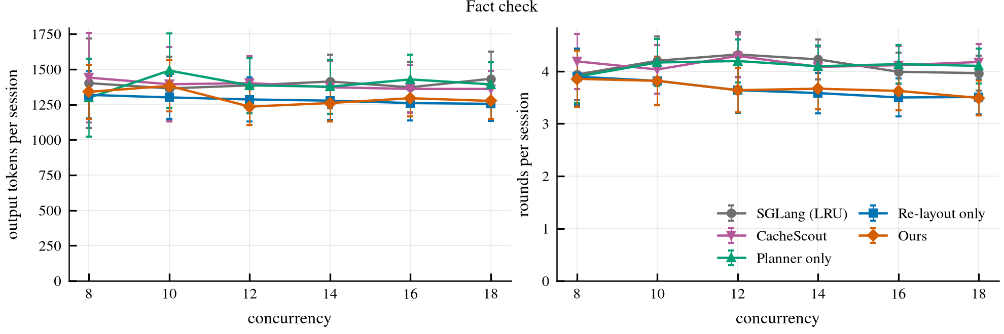
Preliminary: serving transformations preserve comparable application-level task quality
Arm / Success Rate | Coding agent | Fact check
SGLang (LRU) | 57.2% | 47.6%
CacheScout | 57.2% | 47.2%
Planner only | 54.9% | 46.2%
Re-layout only | 56.4% | 45.5%
Ours | 58.0% | 45.3%

Slide 10
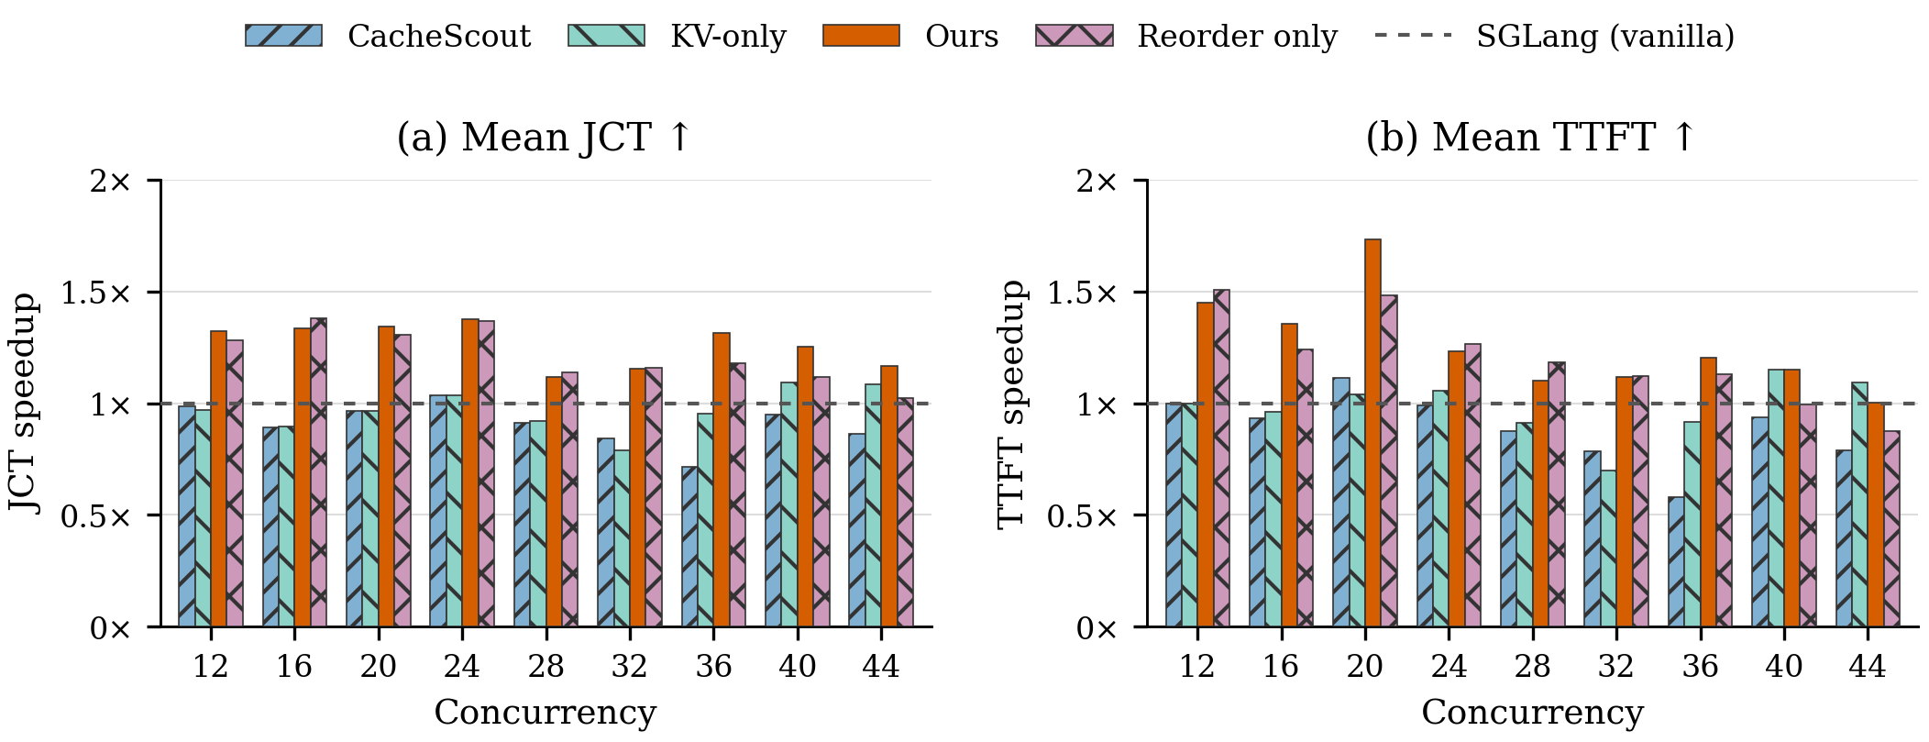
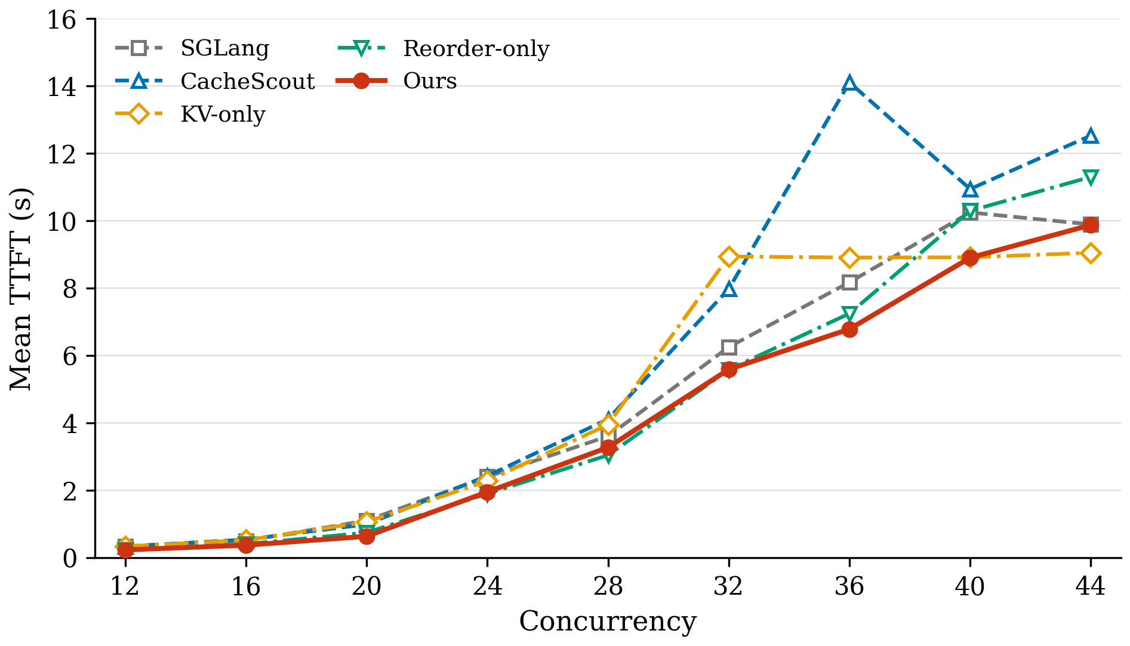
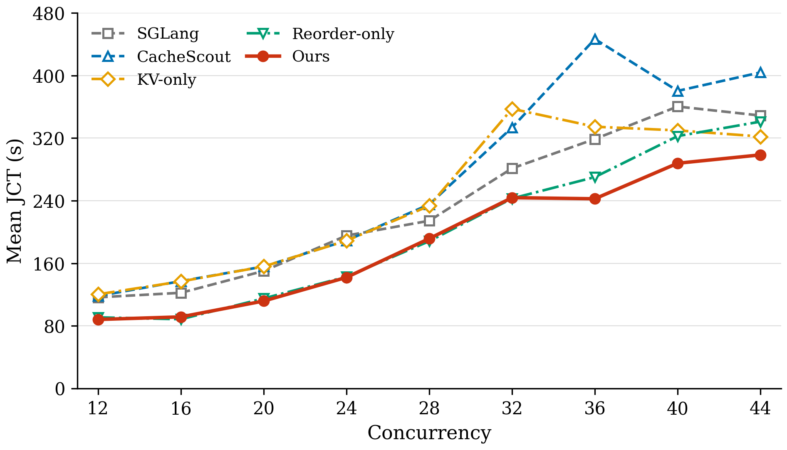
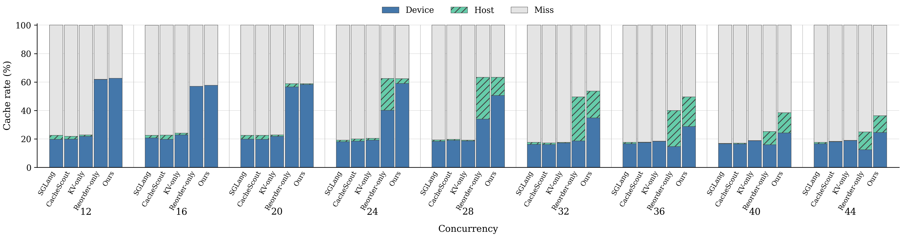
Primary results for Code Agent at different concurrency. (Host=8GB)
Initially (c<= 28), re-layout creates all improvements. Because it creates shared prefix and thus reduced cache pressure.
For 20<=c<=28, the benefit of KV management is higher device hit rate. But because SGLang HiCache has excellent kernel assisted IO, fetch kv from host is nearly free.
When concurrency grows (c>=36), rely only on reordering prompt cannot help. KV Management evict caches that won’t be used so that it reduces cache miss rate, which improved performance.

Slide 11
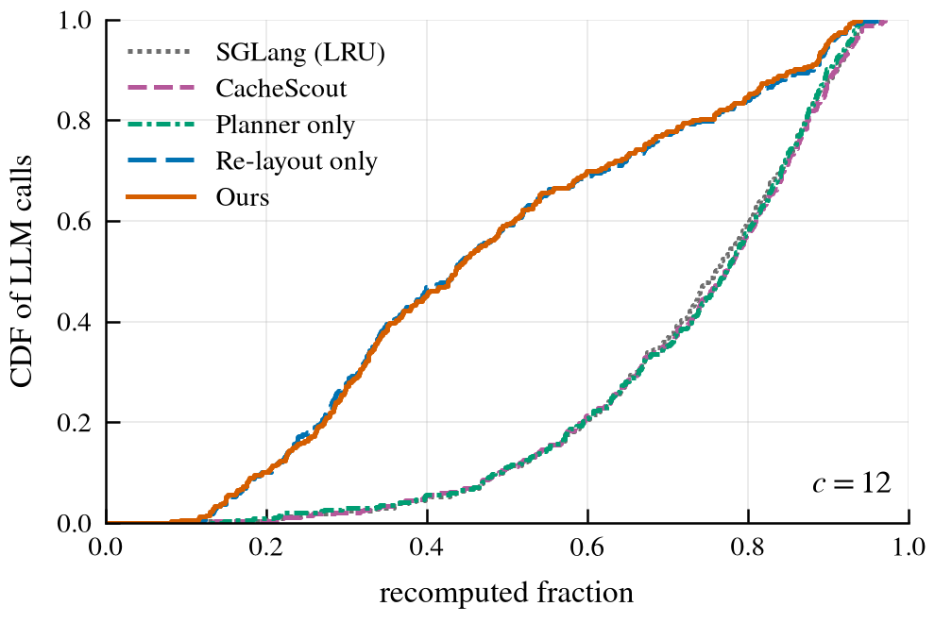
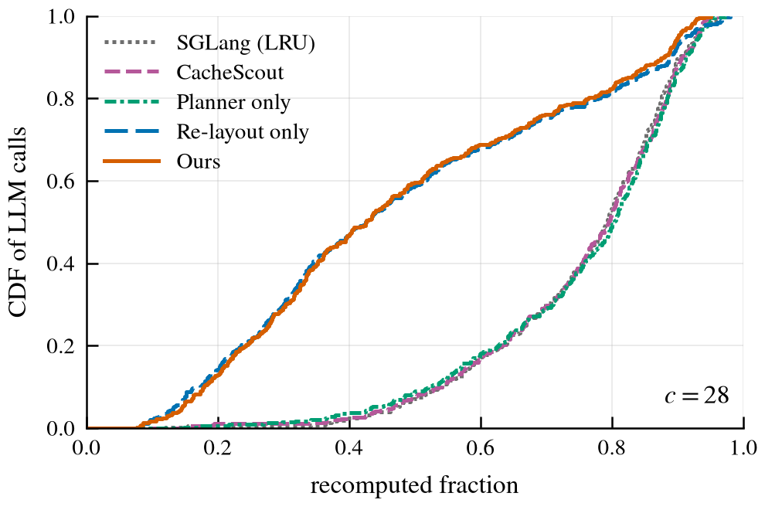
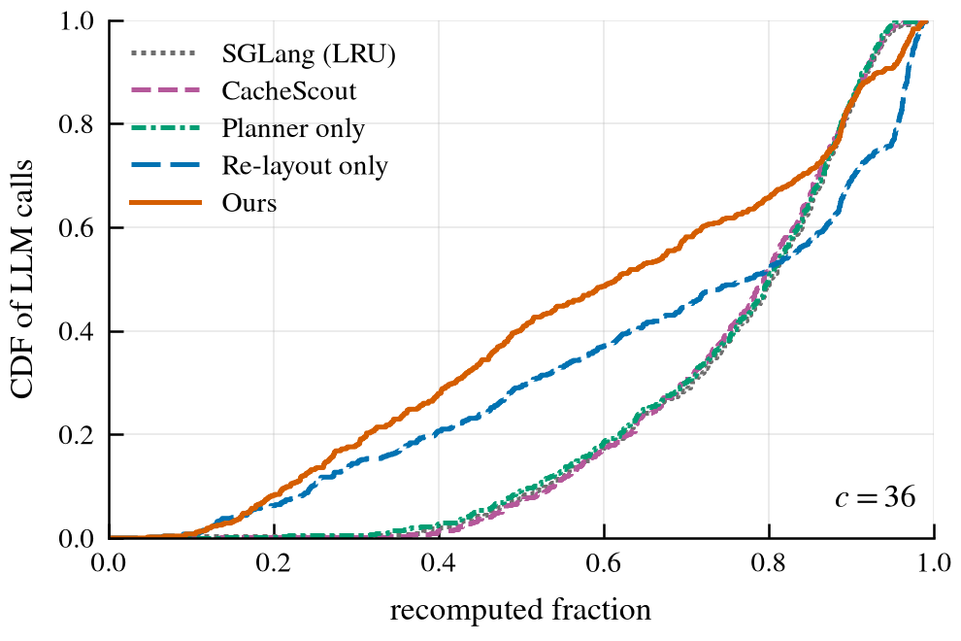
CDF for recomputed token ratio at representative concurrency
c=12, 28, 36 are chosen. We are focusing on rate of recomputed tokens in the input. Re-prefill is what eats resources.
Initially, enhancement is obtained from reordering of prompt. At median capacity, gains are device hit, kv management doesn’t reduce recompute tokens.
When pressure grew, kv management began to make sense based on the reduced pressure from prompt reordering. Ours has less tokens to recompute compared to re-layout only.

Slide 12
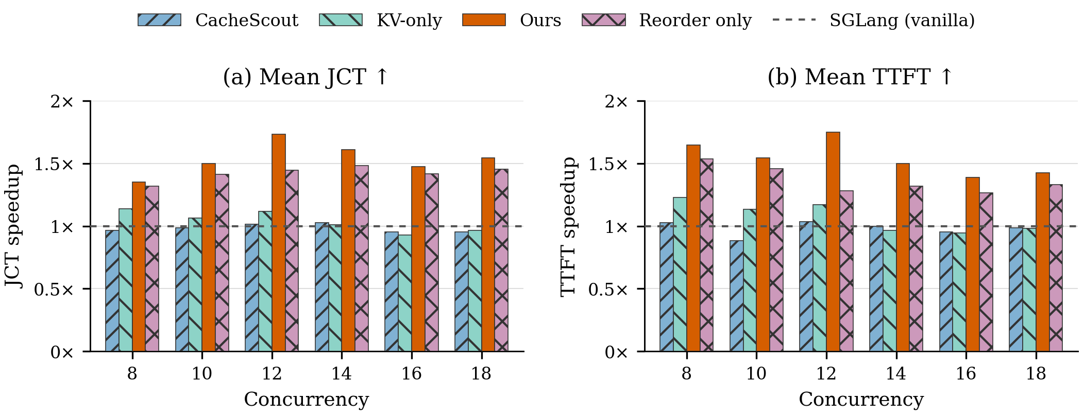
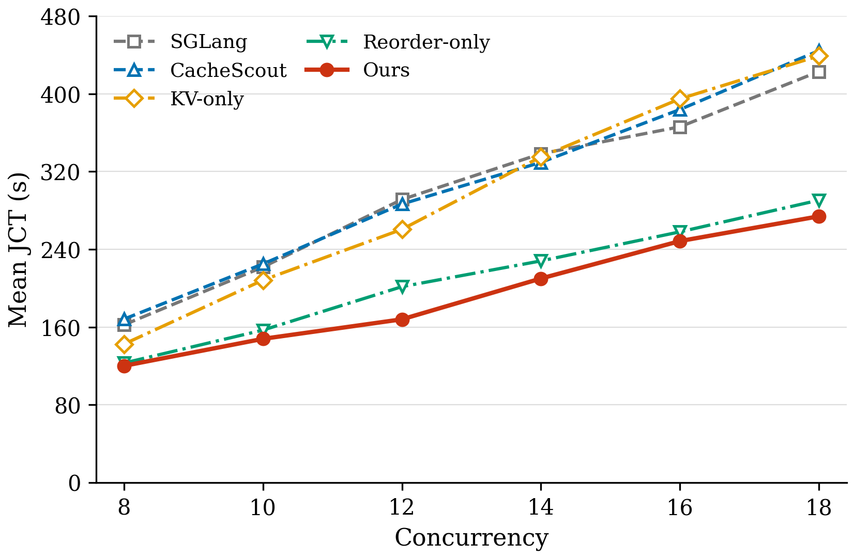
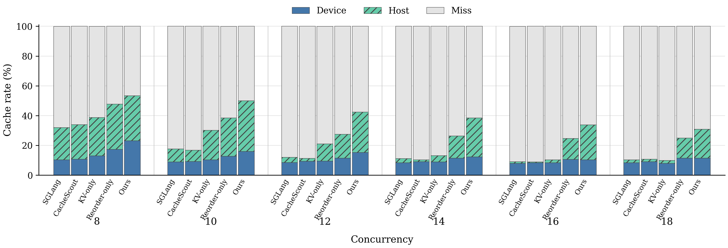
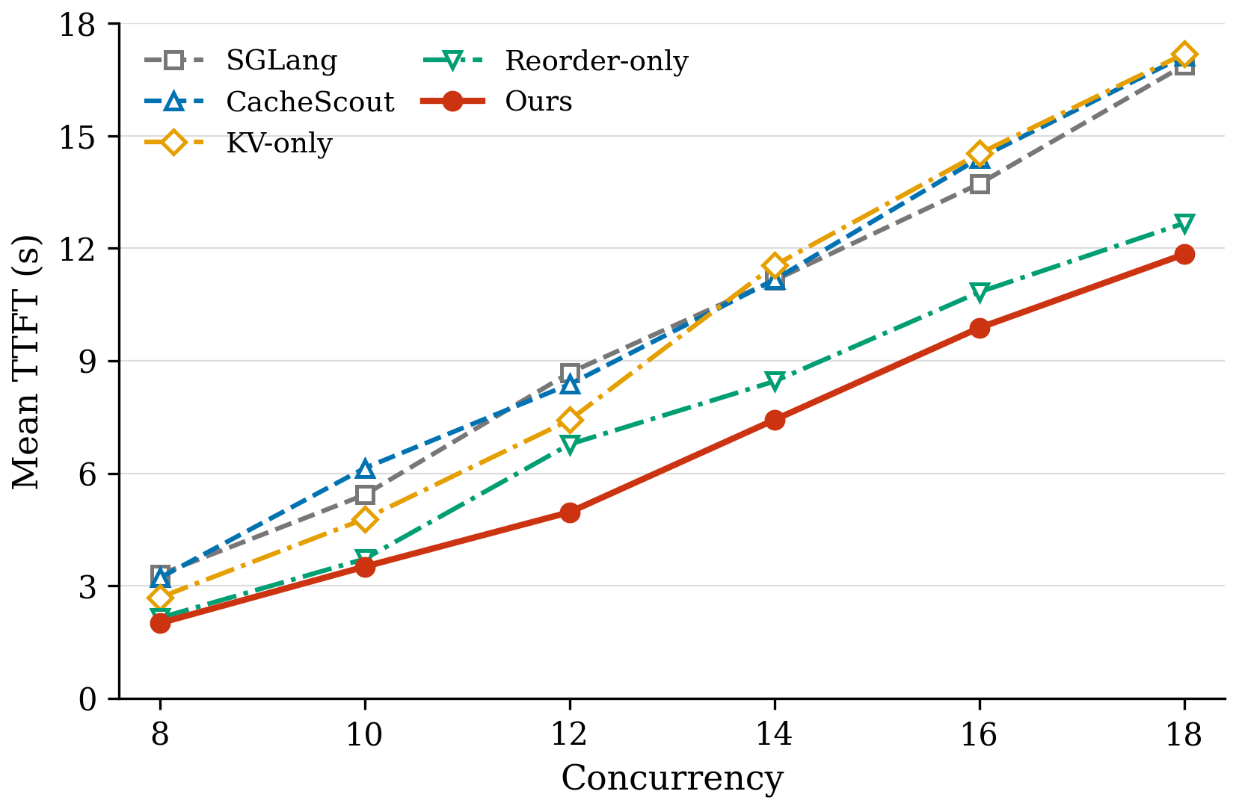
Primary results for FactCheck Agent at different concurrency. (Host=16GB)
When pressure is low, kvcache only could improve performance by better management.
But when pressure grows (KV >= 14), there is no space for kv scheduling. Then it collapsed.
Prompt re-layout creates more opportunities for prefix caching, thus reduces cache pressure. Not only increased performance but also left space for KV scheduling(So that Ours is better than Reorder-only)

Slide 13
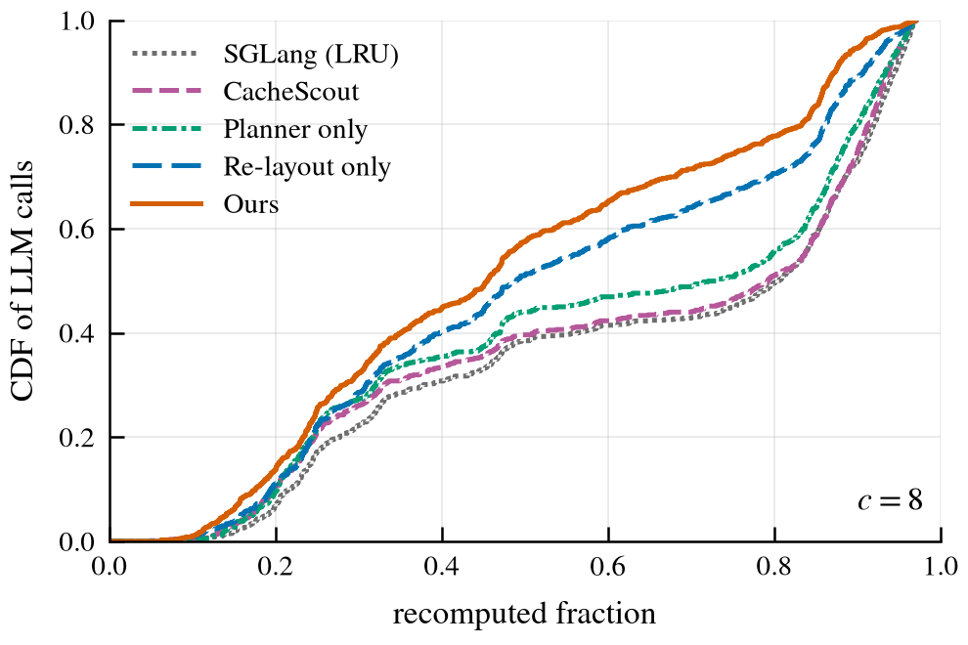
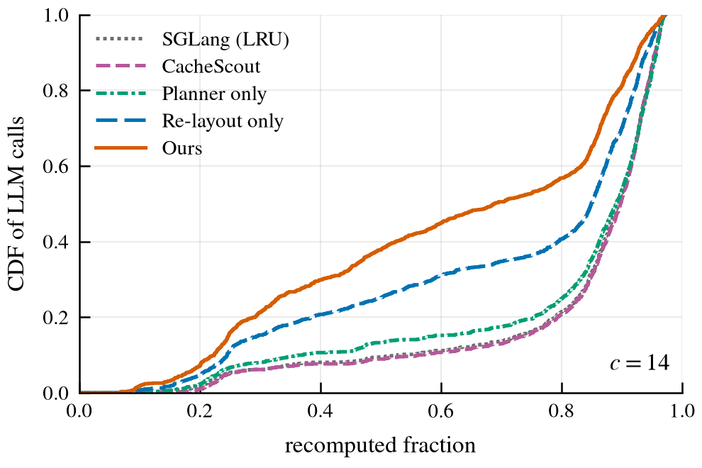
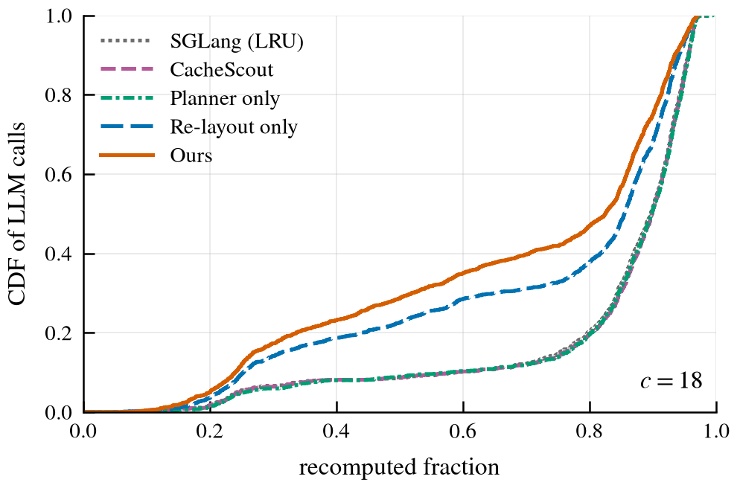
CDF for recomputed token ratio at representative concurrency
c= 8, 14, 18 are chosen.
At c=8, every mechanism works. KV-planner can schedule kvcache more efficiently; Prompt re-layout improve performance by creating larger prefix cache reuse. CacheScout also reduced the ratio of recomputed tokens. But it is not as effective as our planner.
As workload increases, KV-planner’s gain decreased, even diminished, because there is no space for scheduling. Cache pressure is high, nothing can survive.
However, as 3 CDF showed. Ours, which is kv-planner + re-layout, performed best. Efficient KV Cache management can earn extra optimization based on the reduced cache pressure provided by prompt re-layout.

Slide 14
Generality: DSPy, same heterogeneity inside prompt
def implement(spec: str, plan: Plan, advice: str, attempts: list[Attempt]) -> str by llm();
-------------------------------------------------------------------------------------------------------------
implement = dspy.Predict(Implement)
code = implement(spec=spec, plan=plan, advice=advice, attempts=attempts).code
[system]
This is a task you must complete by returning only the output. ... ← framework-static
…
[user]
Coder.implement(spec: str, plan: Plan, advice: str, attempts: list[Attempt]) -> str
--- Return the complete function from `spec` ... apply it.
spec: str ---- The signature and docstring ...
plan: Plan ---- ... advice: str ---- ... attempts: Attempt ---- ...
spec = 'def has_close_elements(...)...'
plan = Plan(approach=..., edge_cases=[...])
advice = 'fix 43'
attempts = [Attempt(function=..., code=..., passed=False, output="...pytest...")]
self = Coder() ---- Writes one function of the module
…[static tail]
[system] Your input fields are:
1. `spec` (str): The signature and docstring ...
2. `plan` (Plan): ... 3. `advice` (str): ... 4. `attempts` (list[Attempt]): ...
Your output fields are: 1. `code` (str):
All interactions will be structured in the following way ...
[[ ## spec ## ]] {spec} [[ ## plan ## ]] {plan} [[ ## advice ## ]] {advice}
[[ ## attempts ## ]] {attempts} [[ ## code ## ]] {code} [[ ## completed ## ]]
In adhering to this structure, your objective is: Return the complete function ...
[user] [[ ## spec ## ]] def has_close_elements(...)... ← per-function
[[ ## plan ## ]] {"approach": ..., "edge_cases": [...]} ← per-function
[[ ## advice ## ]] fix 43 ← per-call
[[ ## attempts ## ]] [{"function": ..., "code": ..., "passed": false, "output": ...}]
Respond with the corresponding output fields, starting with `[[ ## code ## ]]` ...
[framework-static tail]
LLMs declared as functions have similar inherent heterogeneity. Headers, values, schemas are ordered by compiler. They expose opportunities from exploiting such heterogeneity.

