Slide 1
Wireless Embedded InterNetworking
Foundations of Ubiquitous Sensor Networks
6LoWPAN
David E. Culler
University of California, Berkeley
June 2008
Notes:
Thank you
Tag team: software / tinyos part, Kris hardware/smart dust part
Hopefully let you play with the toys so you don’t get too anxious before lunch

Slide 2
2007 - The IP/USN Arrives

Slide 3
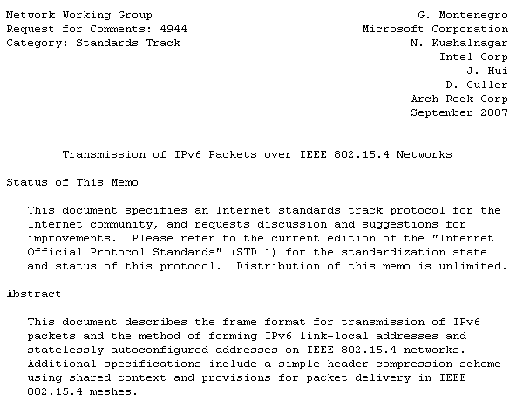


6LoWPAN Standard …

Slide 4
6LoWPAN … what it means for sensors
Low-Power Wireless Embedded devices can now be connected using familiar networking technology,
  like ethernet (but even where wiring is not viable)
  and like WiFi (but even where power is not plentiful)
all of these can interoperate in real applications
Interoperate with traditional computing infrastructure
Utilize modern security techniques
Application Requirements and Capacity Plan dictate how the network is organized,
  not artifacts of the underlying technology

Slide 5

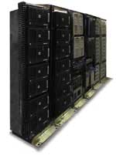










Internet – Networks of Networks
Networks
  Ethernet
  WiFi
  Serial links
connect hosts and devices and other networks together
Horizontally integrated
vs
Peripheral Interconnects
  USB, Firewire
  IDE / SCSI
  RS232,RS485
  IRDA
  BlueTooth
connect one or more devices to a host computer
Vertically integrated
  Physical link to application
ethernet
wifi
LoWPAN

Slide 6
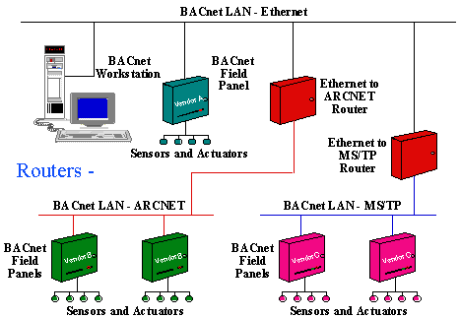


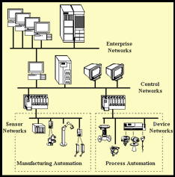



Which are sensors like?
Trending
Monitoring
Data
Analytics
Management
Ethernet
WiFi
GPRS
RS232
RS485
Controllers
Operations
Field
Units
hartcomm.org

Slide 7
Internet Concepts: Layering
Diverse Object and Data Models (HTML, XML, …, BacNet, …)
7: app
Application (Telnet, FTP, SMTP, SNMP, HTTP)
4: xport
Transport (UDP/IP, TCP/IP)
3: net
Network (IP)
6LoWPAN
2: link
Link
Serial
Modem
X3T9.5
FDDI
802.3
Ethernet
802.5
Token Ring
802.11
WiFi
802.15.4
LoWPAN
802.3a
Ethernet
10b2
802.11a
WiFi
802.3i
Ethernet
10bT
802.11b
WiFi
ISDN
Sonet
802.3y
Ethernet
100bT
802.11g
WiFi
DSL
802.3ab
Ethernet
1000bT
802.11n
WiFi
GPRS
802.3an
Ethernet
1G bT
1: phy

Slide 8

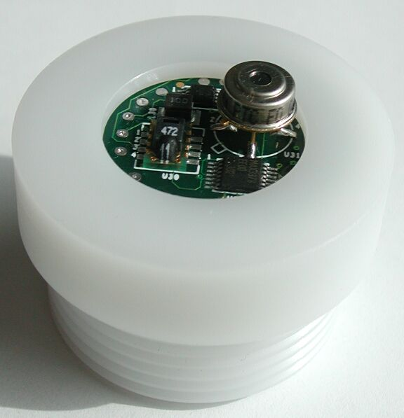

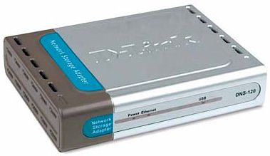
Making sensor nets make sense
LoWPAN – 802.15.4
1% of 802.11 power, easier to embed, as easy to use.
8-16 bit MCUs with KBs, not MBs.
Off 99% of the time
Proxy / Gateway
Web Services
XML / RPC / REST / SOAP / OSGI
HTTP / FTP / SNMP
TCP / UDP
IP
Ethernet
Sonet
802.11
802.15.4, …
IETF 6lowpan

Slide 9
Many Advantages of IP
Extensive interoperability
  Other wireless embedded 802.15.4 network devices
  Devices on any other IP network link (WiFi, Ethernet, GPRS, Serial lines, …)
Established security
  Authentication, access control, and firewall mechanisms
  Network design and policy determines access, not the technology
Established naming, addressing, translation, lookup, discovery
Established proxy architectures for higher-level services
  NAT, load balancing, caching, mobility
Established application level data model and services
  HTTP/HTML/XML/SOAP/REST, Application profiles
Established network management tools
  Ping, Traceroute, SNMP, … OpenView, NetManager, Ganglia, …
Transport protocols
  End-to-end reliability in addition to link reliability
Most “industrial” (wired and wireless) standards support an IP option

Slide 10
Leverage existing standards, rather than “reinventing the wheel”
RFC 768 UDP - User Datagram Protocol [1980]
RFC 791 IPv4 – Internet Protocol [1981]
RFC 792 ICMPv4 – Internet Control Message Protocol [1981]
RFC 793 TCP – Transmission Control Protocol [1981]
RFC 862 Echo Protocol [1983]
RFC 1101 DNS Encoding of Network Names and Other Types [1989]
RFC 1191 IPv4 Path MTU Discovery [1990]
RFC 1981 IPv6 Path MTU Discovery [1996]
RFC 2131 DHCPv4 - Dynamic Host Configuration Protocol [1997]
RFC 2375 IPv6 Multicast Address Assignments [1998]
RFC 2460 IPv6 [1998]
RFC 2463 ICMPv6 - Internet Control Message Protocol for IPv6 [1998]
RFC 2765 Stateless IP/ICMP Translation Algorithm (SIIT) [2000]
RFC 3068 An Anycast Prefix for 6to4 Relay Routers [2001]
RFC 3307 Allocation Guidelines for IPv6 Multicast Addresses [2002]
RFC 3315 DHCPv6 - Dynamic Host Configuration Protocol for IPv6 [2003]
RFC 3484 Default Address Selection for IPv6 [2003]
RFC 3587 IPv6 Global Unicast Address Format [2003]
RFC 3819 Advice for Internet Subnetwork Designers [2004]
RFC 4007 IPv6 Scoped Address Architecture [2005]
RFC 4193 Unique Local IPv6 Unicast Addresses [2005]
RFC 4291 IPv6 Addressing Architecture [2006]
Proposed Standard - "Transmission of IPv6 Packets over IEEE 802.15.4 Networks"

Slide 11
IEEE 802.15.4 – The New IP Link
http://tools.ietf.org/wg/6lowpan/
Problem Statement: http://tools.ietf.org/html/rfc4919
Format: http://tools.ietf.org/html/rfc4944
Routable: http://tools.ietf.org/id/draft-hui-6lowpan-hc-00.txt
Interoperability
Architecture
1% of 802.11 power, easier to embed, as easy to use.

Slide 12


Wireless links
 | 802.15.4 | 802.15.1 | 802.15.3 | 802.11 | 802.3
Class | WPAN | WPAN | WPAN | WLAN | LAN
Lifetime (days) | 100-1000+ | 1-7 | Powered | 0.1-5 | Powered
Net Size | 65535 | 7 | 243 | 30 | 1024
BW (kbps) | 20-250 | 720 | 11,000+ | 11,000+ | 100,000+
Range (m) | 1-75+ | 1-10+ | 10 | 1-100 | 185 (wired)
Goals | Low Power, Large Scale, Low Cost | Cable Replacement | Cable Replacement | Throughput | Throughput

Slide 13
Key Factors for IP over 802.15.4
Header
  Standard IPv6 header is 40 bytes [RFC 2460]
  Entire 802.15.4 MTU is 127 bytes [IEEE ]
  Often data payload is small
Fragmentation
  Interoperability means that applications need not know the constraints of physical links that might carry their packets
  IP packets may be large, compared to 802.15.4 max frame size
  IPv6 requires all links support 1280 byte packets [RFC 2460]
Allow link-layer mesh routing under IP topology
  802.15.4 subnets may utilize multiple radio hops per IP hop
  Similar to LAN switching within IP routing domain in Ethernet
Allow IP routing over a mesh of 802.15.4 nodes
  Options and capabilities already well-defines
  Various protocols to establish routing tables
Energy calculations and 6LoWPAN impact

Slide 14
6LoWPAN Challenges
UDP datagram or
TCP stream segment
…, modbus, BacNET/IP, … , HTML, XML, …, ZCL
transport header
application payload
Network packet
40 B + options
cls
flow
len
hops
NH
src IP
dst IP
net payload
16 B
16 B
Link frame
1280 Bytes MIN
ctrl
len
src UID
dst UID
link payload
chk
128 Bytes MAX
Large IP Address & Header => 16 bit short address / 64 bit EUID
Minimum Transfer Unit => Fragmentation
Short range & Embedded => Multiple Hops

Slide 15
6LoWPAN – IP Header Optimization
Network packet
40 B
cls
flow
len
hops
NH
src IP
dst IP
net payload
Link frame
3 B
ctrl
len
src UID
dst UID
hops
chk
6LoWPAN adaptation header
Eliminate all fields in the IPv6 header that can be derived from the 802.15.4 header in the common case
  Source address : derived from link address
  Destination address : derived from link address
  Length : derived from link frame length
  Traffic Class & Flow Label : zero
  Next header : UDP, TCP, or ICMP
Additional IPv6 options follow as options

Slide 16
IEEE 802.15.4 Frame Format
D pan
Dst EUID 64
S pan
Src EUID 64
Max 127 bytes
preamble
SFD
Len
FCF
DSN
Dst16
Src16
Fchk
Network Header
Application Data
Low Bandwidth (250 kbps), low power (1 mW) radio
Moderately spread spectrum (QPSK) provides robustness
Simple MAC allows for general use
  Many TinyOS-based protocols (MintRoute, LQI, BVR, …), TinyAODV, Zigbee, SP100.11, Wireless HART, …
  6LoWPAN => IP
Choice among many semiconductor suppliers
Small Packets to keep packet error rate low and permit media sharing

Slide 17
RFC 3189 –
"Advice for Internet Sub-Network Designers"
Total end-to-end interactive response time should not exceed human perceivable delays
Lack of broadcast capability impedes or, in some cases, renders some protocols inoperable (e.g. DHCP). Broadcast media can also allow efficient operation of multicast, a core mechanism of IPv6
Link-layer error recovery often increases end-to-end performance. However, it should be lightweight and need not be perfect, only good enough
Sub-network designers should minimize delay, delay variance, and packet loss as much as possible
Sub-networks operating at low speeds or with small MTUs should compress IP and transport-level headers (TCP and UDP)

Slide 18
6LoWPAN Format Design
Orthogonal stackable header format
Almost no overhead for the ability to interoperate and scale.
Pay for only what you use
IEEE 802.15.4 Frame Format
D pan
Dst EUID 64
S pan
Src EUID 64
Max 127 bytes
preamble
SFD
Len
FCF
DSN
Dst16
Src16
Fchk
Network Header
Application Data
IETF 6LoWPAN Format
HC1
HC2
dsp
IP
UDP
Dispatch: coexistence
dsp
HC1
Header compression
mhop
frag
dsp
HC1
Mesh (L2) routing
mhop
frag
dsp
HC1
Message > Frame fragmentation

Slide 19
6LoWPAN – The First Byte
Coexistence with other network protocols over same link
Header dispatch - understand what’s coming
IEEE 802.15.4 Frame Format
D pan
Dst EUID 64
S pan
Src EUID 64
preamble
SFD
Len
FCF
DSN
Dst16
Src16
Fchk
Network Header
Application Data
IETF 6LoWPAN Format
00
Not a LoWPAN frame
01
LoWPAN IPv6 addressing header
10
LoWPAN mesh header
11
LoWPAN fragmentation header

Slide 20
6LoWPAN – IPv6 Header
IEEE 802.15.4 Frame Format
D pan
Dst EUID 64
S pan
Src EUID 64
preamble
SFD
Len
FCF
DSN
Dst16
Src16
Fchk
dsp
Network Header
Application Data
IETF 6LoWPAN Format
01
0
0
0
0
0
1
Uncompressed IPv6 address [RFC2460]
40 bytes
01
0
0
0
0
1
0
HC1
Fully compressed: 1 byte
Source address : derived from link address
Destination address : derived from link address
Traffic Class & Flow Label : zero
Next header : UDP, TCP, or ICMP

Slide 21
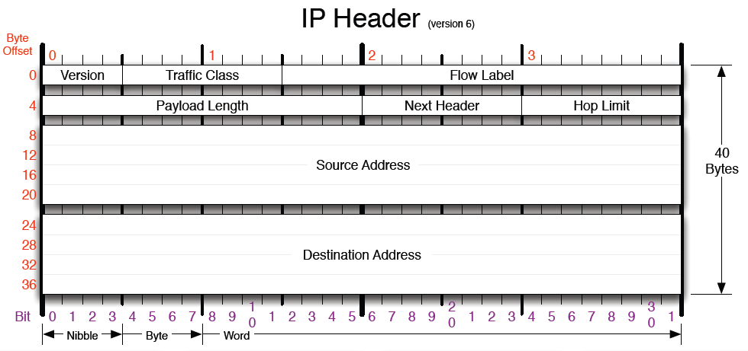
IPv6 Header Compression
in HC1 byte
v6
zero
In 802.15.4 header
Link local => derive from 802.15.4 header
Link local => derive from 802.15.4 header
http://www.visi.com/~mjb/Drawings/IP_Header_v6.pdf
uncompressed

Slide 22
HC1 Compressed IPv6 Header
Source prefix compressed (to L2)
Source interface identifier compressed (to L2)
Destination prefix compressed (to L2)
Destination interface identified compressed (to L2)
Traffic and Flow Label zero (compressed)
Next Header
  00 uncompressed, 01 UDP, 10 TCP, 11 ICMP
Additional HC2 compression header follows
HC1
Zero or more uncompressed fields follow in order
0
7
IPv6 address <prefix64 || interface id> for nodes in 802.15.4 subnet derived from the link address.
  PAN ID maps to a unique IPv6 prefix
  Interface identifier generated from EUID64 or Pan ID & short address
Hop Limit is the only incompressible IPv6 header field

Slide 23
6LoWPAN: Compressed IPv6 Header
IEEE 802.15.4 Frame Format
D pan
Dst EUID 64
S pan
Src EUID 64
preamble
SFD
Len
FCF
DSN
Dst16
Src16
Fchk
dsp
HC1
Network Header
Application Data
IETF 6LoWPAN Format
01
0
0
0
0
1
0
HC1
uncompressed v6 fields
Non 802.15.4 local addresses
non-zero traffic & flow
  rare and optional
“Compressed IPv6”
“how it is compressed”

Slide 24
6LoWPAN – Compressed / UDP
IEEE 802.15.4 Frame Format
D pan
Dst EUID 64
S pan
Src EUID 64
preamble
SFD
Len
FCF
DSN
Dst16
Src16
Fchk
Network Header
Application Data
IETF 6LoWPAN Format
dsp
HC1
IP
UDP
Dispatch: Compressed IPv6
HC1: Source & Dest Local, next hdr=UDP
IP: Hop limit
UDP: 8-byte header (uncompressed)

Slide 25
6LoWPAN – UDP/IP Optimization
Network packet
40 B
8 B
cls
flow
len
hops
NH
src IP
dst IP
UDP hdr
appln payload
Link frame
7 B
ctrl
len
src UID
dst UID
hops
chk
6LoWPAN adaptation header
Transport length derived from link
Subset of ports in compressed form

Slide 26
IPv6 Header Compression
in HC byte
v6
zero
In 802.15.4 header
derive from 802.15.4 header
derive from 802.15.4 header
http://www.visi.com/~mjb/Drawings/IP_Header_v6.pdf
uncompressed

Slide 27
6LoWPAN – Compressed / Compressed UDP
IEEE 802.15.4 Frame Format
D pan
Dst EUID 64
S pan
Src EUID 64
preamble
SFD
Len
FCF
DSN
Dst16
Src16
Fchk
Network Header
Application Data
IETF 6LoWPAN Format
dsp
HC1
HC2
IP
UDP
Dispatch: Compressed IPv6
HC1: Source & Dest Local, next hdr=UDP
IP: Hop limit
UDP: HC2+3-byte header (compressed)
source port = P + 4 bits, p = 61616 (0xF0B0)
destination port = P + 4 bits

Slide 28
6LoWPAN / Zigbee Comparison
IEEE 802.15.4 Frame Format
D pan
Dst EUID 64
S pan
Src EUID 64
preamble
SFD
Len
FCF
DSN
Dst16
Src16
Fchk
Network Header
Application Data
IETF 6LoWPAN Format
HC1
HC2
dsp
IP
UDP
Zigbee APDU Frame Format
fctrl
D ep
clstr
prof
S ep
APS
fctrl: Frame Control bit fields
D ep: Destination Endpoint (like UDP port)
clstr: cluster identifier
prof: profile identifier
S ep: Source Endpoint
APS: APS counter (sequence to prevent duplicates)
*** Typical configuration. Larger and smaller alternative forms exist.

Slide 29
6LoWPAN – Compressed / ICMP
IEEE 802.15.4 Frame Format
D pan
Dst EUID 64
S pan
Src EUID 64
preamble
SFD
Len
FCF
DSN
Dst16
Src16
Fchk
Network Header
Application Data
IETF 6LoWPAN Format
dsp
HC1
IP
ICMP
Dispatch: Compressed IPv6
HC1: Source & Dest Local, next hdr=ICMP
IP: Hops Limit
ICMP: 8-byte header

Slide 30
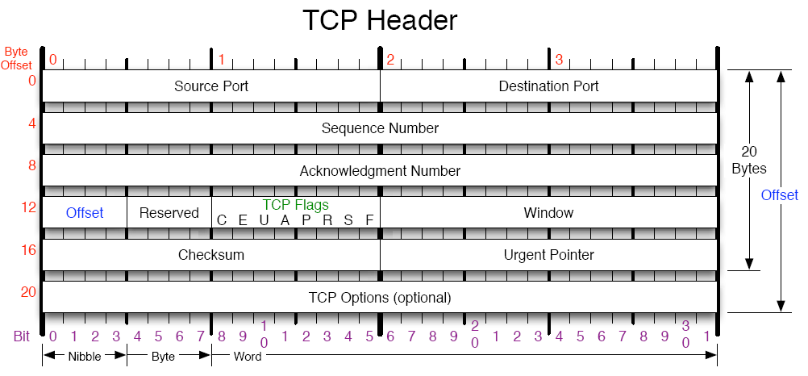
L4 – TCP Header (20 bytes)

Slide 31
6LoWPAN – Compressed / TCP
IEEE 802.15.4 Frame Format
D pan
Dst EUID 64
S pan
Src EUID 64
Max 127 bytes
preamble
SFD
Len
FCF
DSN
Dst16
Src16
Fchk
Network Header
Application
Data
IETF 6LoWPAN Format
dsp
HC1
IP
TCP
Dispatch: Compressed IPv6
HC1: Source & Dest Local, next hdr=TCP
IP: Hops Limit
TCP: 20-byte header

Slide 32
Key Points for IP over 802.15.4
Header overhead
  Standard IPv6 header is 40 bytes [RFC 2460]
  Entire 802.15.4 MTU is 127 bytes [IEEE std]
  Often data payload is small
Fragmentation
  Interoperability means that applications need not know the constraints of physical links that might carry their packets
  IP packets may be large, compared to 802.15.4 max frame size
  IPv6 requires all links support 1280 byte packets [RFC 2460]
Allow link-layer mesh routing under IP topology
  802.15.4 subnets may utilize multiple radio hops per IP hop
  Similar to LAN switching within IP routing domain in Ethernet
Allow IP routing over a mesh of 802.15.4 nodes
  Localized internet of overlapping subnets
Energy calculations and 6LoWPAN impact

Slide 33
6LoWPAN Fragmentation
IP interoperability over many links => users not limited by frame size
IP datagrams that are too large to fit in a 802.15.4 frame are fragmented into multiple frames
  Self describing for reassembly
Network packet
IP header
net payload
Multiple Link frames
15.4 header
Fn
IP
chk
. . .
. . .
15.4 header
F2
IP
net payload
chk
15.4 header
F1
IP
chk

Slide 34
Fragmentation
All fragments of an IP packet carry the same “tag”
  Assigned sequentially at source of fragmentation
Each specifies tag, size, and position
Do not have to arrive in order
Time limit for entire set of fragments (60s)
First fragment
11
0
0
0
size
tag
Rest of the fragments
11
1
0
0
size
tag
offset

Slide 35
6LoWPAN – Example
Fragmented / Compressed / Compressed UDP
IEEE 802.15.4 Frame Format
D pan
Dst EUID 64
S pan
Src EUID 64
preamble
SFD
Len
FCF
DSN
Dst16
Src16
Fchk
Network Header
Application
Data
IETF 6LoWPAN Format
Frag 1st
HC1
dsp
HC2
IP
UDP
Dispatch: Fragmented, First Fragment, Tag, Size
Dispatch: Compressed IPv6
HC1: Source & Dest Local, next hdr=UDP
IP: Hop limit
UDP: HC2+3-byte header (compressed)

Slide 36
Key Points for IP over 802.15.4
Header overhead
  Standard IPv6 header is 40 bytes [RFC 2460]
  Entire 802.15.4 MTU is 127 bytes [IEEE std]
  Often data payload is small
Fragmentation
  Interoperability means that applications need not know the constraints of physical links that might carry their packets
  IP packets may be large, compared to 802.15.4 max frame size
  IPv6 requires all links support 1280 byte packets [RFC 2460]
Allow link-layer mesh routing under IP topology
  802.15.4 subnets may utilize multiple radio hops per IP hop
  Similar to LAN switching within IP routing domain in Ethernet
Allow IP routing over a mesh of 802.15.4 nodes
  Localized internet of overlapping subnets
Energy calculations and 6LoWPAN impact

Slide 37



Multi-Hop Communication
PAN
Short-range radios & Obstructions => Multi-hop Communication is often required
  i.e. Routing and Forwarding
  That is what IP does!
“Mesh-under”: multi-hop communication at the link layer
  Still needs routing to other links or other PANs
“Route-over”: IP routing within the PAN
6LoWPAN supports both

Slide 38
IP-Based Multi-Hop
IP has always done “multi-hop”
  Routers connect sub-networks to one another
  The sub-networks may be the same or different physical links
Routers utilize routing tables to determine which node represents the “next hop” toward the destination
Routing protocols establish and maintain proper routing tables
  Routers exchange messages with neighboring routers
  Different routing protocols are used in different situations
  RIP, OSPF, IGP, BGP, AODV, OLSR, …
IP routing over 15.4 links does not require additional header information at 6LoWPAN layer
Vast body of tools to support IP routing
  Diagnosis, visibility, tracing, management
  These need to be reinvented for meshing
IP is widely used in isolated networks too
  Broad suite of security and management tools

Slide 39
Meshing vs Routing
Conventional IP link is a full broadcast domain
  Routing connects links (i.e, networks)
Many IP links have evolved from a broadcast domain to a link layer “mesh” with emulated broadcast
  ethernet => switched ethernet
  802.11 => 802.11s
Utilize high bandwidth on powered links to maintain the illusion of a broadcast domain
802.15.4 networks are limited in bandwidth and power so the emulation is quite visible.
Routing at two different layers may be in conflict
On-going IETF work in ROLL working group
  Routing Over Low-Power and Lossy networks

Slide 40
“Mesh Under” Header
Originating node and Final node specified by either short (16 bit) or EUID (64 bit) 802.15.4 address
  In addition to IP source and destination
Hops Left (up to 14 hops, then add byte)
Mesh protocol determines node at each mesh hop
LoWPAN mesh header
10
o
f
hops left
orig. addr (16/64)
final. addr (16/64)
final short address
originator short address

Slide 41
6LoWPAN – Example
Mesh / Compressed / Compressed UDP
IEEE 802.15.4 Frame Format
D pan
Dst EUID 64
S pan
Src EUID 64
preamble
SFD
Len
FCF
DSN
Dst16
Src16
Fchk
Network Header
Application
Data
IETF 6LoWPAN Format
M
o16
f16
dsp
HC1
HC2
IP
UDP
Dispatch: Mesh under, orig short, final short
Mesh: orig addr, final addr
Dispatch: Compressed IPv6
HC1: Source & Dest Local, next hdr=UDP
IP: Hop limit
UDP: HC2+3-byte header

Slide 42
6LoWPAN – Example
Mesh / Fragmented / Compressed / UDP
IEEE 802.15.4 Frame Format
D pan
Dst EUID 64
S pan
Src EUID 64
preamble
SFD
Len
FCF
DSN
Dst16
Src16
Fchk
Network Header
IETF 6LoWPAN Format
M
o16
f16
Frag 1st
Application
Data
HC1
dsp
HC2
IP
UDP
Dispatch: Mesh under, orig short, final short
Mesh: orig addr, final addr
Dispatch: Fragmented, First Fragment, Tag, Size
Dispatch: Compressed IPv6
HC1: Source & Dest Local, next hdr=UDP
IP: Hop limit
UDP: HC2 + 3-byte header

Slide 43
Key Points for IP over 802.15.4
Header overhead
  Standard IPv6 header is 40 bytes [RFC 2460]
  Entire 802.15.4 MTU is 127 bytes [IEEE std]
  Often data payload is small
Fragmentation
  Interoperability means that applications need not know the constraints of physical links that might carry their packets
  IP packets may be large, compared to 802.15.4 max frame size
  IPv6 requires all links support 1280 byte packets [RFC 2460]
Allow link-layer mesh routing under IP topology
  802.15.4 subnets may utilize multiple radio hops per IP hop
  Similar to LAN switching within IP routing domain in Ethernet
Allow IP routing over a mesh of 802.15.4 nodes
  Localized internet of overlapping subnets
Energy calculations and 6LoWPAN impact

Slide 44
IP-Based Multi-Hop Routing
IP has always done “multi-hop”
  Routers connect sub-networks to one another
  The sub-networks may be the same or different physical links
Routers utilize routing tables to determine which node represents the “next hop” toward the destination
Routing protocols establish and maintain proper routing tables
  Routers exchange messages using more basic communication capabilities
  Different routing protocols are used in different situations
  RIP, OSPF, IGP, BGP, AODV, OLSR, …
IP routing over 6LoWPAN links does not require additional header information at 6LoWPAN layer

Slide 45
IPv6 Address Auto-Configuration
64-bit Suffix or
Interface Identifier
64-bit Prefix
EUID - 64
802.15.4
Address
Link Local
pan*
00-FF-FE-00
short
PAN* - complement the “Universal/Local" (U/L) bit,
which is the next-to-lowest order bit of the first octet

Slide 46
Compression of Routable Headers
HC1 only defined header compression for Link Local prefix
HC1g defined header compression for Common Global Routing Prefix, while preserving HC1
HC (http://tools.ietf.org/id/draft-hui-6lowpan-hc-00.txt) subsumes both

Slide 47
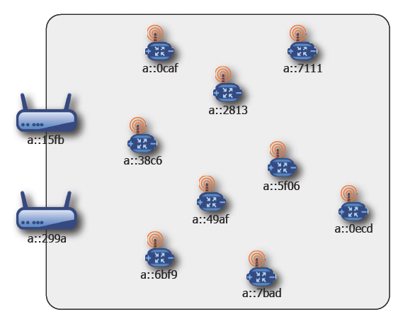
Common Routable Prefix

Slide 48
IP HC (draft-hui-6lowpan-hc-00.txt)
Adds two new dispatch type IPHC – for compressed IPv6 Header
  0x03 (TBD) LOWPAN_IPHC with link-local addresses
  0x04 (TBD) LOWPAN_IPHC with Common Routable Prefix
All forms of header compression in same format
Cleans up Next Header
Cleans up L4 header compression
Enables compression of multicast addresses

Slide 49
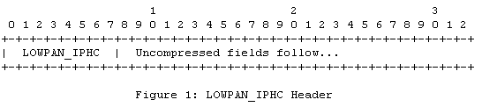
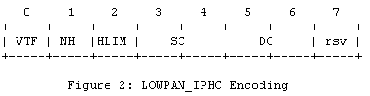
IPHC
Dispatch
VTF: Version, Traffic Class, and Flow Label (bit 0):
  0: Full 4 bits for Version, 8 bits for Traffic Class, and 20 bits for Flow Label are carried in-line.
  1: Version, Traffic Class, and Flow Label are elided. Version is 6. Traffic Class and Flow Label are 0.
NH: Next Hop (bit 1):
  0: Full 8 bits for Next Hop are carried in-line.
  1: Next Hop is elided and the next header is compressed using LOWPAN_NHC
HLIM: Hop Limit (bit 2):
  0: All 8 bits of Hop Limit arecarried in-line.
  1: All 8 bits of Hop Limit are elided.
    receiving interface => 1, otw 64 (TBD).
SRC: Source Address (bits 3 and 4):
  00: All 128 bits of Source Address are carried in-line.
  01: 64-bit Compressed IPv6 address.
  10: 16-bit Compressed IPv6 address.
  11: All 128 bits of Source Address are elided.
DST: Destination Address (bits 5 and 6):

Slide 50
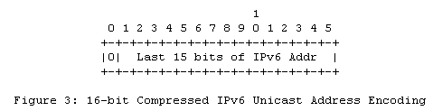
IPv6 Unicast Address Hdr Compression
SRC/DST may be compressed to 64, 16, or 0 bits
  64: CP elided, IID carried in line
  16: CP and upper bits elided, last 16 bits carried in lin
  0: determined entirely from L2 Header
16-bit compressed form is also used for IPv6 multicast address compression,
the 16-bit address space is divided into multiple ranges.
For unicast addresses, the first bit carried in-line must be zero.

Slide 51
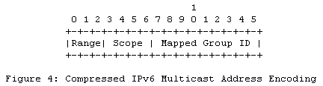
Multicast Address Compression
Range (bits 0-2):
  set to '101' (TBD) - 6LoWPAN short address range for compressed IPv6 multicast addresses.
  0, 0xxxxxxxxxxxxxxx: As specified in RFC 4944.
  1, 101xxxxxxxxxxxxx: The remaining 13 bits represent a compressed IPv6 multicast address
  2, 100xxxxxxxxxxxxx: As specified in RFC 4944.
Scope (bits 3-6):
  4-bit multicast scope as specified in RFC 4007
Mapped Group ID (bits 7-15):
  9-bit mapped multicast group identifier.

Slide 52
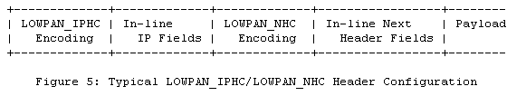

Next Header Compression

Slide 53

L4 UDP Header Compression
D: Identifier (bit 0):
0: IPv6 Next Header = 17, compressed
1: IPv6 Next Header != 17, uncompressed
S: Source Port (bit 1):
0: All 16 bits of Source Port are carried in-line.
1: First 12 bits of Source Port are elided and the remaining 4 bits are carried in-line. The Source Port is recovered by: P + short_port, where P is 61616 (0xF0B0).
D: Destination Port (bit 2):
C: Checksum (bit 3):
0: All 16 bits of Checksum are carried in-line. The Checksum MUST be included if there are no other end-to-end integrity checks that are stronger than what is provided by the UDP checksum. Such an integrity check MUST be end-to-end and cover the IPv6 pseudo-header, UDP header, and UDP payload.
1: All 16 bits of Checksum are elided. The Checksum is recovered by recomputing it.

Slide 54
Pay-as-you-go Adaptation
802.15.4
7 bytes
Compressed IPv6
Compressed UDP
Single Hop*
Length
FCF
DSN
DSTPAN
DST
SRC
Dispatch
Checksum
IPHC
Hop Limit
NHC
Ports
11 bytes
Mesh Hop
Length
FCF
DSN
DSTPAN
DST
SRC
Dispatch
Source
Address
Destination
Address
Checksum
IPHC
Hop Limit
NHC
Ports
15 bytes
Fragment
Header
Mesh Hop
Fragmented
FCF
DSTPAN
DST
SRC
Source
Address
Destination
Address
Checksum
Length
DSN
Dispatch
IPHC
Hop Limit
NHC
Ports
Link addresses of originator and final
* including each of multiple IP hops

Slide 55
Single Hop, No Fragmentation
IEEE 802.15.4
Dispatch
Compressed IP
Payload…
Multihop, No Fragmentation
IEEE 802.15.4
Mesh Addressing
Dispatch
Compressed IP
Payload…
Single Hop, Fragmentation
IEEE 802.15.4
Fragmentation
Dispatch
Compressed IP
Payload…
Multi Hop, Fragmentation
IEEE 802.15.4
Mesh Addressing
Fragmentation
Dispatch
Compressed IP
Payload…
Dispatch Header (1-2 bytes)
0
1
Dispatch (6)
0
1
0x3F
Dispatch (8)
Fragmentation Header (4-5 bytes)
1
1
0
0
0
Datagram Size (11)
Datagram Tag (16)
1
1
1
0
0
Datagram Size (11)
Datagram Tag (16)
Offset (8)
Mesh Addressing Header (5-18 bytes)
1
0
O
F
Hops (4)
Originator Addr (16-64)
Final Addr (16-64)
1
0
O
F
0xF
Hops (8)
Originator Addr (16-64)
Final Addr (16-64)

Slide 56
Adaptation Summary
Efficient Transmission of IPv6 Datagrams
IPv6 Stacked Header Format
IPv6 Base
Hop-by-Hop
Routing
Fragment
Destination
Payload
IPv6 Options
6LowPAN Stacked Adaptation Header Format
15.4 Header
Payload
15.4 Header
IPv6 HC
Payload
15.4 Header
IPv6 HC
NH HC
Payload
15.4 Header
Fragmentation
IPv6 HC
NH HC
Payload
Dispatch
Header
http://tools.ietf.org/html/rfc4944

Slide 57
Key Points for IP over 802.15.4
Header overhead
  Standard IPv6 header is 40 bytes [RFC 2460]
  Entire 802.15.4 MTU is 127 bytes [IEEE std]
  Often data payload is small
Fragmentation
  Interoperability means that applications need not know the constraints of physical links that might carry their packets
  IP packets may be large, compared to 802.15.4 max frame size
  IPv6 requires all links support 1280 byte packets [RFC 2460]
Allow link-layer mesh routing under IP topology
  802.15.4 subnets may utilize multiple radio hops per IP hop
  Similar to LAN switching within IP routing domain in Ethernet
Allow IP routing over a mesh of 802.15.4 nodes
  Localized internet of overlapping subnets
Energy calculations and 6LoWPAN impact

Slide 58
Energy Efficiency
Battery capacity typically rated in Amp-hours
  Chemistry determines voltage
  AA Alkaline: ~2,000 mAh = 7,200,000 mAs
  D Alkaline: ~15,000 mAh = 54,000,000 mAs
Unit of effort: mAs
  multiply by voltage to get energy (joules)
Lifetime
  1 year = 31,536,000 secs
  228 uA average current on AA
  72,000,000 packets TX or Rcv @ 100 uAs per TX or Rcv
  2 packets per second for 1 year if no other consumption

Slide 59
Energy Profile of a Transmission
Datasheet
Analysis
20mA
Power up oscillator & radio (CC2420)
Configure radio
Clear Channel Assessment, Encrypt and Load TX buffer
Transmit packet
Switch to rcv mode, listen, receive ACK
10mA
5 ms
10 ms

Slide 60
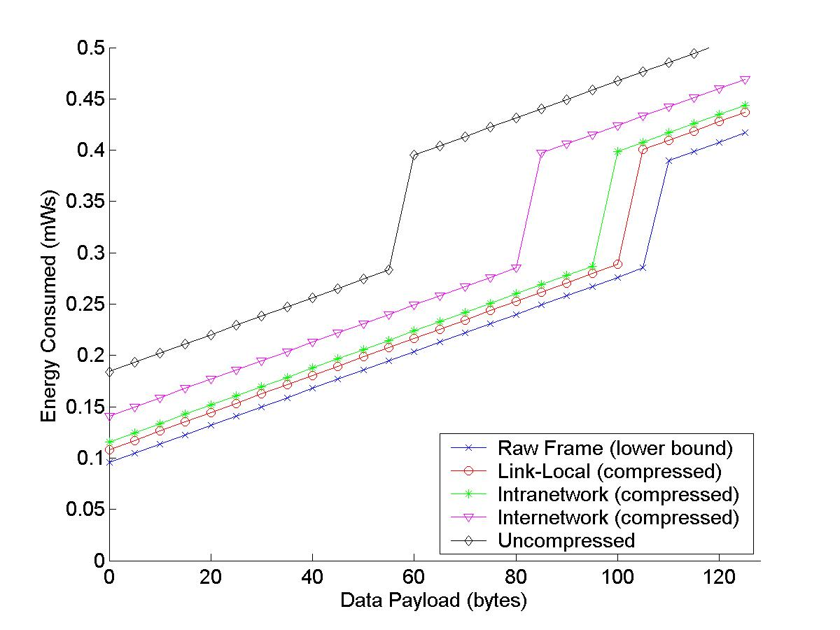
Energy Consumption Analysis
*
*
Payload Δ
Energy Δ for
fixed payload

Slide 61
Rest of the Energy Story
Energy cost of communication has four parts
  Transmission
  Receiving
  Listening (staying ready to receive)
  Overhearing (packets destined for others)
The increase in header size to support IP over 802.15.4 results in a small increase in transmit and receive costs
  Both infrequent in long term monitoring
The dominant cost is listening! – regardless of format.
  Can only receive if transmission happens when radio is on, “listening”
  Critical factor is not collisions or contention, but when and how to listen
  Preamble sampling, low-power listening and related listen “all the time” in short gulps and pay extra on transmission
  TDMA, FPS, TSMP and related communication scheduling listen only now and then in long gulps. Transmission must wait for listen slot. Clocks must be synchronized. Increase delay to reduce energy consumption.

Slide 62
Conclusion
6LoWPAN turns IEEE 802.15.4 into the next IP-enabled link
Provides open-systems based interoperability among low-power devices over IEEE 802.15.4
Provides interoperability between low-power devices and existing IP devices, using standard routing techniques
Paves the way for further standardization of communication functions among low-power IEEE 802.15.4 devices
Offers watershed leverage of a huge body of IP-based operations, management and communication services and tools
Great ability to work within the resource constraints of low-power, low-memory, low-bandwidth devices like WSN

Slide 63
Frequently Asked Questions

Slide 64
How does 6LoWPAN compare to Zigbee, SP100.11a, …?
Zigbee
  only defines communication between 15.4 nodes (“layer 2” in IP terms), not the rest of the network (other links, other nodes).
  defines new upper layers, all the way to the application, similar to IRDA, USB, and Bluetooth, rather utilizing existing standards.
  Specification still in progress (Zigbee 2006 incompatible with Zigbee 1.0. Zigbee 2007 in progress.) Lacks a transport layer.
SP100.11a
  seeks to address a variety of links, including 15.4, 802.11, WiMax, and future “narrow band frequency hoppers”.
  Specification is still in the early stages, but it would seem to need to redefine much of what is already defined with IP.
  Much of the emphasis is on the low-level media arbitration using TDMA techniques (like token ring) rather than CSMA (like ethernet and wifi). This issue is orthogonal to the frame format.
6LoWPAN defines how established IP networking layers utilize the 15.4 link.
  it enables 15.4 ⬄15.4 and 15.4 ⬄non-15.4 communication
  It enables the use of a broad body of existing standards as well as higher level protocols, software, and tools.
  It is a focused extension to the suite of IP technologies that enables the use of a new class of devices in a familiar manner.

Slide 65
Do I need IP for my stand-alone network?
Today, essentially all computing devices use IP network stacks to communicate with other devices, whether they form an isolated stand-alone network, a privately accessible portion of a larger enterprise, or publicly accessible hosts.
  When all the devices form a subnet, no routing is required, but everything works in just the same way.
The software, the tools, and the standards utilize IP and the layers above it, not the particular physical link underneath.
The value of making it “all the same” far outweighs the moderate overheads.
6LoWPAN eliminates the overhead where it matters most.

Slide 66
Will the “ease of access” with IP mean less security?
No.
The most highly sensitive networks use IP internally, but are completely disconnected from all other computers.
IP networks in all sorts of highly valued settings are protected by establishing very narrow, carefully managed points of interconnection.
  Firewalls, DMZs, access control lists, …
Non-IP nodes behind a gateway that is on a network are no more secure than the gateway device. And those devices are typically numerous, and use less than state-of-the-art security technology.
802.15.4 provides built-in AES128 encryption which is enabled beneath IP, much like WPA on 802.11.

Slide 67
Does using 6LoWPAN mean giving up deterministic timing behavior?
No.
Use of the 6LoWPAN format for carrying traffic over 802.15.4 links is orthogonal to whether those links are scheduled deterministically.
  Deterministic media access control (MAC) can be implemented as easily with 6LoWPAN as with any other format.
There is a long history of such TDMA mechanisms with IP, including Token Ring and FDDI.
  MAC protocols, such as FPS and TSMP, extend this to a mesh.
  Ultimately, determinacy requires load limits and sufficient headroom to cover potential losses.
  Devices using different MACs on the same link (TDMA vs CSMA) may not be able to communicate, even though the packet formats are the same.

Slide 68
Is 6LoWPAN less energy efficient than proprietary protocols?
No.
Other protocols carry similar header information for addressing and routing, but in a more ad hoc fashion.
While IP requires that the general case must work, it permits extensive optimization for specific cases.
6LoWPAN optimizes within the low-power 802.15.4 subnet
  More costly only when you go beyond that link.
  Other protocols must provide analogous information (at application level) to instruct gateways.
Ultimately, the performance is determined by the quality the implementation.
  With IP’s open standards, companies must compete on performance and efficiency, rather than proprietary “lock in”

Slide 69
Do I need to run IPv6 instead of IPv4 on the rest of my network to use 6LoWPAN?
No.
IPv6 and IPv4 work together throughout the world using 4-6 translation.
IPv6 is designed to support “billions” of non-traditional networked devices and is a cleaner design.
  Actually easier to support on small devices, despite the larger addresses.
The embedded 802.15.4 devices can speak IPv6 with the routers to the rest of the network providing 4-6 translation.
  Such translation is already standardized and widely available.

